Slide 1
Uses of Plants to People and Surroundings

Slide 2
What Plants Give Us
Plants give us many things. Plants give us food. Plants give us materials for making clothes. Examples of these plants are the cotton plant, pineapple plant, and abaca.
Look around you. There are some places where there are plenty of plants. It feels cool and fresh in a place where there are many plants.
Plants give off oxygen that makes air good to breathe in. People need fresh air to live and be healthy.
With fewer trees, there will be less fresh air. With less fresh air, more people will get sick. With fewer trees, many places will be flooded when it rains hard.

Slide 3
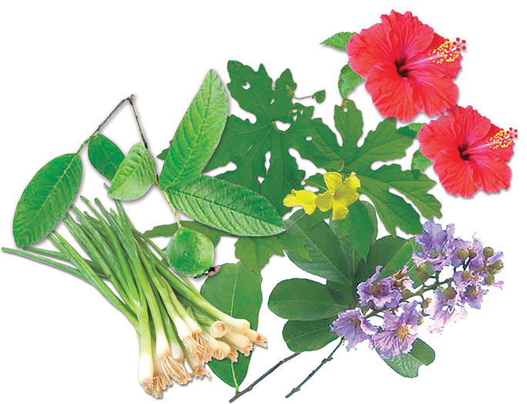
Other Things Plants Give Us
Some Plants Are Used As Medicines
Medicines obtained from plants are called herbal medicines. These are effective cures for common ailments.
Here are some of the plants we use when we get sick.
1. guava leaves for wounds and diarrhea
2. ampalaya leaves for colds and fever
3. banaba leaves for kidney problems
4. garlic for hypertension
5. gumamela flowers for boils

Slide 4
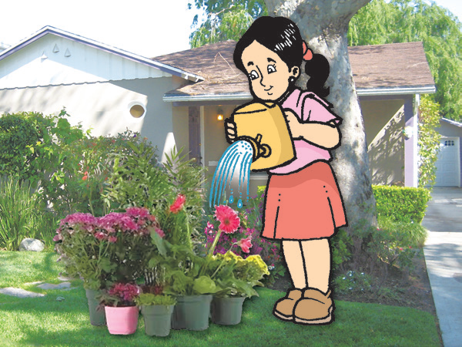
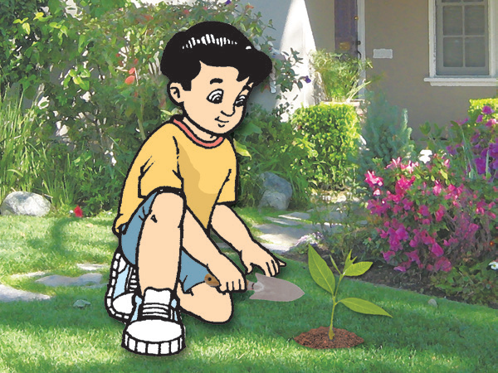
Some Plants Give Us Building Materials
Trees grow big, tall, and hard. They are good materials for building houses and schools. We get almost everything we need from plants. We should take good care of plants.
Care for the Plants
Here are some ways of caring for plants:
Put the plants in spaces where they can get sunlight.
1. Water plants regularly.

Slide 5
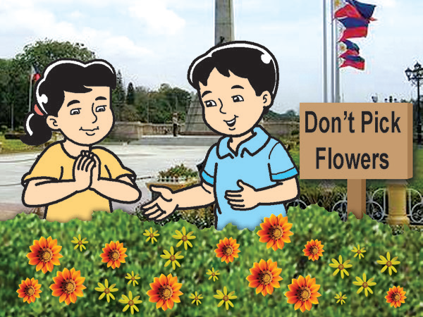
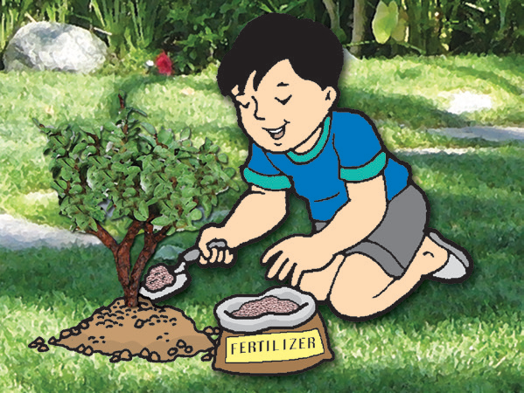
Obey signs in gardens and parks.
Put enough fertilizer.
Plants are important to everyone. You must take good care of them. Some people cut down trees in the forest. They also burn the trees.

Slide 6
What do you think would happen if there are no trees left in our forests?
Animals in the forest will lose their homes. The lowlands will get flooded easily when the rains come.
Do you know that the roots of plants help prevent floods? They also help prevent soil from being washed away by heavy rains. The roots of plants hold the soil in place.
We must stop cutting down trees and burning down forests. In fact, we should plant more trees.

Slide 7
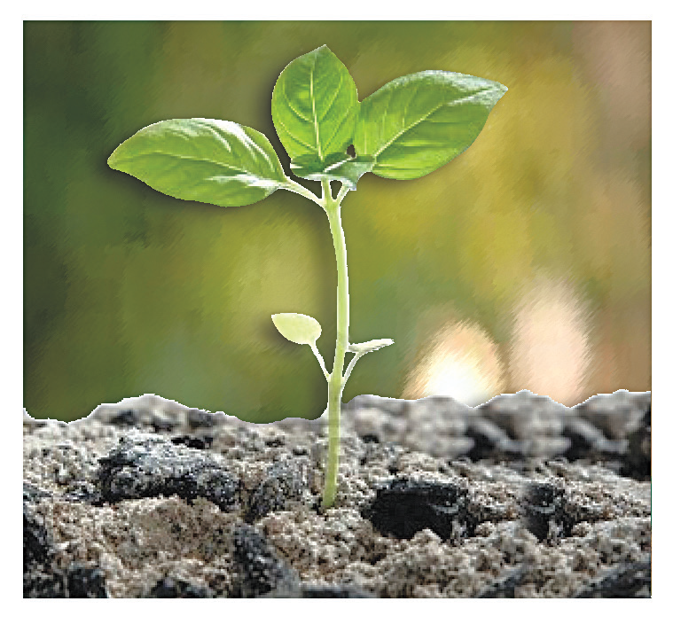
Growth in Plants
When you plant seeds and provide what they need, they grow. As they grow, changes take place. The body parts of plants grow and change.
Most new plants grow from seeds. A seed has three important parts. These are the seed coat, seed leaves, and baby plant.

Slide 8
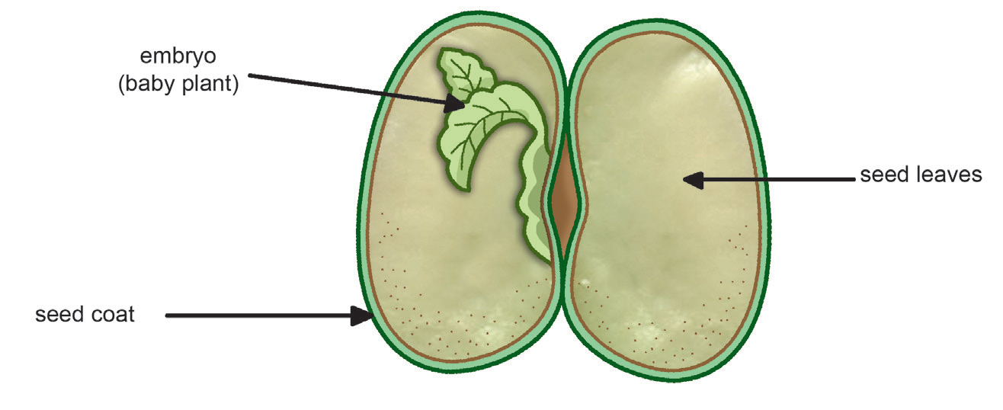
The seed coat protects the baby plant inside the seed. The seed leaves provide the baby plant with the food it needs to grow. As the baby plant or embryo grows, the seed leaves become smaller. Then the seed breaks open and the roots begin to move down into the soil. When the roots have fully anchored the young plant to the soil, other parts begin to grow and develop as well— the main stem begins to grow in length and branches emerge and more leaves start to grow and develop. A new young plant begins to grow!

