Slide 1
Animal and Plant Cells

Slide 2
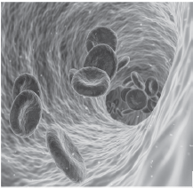
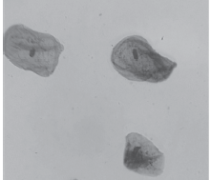
Animal and Plant Cells
The Biological Levels of Organization
There are many levels of organization in living organisms. Biologists differ as regards the number of levels they consider. In this lesson, we will consider nine levels of organization. The levels will be presented hierarchical or from the simplest to the most complex level.
The Different Levels of Organization
The cell is the first and the simplest level of organization. Considered the basic unit of life, the cell is capable of carrying out all the functions of living Things.
Cells have varying sizes, shapes, and organelles that function together to bring about life.
qimono via wikimedia commonsCC BY-SA 4.0
Fritzmann2002 via wikimedia commons CC BY-SA 4.0
Human Red Blood Cells
Human Cheek Cells

Slide 3
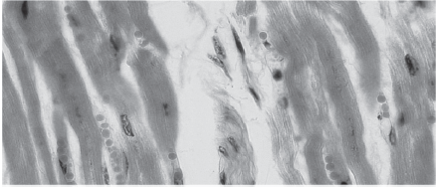
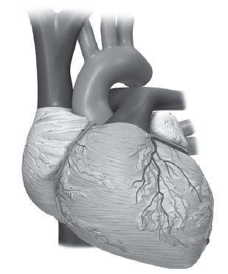
Animal and Plant Cells
Tissue is a group of distinct and similar cells that work together to perform a specific set of functions. Examples of tissues in plants are parenchyma, collenchyma, and sclerenchyma. Examples of tissues in animals are epithelial, connective, muscular, and nervous tissues.
Cardiac muscle is composed of cardiac muscle cells.
From The Berkshire Community College Bioscience Image Library via Wikimedia commons Public Domain
An organ is composed of different tissues that perform a certain function. For example, the heart is made up of different tissues (epithelial, connective, muscular, and nervous) that enable it to perform the task of pumping blood to all parts of the body.
The heart is primarily composed of the cardiac muscle and other tissues.
From The Blausen Medical Communications, Inc., Dcoetzee via wikimedia commons CC BY-SA 3.0

Slide 4
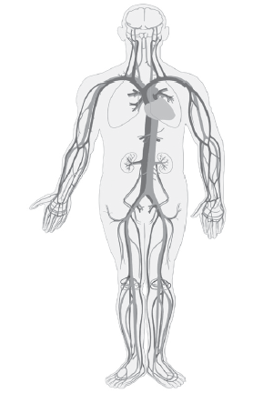
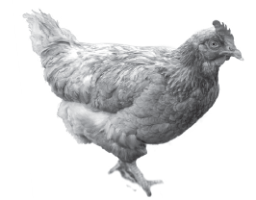
Animal and Plant Cells
An organ system consists of different organs that perform a broad spectrum of functions. For example, the circulatory system is composed of the heart, blood, and blood vessels that function in transporting nutrients and oxygen to the different cells of the body and, at the same time, removing wastes from them.
The circulatory system is composed of the heart,
blood, and blood vessels.
By Clker-Free-Vector-Images via
pixabay.com Public Domain
An organism is an aggregation of the organ systems that work together to bring about various life activities. Humans, for example, are composed of eleven organ systems. An organism is an individual belonging to a particular species that has its own distinct existence as a complex, self-reproducing unit.
A hen is an example of an organism.
By kissu via pixabay.com Public Domain

Slide 5
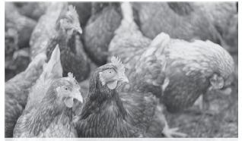
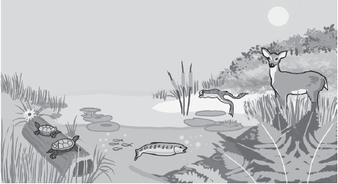
Animal and Plant Cells
A population is a group of organisms of the same species occupying any given area. These organisms are freely interacting with one another. Populations are sometimes associated with small Groups a pack of goats, a brood of chicken, towns of squirrels, a herd of cattle, and a colony of termites.
A Brood of Chickens on a Field of Grass
Alexas-Fotos via pixabay.com Public Domain
A community consists of all the populations
of different species of organisms living together in a given area. These organisms are interacting with one another. Their interactions may be harmful, symbiotic, or cooperative. Examples are all the living things in a freshwater pond, all the species in a rice fi eld, and all the living things in a grassland.
The pond is inhabited by different species of organisms.

Slide 6
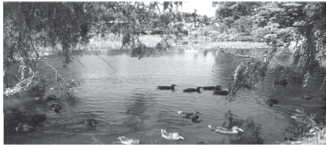
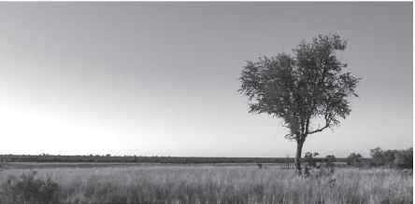
Animal and Plant Cells
An ecosystem consists of all the community of organisms (biotic components) that inhabit the same area, as well as the nonliving (or abiotic) components of the area and the set of interactions that exist between these two components.
The pond is an example of an aquatic ecosystem.
John Newcomb via wikimedia commons CC BY 3.0
Biome pertains to a collection of ecosystems with similar climates and covers a large geographical area. Grasslands, savannas, deserts, and tropical rainforests are examples of biomes.
A savanna is an example of a terrestrial ecosystem
covering a large geographic area (called biome) .
Javier Puig Ochoa via wikimedia commons CC BY 3.0

Slide 7
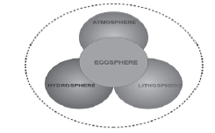
Animal and Plant Cells
The biosphere consists of the totality of the ecosystems on planet Earth. It also pertains to any part of the Earth’s sphere where life exists. It is also referred to as the world of life.
Prosopee via wikimedia commons CC BY-SA 3.0
The Earth’s spheres are the hydrosphere,
atmosphere, and lithosphere.

Slide 8
Animal and Plant Cells
Development of the Cell Theory
The presence of cells is a characteristic that identifies living things from nonliving things. The knowledge about cells began when Robert Hooke observed a slice of cork using a compound microscope designed by himself. He saw tiny, box-like compartments that reminded him of the small rooms in the monastery where he lived. He called these tiny compartments cells. His discovery paved the way for the rest of the studies about the structure and functions of a cell. Cytology is the field of science that deals with the study of cells. Table below shows the timeline starting from the invention of the microscope up to the time that the cell theory was formulated.

Slide 9
Animal and Plant Cells
History of the Development of Cell Theory
Scientists | Year | Discoveries/Inventions
Zacharias Janssen | 1590 | He invented the first compound microscope.
Robert Hooke | 1665 | He discovered tiny compartments in a thin slice of cork, which he called “cells.”
Anton Van Leeuwenhoek | 1673 | He discovered tiny creatures in a drop of rainwater using his simple microscope. He called these tiny living things “animalcules.”

Slide 10
Animal and Plant Cells
History of the Development of Cell Theory
Scientists | Year | Discoveries/Inventions
Matthias Schleiden | 1838 | He examined several plant parts and concluded that “all plants are made up of cells.”
Theodore Schwann | 1839 | He examined several animal parts and concluded that “all animals are made up of cells.”
Rudolf Virchow | 1855 | He discovered the process of cell division and proposed that “cells come from the division of preexisting cells.”

Slide 11
Animal and Plant Cells
The investigations conducted by Schleiden, Schwann, and Virchow formed the basis of the cell theory, which was formulated in 1839. The theory states the following:
• All organisms are composed of cells.
• The cell is the basic unit of structure of all living things.
• The cell is the basic unit of function of all living things.
• Cells arise by the division of preexisting cells, and they can be cultured to produce more cells in two ways: outside the organism or cell (in vitro) or inside the organism or cell (in vivo).

Slide 12
Animal and Plant Cells
The Structure of a Typical Cell
Living things vary in terms of the number of cells that compose their bodies. Some organisms like humans, sea stars, and frogs are composed of many cells. These organisms are described as multicellular. Others like the Amoeba, Paramecium, and bacteria are composed only of one cell; thus, they are described as unicellular.
Living things also differ in the kind of cells they have. Some living things like plants, animals, fungi, and protists (Paramecium and Amoeba) have eukaryotic cells. This means that their cells have a distinct nucleus (plural: nuclei) and their organelles are membrane-bound. The membrane is the single or double-layered outer boundary or covering of an organelle. Organelles (Latin: organella, meaning instrument or tool) are structures that perform specific functions that are crucial to the survival of the cell.

Slide 13
Animal and Plant Cells
Two groups of living things have prokaryotic cells the Archaea (e.g., blue-green algae) and the Eubacteria (bacteria). They are considered prokaryotic because their cells lack a distinct nucleus and they have fewer organelles that are not membrane-bound.
Structures of a Eukaryotic Cell
Part/Organelle | Structure | Function
1. Cell wall | A nonliving component; composed of cellulose, a polysaccharide (several units of glucose) | Provides mechanical support and maintains cell shape in cells
2. Plasma membrane | Flexible and elastic; composed of double layers of phospholipids, proteins, carbohydrates, and steroids | A selectively permeable membrane that regulates the entry and exit of materials

Slide 14
Animal and Plant Cells
3. Mitochondrion | A double membrane-bound structure; inner membrane is folded forming cristae; referred to as the “powerhouse” of the cell | Provides energy for the cell in the form of adenosine triphosphate (ATP)
4. Vacuole | A compartment covered by a single membrane called tonoplast | Stores water, food, and waste for the cells
5. Golgi apparatus | Stacks of single membranes that are connected to the plasma membrane and endoplasmic reticulum | Sorts, packages, and secretes materials; also involved in the processing and modification of proteins
6. Cytoplasm | The complex fluid that fills the cell; the outer cytoplasm (exoplasm) is gel like while the inner cytoplasm is fluid (sol like); the fluid part is capable of streaming (cyclosis) | The matrix of the different cellular organelles; distribution of materials throughout the cell due to cyclosis

Slide 15
Animal and Plant Cells
7. Nuclear membrane | A double-layered membrane that encloses the nucleus; outer membrane is porous | Separates the nuclear contents from the contents of the cytoplasm
8. Nucleolus | The dense, spherical body inside the nucleus; contains the nucleic acid RNA | Synthesis of RNA and production of ribosomes
9. Nucleoplasm/ nuclear sap | The gel-like material that fills the nucleus | Functions as the matrix of the chromosomes and nucleolus
10. Chromosomes | Highly coiled structures that form a network over the nucleoplasm | Carriers of genes responsible in transmitting hereditary characteristics

Slide 16
Animal and Plant Cells
11. Nucleus | The spherical body that is composed of nuclear membrane, nucleolus, and nucleoplasm | It is the control center of the cell. It directs and coordinates all cellular activities.
12. Endoplasmic reticulum (ER) | The network of channels composed of a single membrane that may be bumpy if it contains ribosomes (Rough ER) or smooth (SER) if it does not contain ribosomes | Translocation of materials within the cell and in and out of the nucleus
13. Plastids | A double membrane-bound structure that contains chlorophyll pigments | Provide the green color of plants; function for photosynthesis
14. Centrioles | Two small rods that lie at right angles to each other; each rod is surrounded with tiny microtubules arranged like the spokes of a wheel | Formation of spindle fibers during cell division; function as the anchor for the cytoskeleton

Slide 17
Animal and Plant Cells
15. Lysosome | A single membrane compartment containing powerful hydrolytic enzymes; referred to as the “suicide bag” of the cell | Simplifies/Breaks down complex materials
16. Ribosomes | Small spherical bodies that are attached to the endoplasmic reticulum or free floating in the cytoplasm (free ribosomes); referred to as “protein factories” | Synthesis of amino acid using the RNA from the nucleolus
17. Cytoskeleton | Network of fibers scattered in the cytoplasm; there are two types: microtubules and microfilaments | The microtubules function in maintaining the shape of the cells and aid in the movement of some organelles. The microfilaments provide contractility to some cells and aid in

Slide 18
Animal and Plant Cells
18. Microbodies | Very tiny organelles that are scattered throughout the cytoplasm together with the free ribosomes; contain enzymes that break down toxic materials that are products of metabolic activities | Neutralization of toxic materials; examples are the peroxisomes that break down hydrogen peroxide
19. Cellular Inclusions | These are various materials (organic or inorganic) that are scattered in the cytoplasm together with the ribosomes and microbodies. They are either useful materials that can be extracted due to their economic importance or products of cell metabolism. Inclusions are normally being eliminated and replaced.

Slide 19
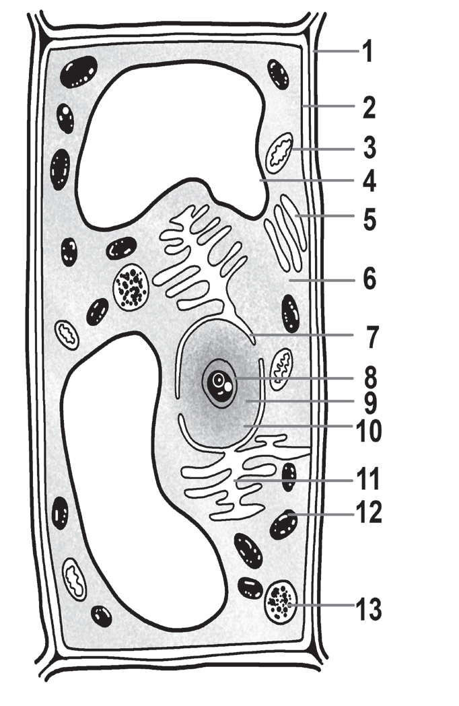
Animal and Plant Cells
The diagram of the ultrastructure of a typical eukaryotic cell. Ultrastructure means that most of the labeled parts can be seen only under an electron microscope.
 | 1. Cell wall 2. Plasma membrane 3. Mitochondrion 4. Vacuole 5. Golgi body 6. Cytoplasm 7. Nuclear membrane 8. Nucleolus 9. Nucleoplasm/Nuclear sap 10. Chromatin/Chromosome 11. Endoplasmic reticulum 12. Chloroplast 13. Lysosome
8. Nucleolus
9. Nucleoplasm/Nuclear sap
10. Chromatin/Chromosome
11. Endoplasmic reticulum
12. Chloroplast
13. Lysosome
The parts numbered from 6 to 10 comprise the nucleus of the cell.
The Structure of a Typical
Eukaryotic Cell

Slide 20
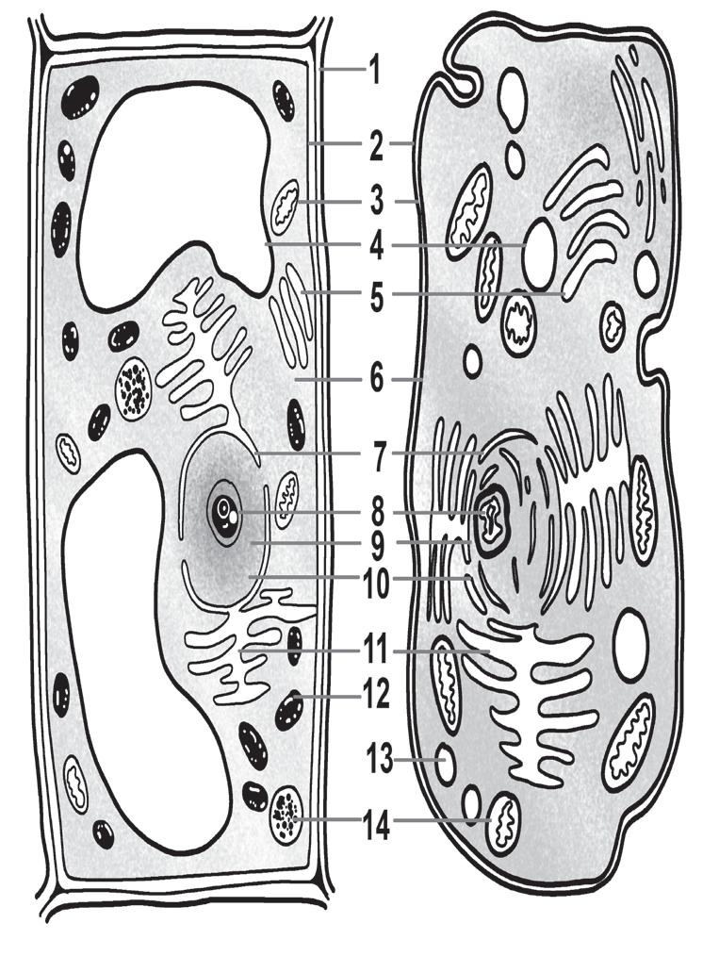
Animal and Plant Cells
Comparison between a Plant Cell and an Animal Cell
The comparative structures of a plant cell and an animal cell. The numbers represent the different cellular structures and organelles. The numbered parts of the cell are identified on the right side of the figure.
1. Cell wall
2. Plasma membrane
3. Mitochondrion
4. Vacuole
5. Golgi body
6. Cytoplasm
7. Nuclear membrane
8. Nucleolus
9. Nucleoplasm/Nuclear sap
10. Chromatin/Chromosome
11. Endoplasmic reticulum
12. Chloroplast
13. Centrioles
14. Lysosome
Parts numbered 7–10
comprise the nucleus
of the cells.
Comparative Structure of a Plant Cell and an
Animal Cell

Slide 21
Animal and Plant Cells
Take note that plant and animal cells are eukaryotic. That is, they both have a distinct nucleus and several membrane-bound organelles. Take note further that in the numbered organelles, there are parts/organelles that are specific only to a particular type of cell. Thus, although the basic structure and most of the features are the same, there are some points of difference between the two cells.
In terms of size and shape, a plant cell is usually larger and has a somewhat permanent shape (usually polygonal), whereas an animal cell is smaller and has various shapes. Typically, the fixed shape of plant cells is due to the presence of the cell wall. The cell wall (number 1 in the table above) is a tough structure composed of cellulose, a type of polysaccharide. The cell wall, aside from maintaining the cell’s shape, also makes the cell more rigid and protects the cell from mechanical injury and adverse environmental conditions. On the other hand, an animal cell does not have a cell wall. Instead, it has a plasma membrane that serves as its outer boundary. The absence of the cell wall makes the cell more flexible the reason it can assume different shapes.

Slide 22
Animal and Plant Cells
Plastids are organelles that contain pigments and store food materials. One of the most common plastids is the chloroplast (number 12 in the table above). Chloroplasts contain chlorophyll pigments. These pigments give many plants their characteristic green color. The pigments are also light-trapping. During photosynthesis, light energy is absorbed to help provide plant cells energy and help carbon dioxide and water be chemically changed into food. The photosynthetic ability of plants is the reason they are called photosynthetic autotrophs.
Centrioles are organelles that become prominent only during cell division. Only animal cells have centrioles (number 13 in the table above). During cell division, centrioles help move chromosomes toward their respective poles. Plant cells do not need centrioles. Their more fixed shape can safely and correctly position the chromosomes.

Slide 23
Animal and Plant Cells
Vacuoles are membrane-bound and fluid-filled organelles that function as a storage tank for food, water, and waste products. Vacuoles can be found both in plant and animal cells. However, in plant cells, the vacuoles are large and built-in and almost fill the entire volume of the plant cell. When filled with water, the vacuoles exert internal pressure (called turgor pressure). This presses the plasma membrane tightly against the cell wall that causes the characteristic rigidity of plant cells. Also, plant vacuoles usually store several materials that are useful for the plant (starch grains, essential oils, water-soluble pigments, crystalline molecules that are toxic to herbivores, and many more).
Conversely, in animal cells, the vacuoles are random structures in the cytoplasm that are small and temporary. Observe the animal cell in the table above. Where are the vacuoles? Most often, they are near the plasma membrane. Why is it so? Usually, the plasma membrane undergoes an in-pocketing that forms these vacuoles. Unfortunately, complex unusable materials could “forcibly” enter the cell through this process. No worries, because there are lysosomes that break down these materials into usable forms.

Slide 24
Animal and Plant Cells
Summarizes the differences between a plant cell and an animal cell
Differences Between a Plant and Animal Cell
Plant Cell | Animal Cell
With cell wall | Lacks cell wall
With chloroplasts | Lacks chloroplasts
Lacks centrioles | With centrioles
Vacuoles are large, built-in, and located at the center of the cell. | Vacuoles are small, temporary structures and are found everywhere in the cell.

Slide 25
Animal and Plant Cells
Activity
Directions: Identify what level of organization is being referred to in the following examples. Put your answer in the blank before each number.
_________________1. ant, frog, bacterium, frog, earthworm
_________________2. pond, lake, river, grassland, prairie
_________________3. stomach, liver, small intestine, pancreas, heart
_________________4. colony of termites, pack of squirrels, herd of cattle
_________________5. skeletal system, immune system, reproductive system
_________________6. epithelium, parenchyma, nervous, muscular, collenchyma

Slide 26
Animal and Plant Cells
Answer Key
_________________1. ant, frog, bacterium, frog, earthworm
_________________2. pond, lake, river, grassland, prairie
_________________3. stomach, liver, small intestine, pancreas, heart
_________________4. colony of termites, pack of squirrels, herd of cattle
_________________5. skeletal system, immune system, reproductive system
_________________6. epithelium, parenchyma, nervous, muscular, collenchyma
Organism
Ecosystem
Organ
Population
Organ Ecosystem
Tissue

