Slide 1
Direct Current Motor

Slide 2
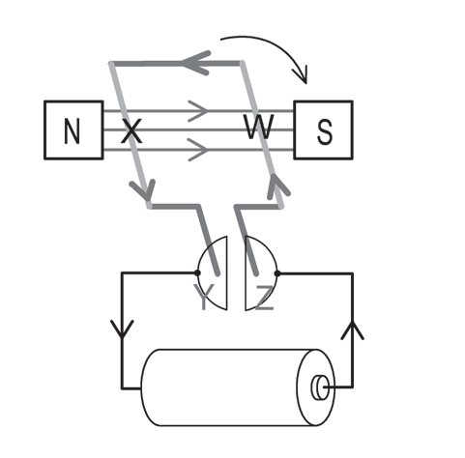
Direct Current Motor
You can find motors in everything from electric trains to remote-controlled cars. At home, you will find motors in hairdryers, washing machines, blenders, computers, and many more. Electric motors are among the greatest inventions of all time. Let us find out how an electric motor works.
In addition to the concepts of the law of magnetism and types of magnets that you learned in the previous lessons, you also need to know the following concepts:
1. Fleming’s left-hand rule – It is used to determine the direction of movement of the current-carrying wire if placed in a magnetic field. To do this, just put your middle finger in the direction of the current. Then, stretch your index finger and thumb. The index finger will then indicate the direction of the magnetic field, and the thumb will indicate the direction of the force.
Fleming’s Left-hand Rule

Slide 3
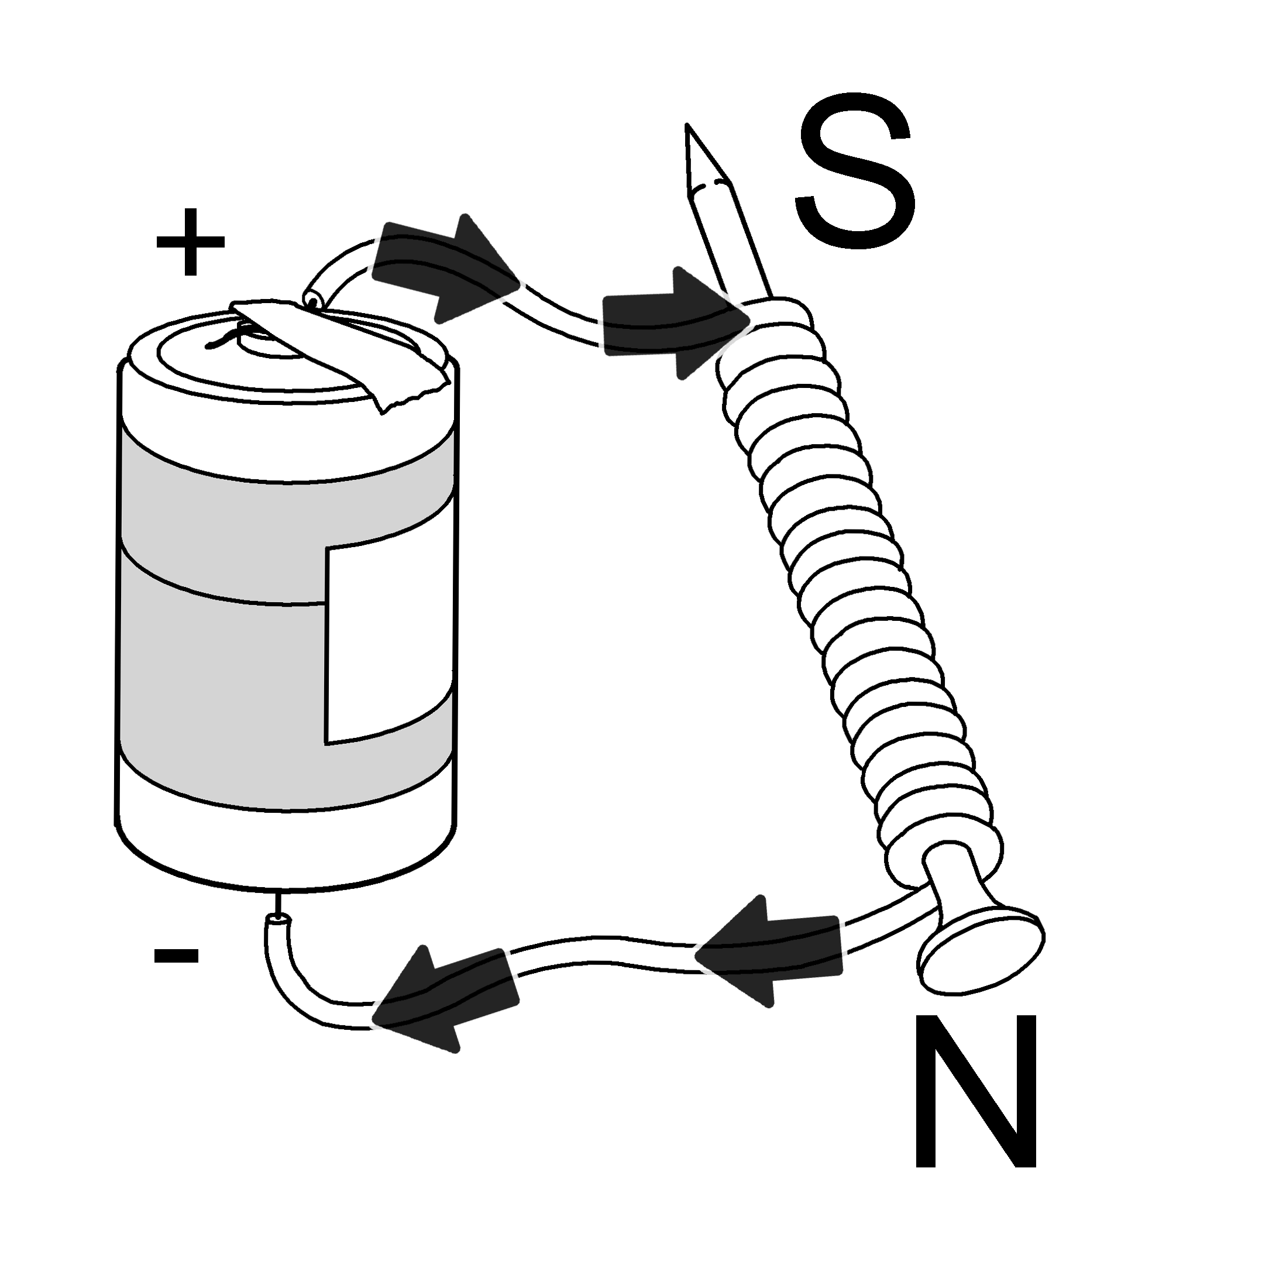
2. Which end of an electromagnet is north and south – The polarity of the electromagnet can change depending on the current direction. Just remember that if the end is connected to the positive end, it is the south pole. If the end is connected to the negative end, it is the north pole.
An Electromagnet

Slide 4
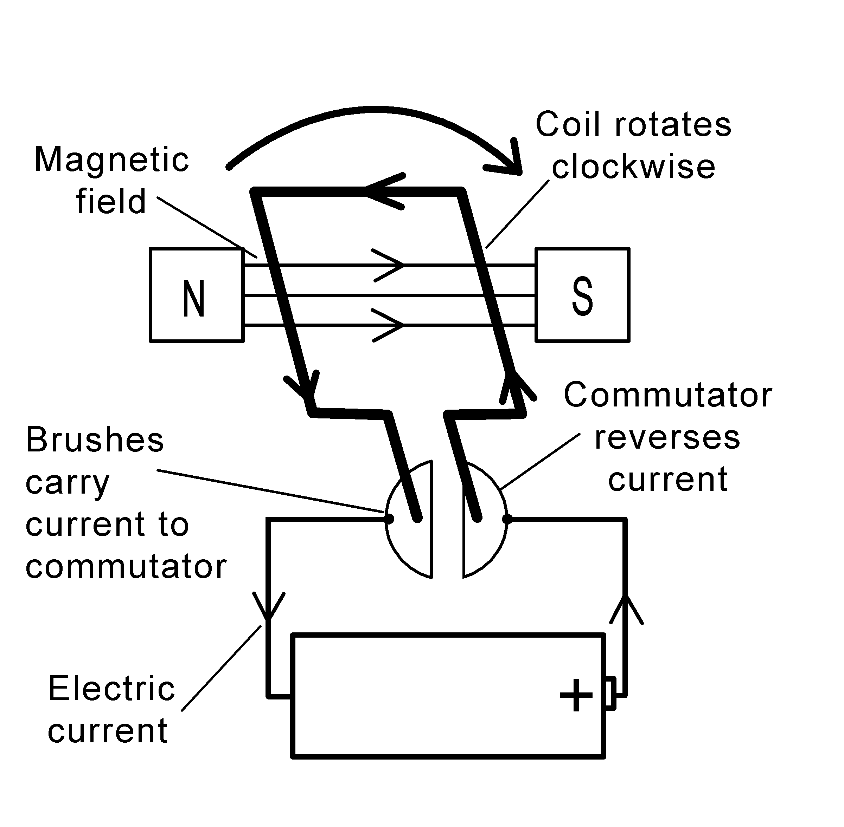
Direct Current Motor
3. Rotor vs. stator – The rotor is the rotating part of the motor, while the stator is the stationary part.
The two magnets on the sides are permanent magnets and are referred to as the stator. The loop of wire connected to a battery is an electromagnet, a rotor. The commutator is responsible for reversing the current while the brushes carry current to the commutator.
Parts of an Electric Motor

Slide 5
Direct Current Motor
Use Fleming’s left-hand rule in the part labeled X and W in the figure below. Point your middle finger to the direction of the current. Note that in conventional current, the current flows from positive to negative. Hence, your middle finger should point upward in part X. Stretch your forefinger and thumb. Your forefinger denotes that the direction of the magnetic field is from north to south, and your thumb is pointing downward, which means the movement of the coil in that part is downward.
Another way to look at it is by using the law of magnetism. Since part X is connected to the positive end of the battery, it is the south pole. As you see, it will repel because the permanent magnet side it is facing is a south pole as well. Like poles repel.

Slide 6

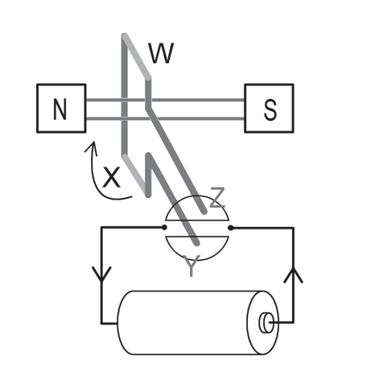
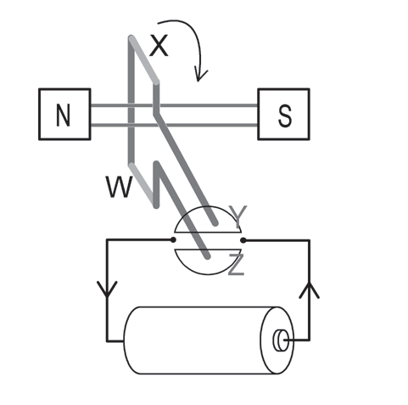
Direct Current Motor
a
b
c
d
How does the electric motor rotate? We identified that part X is the south pole in (Figure 3.11a). As it goes down, it is attracted by the north pole of the permanent magnet on the left side (Figure 3.11b). The attraction will not last because the commutator reverses the current. Previously, part Y of the commutator is attached to the positive end, but now, it is connected to the negative end (Figure 3.11c). Hence, part X is now a north pole. This causes repulsion. The process will repeat continuously, which we can see as the rotation of the loop. This is the working principle of electric motors. As a whole, electric motors transform electrical energy into mechanical energy.

Slide 7
Direct Current Motor
There are two types of motors
Direct current (DC) and alternating current (AC) motors. A DC motor has a stationary magnetic field and a rotating coil of wire, whereas an AC motor has a rotating magnetic field and a stationary armature.

Slide 8
Direct Current Motor
Activity
I. Read and answer each item carefully. Encircle the letter of the correct answer.
1. Which law is used to determine the direction of the magnetic field?
A. Fleming’s right-hand rule C. Ampere’s law
B. Fleming’s left-hand rule D. Ohm’s law
2. What two forces are required for generators and electric motors to work?
A. magnetism and thermal C. electricity and magnetism
B. electricity and kinetic D. magnetism and radiant

Slide 9
Direct Current Motor
3. Which of the following transforms electrical energy to mechanical energy?
A. galvanometer C. motor
B. generator D. transformer
II. Answer the question below.
How can motors convert electrical energy into mechanical energy?

Slide 10
Direct Current Motor
Answer Key
I.
1. Which law is used to determine the direction of the magnetic field?
A. Fleming’s right-hand rule C. Ampere’s law
B. Fleming’s left-hand rule D. Ohm’s law
2. What two forces are required for generators and electric motors to work?
A. magnetism and thermal C. electricity and magnetism
B. electricity and kinetic D. magnetism and radiant

Slide 11
Direct Current Motor
3. Which of the following transforms electrical energy to mechanical energy?
A. galvanometer C. motor
B. generator D. transformer
II.
How can motors convert electrical energy into mechanical energy?
- motor converts electrical energy into mechanical energy through a rotating shaft.

