Slide 1
Electric Generator

Slide 2
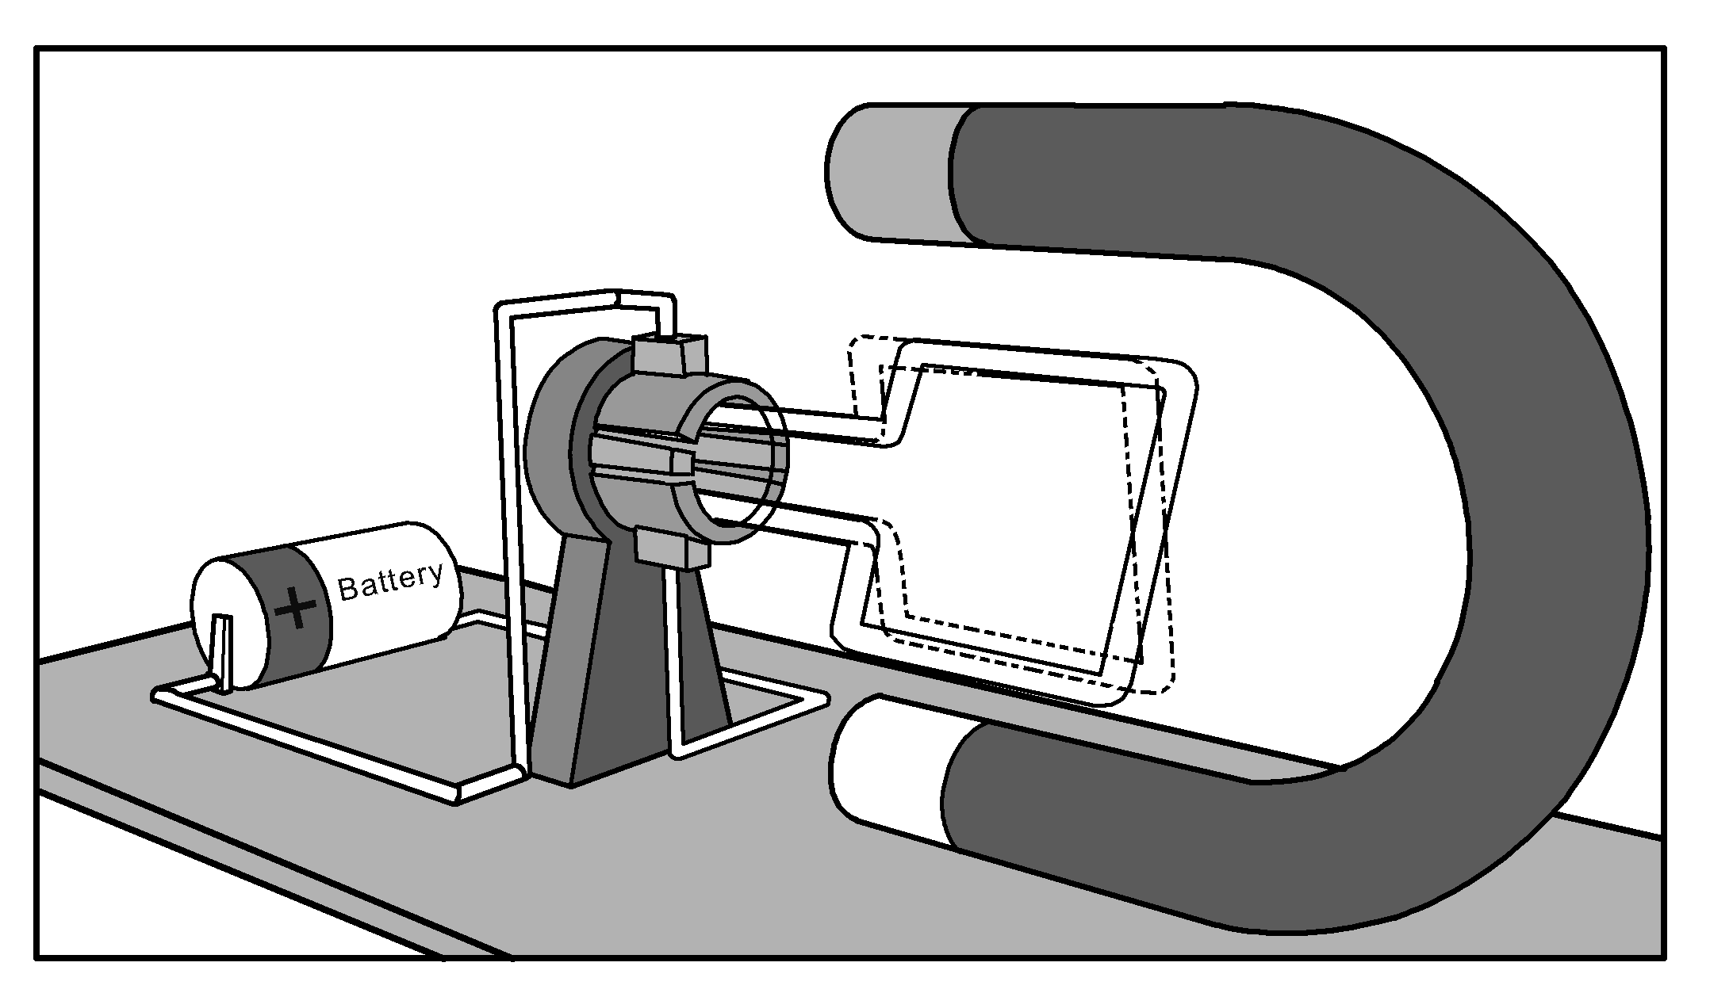
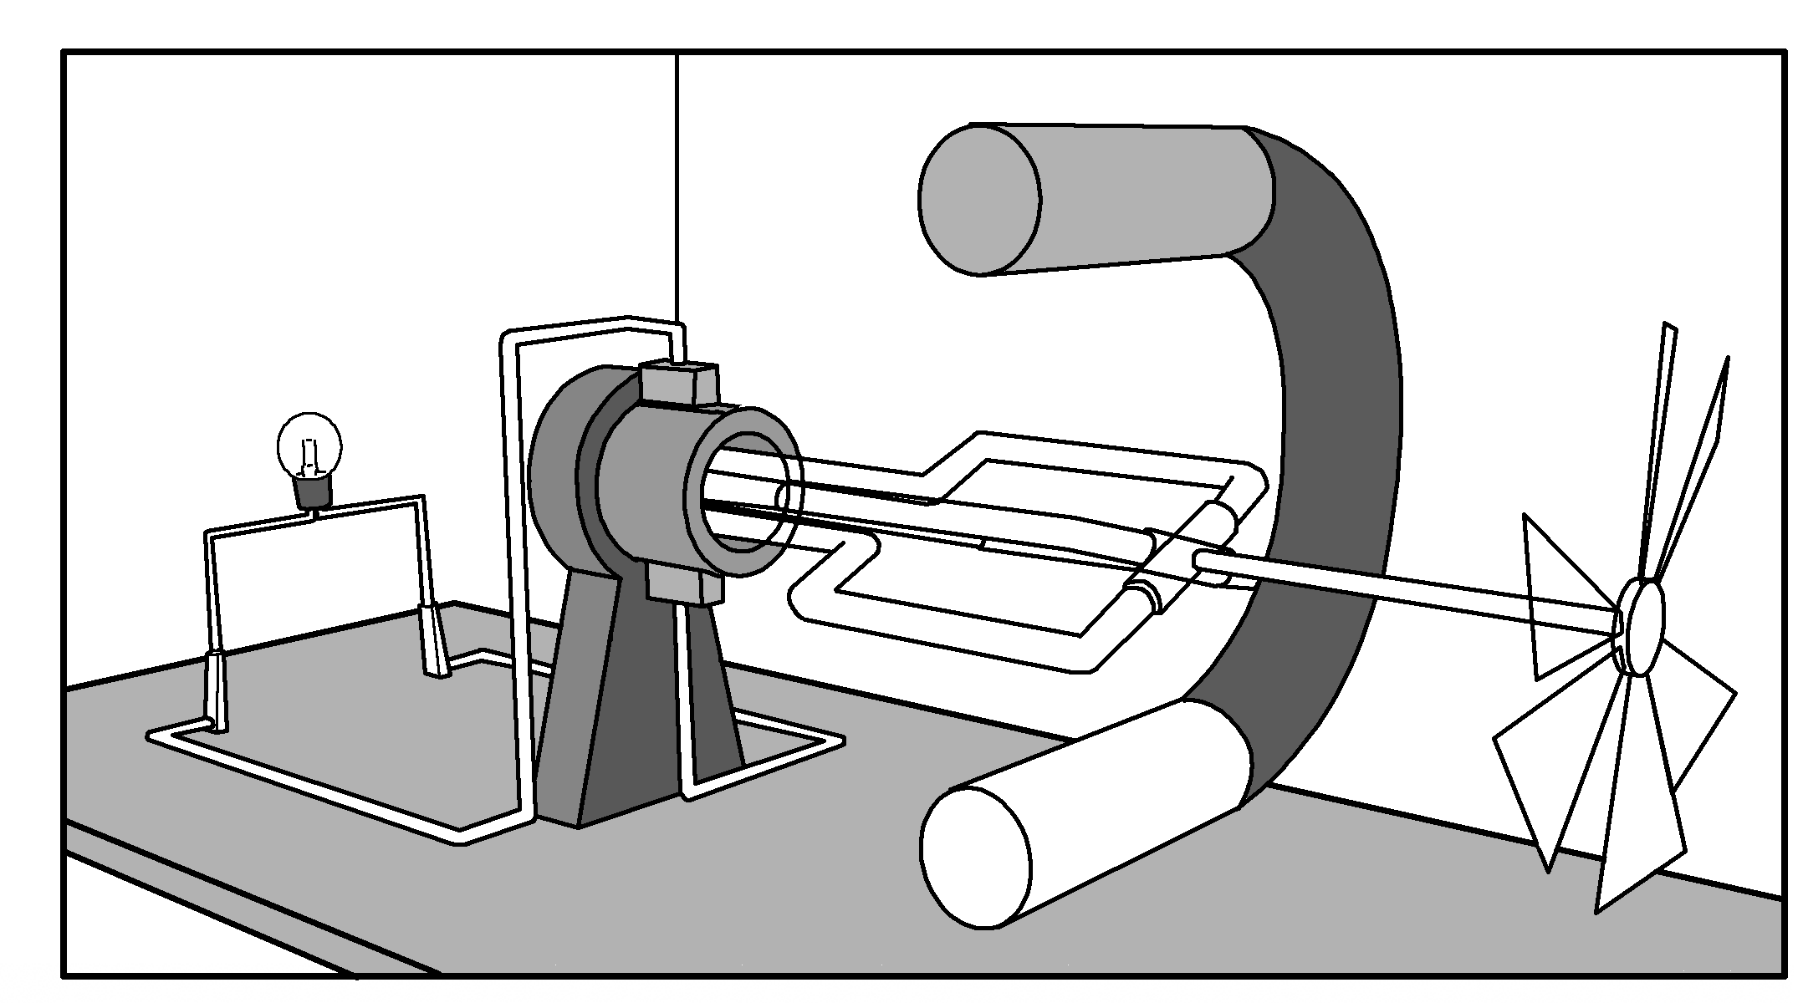
Electric Generator
Power stations use various sources to spin turbines. Some use very hot steam, while others use the energy from falling water to cause the turbine to spin. Another example could be fitting the turbines in windmills and let the wind do the work.
Electric motors and generators are related like two sides of the coin. In the setup below, we can just rearrange the electric motor to become a generator. The magnet stays the same, the battery is replaced with a bulb, and a windmill rotor is attached to the loop. The loop rotates as the wind rotates the blade. Then, electricity is produced. This is the application of the concept of electromagnetic induction.
Electric Motor
Generator

Slide 3
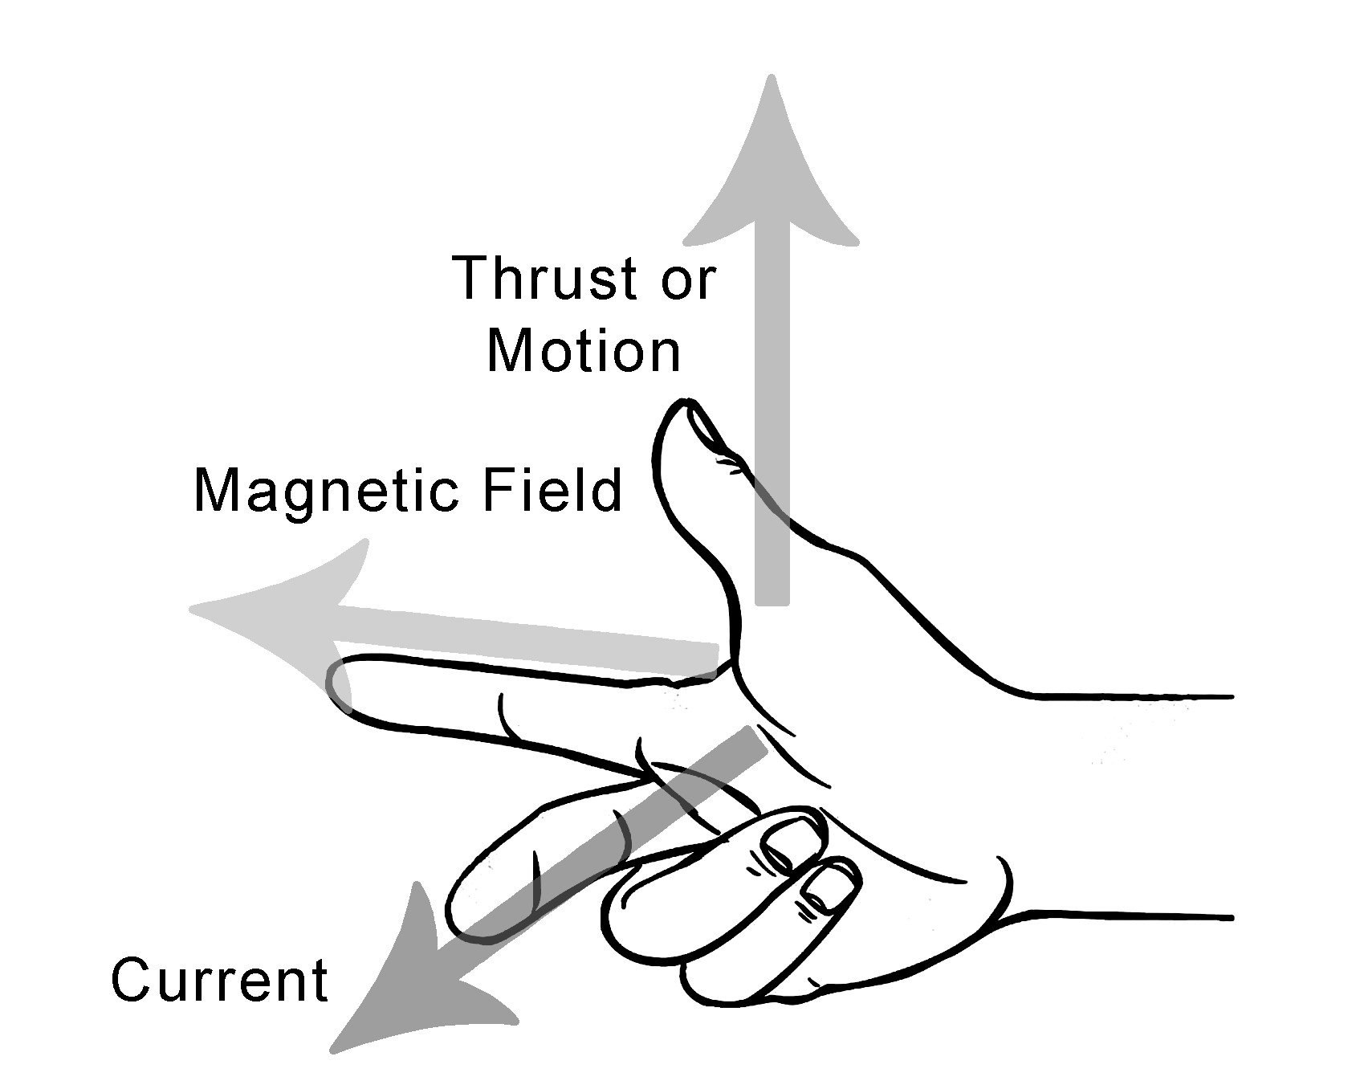
Electric Generator
There are two types of generators: alternating current (AC) and direct current (DC) generators. Both generators depend on the principle of electromagnetic induction.
Fleming’s left-hand rule is used to determine the direction of movement of the current-carrying wire if placed in a magnetic field. For generators, Fleming’s right-hand rule is used to determine the direction of the current. To do the right-hand rule, just point your right thumb to the direction of the movement of the loop. Your right index finger denotes the direction of the magnetic field. Your middle finger will then show you the direction of the current.
Fleming’s Right-hand Rule

Slide 4
Electric Generator
The table below summarizes the difference between a motor and a generator.
Basis | Motor | Generator
Function | It transforms electrical energy into mechanical energy. | It transforms mechanical energy into electrical energy.
Electricity | It uses electricity. | It generates electricity.
Rule followed | Fleming’s left-hand rule | Fleming’s right-hand rule
Examples | Household appliances such as electric fan, blow drier, etc. | Power stations

Slide 5
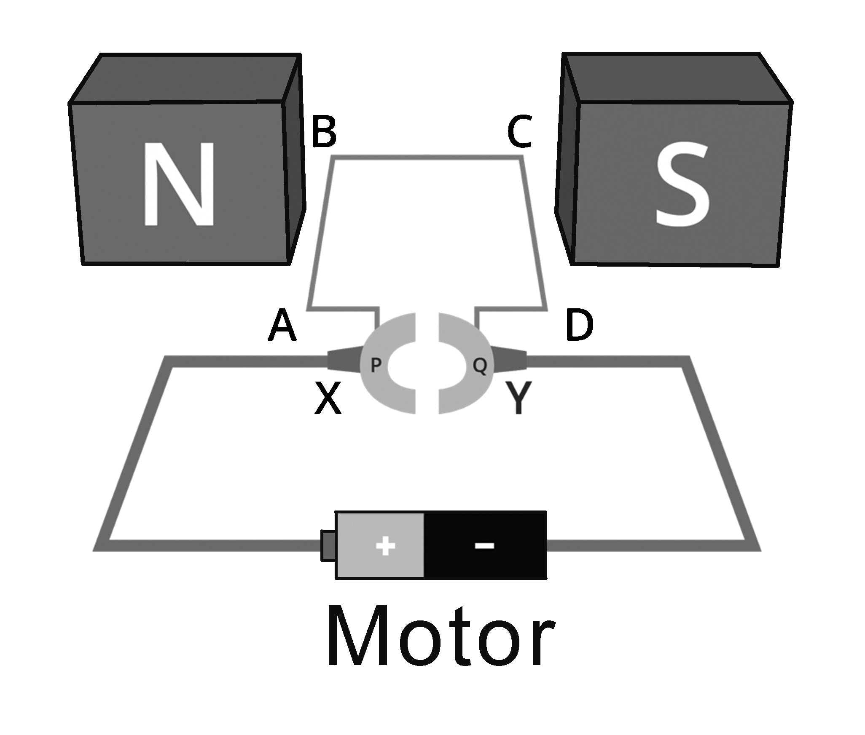
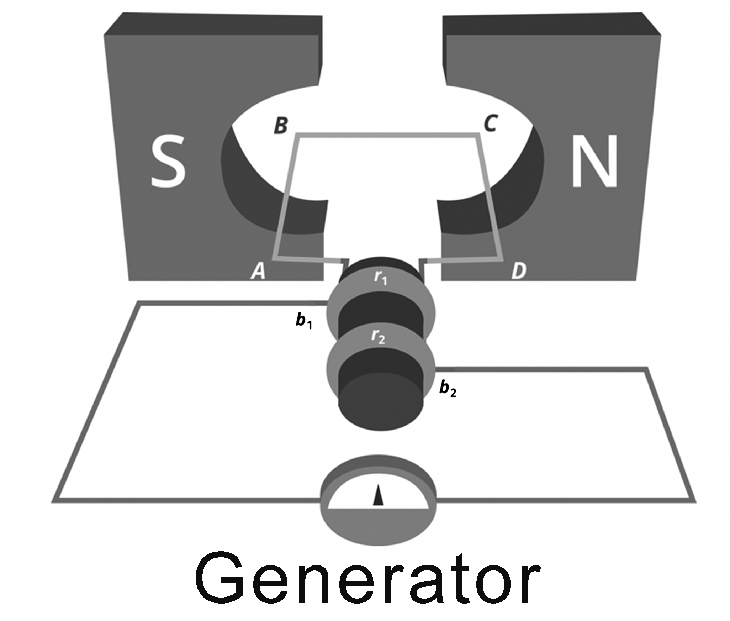
Electric Generator
Activity
Directions: Study the diagram below and find out how similar or different generators are from motors.
Similarities | Differences
Generator – converts mechanical energy to electrical energy Motor – converts electrical energy to mechanical energy | Generator – the source of energy are turbines. Motor – the source of energy are power grids and electrical supply.

Slide 6
Electric Generator
Answer Key
Similarities | Differences
Generator – converts mechanical energy to electrical energy Motor – converts electrical energy to mechanical energy | Generator – the source of energy are turbines. Motor – the source of energy are power grids and electrical supply.

