Slide 1
You Are Who You Are

Slide 2
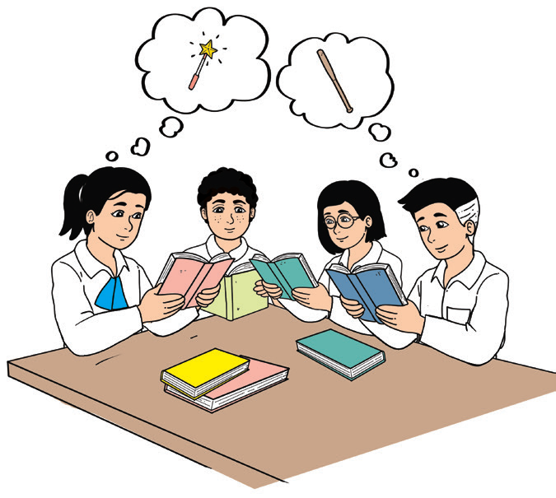
Phonics and Word Recognition
Is it difficult to read words that have a short o sound? How do you read mod and rod? Is it like mood and rood?
The short o sound sometimes appears at the beginning of a word.
Some examples of these words are on, off, octopus, and October.
In many cases, the short o sound can be found in the middle.
Some examples of these words are shop, stop, chop, pot, top, and cop.

Slide 3

Your teacher will read words with a short o sound. Repeat after him/her.
cob fob job | cod mod nod | bog cog fog | bop cop hop | dot got hot
CVC Word Games
Play the game “A Race in the Garden.” Guide the butterflies as
they fly from one flower to another to collect nectar. Each word that has
a short o sound serves as the guide of the butterflies for them to reach the
flower garden. Draw a line to connect the words that have a short o sound.
Avoid the words that do not have the short o sound.

Slide 4

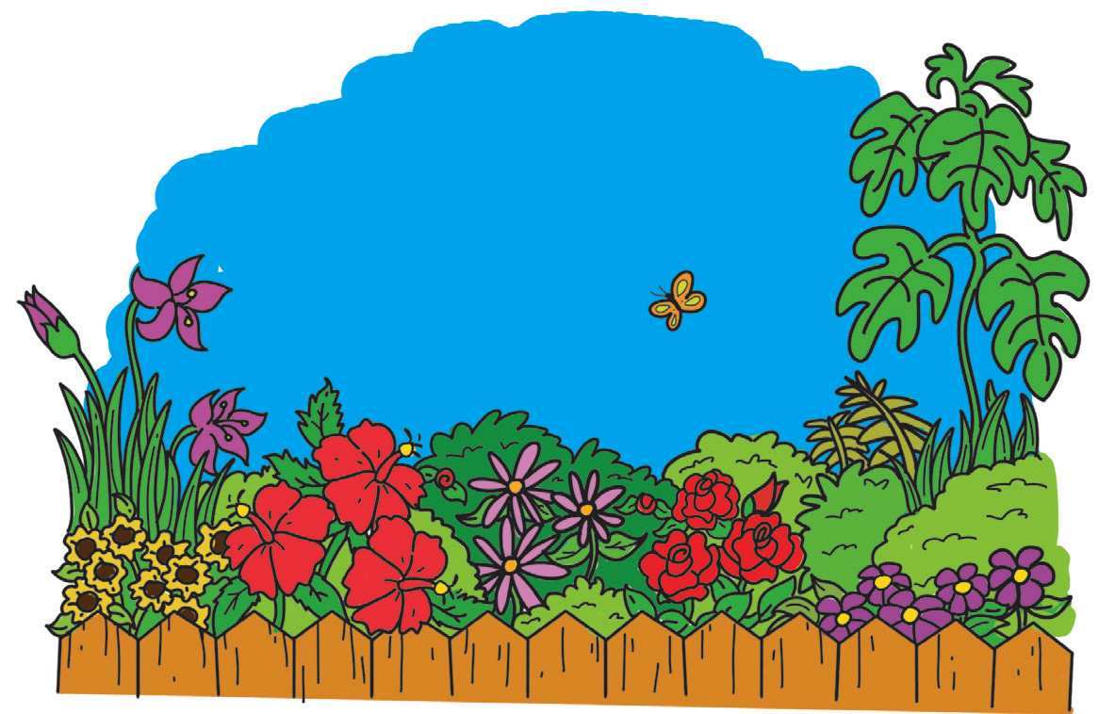
A Race in the Garden
mob how top low jot
cone toe cow sob
vow rob bow lot
now mop row
tow son woe not

Slide 5

Vocabulary Development
Read the following words: nod, jot, jog, hop, and mop. Do you know the meaning of these words that have short o sound?
Choose a word from the list (nod, jot, jog, hop, and mop) to complete each of the sentences.
1. I ______ my head to mean that I agree with an idea.
2. Let us ______ when there are no classes, so we will be physically fit.
3. Birds fly, fishes swim, and rabbits ______.
4. I was told to ______ the floor yesterday.
5. We are told to ________ down our answers.

Slide 6
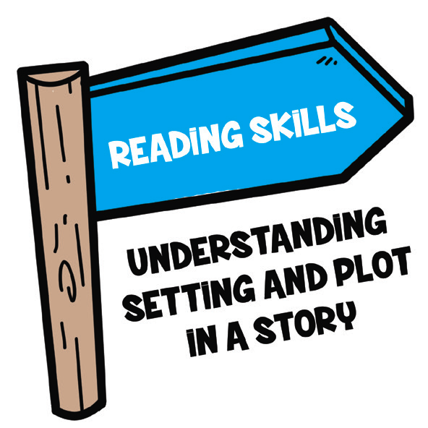
Reading Comprehension
To understand a story better, a good reader needs to know
the setting and plot of a story. The setting tells where and when
the story happened. Plot includes the events or things that
happened in the story.

Slide 7
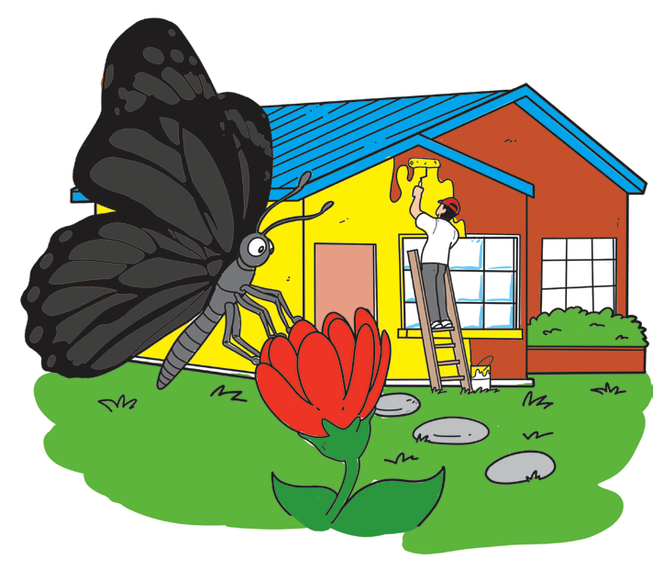
You Are Who You Are!
Boddy was a grasshopper that loved to hop and hop onto grasses and plants in the garden. He had a friend named Dollie, a black butterfly. Dollie was not happy because she did not like her color. She thought she was as black as night. She liked the red and green butterflies. She also liked the yellow and white butterflies. She wanted to be like other colorful butterflies.
Boddy reminded her to just be happy with her color.

Slide 8
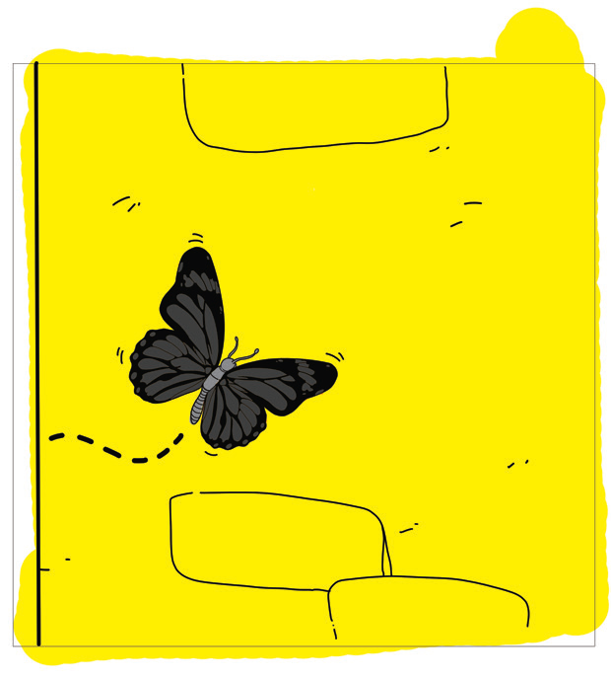
One day, Dollie saw a man who was painting his house yellow. She liked the yellow color. It looked bright and beautiful. She wanted to become yellow just like the color of the house, so she went near the house and rolled on the wet yellow paint. She wanted to make her wings yellow.
“At last, I am now yellow,” said Dollie.
She was so happy that she wanted to jump and fly. But she could
not move her wings. Her wings became heavy. She could not flap them.
She was stuck on the wall!

Slide 9


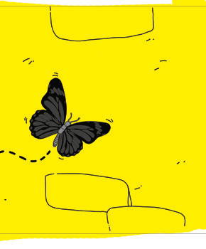
Look at the following pictures. Number the pictures from 1 to 3 according to how they appeared in the story.
________ ________ ________

Slide 10
Comprehension Check
The following questions will help you find out how well you read:
1. Read the title. What was the color of the sad butterfly?
2. Where did the story take place? What were the colors of the other butterflies in the garden?
3. What made the black butterfly want to become a yellow butterfly? What did the butterfly see?
4. What did the butterfly do to become yellow?
5. Why did she roll on the wet yellow paint?
6. Was the butterfly happy after her color became yellow?
7. What do you think could have happened to the butterfly at the end of the story?
8. What could have happened to her if she did not roll on the wet yellow paint?
9. What can we learn from the experience of the butterfly?
10. How did you feel when you read the story? Why did you feel that way?

Slide 11
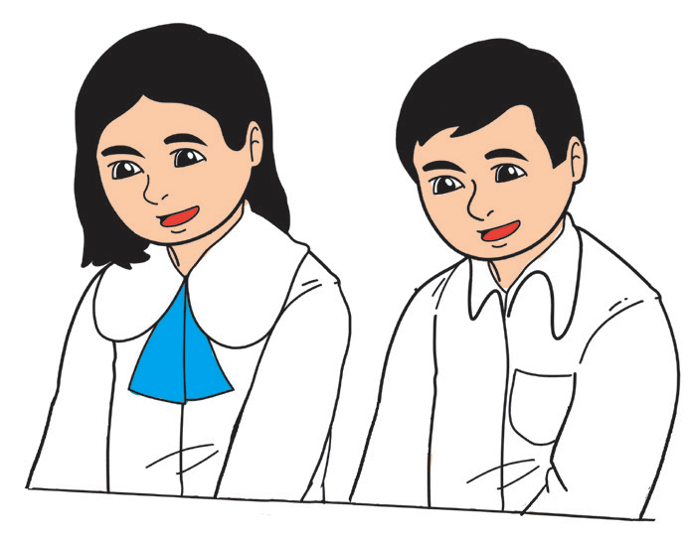
Fluency
Do you know any tongue twisters? Tongue twisters use words or sounds that are repeated many times. These repetitions of words make tongue twisters difficult to say.
Try to read the tongue twisters below repeatedly. Find out how many times you can say them without making a mistake.
The Shop and Stop Stock Shop stocks pork chops.
Does this shop stock pork chops?
If this shop stocks pork chops, where are the pork chops this shop stocks?

Slide 12

Oral Language
Just like in stories, a skit has also the following elements: plot, setting, and characters.
Read the instructions below.
1. Your teacher will divide your class into groups of three. Role-play the story of the black butterfly.
2. Assign the following roles: actors for the black butterfly and a man painting
the house, and a narrator.
3. Make sure each member helps in preparing the costumes or materials.

Slide 13

Grammar
If you would like to state a fact or provide information, you should use a declarative sentence. In reading this type of sentence orally, you should use the falling intonation at the end. You also have to put a period (.) at the end punctuation of the sentence.
Example: She lost her textbook.
At times, you have to use the rising intonation at the end of your sentence to ask for confirmation. You also have to put a question mark (?) at the end of this type of sentence.
Example: She lost her textbook?
When you ask a question, you write an interrogative sentence.
Don’t forget to put a question mark (?) at the end of the question.
Example: What time is our science subject?

Slide 14

A declarative sentence states a fact or an opinion. A period (.) is placed at the end of the sentence.
An interrogative sentence asks a question. A question mark (?) is placed at the end of this type of sentence.

Slide 15

Read each sentence and tell whether it is a declarative sentence or an interrogative sentence. Write D for a declarative sentence or IN for an interrogative sentence.
Examples: D There are many butterflies in the garden.
IN Have you seen many butterflies in the garden?
_______ 1. Flying a kite is fun.
_______ 2. Do you like to fly a kite?
_______ 3. A kite has four sides.
_______ 4. It has a diamond shape.
_______ 5. Did you fly a kite last Saturday?

