Slide 1
To Always Be Alert

Slide 2
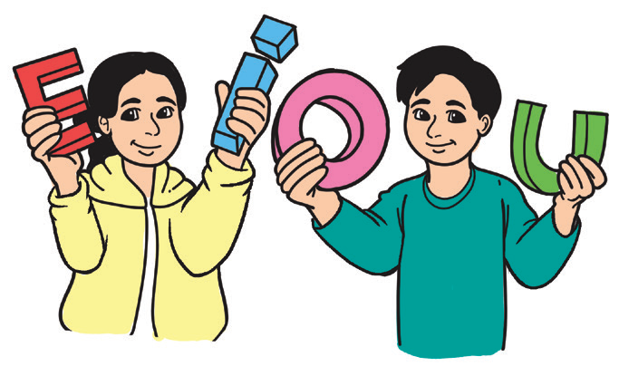
Phonics and Word Recognition
The story that you are about to read includes the following two-syllable words consisting of short e, i, o, and u sound. Your teacher will read them aloud. Repeat after him/her.
Short e sound | enter | very | gently | message
Short i sound | village | children | simply | listen
Short o sound | coming | tower | power | body
Short u sound | sunset | running | jumping | rusting

Slide 3

Reading Comprehension
Making predictions is a reading strategy you use to anticipate what would come next in the reading selection. You can use any previous knowledge you have or the clues that are in the story to predict what would happen next. In doing this, you are truly participating in the reading process.
What will you do when you suddenly feel the ground under your feet shake? This happens when there is an earthquake. The movement of the ground during an earthquake makes buildings and bridges shake. If the buildings and bridges shake to their limit, then they would fall down. Scary, isn’t it? How well-informed are you about earthquakes?

Slide 4
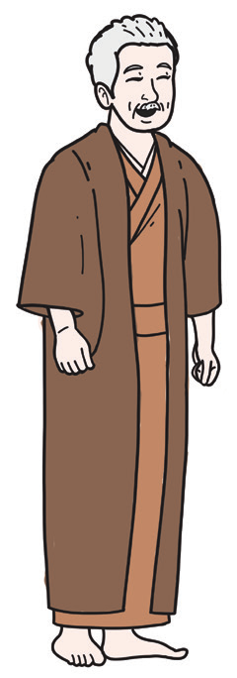
To Be Always Alert
Long ago in Japan, there was a wise old man who was called Ojisan or grandfather by Ichiro, his grandson. They lived on a high mountain, overlooking a village and a sea.
This small village stood beside the sea. When the water was clear, the
village children happily laughed and played in the gentle waves.
But on stormy days, the waves of the sea rolled strongly to the very edge
of the town. People, then, shut their doors and waited for the sea to grow
calm again.
One day, when the air was very hot and still, Ojisan and Ichiro felt a
low shaking from the ground.

Slide 5
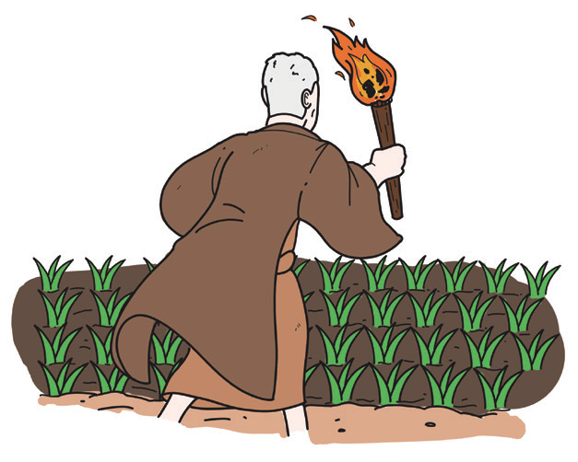
Their house rocked gently. It was not strong enough to frighten Ichiro for Japan experiences many earthquakes. But this one was queer.
As the quaking ceased, Ojisan’s keen old eyes looked at the
seashore. The water had darkened quite suddenly. The sea was
running away from the land. Ojisan suddenly remembered the
things that were told to him in his childhood by his father.
He understood what the sea was going to do and he must
warn the villagers.
There was no time to send a message down
the long mountain road. Ojisan must act. He said
to Ichiro, “Quick! Light me a torch!”

Slide 6
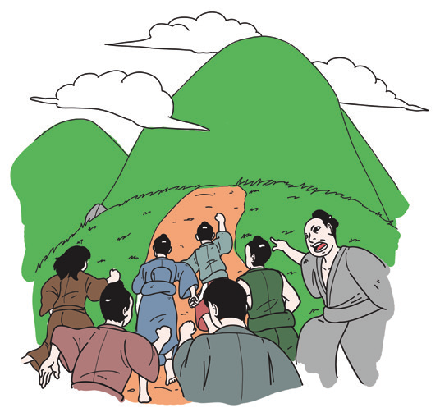
The old man hurried out to the fields where his rice stood, ready for the harvest. He thrust the torch among the dry stalks and the fire blazed up.
Down below, the priests in the temple saw the blaze on
the mountain and set the big bell booming. The whole
village, then, were running to the mountains to put
the fire out and save the rice fields.
But it was too late to save the flaming rice fields
of Ojisan. The village people were all angry. They
shouted at Ojisan,“Why did you destroy the rice fields?”
Ojisan didn’t say a word. He simply raised his
hands and pointed to the sea. “Look!” he said.

Slide 7
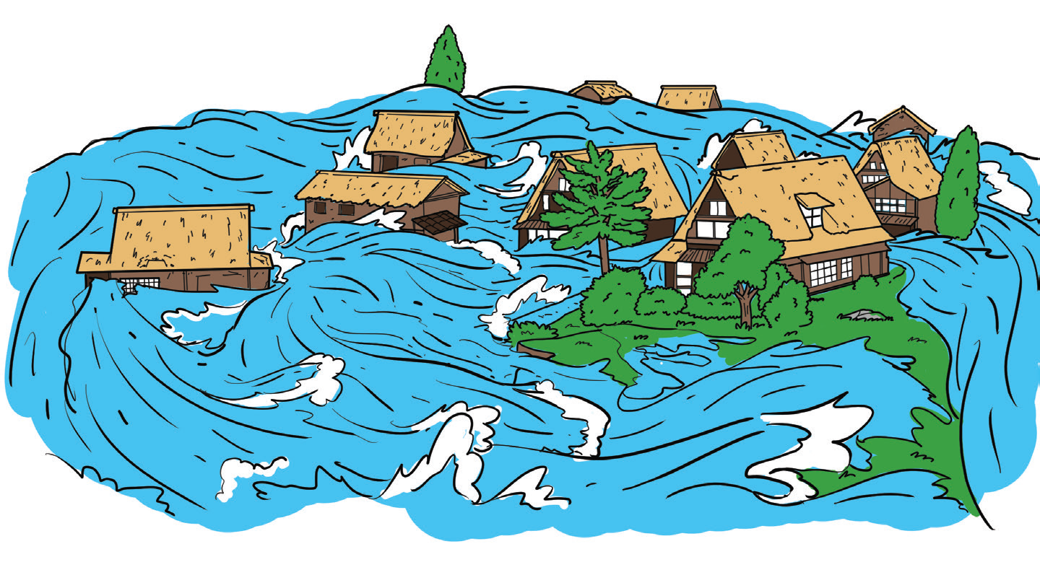
Everybody looked at the sea and saw darkness covering the coastline. The coastline cannot
be seen anymore! Only a long, dim and dark line was visible. The line grew wider and darker. It moved toward them. That long darkness was the returning sea, towering like a cliff and coming toward them very fast!
“Tsunami! Tsunami! Tsunami!” shouted the
people. They saw how the giant wave struck the
shore. When they looked again, they saw a wide,
white sea raging over the place where their homes
had been. It drew back roaring and tearing out the
land as it went.

Slide 8
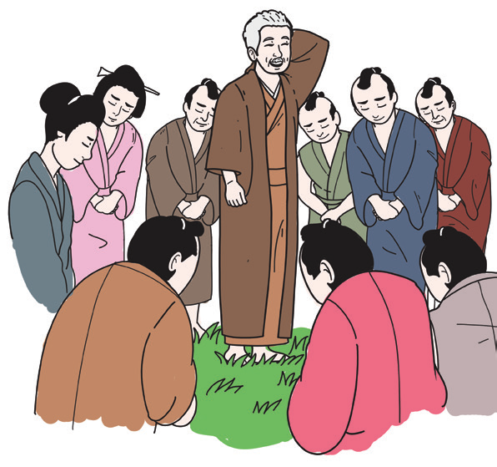
Around the house of Ojisan, no word was spoken.
The people were all shocked to see their houses all
washed away by the giant waves!
Then the voice of Ojisan was heard again, gently
saying, “That was why I set the rice field on fire. So
that you will all climb the mountains and be saved!”

Slide 9

Look around the classroom. How many chairs are there in your room? You have studied that chairs are called nouns in the English grammar. How many big chairs are there for the teacher? If there is only one, it is termed as singular in number. If there are two or more, the term is plural in number.
To change singular nouns to plural nouns, do the following:
1. Add -s to most nouns.
Examples: bag - bags; paper – papers; pen – pens; book – books; eraser – erasers
2. Add -es to common nouns ending in ch, sh, s, ss, x, or zz.
Examples: church – churches; flash – flashes; class – classes; fox – foxes; buzz – buzzes

Slide 10
Rules in constructing the plural form of nouns correctly.
Nouns | Rules | Examples
Nouns ending in s, sh, ch, x, or z | Add -es | 1. kiss – kisses 2. dish – dishes 3. coach – coaches 4. tax - taxes

Slide 11
Rules in constructing the plural form of nouns correctly.
Nouns | Rules | Examples
Nouns ending in o preceded by a consonant | 1. Generally add -es (Check dictionary to be sure.) 2. Add -s to some. 3. Add -s or -es to some. | 1. hero – heroes tomato - tomatoes 2. radio – radios 3. volcano – volcanos/ volcanoes

Slide 12
Rules in constructing the plural form of nouns correctly.
Nouns | Rules | Examples
Nouns ending in f or fe | 1. Change the f to v and add -es. 2. Add -s (Check the dictionary to be sure.) | 1. calf – calves wife – wives 2. chef – chefs roof – roofs

Slide 13

Rules in constructing the plural form of nouns correctly.
Nouns | Rules | Examples
Nouns ending in y | Change y to i and add -es. | 1. tummy – tummies 2. hobby – hobbies 3. sky - skies
A noun that names only one is a singular noun.
A noun that names more than one is a plural noun.

Slide 14

Writing
Writing a paragraph is not as easy as writing a simple sentence.
You have to consider many things such as your topic, what you want to talk about in your paragraph, vocabulary words, and sentences. You have to think of a topic sentence and develop ideas from it. Your sentences should be connected in order to come up with a good paragraph.

