Slide 1
Dare to Fly, Dare to Learn

Slide 2
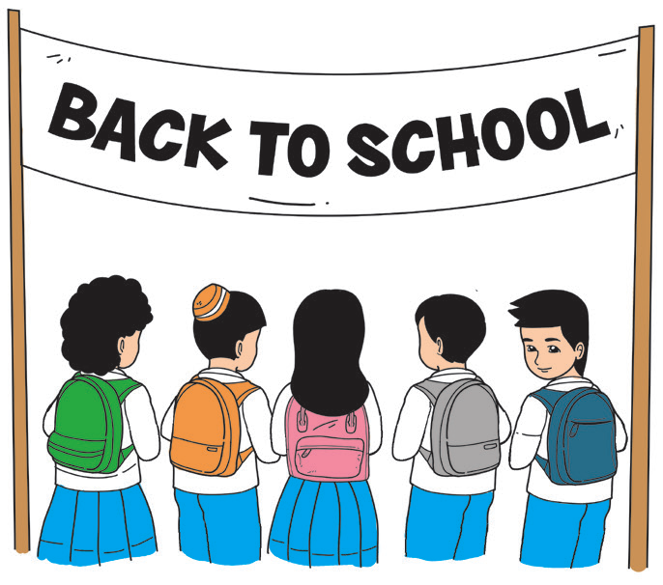
Listening Comprehension
Now that you are in school again, expect to do plenty of listening. How good are your listening skills?
A. With a partner, take turns in telling your most memorable story during your summer vacation. Listen carefully as your partner tells his/her story. Note the important details in your partner’s story. Once your partner is finished, tell him/her how you think and feel about what you heard.

Slide 3
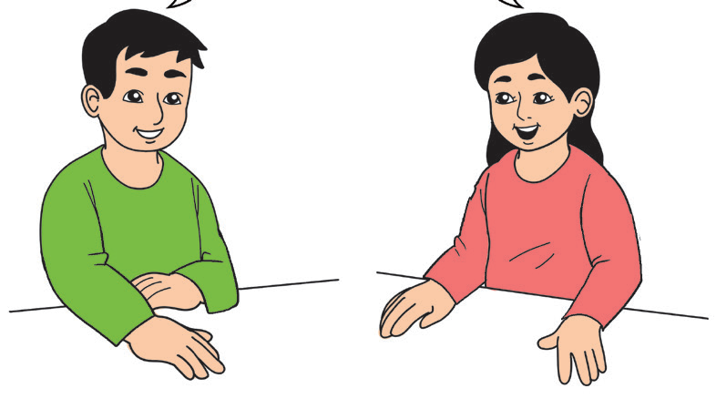
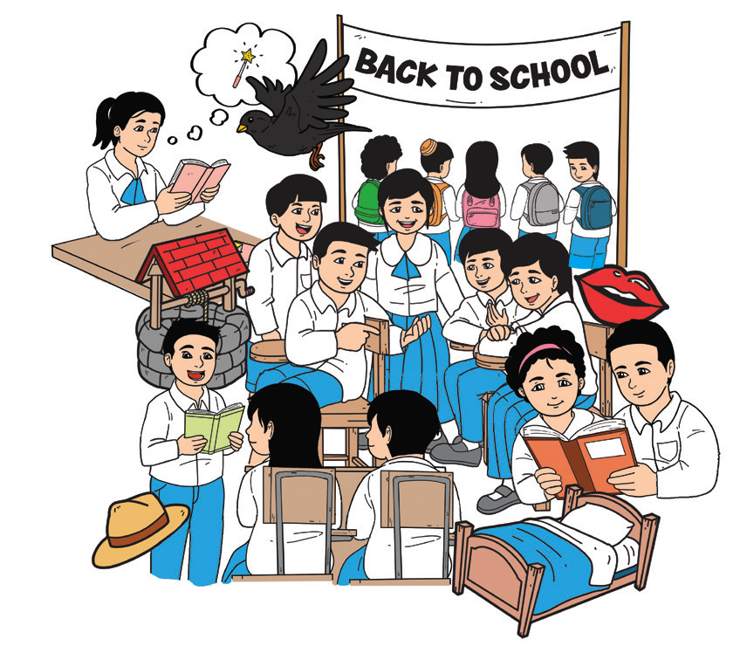
How well did you listen to your partner? Did you look at the speaker? Did you nod your head if you understood what he/she was saying? Did you do other things when you listened to your partner?
We went to the beach.
Really? Tell
me about it.

Slide 4



Read the sentences below. Ask yourself if you did each during your conversation with your partner.
 | Do you do the following?
L | Look at the speaker: I look at my teacher or any speaker and avoid doing many movements.
I | Inquire: I ask questions if I don’t understand what the speaker is saying.
S | Stay focused: I listen with my ears as well as my brain.
T | Think: I think about what the teacher is saying.
E | Ears open: I listen to directions.
N | Nod: I nod my head if I understand what the speaker is saying.

Slide 5
Phonics and Word Recognition
Do you still have a hard time reading and spelling words with short e, short i, and short a sounds? Do you find it confusing whenever you spell bat, bet, bit, wand, when, and win? Practice reading words that have the short e, a, and i sounds.
e | a | i
bet | bat | bit
let | lat | lit
pet | pat | pit
set | sat | sit

Slide 6
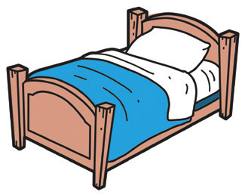


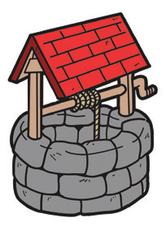
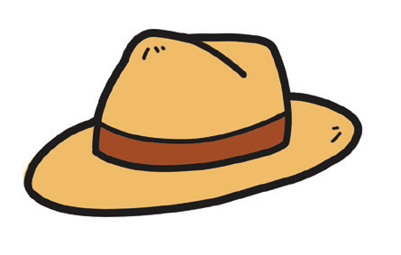



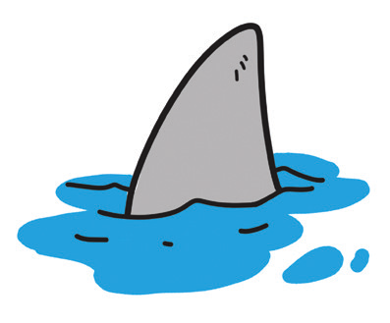
With a partner, take turns in saying the name of each drawing. Your partner will write the spelling of the word that you will say. Check each other’s work.

Slide 7
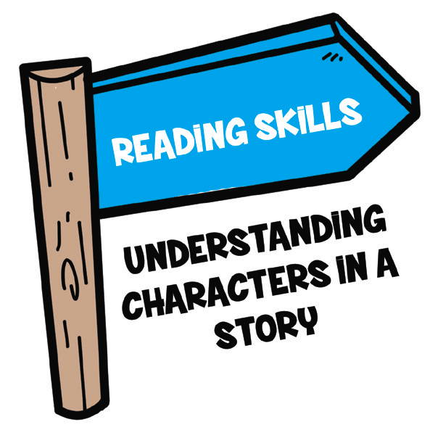
Reading Comprehension
Stories have characters. Characters are people, animals, or animated objects in a story. The characters can be young boys and girls like you, or men and women just like your parents and teachers. The most important characters are called main characters.

Slide 8
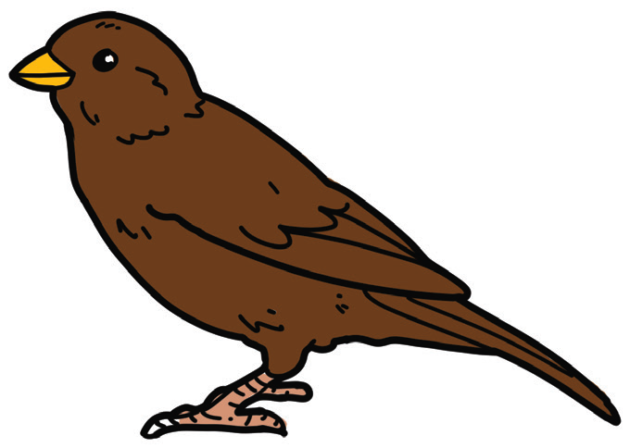
Vocabulary Development
Words are related with other words. The story that you read is about a bird. Try to guess the meaning of the underlined words used in the story.
1. The bird would flap his wings. Flap means (clap, moving the wings).
2. The big birds and the silky white birds saw him. Silky means (sick, smooth).

Slide 9

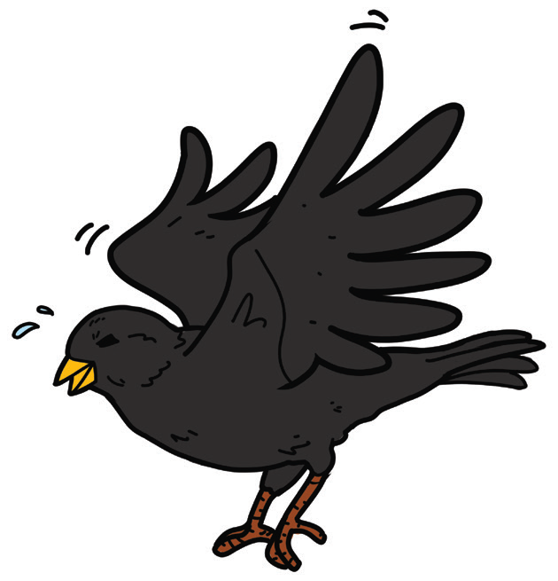
Dare to Fly, Dare to Learn
There was a black bird named Boni. His feathers were as black as night, and he looked
dirty. Every bird in the village did not want to play with Boni, especially the birds whose
feathers were all silky white. They laughed at him. They called him names. Boni was always alone.
But Boni did not stay sad. Each morning, he would fly and fly. He would fly high and low. He would flap his wings one, two, and three. He practiced and practiced until finally, he could fly high in the air. How
happy he was! He felt he was like a king in the sky. The big birds and the silky white birds saw Boni. They liked the way he flies. They also wanted to be able to fly high. Soon, many birds wanted to play with Boni. He became the friend of every bird in town.

Slide 10
Comprehension Check
Answer the following questions:
1. Who was Boni? What made him different?
2. Why was he not a happy bird at the start of the story?
3. How did the other birds treat him?
4. Did he allow himself to be affected by the other birds?
5. What did Boni do to become a happy bird?
6. Did he succeed in becoming a happy bird?
7. What character trait did Boni have that made him a happy bird?

Slide 11
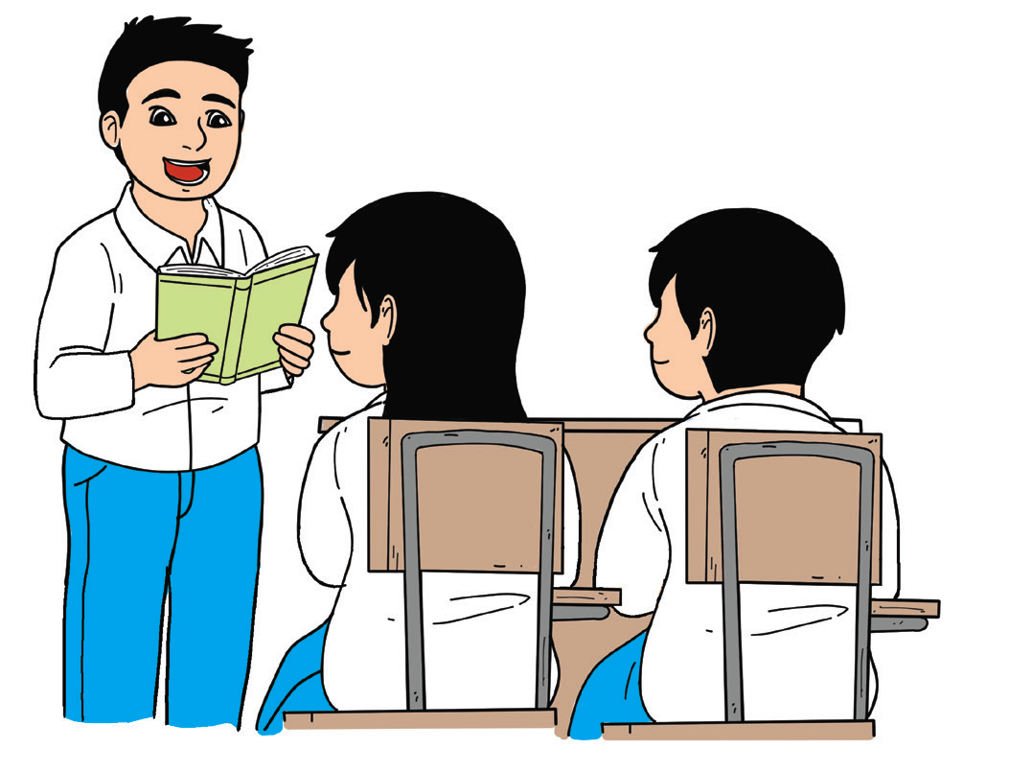
Fluency
How is your oral reading skill? Can you read fluently now? Reading fluency is the ability to read with speed, accuracy, and proper intonation. When you read, you should pay attention to punctuation marks. You must pause when there is a comma (,) and stop when there is a period (.). You could hear the rise and fall of your voice that would express the meaning of the words in the sentence effectively.
One-syllable word | black, as, bird, were, did, not, his, can
Two-syllable word | village, alone, practice, happy, silky, wanted, many

Slide 12
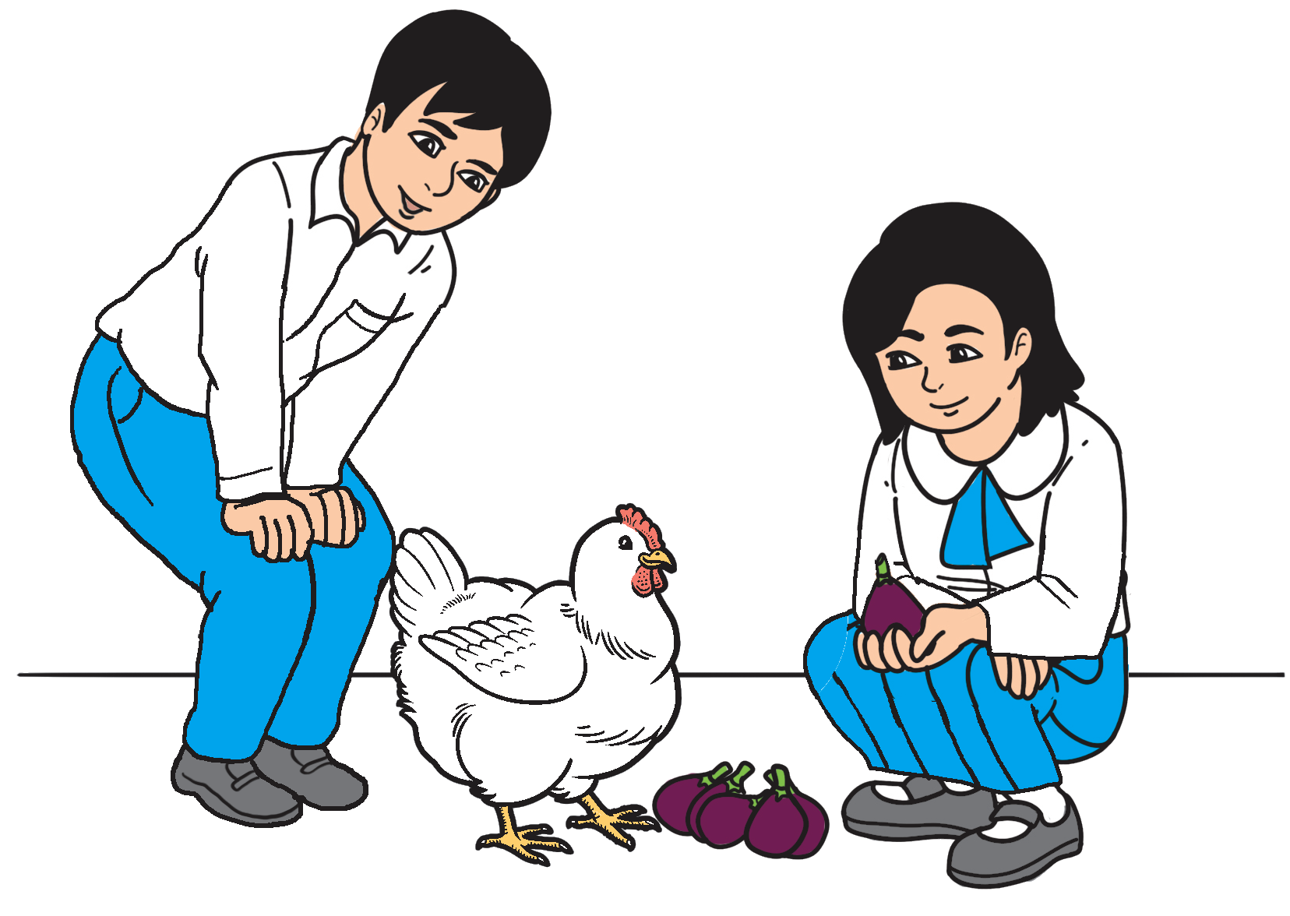
Fluency
Your teacher will divide you into groups of four or five. Engage in a read-along of this repetitive text or tongue twister. Repeat your readings at least three times.
Mat and Pat met a fat hen. They sat on a
mat when they pet the fat hen. Mat and
Pat said, “Fat hen, do you want a fig?”
Mat and Pat fed figs to the fat hen.

Slide 13
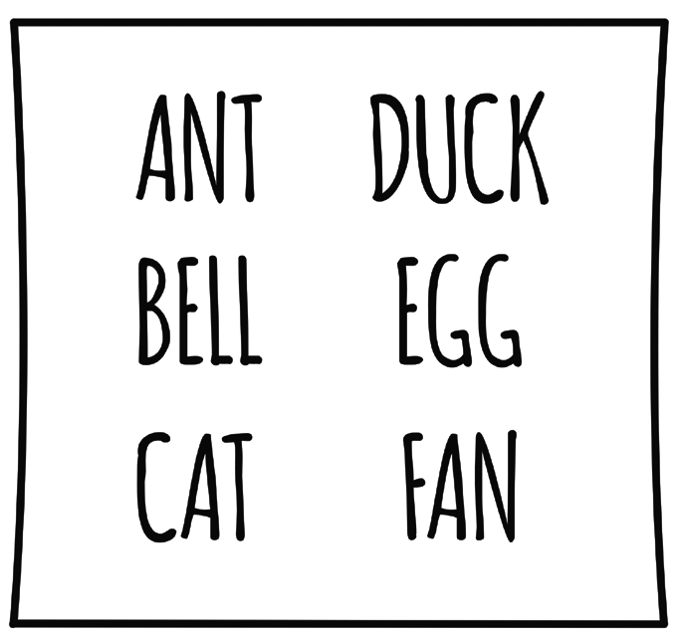
Study Strategy
The words in the dictionary are arranged alphabetically. Your names in the class record of your teacher are also arranged alphabetically. Arranging words in alphabetical order is done by following the order of the letters in the alphabet.
Study the following examples:
art ball car | dog egg fish | geese hat ice | jar keg lip | map nest oven | part quick rest | safe task urn | vase well X-ray | yell zoo

Slide 14

Arrange the names alphabetically.
Cruz, David
Torres, Hannah
Bravo, Rosie
Ortiz, Samuel
Santos, Lea

Slide 15
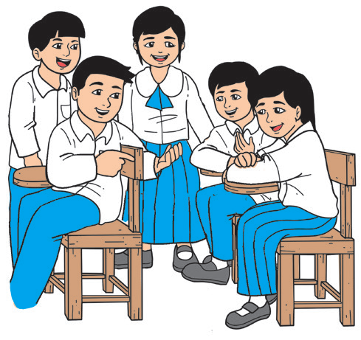
Oral Language
Start a talk with your classmate as you do the activity that follows. Make sure to follow the rules in holding a conversation.
Make a list of the things that you like to do such as drawing animated or cartoon characters, playing street games, helping Mother in preparing snacks, and a lot more. Move
around the classroom to find at least three classmates who like to do the
same things. Be polite when asking your classmates.

Slide 16

Grammar
It is time to review what sentences are and how they differ from nonsentences.
A sentence expresses a complete thought. It has two parts. The part that tells who
or what is being talked about is the subject of the sentence.
Example: Sam and Hannah are good volleyball players.
The part that tells something about the subject is called predicate.
Example: Sam and Hannah are good volleyball players.
There are words that go together but do not express a complete thought. These are nonsentences as they lack the two main parts—subject and predicate.
Example: good basketball players

Slide 17
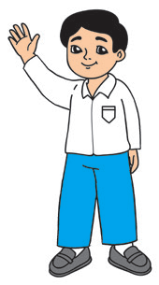
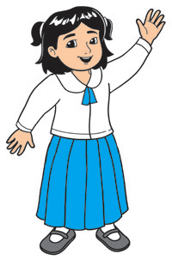
Identify the subject and the predicate.
1. She teaches us to dream high.
2. My uncle is strong and brave.
3. My classmate stops teasing me.
4. We are now friends.
5. The boy practices dribbling and shooting the ball every day.

