Slide 1
They Guide Us, They Love Us

Slide 2
Phonics and Word Recognition
Have you seen words such as like me, a, an, be, we, he, is, are, and to appearing often in the stories, poems, sentences, and paragraphs that you have read? These are sight words. They often appear in your reading materials. Thus, you need to know how they are said, what they mean, and how they are spelled.
Some of these words are in the box below. Read them aloud.
a all an are as at be been but you your by
can do did each for from first has he her him
know now like my many may no not now or one of on
people so said she the to this there up very we why will with

Slide 3
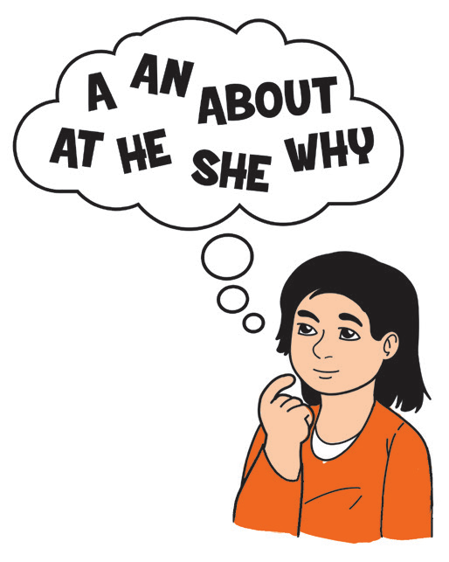
Spot the Sight Word
Choose all the sight words that you can find in the selection.
A Play Has a Setting
Every play has to have a story conflict. What else does a play need? Every play must have a place and a time where and when the action of the story happens. We call this the setting.
There can be pictures on the walls and chairs and tables and other furniture
on the stage. There can be cookies and lemonade and other foods or drinks
on the tables. Sometimes these are real, and sometimes they are only pretend.
Always, the scenery and the stage properties show us when and where the
story of a play is happening.

Slide 4
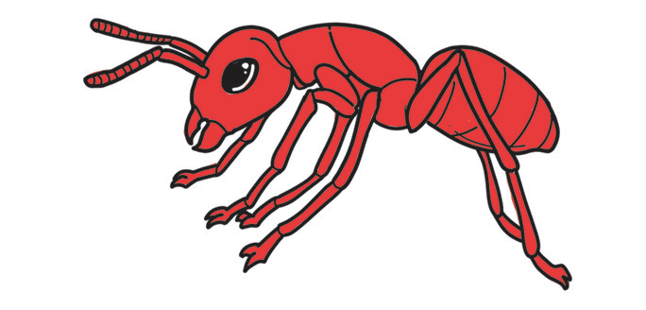
Vocabulary Development
You are about to read a story about Anton, an ant who did not listen to his parents.
Unlock the meaning of the following words which are used in the story: playful, sink, and crawled. Try guessing the meaning of these underlined words based on how they are used in the sentences. Underline the appropriate meaning inside the parentheses.
1. Anton was playful. He could run fast. He could jump high. (energetic, sickly)
2. The kitchen sink is dirty. (a large, open container for washing, a container for eating)
3. The ant crawled on top of the table. (a movement on a dry surface, a movement in the water)

Slide 5
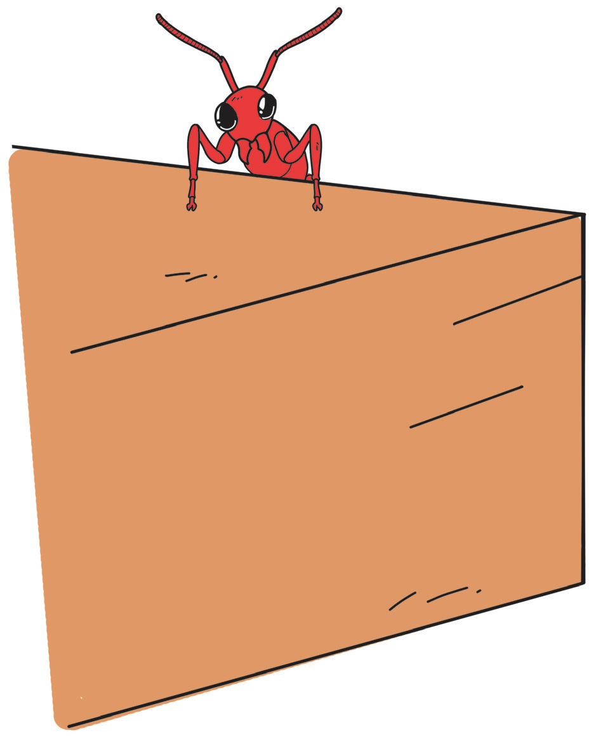
They Guide Us, They Love Us
There was a young ant named Anton. He was a playful ant. Anton had a small head but strong feet. He could run fast. He could jump high. Anton would love to go to the kitchen. He could play near the kitchen sink. He could move fast under the table.
He could run fast under the chair. Anton thought that he was brave and
strong.
But Anton’s Papa and Mama told him not to go out when there were
people in the house. Anton never listened. He believed that he was strong,
and he was fast.

Slide 6
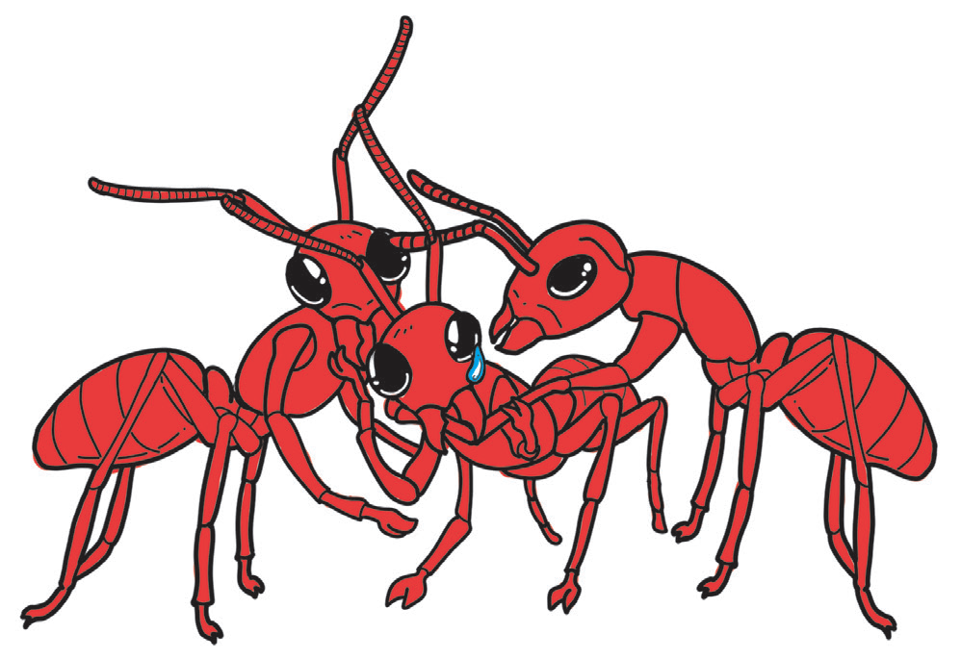
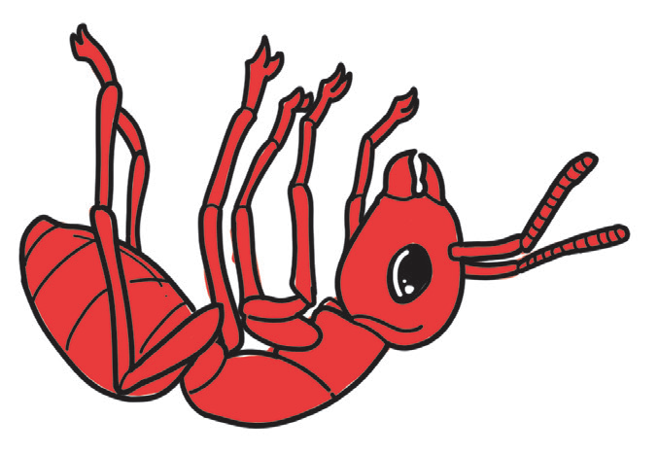
One night, Anton went out to play. The people in the house were eating. Anton crawled on top of the table. He thought that he was strong. He was not afraid, and he enjoyed what he was doing. But, then, something hit the table. He was nearly hit, so he fell on the floor. He called for his Papa and Mama. Unknown to him, they were just waiting under the table. Both of them ran fast towards him. Anton embraced them tightly. He promised never to disobey his loving parents again.

Slide 7
Comprehension Check
Answer the following questions:
1. Who was Anton?
2. How will you describe him?
3. Why did Anton not listen to his parents?
4. What happened to Anton at the end of the story?
5. If you were Anton in the story, what lesson would you have learned from such an experience?
6. How does the story relate to you? Supposing your parents always remind you to go straight home after class, would you go with your classmate to play computer games in the nearest Internet shop?
7. Why is it important to always listen to your parents?
8. How can you best show your love to your parents?

Slide 8
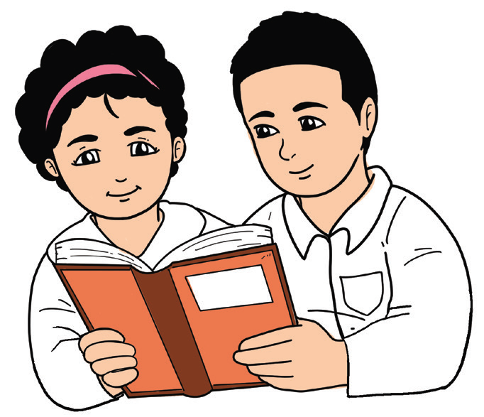
Fluency
Your teacher will read a rhymed verse. These verses contain words with long vowel sounds. He/She will read it with proper pacing or speed, and proper intonation or rise and fall of the voice. Repeat after your teacher. Then, with your classmates, read the poem aloud in class.

Slide 9


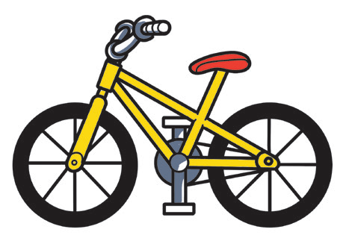
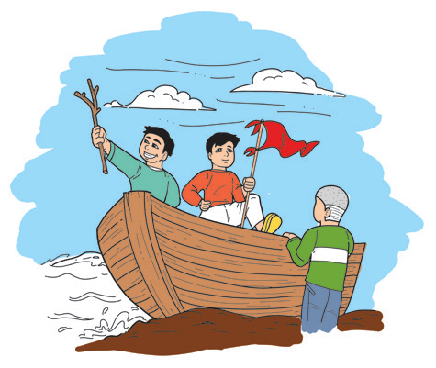
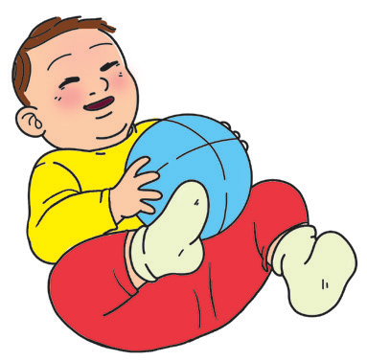
The Long Vowel Sounds
Long A, let us play, Because today The rain has gone away! | Long E, can’t you see? A bee, a bumble bee, Is under a green tree.
Long I, oh my, I smile! Let us ride a bike And fly a kite. | Long O, do you know? How to row a boat? And float when the wind blows.
Long U, you’re so cute And you’re not rude. Oh, I love your attitude!

Slide 10

What is an imperative sentence? What do you say when you give a command or make a request in English? In situations when a speaker would like to give a command or make a request, an imperative sentence is used.
Remember the following:
a. In giving instructions, the speaker uses the present simple form of the verb.
Example: Do it now.
b. In giving a command or in making a request, the speaker may use the words “must” or “should.”
Example: You must do it now.

Slide 11
c. To sound more polite, the speaker may add the word “please.”
Example: Do it now, please.
d. A question form can also serve the purpose of a request.
Example: Could you do it now?
In situations when a speaker would like to express strong feelings or emotions
such as joy, anger, or surprise, then an exclamatory sentence is used.
Example: You did it! That was awesome!

Slide 12
Classify the following sentences. Write IM for an imperative sentence or E for an exclamatory sentence.
Example: IM Do not go out.
E Oh my goodness!
________ 1. Wow! That’s great!
________ 2. Listen to your parents.
________ 3. Oh! I forgot my book at home.
________ 4. Ouch! My head hurts.
________ 5. Close the gate.

Slide 13

Imperative sentences are sentences that give a command or make a request.
Exclamatory sentences are those that express feelings of surprise, happiness, or fear.
With a partner, use different kinds of sentences (declarative, interrogative, exclamatory, and imperative) in the following situations. You may write your sentences or say them aloud.
1. You are looking for your lost ball point pen.
2. You are describing how your ball point pen looks like.
3. You are requesting your classmates to help you find your ball point pen.
4. You finally found your ball point pen.
5. You thank your classmates for helping you find the pen.

Slide 14
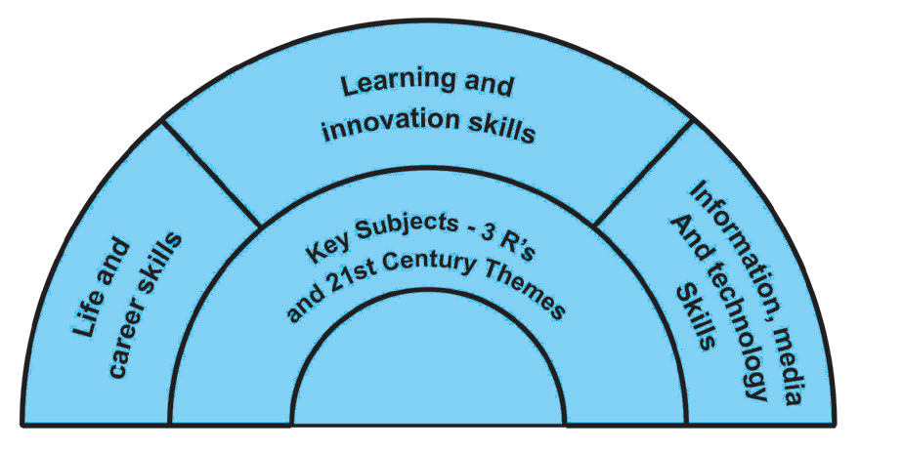

Writing
How do you say thank you to a family member who gives you love and guidance? What will you write to an uncle who taught you how to ride a bike? Aside from saying a simple thank you, you could also try writing a thank-you letter which he will surely treasure.

