Slide 1
A Sunny Day

Slide 2
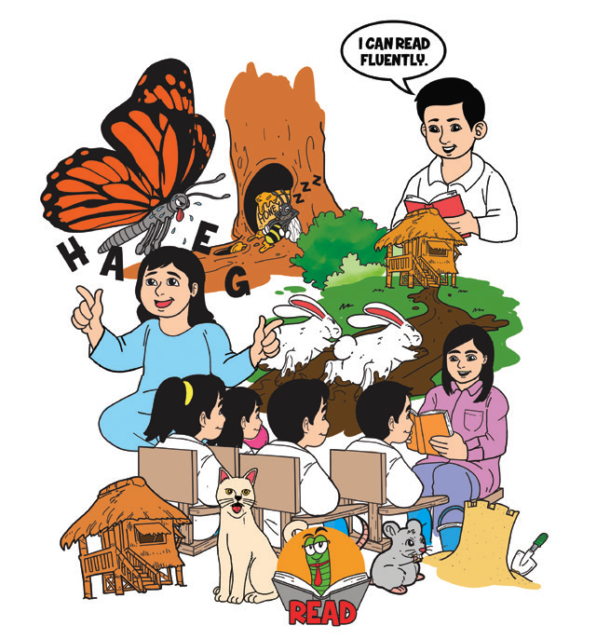
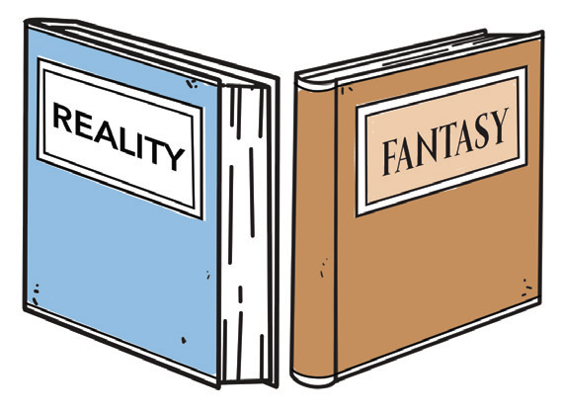
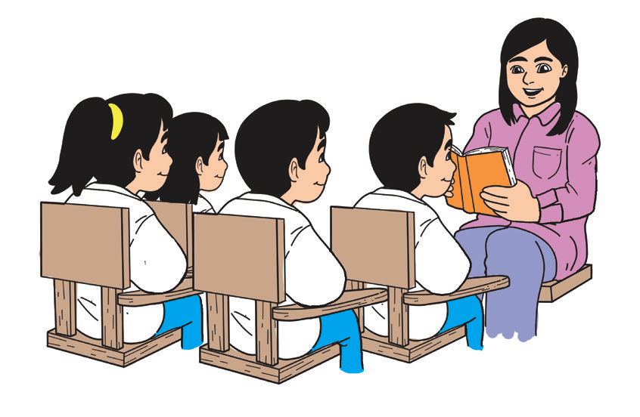
Real stories are based on events that could possibly happen in real life. Stories that could not possibly take place in real life are considered fantasy or make-believe stories.

Slide 3




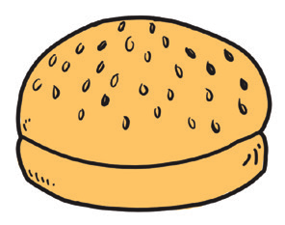

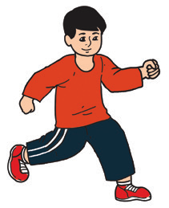
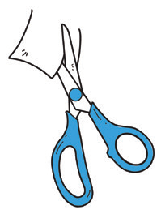
Phonics and Word Recognition
One common mistake in reading words with the letter u is pronouncing them as if they sound like oo. For example, instead of saying “bun,” some would say “boon” for it.
Some words that have the short u sound.
sun
mud
hut
jug
bun
nun
run
cut

Slide 4
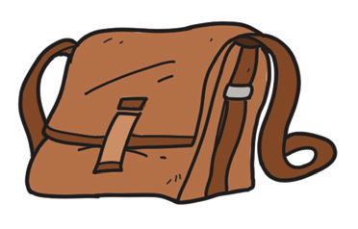


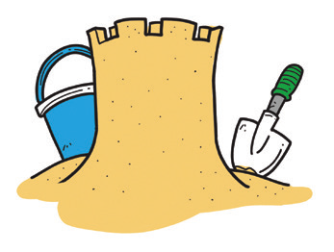

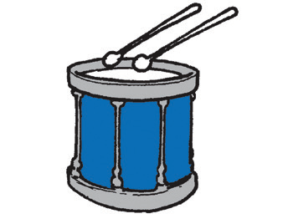
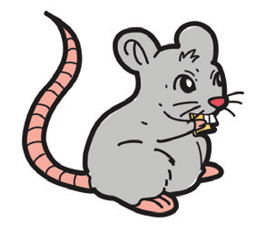



Point out the pictures with a short u sound.

Slide 5
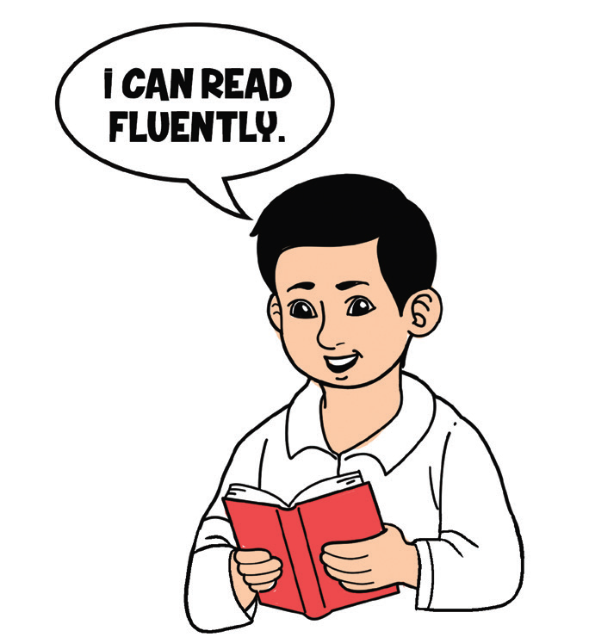
Fluency
Practice reading the short u sound in the following sentences with fluency, appropriate rhythm, pacing, and intonation:
1. It’s fun to chew gum when the sun is up. It’s funny to eat gummy when it is sunny.
2. The pups like running and jumping on the dust on sunny days.

Slide 6
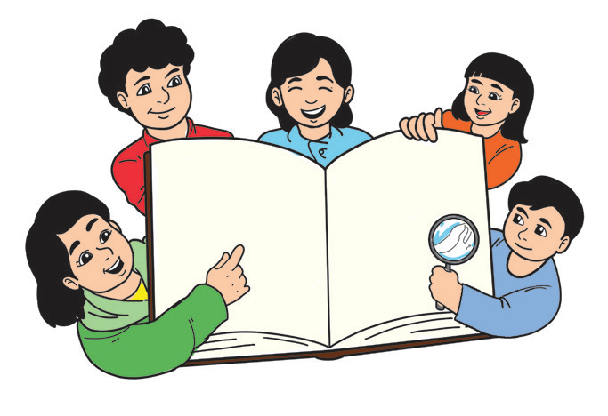
Study Strategy
What is skimming?
When you skim through a material, you should read quickly, and you don’t need to read each word. Skimming is reading quickly to figure out the topic of a selection. Many skim through newspapers, advertisements, food packs, and text messages. Teachers sometimes use this strategy to encourage speed.

Slide 7
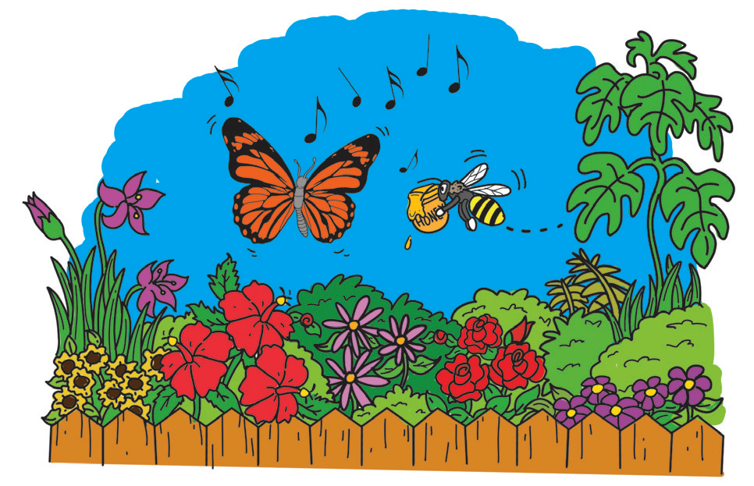
Skim through the story below and find out what it is about.
The Butterfly and the Bee
On one warm day in the merry month of May, a butterfly was singing and dancing in the garden filled with colorful flowers. The butterfly saw a bee which was busy gathering and storing food. She found it strange and funny. She laughed at the busy bee and called the bee some funny names.

Slide 8
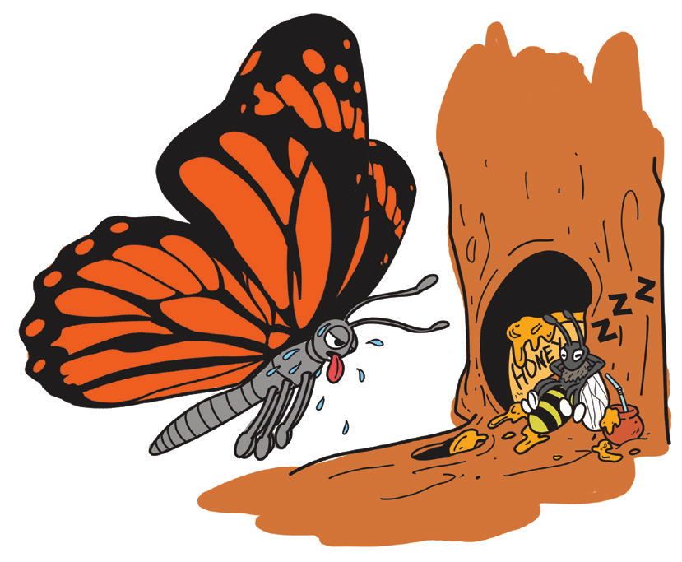
The bee simply ignored the butterfly and instead told her to do the same. “Rainy days are coming, you better be prepared,” said the bee. The butterfly only laughed at the bee.
Rainy days came. Water covered many parts of the garden. The butterfly was so hungry, but it had nothing to eat. She asked the bee for some food.
The bee simply replied, “You sang in the summer; now dance the rainy days away.”

Slide 9

How to skim a selection:
1. Read the title.
2. Read the first sentence of every paragraph.
3. Read the last sentence of every paragraph.
4. Take note of the picture.
5. Read the summary or the last two to three sentences of the paragraph.
6. Try to come up with a statement (what the story is about).

Slide 10
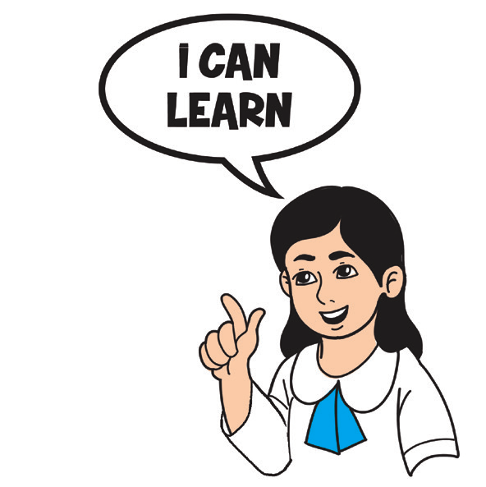
Oral Language
Recounting events clearly is a skill of good news reporters. This skill is also needed when your father or mother asks you to recount an event, so they can decide wisely over a certain situation.
Grammar
There are punctuation marks to be placed at the end when you say or write a sentence. These include a period, a question mark, or an exclamation point.

Slide 11
1. A period (.) is always placed at the end of a declarative sentence.
Example: The little boy is neat and tidy.
2. Use a question mark (?) after an interrogative sentence.
Example: Do you take a bath every day?
3. Use an exclamation point (!) after an exclamatory sentence.
Example: At last, I made it!

Slide 12

A period (.) is used at the end of a declarative sentence and an imperative sentence.
A question mark (?) is used after an interrogative sentence.
An exclamation point (!) is used after an exclamatory sentence.

Slide 13

Writing
What is a descriptive paragraph?
Descriptive paragraphs give a written picture of a person or a place. Using words that describe, a writer can effectively make readers understand a person either in real life or in a make-believe story.

