Slide 1
The Power of Reading

Slide 2
Phonics and Word Recognition
Read the following words.
a | o | u
cat | cot | cut
bat | bot | but
hat | hot | hut
rat | rot | rut

Slide 3
Phrases
1. red ribbon on the rod
2. tip of the top
3. not for storing nuts
Sentences
1. The red ribbon is tied on the rod.
2. You tap the tip of the top on the floor.
3. The net is not for storing nuts.

Slide 4
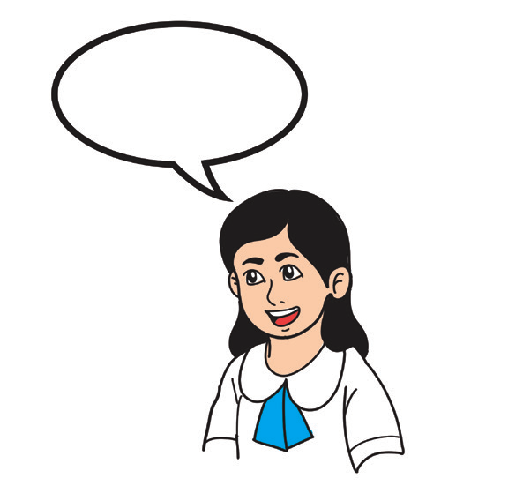
Vocabulary Development
Can you count the number of English words you know?
You must have known the English words of many animals, toys, and food you see at home and in school.
Do you know that each word belongs to a category of words? For example: Labrador and Shih Tzu are dogs; dogs are animals; and all animals are considered living things that grow, change, and die.
What’s a word category?

Slide 5
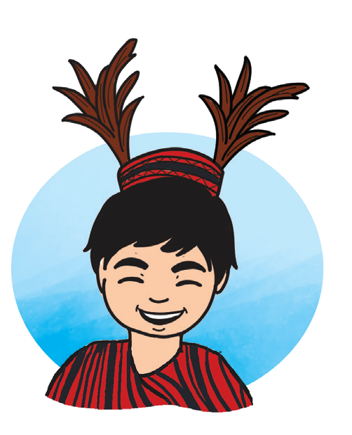
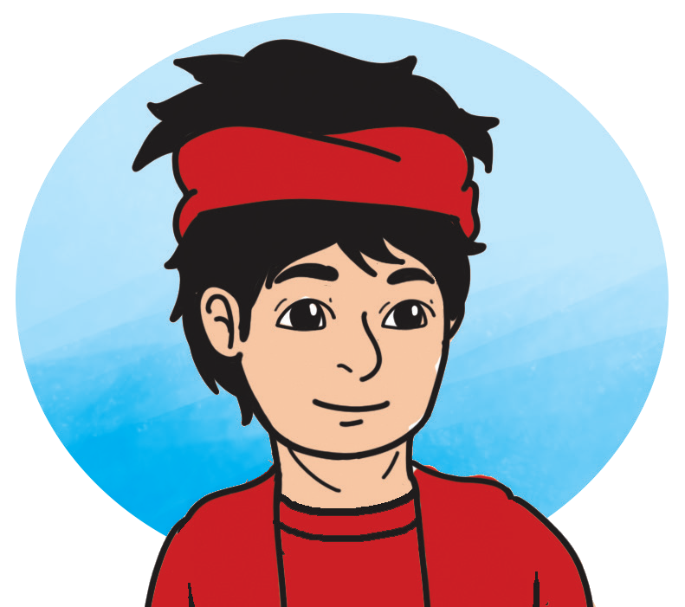
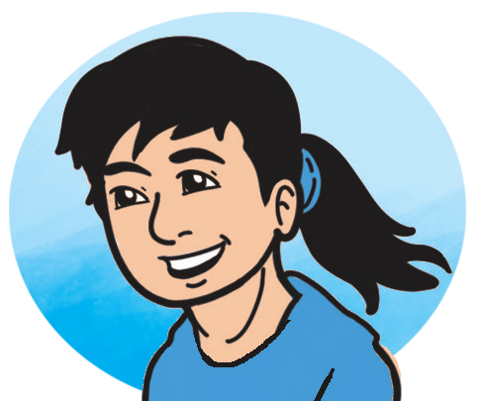
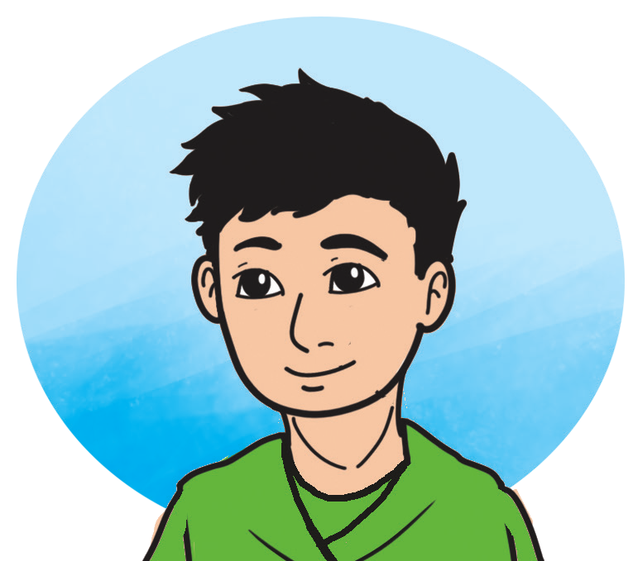
The Power of Reading
A long, long time ago, many boys and girls did not learn to read. Books were hardly found at home. They were very expensive and only a few rich men could read books.
During those times, there were tribal leaders who could not read. Thus, their children choose to hunt and fight rather than read or study.
In the Northern part of the country, there was a tribal leader who had three sons. His sons were Makisig, Malakas, and Masigasig. The two older boys, Makisig and Malakas, were strong and athletic. Both love to run, swim, and climb trees. The youngest, Masigasig, was small and frail-looking.

Slide 6
One day, their mother showed them a wonderful book. She turned the pages of the book where there were letters and drawings on them. She showed them how the colorful drawings had been drawn and painted. The three children admired the book very much for they had never seen anything like it.
“But the best part of it is the story which this book tells,” said their mother. “If you could only read, you might learn that story and enjoy it. Now who would like to have this book?”
“Will you give it to me, Mother?” asked Masigasig.
“I think I would rather have a good bow with arrows than that thing,” said Malakas.
“Well, I am the tribal leader's son, and it is foolish for me to waste my time reading books,” said Makisig.
“But I should like to know the story which this book tells,” said Masigasig.

Slide 7
With that, Mother gave Masigasig the book.
After a few weeks, Masigasig went back to his mother and then began reading the first word on the first page and read the whole story aloud without making one mistake.
“O my child, how did you learn to do that?” cried his mother.
“I asked grandfather to teach me,” said Masigasig. “And every day since you showed me the book, he has given me a lesson. It was no easy thing to learn these letters and how they are put together to make words. Now, grandfather says that I can read almost as good as he.”
“How wonderful!” said his mother.
His mother kissed him and gave him the beautiful book. “The prize is yours, Masigasig,” she said. “I am sure that someday, you will become a good and wise leader of our tribe.”

Slide 8
Answer the following questions:
1. Who were the main characters in the story?
2. Who was the character who wanted to increase his knowledge?
3. Was Makisig humble?
4. How about Malakas? What was he known for?
5. Do you agree with what the mother was saying about Masigasig?
6. When and where did the story take place?
7. Is reading still important in our present time?
8. How did the story start?
9. What was the problem in the story? How was it solved?
10. How did the story end?

Slide 9
The three elements of the story can be placed in a story map. A story map identifies the elements of the story such as the characters, the setting, and the plot or the events in the story.
A story map that can be used for the story “The Power of Reading.”
The Power of Reading
Setting | When and where did the story take place?
Characters | Who are the characters in the story? Who among them can you relate to?
Beginning | Was there a problem at the beginning of the story? What was it?
Middle | Was the problem in the story resolved in the middle?
End | Is the ending of the story a happy one?

Slide 10
Oral Language:
Read the tongue twister below. Find out how many times you can say it without making a mistake.
The cat sat on a bed when a rat with a hat passes by. The cat asks the rat, “What is it with the hat?” The rat replied, “I’m wearing a hat because the bed is wet.”

Slide 11
Grammar
Food, toys, or animals are name words.
Nouns are names of persons, places, and things.
Nouns
A noun is the name of a person, place, thing, an animal, event, or idea.
Count Nouns and Noncount Nouns
1. Some nouns can be counted. These are called count nouns. Count nouns are usually formed into plural by adding -s or -es. You need to use a or an before the singular count nouns in a sentence.
Examples: glass – glasses; spoon – spoons
2. Other nouns cannot be counted so they are called noncount nouns. These nouns have no plural form, and you do not need to put the words a or an before them.
Examples: fun, bravery, loyalty

