Slide 1
The Real Friends

Slide 2

Phonics and Word Recognition
Two – syllable words
helpful | friendship | loving | coming
mountain | wiser | hiking | climbing
treasure | pressure | followed | ashamed

Slide 3

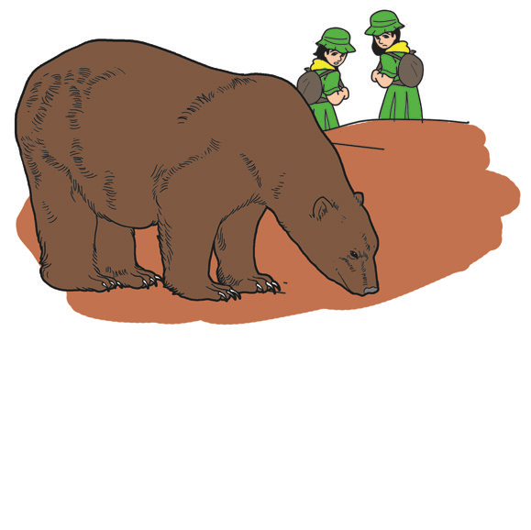
The Real Friends
A group of girl scouts were hiking on a mountain trail when they saw a big wild bear coming near them. Emma and Diana ran toward the east. They were, unfortunately, followed by the wild bear.
One of the girls saw a tree. She pushed the other girl, so she can be first in climbing the tree. She climbed the tree
very fast. She did not wait for her friend.
The other girl had no more time to climb the tree.
She laid down like a dead girl. The wild bear came
near her, but it then went away.

Slide 4
Emma, the girl up the tree came down and asked,
“The wild bear came to you and smelled you. What did
the wild bear say?”
“The wild bear,” said Diana, “told me not to go
with friends like you. The wild bear said that
you are not a good friend.”
Soon, the two girls went their separate ways.
One was wiser; the other was ashamed.

Slide 5
Comprehension Check
Answer the following questions:
1. Who were the main characters in the story?
2. What happened to both of them?
3. Why did Emma leave her friend behind?
4. If you were the Emma, would you do the same with your friend?
5. Why didn’t the wild bear hurt the girl who just laid down like she was dead?
6. How did the story start?
7. What was the problem in the story?
8. How was the problem solved?
9. How did the story end?
10. What happened to both of them in the end?

Slide 6


Grammar
There is much more to learn about nouns, irregular nouns, and mass nouns.
There are nouns that have different forms for their plural.
There are also nouns that have the same form for both singular and plural. Many of these nouns refer to animals or fishes, and the others are more varied in meaning.

Slide 7
Nouns that have different forms for their plural.
Singular - Plural | Singular - Plural
1. foot – feet 2. tooth – teeth 3. man – men 4. mouse - mice | 5. goose – geese 6. child – children 7. man – men 8. woman - women

Slide 8
Nouns that have the same form for both singular and plural.
1. deer 5. Shellfish
2. sheep 6. Aircraft
3. cod 7. Spacecraft
4. goldfish 8. grapefruit

