Slide 1
The Value of Thinking

Slide 2
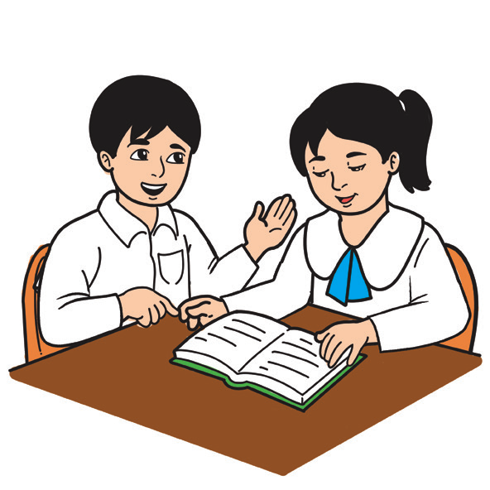
Phonics and Word Recognition
a | i | u
fan | fin | fun
bat | bit | but
hat | hit | hut
lamp | limp | lump
mast | mist | mast

Slide 3
Read the given phrases, sentences, and short story with emphasis on short vowel sounds.
Phrases Sentences
1. cut the cot 1. The hat is in the hut.
2. cap of the cop 2. The cop holds a cup.
3. hit the hat 3. It’s fun to use a fan.
Short Story
Hannah and Ben had a cat. The cat was fat. It loved to nap on a mat. One day, Hannah and Ben could not find the cat. On the mat was a hen with an egg, a pig that winked, and a duck that quacked. It was odd, said Hannah and Ben, so they left the room and went to a hut on top of a hill. When they opened the door, they saw their fat cat that was napping on a mat!

Slide 4
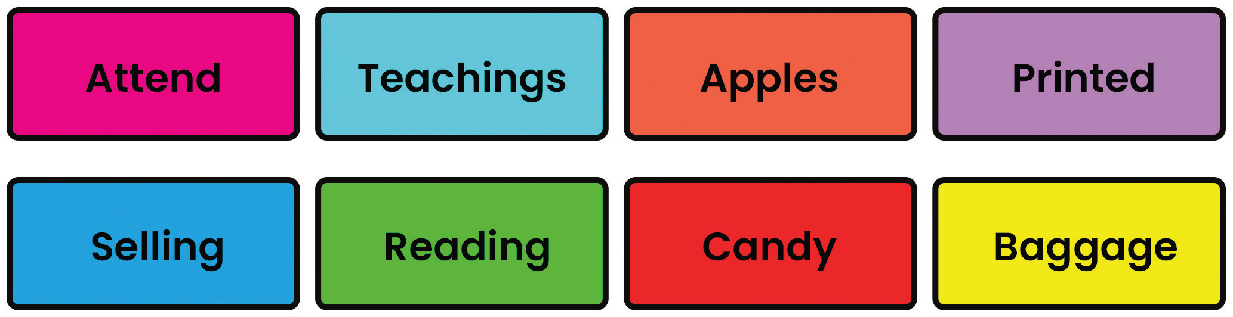
Vocabulary Development
Read the following words that are found in the story you are about to read. These are two-syllable words consisting of short vowel sounds.

Slide 5

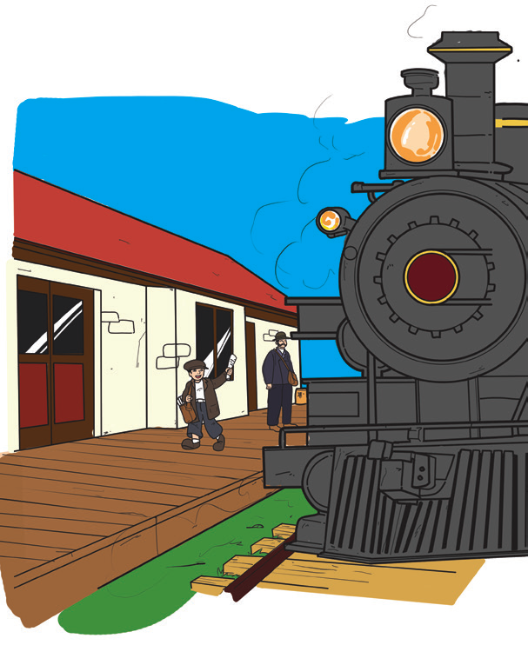
The Value of Thinking
There was a boy who attended school for only three months. Life during those times was hard. His mother continued his education by teaching him reading, writing, and arithmetic. The boy learned how to think clearly!

Slide 6
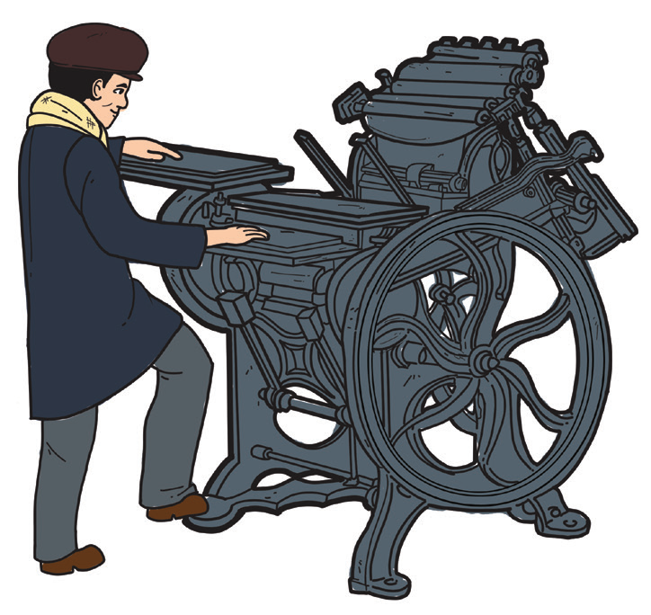
This boy is called Thomas Edison. When he was 12 years old, he earned a job selling newspapers, apples, and candies on the railroad. Around this time, his hearing began to decline. This was because of his childhood experience with scarlet fever. But his condition didn’t stop him from reading newspapers and books. He became interested on how books and newspapers were produced and printed.

Slide 7
When he was 15 years old, Edison bought a small secondhand printing press out of his earnings from his railroad works. Because of his creativity, he installed the press in a baggage car! Soon enough, he began producing a newspaper which he printed, edited, and sold on the railroad.
Later on, he also learned to operate the telegraph, electric light, phonograph, and motion picture. No wonder his creativity and his ability to think clearly made him one of the greatest inventors of his time.

Slide 8
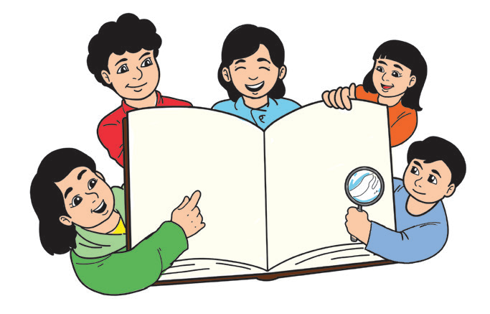
Answer the following questions:
1. Who was the boy in the reading selection? Why was he famous?
2. How did the boy learn to read, write, and count?
3. What made him lose his hearing?
4. Did he stop reading after he became deaf?
5. When did Edison start producing newspapers?
6. What were the other things that Thomas Edison learned to operate and create?
7. Do you think Edison is a great inventor? Why or why not?

Slide 9

Nouns
A noun that names a class of persons, a class of places, or a class of things is a
common noun.
Examples: teacher, school, pencils, and books
A noun that names a specific person, place, or thing is a proper noun.
A proper noun begins with a capital letter.
Examples: Teacher Liza, General Santos City, and Marikina Pet Clinic

Slide 10
Writing
A diary is a record of your daily activities. It includes your thoughts and feelings toward a particular activity. Keeping a diary will help you learn and understand a lot more about yourself. So, if you have not tried one yet, why don’t you start now?
Remember, it pays to have your thoughts recorded even if you are still young. You will enjoy looking back at it and reading it once you grow to become a fine-grown up someday.
Writing can also improve your critical thinking skills and your skill in composing words, sentences, and paragraphs on paper.

Slide 11
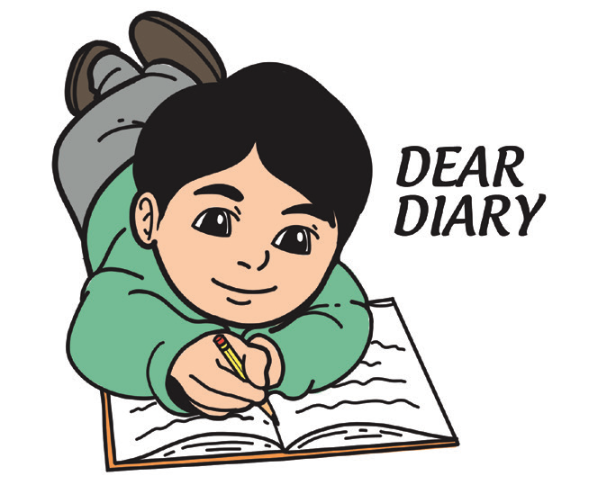
Writing the Draft
As ideas come to you, write them down in paragraph form. Do not worry yet about spelling, punctuation, and other mechanics at this point. Be guided by the following questions:
1. What particular experience today are you going to write about?
2. What are your thoughts and feelings about your experience?
3. What was it that was unclear to you at first?
4. What change did you observe in yourself since the experience?
5. What have you concluded from the experience that you had?

