Slide 1
I Love to Live in a Safe Community (Be Verbs: Am, Is, Are, Was, Were)

Slide 2
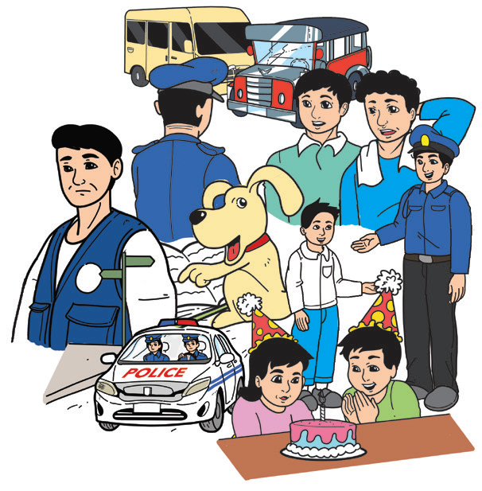
Every night, your Mama and Papa pray and thank God that your family is safe and sound. They are also thankful that there are peace officers in your community who look after the safety of everyone.

Slide 3
Phonics and Word Recognition
L Blends
black | blank | blanket | blast
blend | blot | bless | blink
clan | clap | clash | clip
clatter | clever | clinic | clog
flag | flap | flash | flesh
flat | flesh | flower | flush
glass | glitter | glass | gloves
planet | plant | plaster | plastic

Slide 4
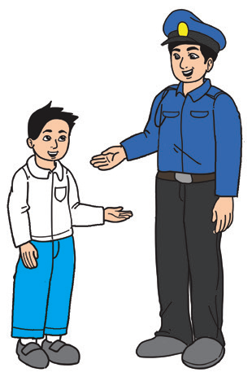
I Love to Live in a Safe Community
Rody: Dad, I’d like to be a police officer just like you when I grow up.
Father: But police work can be difficult and
dangerous.
Rody: (smiling) It’s okay, Dad. You know I am brave just like you.

Slide 5
Father: Well, remember that a police officer performs many different jobs. We do not just enforce laws and maintain order. We also investigate crimes and patrol neighborhoods to keep people safe. When there is an accident on the highway, we offer assistance and take charge of the situation. If you get lost, we’ll give you directions.

Slide 6
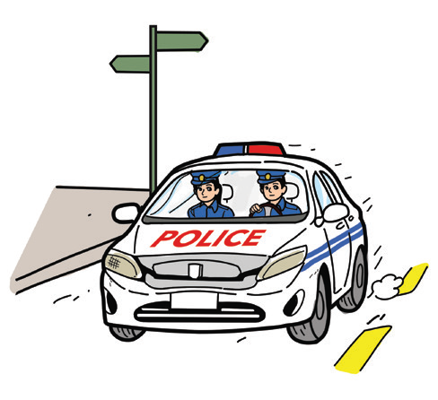
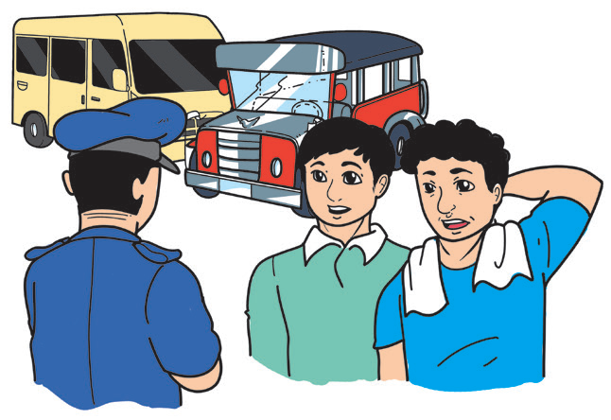
Rody: And you also teach people how to help prevent crimes and protect themselves. Right, Dad?
Father: You are right. We also rush to help people in emergencies such as car accidents, flooding, and hurricanes. We help find
missing people and settle
arguments between them.
We also watch for speeding
drivers on the road and give
traffic tickets.

Slide 7

Grammar
Continue to study the be verbs. The forms of the be verbs change depending on the time element of the sentence.
The be verbs (am, is, are) are used to mean a state of being in the present. Was and were are used to refer to a status in the past. Study the chart on the next page.
Be Verbs Am, Is, Are, Was, Were

Slide 8
Grammar
Subject | Be Verbs
 | Present Tense | Past Tense
I (the speaker) | am | was
He, She, It (only one subject) | is | was
They, We (more than one) | are | were
Be Verbs Am, Is, Are, Was, Were
Examples: My teacher in Science this year is Mr. Cruz.
My class adviser last year was Mrs. Arden.

Slide 9

The be verbs (am, is, are) are used to refer to a state of being in the present. Was and were are used to refer to a status in the past.

Slide 10

Valuing: Cooperating in class activities will help you develop a sense of responsibility toward self, family, and community.

