Slide 1
Not Only One, But Many
(Be Verbs)

Slide 2
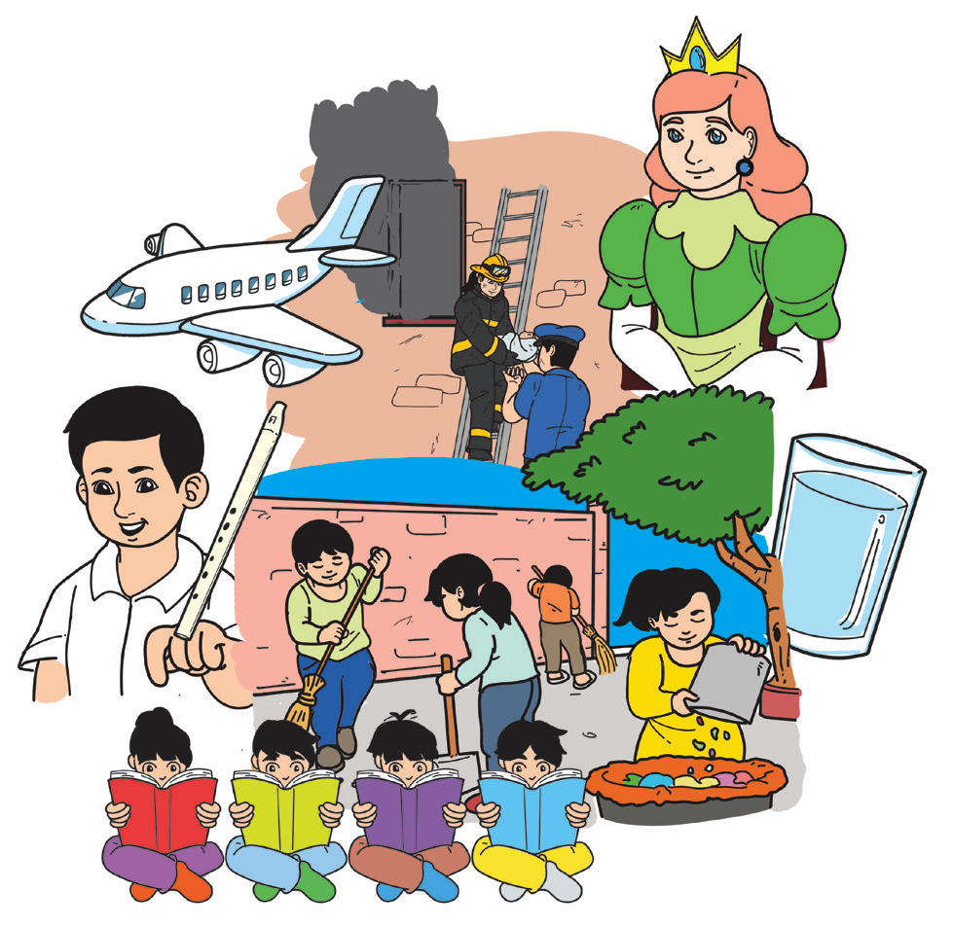
There is strength in numbers, as the
saying goes. If you, your neighbor, your neighbor’s
neighbor, and all of you in the neighborhood will
clean your surroundings then you will have a clean
community.

Slide 3
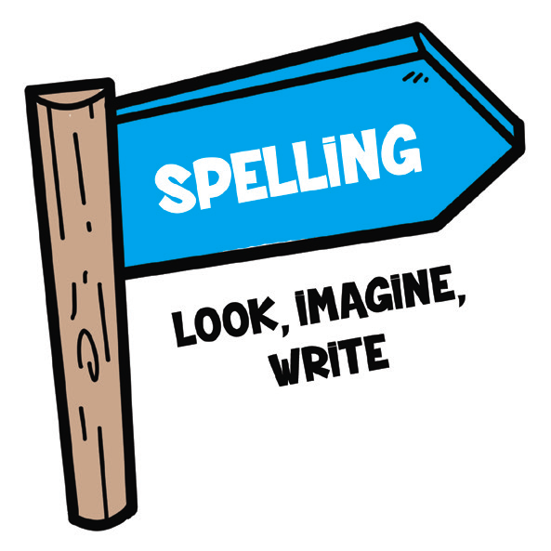

Spelling
Have you tried some ways to learn new spellings? Read the following words and their meanings:
1. Look – This means looking at the shape of the word. Does it have sticks like “d or b” or tails like “p or y”?
2. Imagine – Try to make a picture in your mind of the shape of the word.
3. Write – Try writing it on air using your finger or a pen.

Slide 4

Poetry has a special rhythm and form that are different from paragraphs or speeches. Poetry or poems have many forms. Some rhyme, while some don’t. Some are long, while some are short. Some are funny, while some are sad.
The structure of a poem is called a stanza. A stanza can have two, three, four, five, or more number of lines. The lines share a pattern with regard to the number of syllables and rhymes.

Slide 5
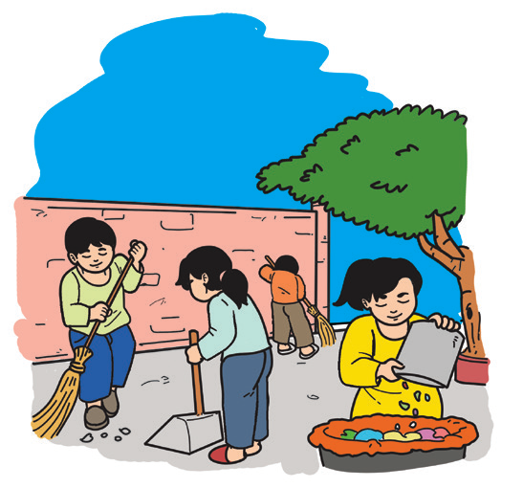
Not Only One, But Many
1
All around my neighborhood,
People work for the common good;
To keep the community safe and clean
Making our surrounding quiet and green.

Slide 6
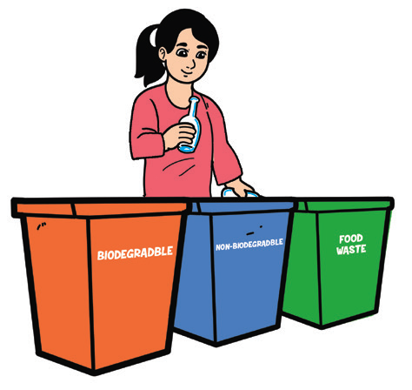
2
All around my neighborhood,
People work for the common good;
The trash we segregate
Be thrown only on a day we anticipate.

Slide 7
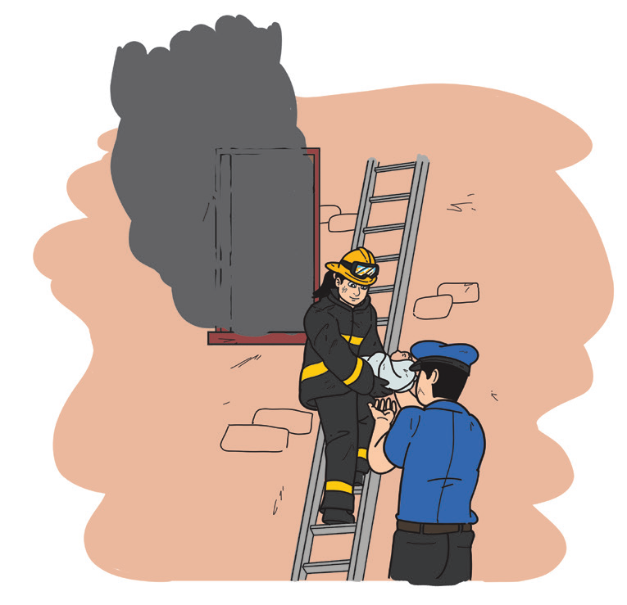
3
All around my neighborhood,
People work for the common good;
Firefighters join the police,
To maintain order and keep our place in peace!

Slide 8

Study Strategy
The words in the dictionary are arranged alphabetically. It is good to know, then, how words are arranged alphabetically especially if you will use the dictionary. To list down words alphabetically, arrange the first letter as they appear in the English alphabet. When the words have the same first and second letters, consider the third, fourth, and so on as the guide in sequencing them.
A. books, can, down, last, true
B. lad, left, long, lying
C. lead, lean, learn, lease

Slide 9
Look at the words in sets A, B, and C below. How are the words arranged?
Set A Set B Set C
along balls brave
bicycle better break
can bike brief
dinner boss broth
eggs buy bruise

Slide 10
Oral Language
In asking questions in English, you may use these words that start with “wh” what, where, who, when, and why. You may also use the be verbs such as is, are, was, and were at the beginning of simple questions.
Examples: What is the name of your community?
Is there a basketball court near your house?

Slide 11
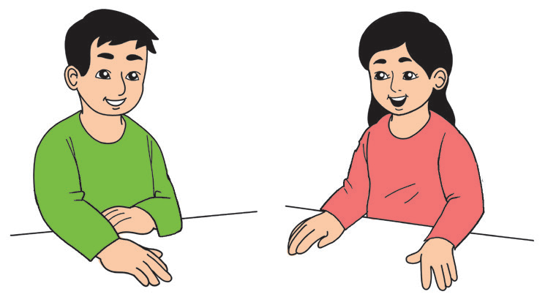
Yes. There are police officers who patrol the place. What about your place?
Are there police officers in your community?

Slide 12

The words am, is, are, was, and were are commonly heard in English. They are called the be verbs or verbs of being. Some of the common uses of be verbs are the following:
Some Uses of Be Verbs | Examples
1. To show the status of a speaker | I am in Grade 3.
2. To describe feelings | We are happy at home.
3. To describe the subject of the sentence | English is my second language.
4. To show location | We are in the classroom right now.
5. To indicate a permanent condition or general truth | The Philippines is an archipelago.

Slide 13

The forms of be verbs may vary depending on the number of the subject.
Forms of Be Verbs
Be Verbs | How to Use the Be Verbs | Examples
am | is used only with I | I am a Filipino.
is | subject is only one | My brother is in Grade 6.
are | subject is more than one | Science and P.E. are my favorite subjects.

