Slide 1
My Chicken Pox

Slide 2

A story has a beginning, a middle part, and an ending.
Like the story, words have beginning, middle, and ending sounds too.

Slide 3


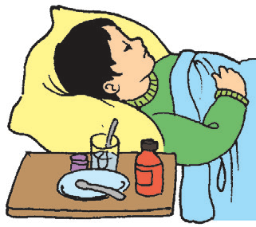

Look at the pictures and try to identify the beginning, middle, and ending sound of the nam of each picture.

Slide 4
What do you think do the following words mean? What are these words in your mother tongue?
spots neck take room
arms chicken pox pills days
face doctor stay play

Slide 5
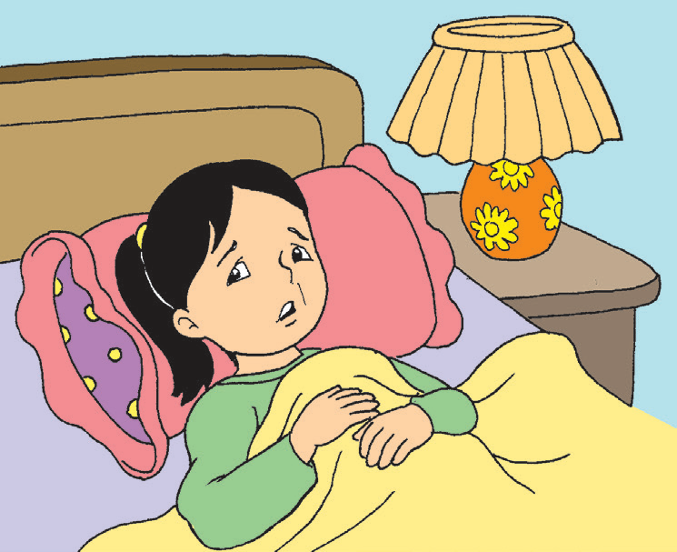
My Chicken Pox
I have red spots on my neck, face, and arms.
Father says, “You have chicken pox.”
My brother jokes, “Are you a chicken?”
“Let us visit the doctor,” Mother says.
Father is right. I have chicken pox. I feel bad.
The doctor gives me some pills and tells me to rest. I need to stay in my room for days.
I am so sad. I want to get well at once. I want to play with Kit and Baby Mina. I know I will get well soon if I follow my doctor’s advice!

Slide 6
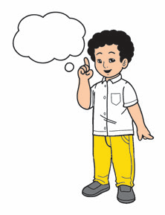
Everyone has feelings. There are times when we are happy, sad, angry, or scared. What other feelings do you know?

Slide 7
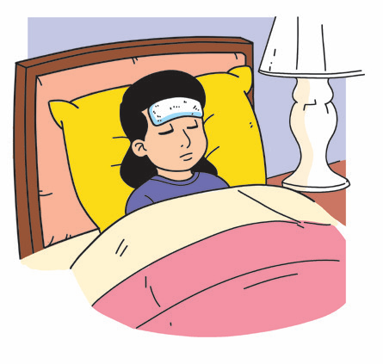
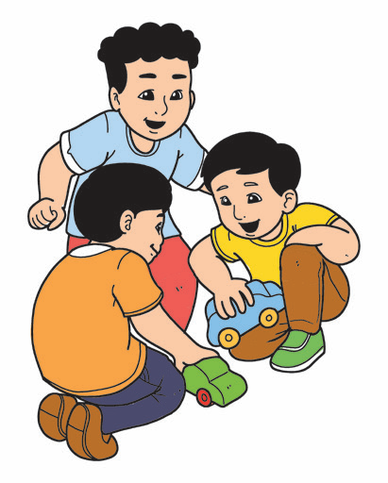
I am sad. I want to get well.
Kit is happy. He plays with his friends.
Some words tell about feelings or emotions. They describe how a person feels.

Slide 8








 | happy |  | excited
 | sad |  | nervous
 | mad |  | afraid
 | surprised |  | hurt

