Slide 1
Stay Grounded, Be Humble

Slide 2
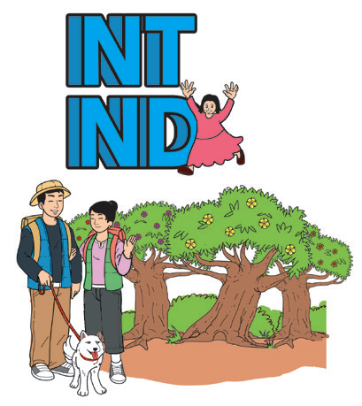
Words with the -nt and -nd sounds:
-nt |  |  | -nd
ant | plant | want | band | land | hand
cent | cement | parent | bend | lend | send
hint | mint | tint | command | demand | defend
font | front | hunt | bond | fond | fund

Slide 3
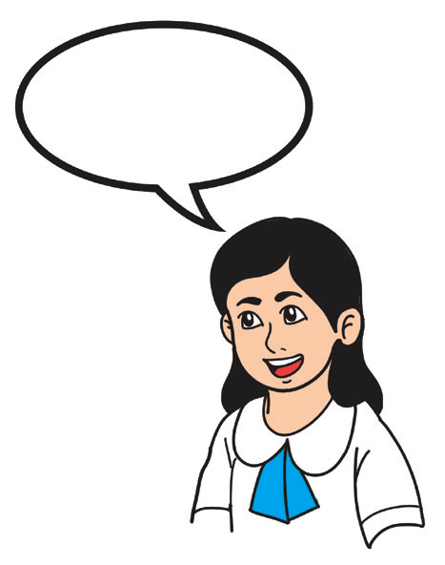
-nt | -nd
1. The brilliant agent is present. 2. The event is a decent one. 3. The silent servant gave his comment in an instant. | 1. They attended the band practice. 2. There is a legend surrounding that pond. 3. They send a thousand soldiers to defend the land.

Slide 4
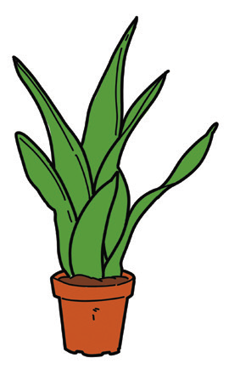
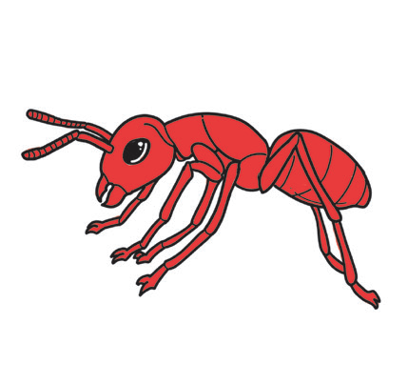
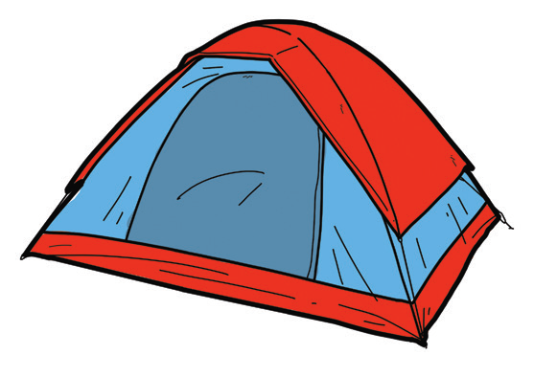
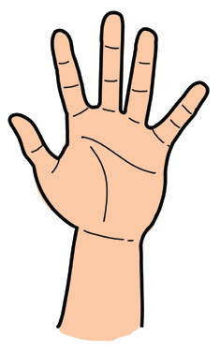
What are the names of the drawings below?

Slide 5
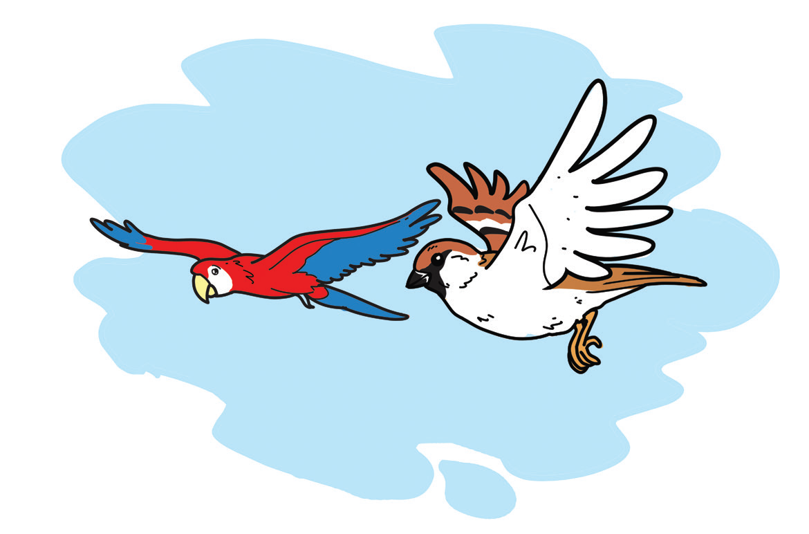
Stay Grounded, Be Humble
A proud parrot met a small maya bird in the forest. The parrot was big and he thought that the little bird was no match for his flying ability.
“Let us see who flies faster and stronger between the two of us!”
The maya bird felt insulted mainly because he was small and the parrot was big. He thought of teaching the parrot a lesson. The maya bird said, “Okay, fine! I accept your challenge.”
“When do we start the race?” the parrot arrogantly asked.

Slide 6
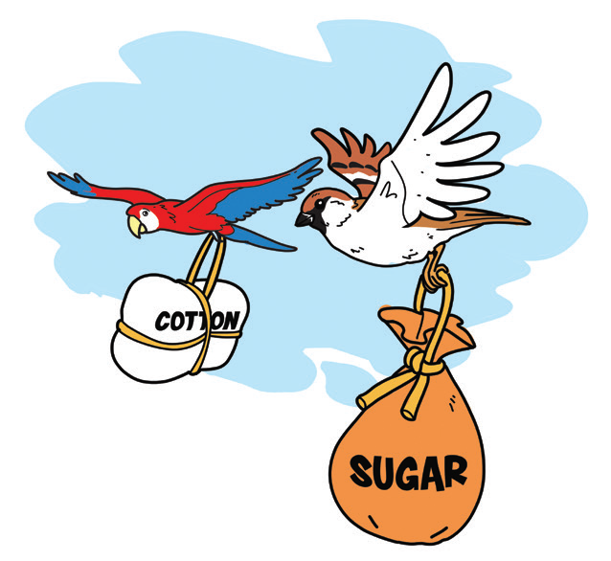
The maya bird noticed that dark clouds have formed in the sky. He knew it was going to rain shortly.
The maya bird replied, “Okay, we’ll begin the race right now! But to make it a little bit exciting, I will carry a bag of sugar while you carry a few bundles of cotton. How is that?”
The parrot laughed aloud and was thinking that the maya bird must have gone crazy. He quickly accepted the challenge. The parrot knew that the cotton is lighter than sugar. He thought he would surely win.

Slide 7
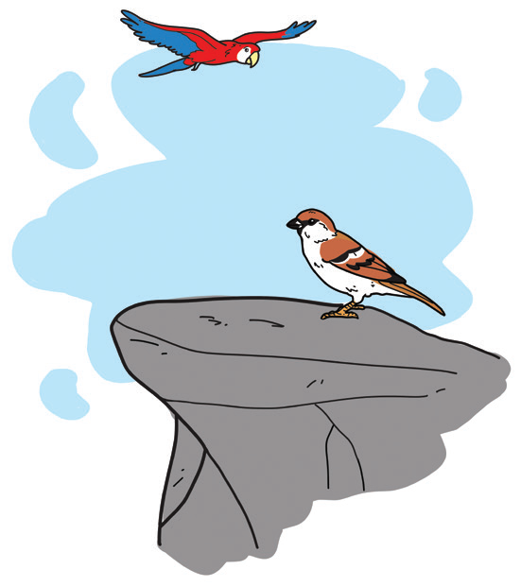
The race was to start from the peak of a mountain and will end at the peak of another mountain. Between the two mountains were miles of sea water.
Just when they were nearing the finish line, a heavy downpour fell from the dark clouds. In a few seconds, the cotton which the parrot was carrying got soaked with rainwater and became heavier. As the load became heavier, the parrot flew slower and slower. The load of sugar also got wet, but it melted with the rainwater. The maya bird was smiling as it flew faster and faster ahead of the parrot to the finish line!

Slide 8
1. What was the contest about? Read the title. Guess who would win in the contest.
2. How did the maya bird win? What are the traits of a maya bird?
3. What do you think did the young maya bird feel after winning the race?
4. Do you think the parrot would humble itself at the end of the story?
5. What lesson could you learn from the parrot in the story?

Slide 9
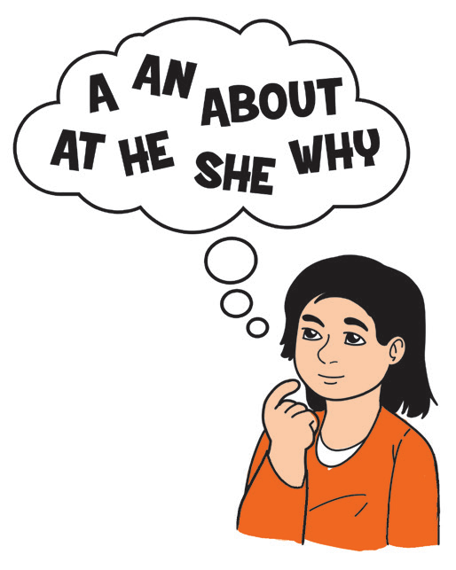
Sequencing Events
Can you show the correct order of events in the story?
_____ The maya reached the mountain peak first and won the race.
_____ As the load of cotton became heavier, the parrot flew slower.
_____ The proud parrot challenged the little maya to a race.
_____ When they were near the finish line, there was a heavy rain.
_____ As they both agreed to make the race exciting, the maya will carry a bag of sugar while the parrot will carry bundles of cotton.

Slide 10

Use the present form of the verb when you refer to actions done at the moment, and -d or -ed forms when you mean actions done in the past.
1. Use the simple form or the base form of regular verbs when you refer to the following: actions done at present, habitual, or repeated action, a permanent condition, or facts or general truth.
2. Add -d or -ed to the form of the verb when you refer to actions done in the past.

