Slide 1
Maxwell, the Gentle Giant
(Simple Forms of Verbs)

Slide 2
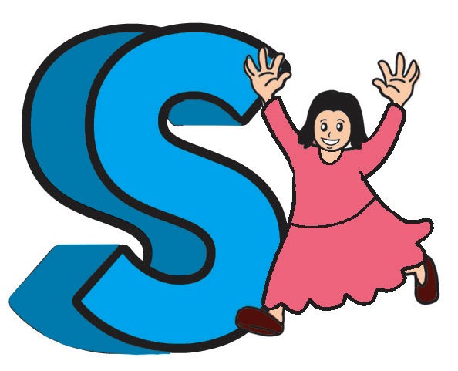
Phonics and Word Recognition
Read words with initial consonant /s/ blend followed by short vowel sounds.
scab | scalp | scam | scan
scar | scarf | score | star
skeleton | sketch | ski | skin
skip | skirt | skull | slab
slack | slam | slang | slant
slap | slash | slim | sling
slipper | small | smack | smart
smash | smell | stop | smog
S Blends

Slide 3
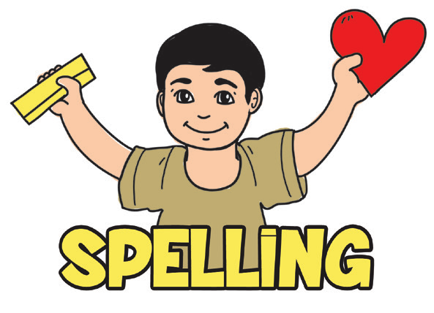
Spelling
When trying to spell a word, listen to the sounds of the word first. Sounds help you in spelling because there are many words that use the same sound. For example: pig, dig, big or cat, bat, hat, fat. So, if you know that the sound -at is spelled as a-t, then, it will help you spell other words such as rat, pat, chat, brat, what, habitat, and acrobat.

Slide 4
Read the following words:
band | land | hand | sand
frog | log | cog | fog
mug | bug | tug | rug
crown | drown | brown | frown

Slide 5

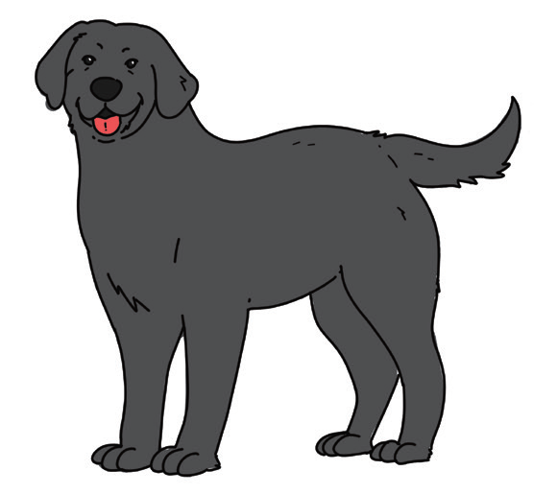
Maxwell, the Gentle Giant
1
I have a loyal buddy named Maxwell,
A dog so big, his voice is louder than an alarm bell;
Black as night, his hair is thick and shiny,
You will love to touch him gently and carefully.

Slide 6
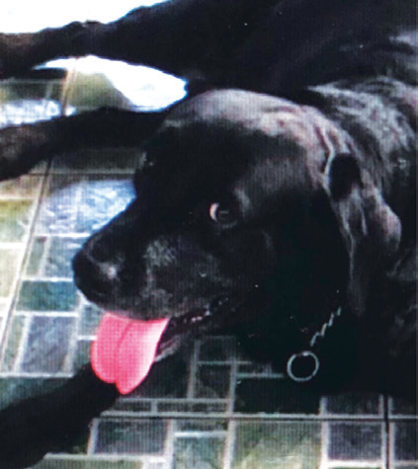
2
Maxwell’s a giant but a gentle furry companion,
He always looks at me with warmth and affection;
For eight years he has given me a loving company,
A walk by the seashore each morning regularly.

Slide 7
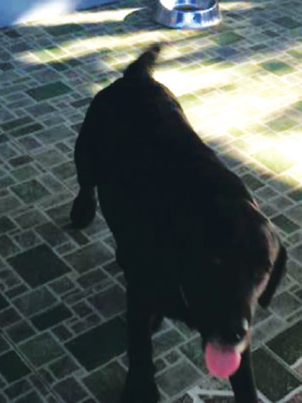
3
But Maxwell suddenly passed away!
Several days after his major surgery;
Truly, I felt down and weary,
On that sad day when we buried my beloved buddy.

Slide 8
4
Maxwell is gone, his loud voice I could hear no more,
His loving eyes I couldn’t see; his shiny hair I couldn’t touch anymore;
What is left are the memories of his love and gentleness,
His legacy—that I should always show gentleness and friendliness.

Slide 9

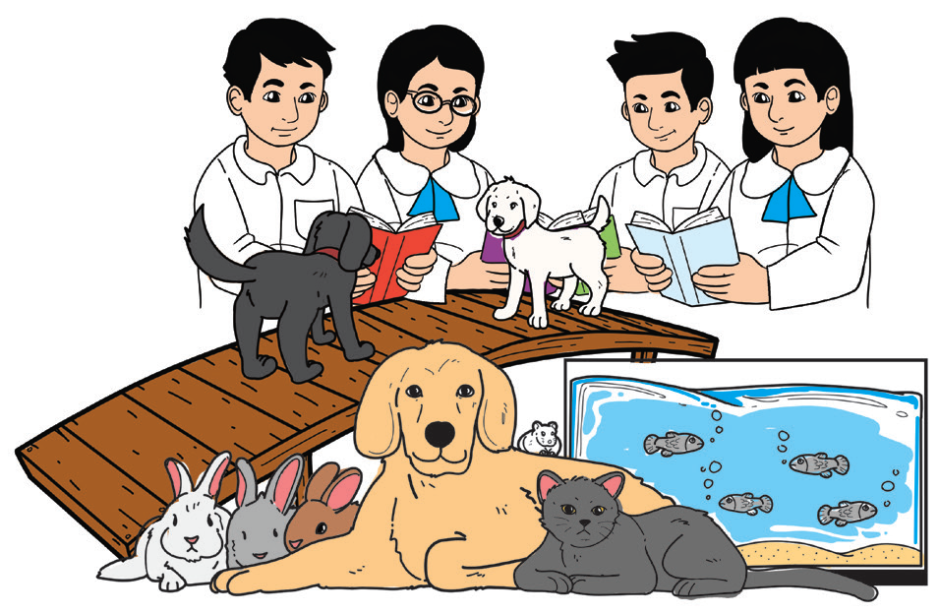
Valuing:
Express kindness by showing a caring attitude toward animals.

Slide 10
Comprehension Check
1. What is the meaning of each of the underlined words? Circle the letter of your answer.
a. Maxwell’s a giant but a gentle furry companion. (fierce, hairy, friendly)
b. He looks at me with warmth and affection. (love, attention, action)
2. What kind of dog was Maxwell? Describe him.
3. Maxwell had a major surgery as mentioned in the poem. Was he seriously ill?
4. What did Maxwell’s pet parent or owner feel about his death?
5. What did the owner learn from his experience with his dog Maxwell?
6. How does the poem relate to you?

Slide 11

Fluency
Practice reading another poem about pets. Read it aloud with fluency, appropriate rhythm, pacing, and intonation.

Slide 12
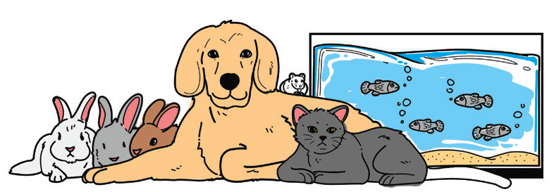
Pets We Love
1
Pets are lovely;
They can make us happy.
Healthy we are when we play,
Run, walk, jump with them every day.
2
Dogs are active and lively;
Loving companions they will always be.
Cats also love to play;
Entertaining us with their curiosity.

Slide 13
3
Pets in cages are best for a family
Without a lot of time or space.
Rabbits and hamsters that are friendly,
Are for people of any race.
4
Watching aquarium fishes swimming
Is fun, joyful, and relaxing;
Indeed, pet animals are lovely,
And can make u active and lively.

Slide 14


Action words in their simple forms
A verb, in its simple form, shows present action, habitual or repeated action, a permanent condition, and facts or general truth.

Slide 15
Action words in their simple forms
Present action | I read a book.
Habitual or repeated action | My brothers and sisters go to school every day.
A permanent condition | The sun rises in the east.
Facts or general truth | Birds fly but fishes swim.

