Slide 1
We Need Good Leaders
(The Past Form of Regular Verbs)

Slide 2

Syllabication is the division or separation of words into syllables. It helps you in reading and spelling words.
The number of syllables is identified through the number of vowel sounds that are heard in each word.
Remember the following rules in dividing words with a single consonant between two vowels:
1. Divide the word after the vowel if the vowel has a long sound.
Examples: water – wa/ter; paper – pa/per

Slide 3
2. Divide the word after the consonant if the vowel has a short sound.
Examples: visit – vis/it; seven – sev/en
3. If a word has two consonants in the middle, divide it in between the consonants.
Examples: summer – sum/mer; traffic – traf/fic

Slide 4
4. If a word has a prefix, divide the word between the prefix and the root word.
Examples: unfair – un/fair; return – re/turn
If a word has a suffix, divide the word between the root word and the suffix.
Examples: helpful – help/ful; player – play/er

Slide 5
5. A compound word which is written and combined as one is divided between the two words.
Examples: birthday – birth/day; football – foot/ball

Slide 6


Words with final -ft, -lt, and -st blends preceded by short /e/, /a/, /i/, /o/, and /u/ sounds.
-ft |  |  | -lt |  |  | -st
raft | craft | draft | belt | felt | melt | cast | last | past
left | theft | loft | hilt | silt | tilt | best | nest | dust

Slide 7
-ft | -lt | -st
1. He left the gift in the loft. 2. They turned the raft to the left. 3. The shift of the shaft was swift. 4. The theft left the raft. 5. The art craft was given as a gift. | 1. We felt the sudden jolt. 2. I wear a belt today. 3. They knelt on the quilt. 4. The chocolates melt in his hands. | 1. Her eldest child is a dentist. 2. The honest artist has his latest list of interesting art works. 3. The terrorists were lost in the forest. 4. We must show our best. 5. We were the last in the contest.

Slide 8

We Need Good Leaders
The Lion Kingdom was in need of a king to replace the old king who recently passed away. The council of elder lions examined all the candidates. They were discussing on what their bases should be in choosing a leader. Zemba, the oldest one, stood up and said, “I will tell a story about one lion.” All members were listening to him.
“I hope that with my story, you will know the important trait that you should look for in a leader.” Zemba then told this story:

Slide 9
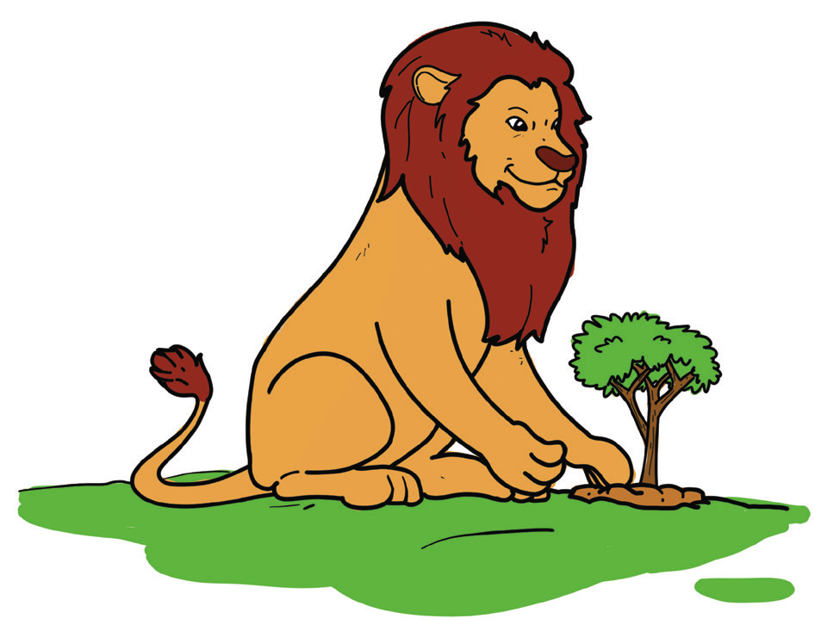
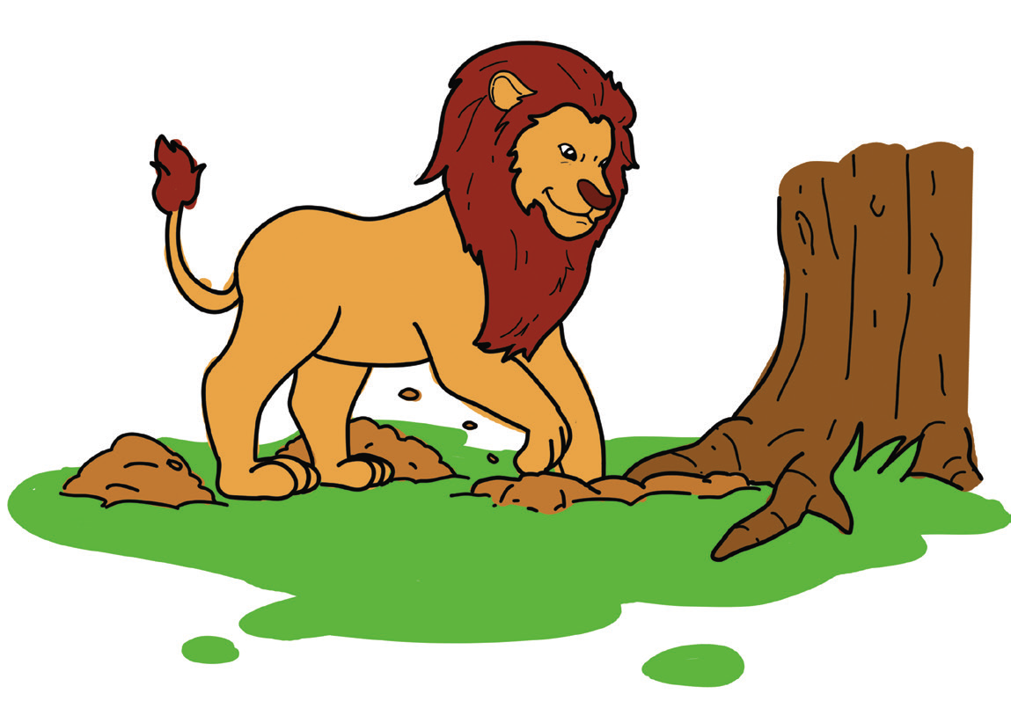
A lion planted a fruit tree on a hill. When the tree started to bear fruit, the lion would go to the hill every day to get a fruit. Then, he noticed that the tree only bore one fruit a day. He got tired.
He told the tree to give him more fruits so he would not go to the hill every day. The next day, the lion was excited to go to the hill. He expected to see more fruits. But still the tree had only one fruit! The lion was not happy.

Slide 10
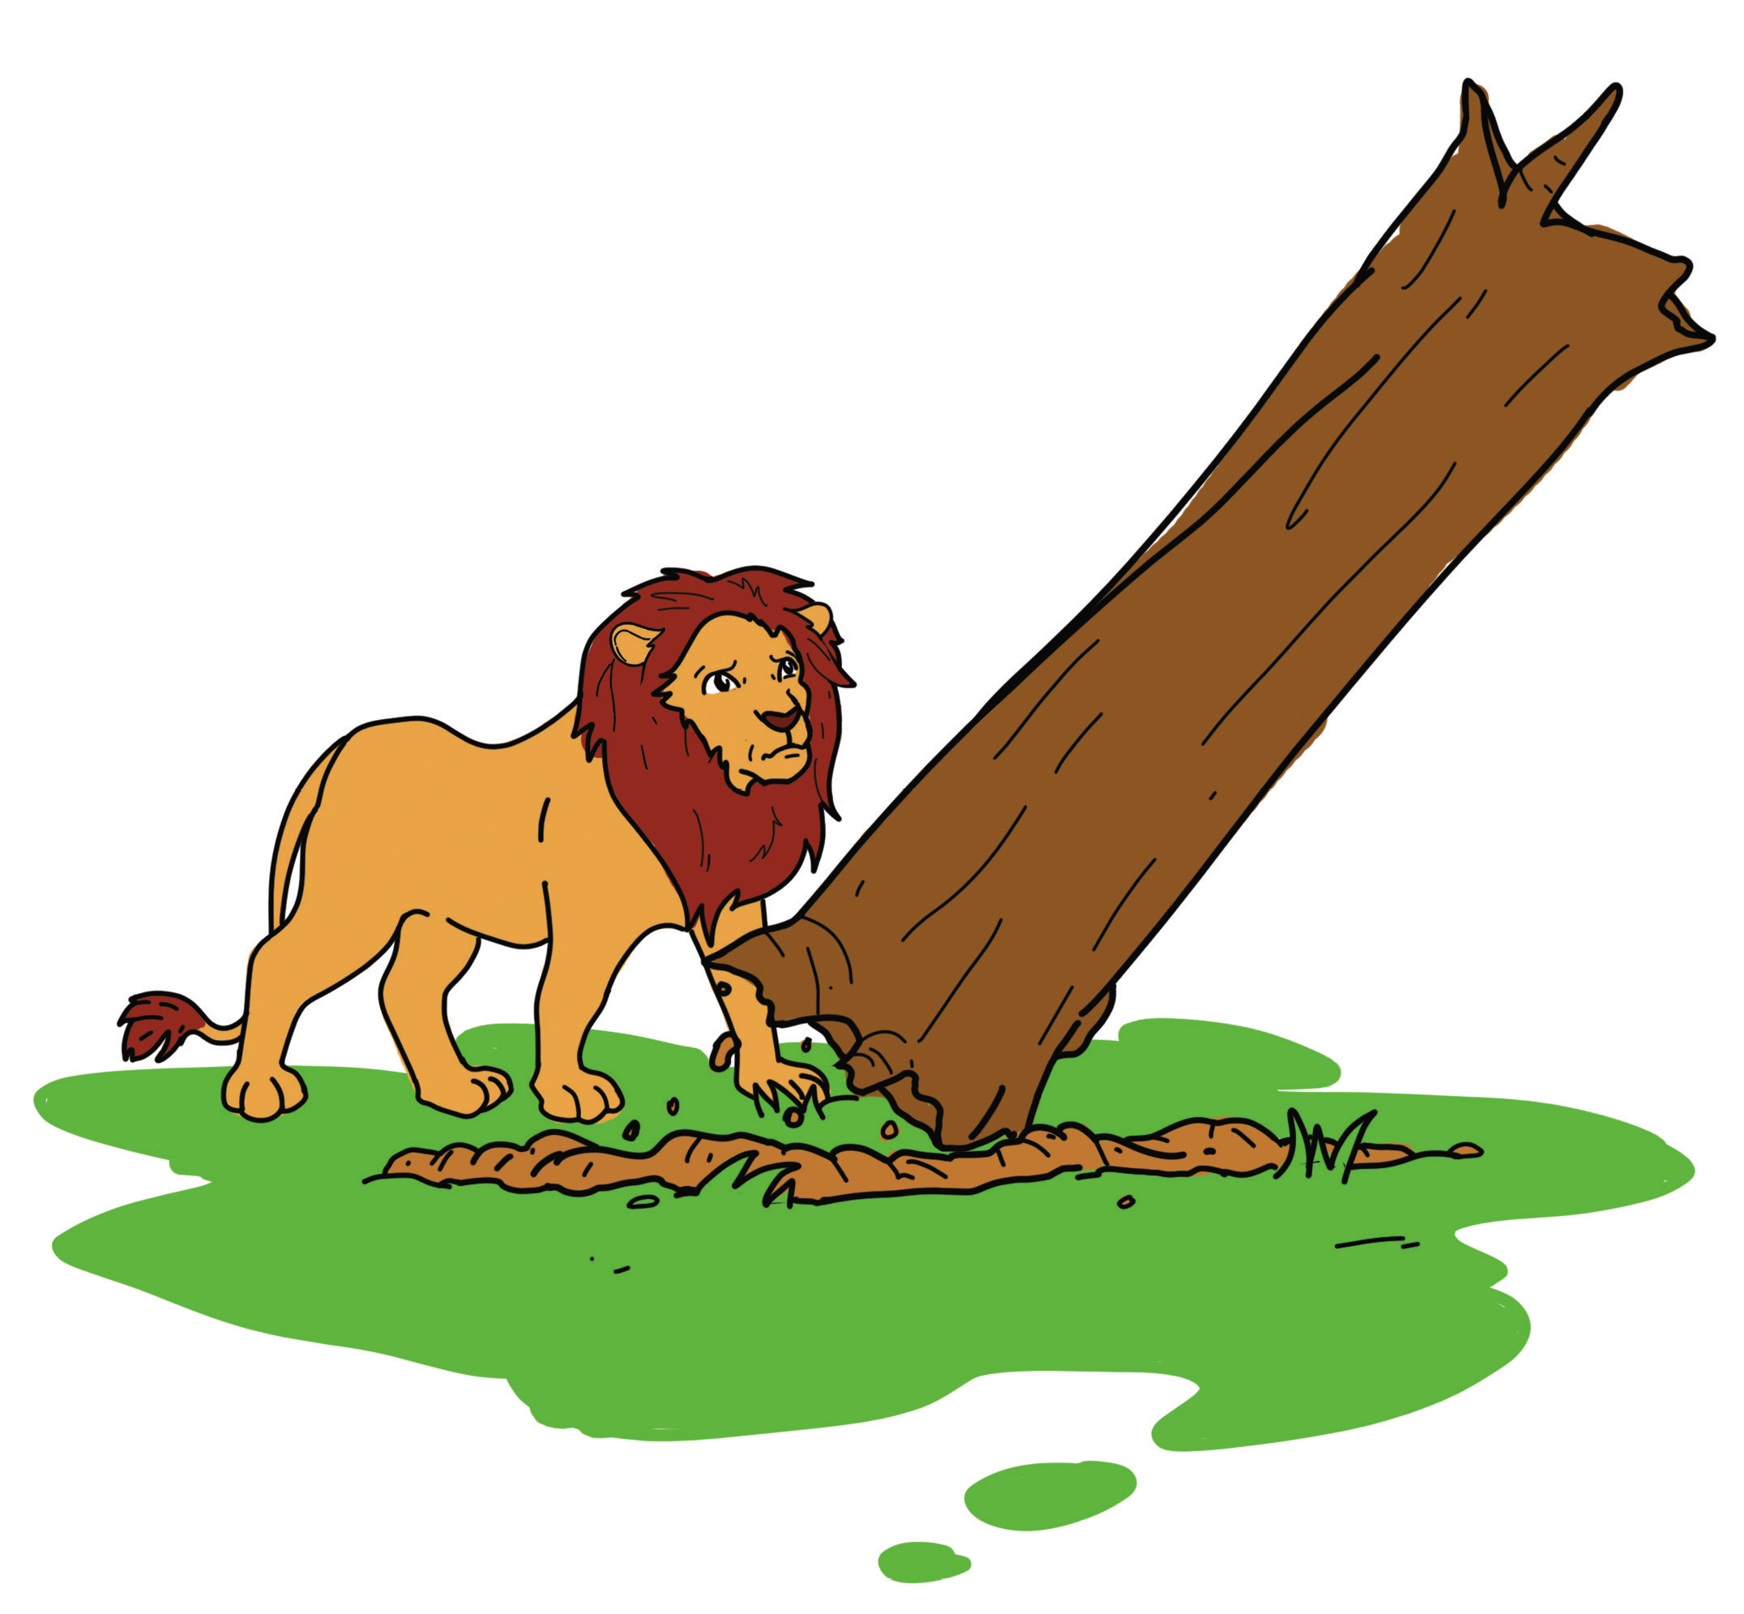
He thought that the tree did not like to give more fruits. The lion was angry. He thought that the tree kept more fruits in its branches. So, the lion cut the branches of the trees. But he found no fruits in the branches. He then thought that the tree kept more fruits in its roots. He dug and dug the soil. He cut the roots. He looked for fruits but there were no fruits. To his surprise, the tree fell down. It had no more branches and no more roots at all!

Slide 11

1. What did the lion notice about the fruit tree that he planted on a hill?
2. Was he happy with the fruit tree that he planted on a hill?
3. Why did the lion cut the branches of the tree?
4. Why did he cut the roots of the tree?
5. What happened to the tree at the end of the story?
6. What did you learn from the lion in the story?
7. Do you think this lion could make a good leader in his community?

Slide 12
Reading materials have drawings, charts, maps, and other visuals. These are called graphic organizers. These can help you in better understanding your reading materials.
A sample story map for the story “We Need Good Leaders.”
We Need Good Leaders
Setting
Characters
Beginning
Middle
End

Slide 13

The Past Form of Regular Verbs
The past form of verbs is used to express past action. The time expressions yesterday, last week, this morning, the other day, and once upon a time all signal past action.
To show past action, -d or -ed is added at the end of regular verbs.
Examples:
cook – cooked; bake – baked

Slide 14
Uses | Examples
1. For completed actions | 1. I submitted my homework a while ago.
2. For past habits | 2. I recited many nursery rhymes when I was in kindergarten.
3. For situations which were true in the past | 3. My mother attended the meeting in school yesterday.

Slide 15
Some regular verbs:
Present |  | Past
arrive clean play talk help | dance attend greet recite helped | arrived cleaned played talked | danced attended greeted recited

