Slide 1
Work! Work! Work!
(Simple Future Tense)

Slide 2

Words Starting with ch |  | Words That have Medial ch Sound | Words Ending in ch
China | child | achiever | French | pouch
check | chili | bleacher | hatch | punch
cheer | cheese | catcher | itch | sandwich
cheetah | chimpanzee | merchant | lunch | stitch
cherry | chocolate | pitcher | march | stretch
chess | church | teacher | match | switch
chicken | chair | watcher | catch | coach

Slide 3

1. a chubby child
2. the preacher in the church
3. the cheating butcher
4. the approaching snatcher
5. the teacher’s achievement
6. a high-pitched chant
7. the brooch of the merchant
8. the choosy chief
9. the coach with a couch
10. the mischievous catcher

Slide 4
Phrases | Sentences
1. a lunch on the beach 2. catch the chicken 3. check the kitchen 4. match the children 5. lunch with the teacher 6. watch your speech | 1. How much of other people’s manners do you know? 2. Do you speak Chinese? 3. No, I speak French. 4. The British love to drink tea and eat sandwiches in the afternoon. 5. The British say chips instead of French fries.

Slide 5
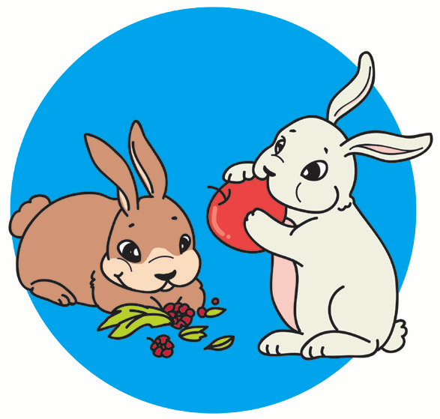
Work! Work! Work!
Two bunnies, one brown and the other white, were eating the fruits they got from a garden. Some fruits were round; some were oblong. The brown bunny told the white bunny to plant the seed of the fruits so they could have a regular supply of fruits. The brown bunny planted the seed. Contrary to what he said, the white bunny just smiled and threw the seeds of the fruits into the garbage can.

Slide 6
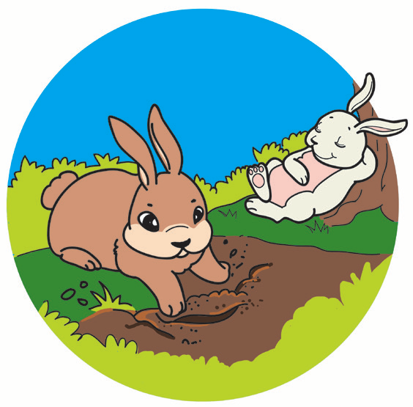
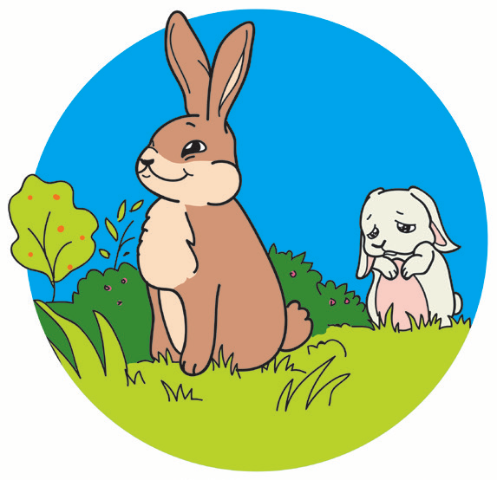
Soon, the seeds grew until they became plants that bore fruits. Now, the brown rabbit had a steady supply of fruits—big fruits and small fruits and green fruits and yellow fruits. He didn’t have to sneak into a man’s garden to have something to eat anymore. When the white bunny asked for some fruits, the brown bunny gave him seeds instead. He told the white bunny to stop being lazy.

Slide 7
1. What happened to the seeds that the brown bunny planted?
2. Why did the white bunny ask the brown bunny for some fruits?
3. What did the brown bunny give the white bunny instead?
4. What lesson did you learn from the story?

Slide 8

The simple future tense indicates future time. It expresses an action which is expected to come or happen. The helping verb will together with the base form of the verb is used to indicate future tense. Sometimes, the helping verb shall together with the base form of the verb is used for the subjects “I” or “we” to indicate future time, and to emphasize duty or obligation.
Examples: We will go to the zoo next month.
I shall do everything I can to help you.

Slide 9

Use will to tell about what you would like to do in the future. I’ll is the short form of I will. Won’t is the short form of will not.

