Slide 1
Save the Endangered Animals
(Verbs in Simple Future Tense)

Slide 2

Words Starting With sh- |  | Words Ending in -sh
shade | shed | blush | flesh
shake | sheep | brush | fresh
shall | shell | cash | trash
shape | shoe | crash | punish
shark | shirt | dish | rush
shave | shoe | fish | slash
she | shop | flash | slush
short | shore | wash | smash

Slide 3
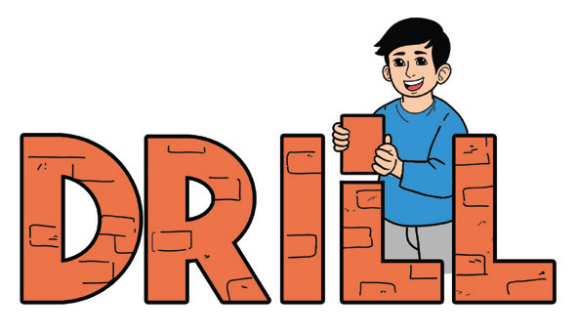
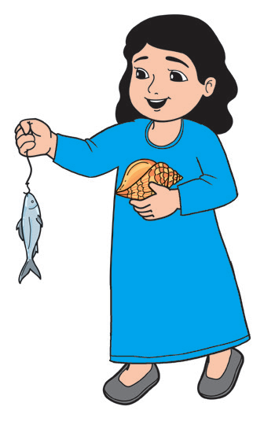
1. She sells seashells by the seashore.
2. She flashes a sigh that shines in the shelf.
3. Be seated and get a sheet of paper.
4. Her class clashed with my class over a mass of mashed potatoes.
5. She was shocked to see her sock sheared to shreds.
shell – fish

Slide 4
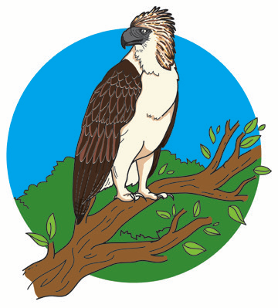
Save the Endangered Animals
The Philippine Eagle is a giant bird of prey. It is one of the three largest eagles in the world. It has become our national bird because of its beauty, strength, and speed. Its height reaches 1 m or 3 ft. The eagle has brown and white-colored feathers. Its crest or feathers on its head are rough and thick. It is the only eagle in the world that has blue eyes. Its eyes are powerful because it can see eight times farther than that of the human eyes.

Slide 5

There are many things that the Philippine Eagle can do. It can fly from the ground straight up and above the trees with great ease. It lives up to 60 years. This is why it is called the “King of Birds.”
Unfortunately, the Great Philippine Eagle is endangered. This means that there are very few of them that are alive now and so they may soon stop existing. Their survival is at risk because hunters still shoot or capture them.

Slide 6
Another reason is deforestation. The forest is their only home. The Philippine Eagle loves to live in the forest where they get their food, produce, and take care of their young. However, loggers have cut down the trees where many of the eagles live in. This resulted to the disappearance of their home which is the forest.
The Philippine Eagle needs to be protected because it is found only in our country.

Slide 7
1. Where does the Philippine Eagle love to live?
2. Why is the Philippine Eagle very rare?
3. What should be done to have more Philippine Eagles?
4. Why is it called the “King of Birds”?

Slide 8

Simple future tense:
Be Verbs + going to + simple form of the verbs
Another way of expressing an action to be done at some future time is to use be verbs (am, is, are) plus going to and the simple form of the verb.
am, is, are + going to + simple form of the verb
Examples:
1. I am going to visit my grandparents in Laguna next week.
2. Marlon is going to attend the Boy Scout camping.
3. We are going to tell father about the lost money.

