Slide 1
Firefighters Are Our Friends
(Verbs)

Slide 2

Phonics and Word Recognition
Read words, phrases, and sentences with initial consonant r blend followed by short vowel sounds.
branch | brand | frog | crop
breath | brick | from | crush
brink | bronze | draft | drag
crab | crack | drum | grip
What are R blends?

Slide 3
Practice reading the following:
Phrases
1. crack in the crib 2. cross the bridge 3. press the dress
Sentences
1. The princess will attend the program.
2. The frog hops in the grass.
3. My brother has a toy drum.
What are R blends?

Slide 4

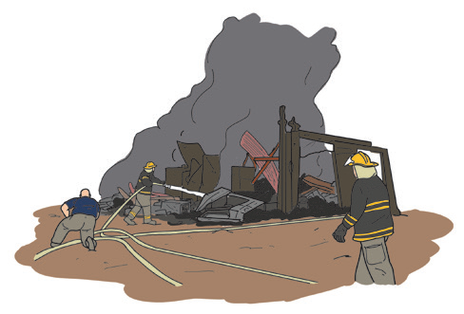
The Brave Firefighters
When the sirens from fire trucks are heard on the streets, the community is alerted. It means there is danger. Thus, drivers of cars, buses, and jeepneys clear the path right away for the fire truck to freely pass by.
Firefighters are modern-day heroes. When a fire Breaks out, they perform an important rescue operation. They run into a burning house or building. They risk injuries from falling objects and broken glasses to save lives. They put out the fire and protect the nearby areas.

Slide 5
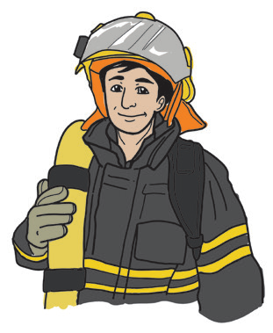
Firefighters begin to fight fires long before the fires start. Firefighters carry out fire prevention programs. They educate people about the dangers of fire.
They also teach people what to do when a fire breaks out.

Slide 6
Comprehension Check
1. What does it mean when the sirens of the firetrucks are heard on the streets?
2. What do drivers of cars and buses do when they hear the sirens from the fire trucks?
3. What are the different duties of the firefighters?
4. Which one from the following is not the job of firefighters? Choose the letter of your best answer.
a. They protect the mountains and the seas.
b. They arrest bad guys in the cities.
c. They perform important rescue operations.
d. They educate people about the dangers of fire.

Slide 7
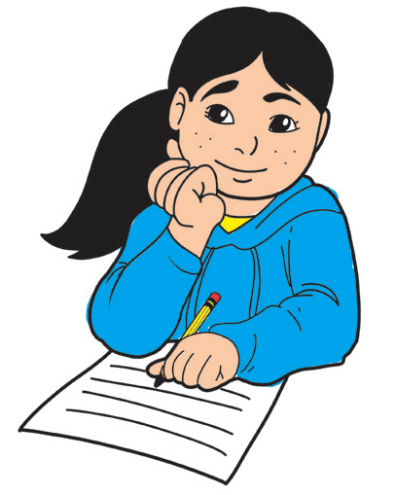
Making predictions is one’s ability to tell what will happen next as a result of a series of related events. Your understanding and familiarity of certain facts or information will help you predict possible outcomes.

Slide 8

Valuing: It is good to develop the ability to predict possible outcomes as effects from a series of events. For example, if people do not know how to prevent fire how can they predict the danger it may cause them?

Slide 9


A verb does not just show a state of being; it also shows action. You move around a community and do some activities. Playing and studying are action words. These words are called verbs.
The verb is known to be the heart of a sentence. Thus, every sentence must have a verb.
Verbs as action words
A verb shows action. Recognizing the verb is often the most important step in understanding the meaning of a sentence.

