Slide 1
The Wheels on the Bus

Slide 2

Ben is the van driver.
He bans left over food from the trash bin in his van.
Ben = Be + n
ban = ba + n
bin = bi + n
The highlighted words are consonant-vowel blends.
B is a consonant followed by the vowel a, e, or i.

Slide 3
a | e | i
ba | be | bi
da | de | di
fa | fe | fi
ga | ge | gi
ha | he | hi
ja | je | ji
ka | ke | ki
la | le | li
ma | me | mi

Slide 4
a | e | i
na | ne | ni
pa | pe | pi
ra | re | ri
sa | se | si
ta | te | ti
va | ve | vi
wa | we | wi
ya | ye | yi
za | ze | zi

Slide 5
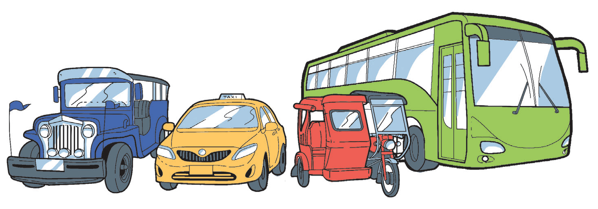
What public transportation have you used?

Slide 6
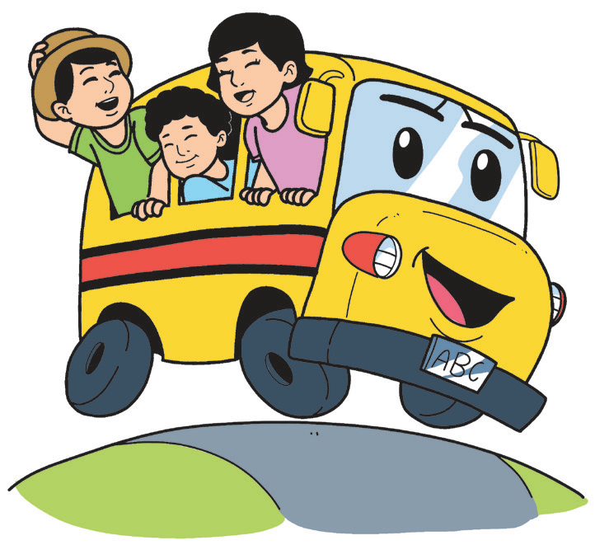
The Wheels on the Bus
Anonymous
The wheels on the bus go round and round,
Round and round, round and round,
The wheels on the bus go round and round,
All through the town.
The wipers on the bus go swish, swish, swish,
Swish, swish, swish, swish, swish, swish.
The wipers on the bus go swish, swish, swish,
All through the town.

Slide 7
The Wheels on the Bus
Anonymous
The door on the bus goes open and shut,
Open and shut, open and shut.
The door on the bus goes open and shut,
All through the town.
The driver on the bus goes, “Move on back!”
“Move on back!” “Move on back!”
The driver on the bus goes, “Move on back!”
All through the town.

Slide 8
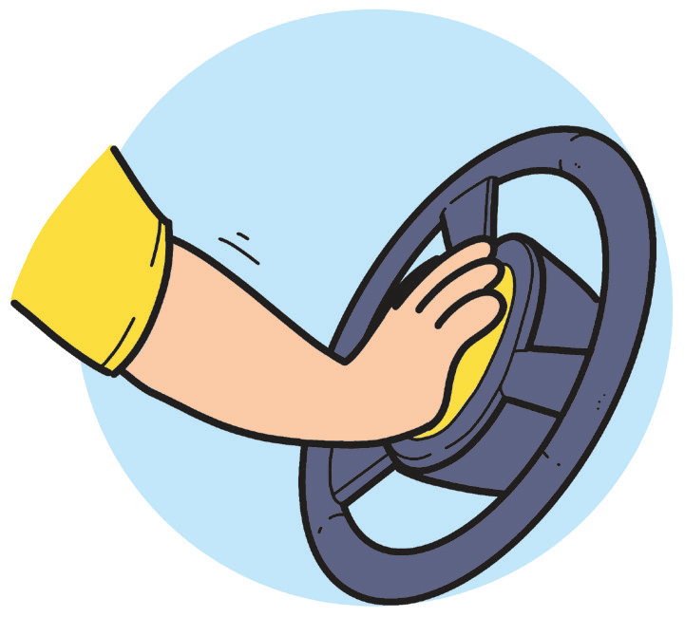
The Wheels on the Bus
Anonymous
The horn on the bus goes beep, beep, beep,
Beep, beep, beep, beep, beep, beep.
The horn on the bus goes beep, beep, beep,
All through the town.
The money on the bus goes clink, clink, clink,
Clink, clink, clink, clink, clink, clink.
The money on the bus goes clink, clink, clink,
All through the town.

Slide 9
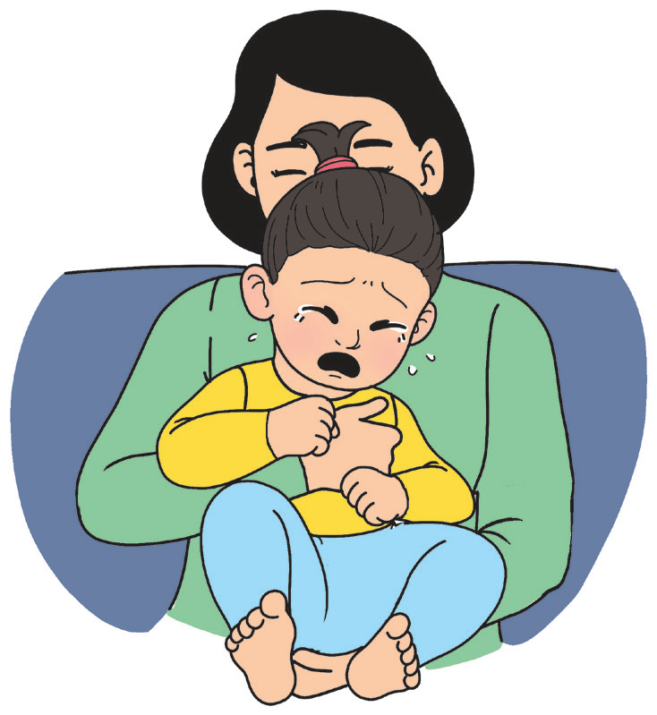
The Wheels on the Bus
Anonymous
The baby on the bus goes wah, wah, wah,
Wah, wah, wah, wah, wah, wah.
The baby on the bus goes wah, wah, wah,
All through the town.
The mommy on the bus goes, “I love you,”
“I love you,” “I love you.”
The mommy on the bus goes, “I love you,”
All through the town.

Slide 10
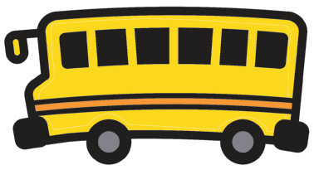
Think about and answer these questions.
Where did the story happen?
At what time of the day do you think the story happened?
Why do you say so?
What do you think are the wipers and horns for?
Why do you think the driver shouted, “Move on back”?
Which do you like better, a bus ride or a car ride? Why?

Slide 11

A bus is a means of transportation. It brings people and things to different places.
There are names for different means of transportation that travel on land, water, and air.

Slide 12
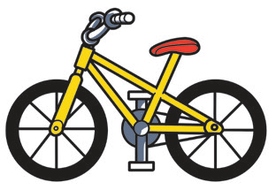
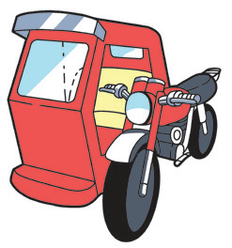
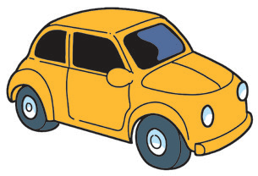
Here are other means of transportation:
This is a bicycle. It is also called a bike.
This is a tricycle. It has three wheels.
This is a car.

Slide 13
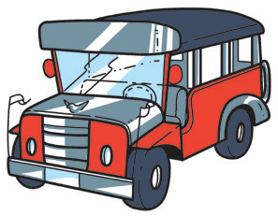
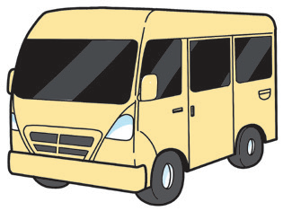
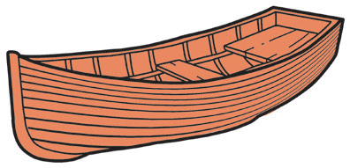
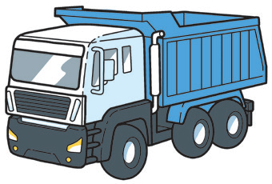
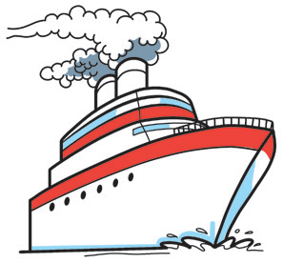
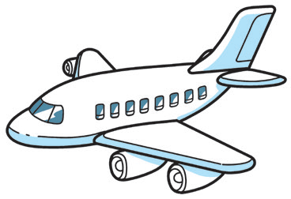
This is a van.
This is a jeepney.
This is a boat.
This is a truck.
This is a plane.
This is a ship.

