Slide 1
Prosodic Features of Speech, Consonant Blends,
and Structural Analysis

Slide 2
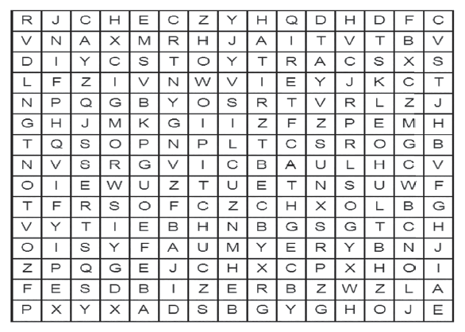
Prosodic Features of Speech, Consonant Blends, and Structural Analysis
What words can you find in this puzzle?
Comparison-and-Contrast in Paragraphs and Writing One

Slide 3
Prosodic Features of Speech, Consonant Blends, and Structural Analysis
Pitch is the highness and lowness of your voice. We use pitch to express our emotions and attitude through a change in our intonation, or the tone of our voice. In order also to express stress, or make certain syllables longer and louder, we use pitch.
Oh, my! I can hardly believe what you have done to me!
The sentence has exclamation marks that signify an emotion. Your pitch also raises as you emphasize the exclamation marks.
Intonation describes how the voice rises and falls in speech. There are two kinds: falling intonation and rising intonation.

Slide 4


Prosodic Features of Speech, Consonant Blends, and Structural Analysis
a. Falling intonation – describes how the voice falls on the fi nal stressed syllable of a phrase or a group of words. Falling intonation is very common in wh- questions.
Example:
Note: We also use falling intonation when we say something definite, or when we want to be very clear about something:

Slide 5

Prosodic Features of Speech, Consonant Blends, and Structural Analysis
b. Rising intonation – describes how the voice rises at the end of a sentence. Rising intonation is common in yes-no questions:
Example:
Stress is the degree of emphasis given in a sound or syllable in speech. It is also called word stress. This means that stress patterns can help distinguish the meanings of two words or phrases that otherwise appear to be the same.

Slide 6
Prosodic Features of Speech, Consonant Blends, and Structural Analysis
Example:
1. We are going to record a record.
2. ”The subject of my talk is …”
3. ”He will subject us to another investigation.”
Note: The two similar words are stressed diff erently so that the fi rst record is stressed on the first syllable whereas the second record is stressed on the second syllable.
Example:
RE-cord (verb) – a piece of evidence
re-CORD (noun) – set down in writing or some other permanent form for later reference

Slide 7
Prosodic Features of Speech, Consonant Blends, and Structural Analysis
Juncture is the manner of transition between two successive syllables in speech. An important type of juncture is the suprasegmental phonemic cue which a listener can distinguish between two otherwise identical sequences of sounds that have different meanings.
Examples:
1. its praise versus it sprays
2. a nice versus an ice
3. it’s wing versus its wing
4. why choose versus white shoes
5. keep sticking versus keeps ticking

Slide 8
Prosodic Features of Speech, Consonant Blends, and Structural Analysis
Volume refers to how loud or soft your voice is. As with speaking rate, you want to avoid the extremes of being too loud or too soft, but still vary your volume within an acceptable middle range.
Rate of speech refers to how fast or slow you speak. If the speaker speaks too fast, the listener will not be able to absorb the information he/she presented. If the speaker speaks too slowly, they may lose interest. The goal is to speak at a rate that will interest the listener and will effectively convey the information.
Voice projection is the strength of speaking or singing whereby the voice is used powerfully and clearly. It is a technique employed to command respect and attention.

Slide 9
Prosodic Features of Speech, Consonant Blends, and Structural Analysis
Pronouncing blends, diphthongs, and glides
A consonant blend is when two or more consonants are blended together. The most common beginning consonant blends include: bl, br, cl, cr, dr, fr, tr, fl, gl, gr, pl, pr, sl, sm, sp and st, tr, tw, scr, spl, spr, and str …
Examples: breeze, screen, splash, fright, glass, graph, plate, slow, smog
Some of the most commonly used final consonant blends, or those found at the end of words are: -st, -sk, -sp, -nd, -nt, -nk, -mp, -rd, -ld, -lp, -rk, -lt, -lf, -pt, -sc, -ct, and -ft.
Examples: milk, limp, paint, scalp, rift, build, park

Slide 10
Prosodic Features of Speech, Consonant Blends, and Structural Analysis
Some common consonants blend, like sm, sk, sp, and st, may be found at the beginning or at the end of words.
Examples: smear, skit, stand, last, clasp, prism, husk
Diphthongs are sounds formed by the combination of two vowels in a single syllable.
Examples: oil, rain, loud, sound, quit, bleed
When combined with vowels, w and y from diphthongs are called glides.
Examples: blow, buy, spray, joyful

Slide 11
Prosodic Features of Speech, Consonant Blends, and Structural Analysis
Structural analysis is used to know the definition of words. It is done by dividing words into parts to discover what an unknown word means. Word parts contribute to the overall meaning of a word. These are composed of a root, a prefix, and/or a suffix.
A root word is a word that does not have a prefix or a suffix and is the base or core that can’t be reduced into a smaller word form.
A prefix is a letter or group of letters that is placed at the beginning of a word to change its meaning.
A suffix is a letter or group of letters that come at the end of a word and change its meaning.

Slide 12
Prosodic Features of Speech, Consonant Blends, and Structural Analysis
Prefix Meaning Example
anti- opposite of anticlimax
hyper- over hyperactive
extra- beyond extravagant
auto- self/same autobiography
co- with/together coauthor
inter- between/among intersect
sub- under/lower submarine
up- higher/better upbeat
tri- three/every third trimester
non- not/without nonfiction

Slide 13
Prosodic Features of Speech, Consonant Blends, and Structural Analysis
Suffix Meaning Example
-age action pilgrimage
-ant a person who applicant
-ation action creation
-dom condition/state freedom
-est most funniest
-ful full of thankful
-ily manner steadily
-less without waterless
-or a person inventor

Slide 14
Prosodic Features of Speech, Consonant Blends, and Structural Analysis
Complete the sentences by the correct prefix in the blank space.
1. I just can’t believe it! The story is _____ believable!
2. No, that answer is _____ correct. It is wrong.
Complete the correct suffix in the blank space.
1. Jason writes a lot of lists, so he always remembers what he has to do. He never forgets! But Melanie cannot remember anything! She’s very forget _____.
2. I teach science in big a university. I am a physics teach _____.
3. Sir Alan is King Richard’s best knight. He is brave and strong. He is the most important knight in Richard’s whole king _____.

Slide 15
Prosodic Features of Speech, Consonant Blends, and Structural Analysis
ANSWER KEY
Complete the sentences by the correct prefix in the blank space.
un
1. I just can’t believe it! The story is _____ believable!
2. No, that answer is _____ correct. It is wrong.
in
Complete the correct suffix in the blank space.
1. Jason writes a lot of lists, so he always remembers what he has to do. He never forgets! But Melanie cannot remember anything! She’s very forget _____.
2. I teach science in big a university. I am a physics teach _____.
3. Sir Alan is King Richard’s best knight. He is brave and strong. He is the most important knight in Richard’s whole king _____.
ful
er
dom

