Slide 1
Playing With Friends

Slide 2
Consonant-vowel (CV) blends
/a/ | /e/ | /i/ | /o/ | /u/
ba | be | bi | bo | bu
ca | ce | ci | co | cu
da | de | di | do | du
fa | fe | fi | fo | fu
ga | ge | gi | go | gu
ha | he | hi | ho | hu
ja | je | ji | jo | ju
ka | ke | ki | ko | ku
la | le | li | lo | lu

Slide 3
Consonant-vowel (CV) blends
/a/ | /e/ | /i/ | /o/ | /u/
ma | me | mi | mo | mu
na | ne | ni | no | nu
pa | pe | pi | po | pu
ra | re | ri | ro | ru
sa | se | si | so | su
ta | te | ti | to | tu
va | ve | vi | vo | vu
wa | we | wi | wo | wu
ya | ye | yi | yo | yu
za | ze | zi | zo | zu

Slide 4
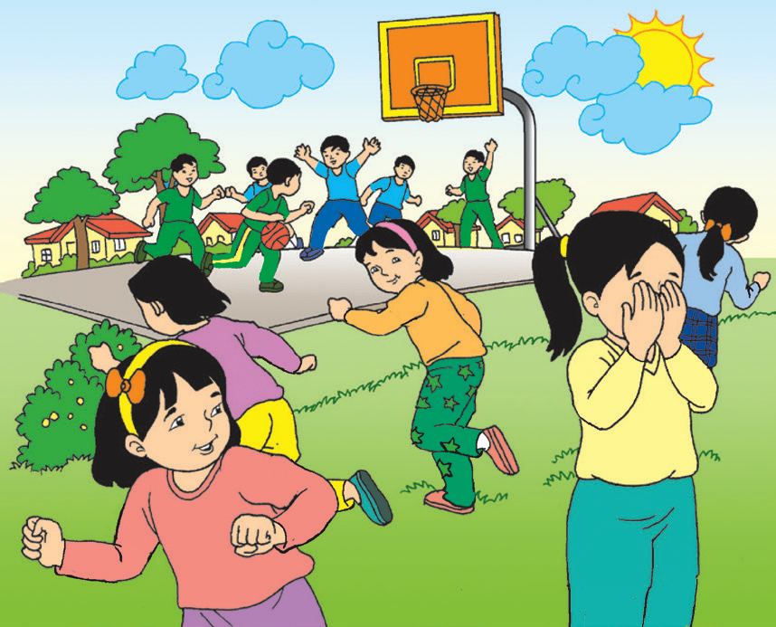
Playing with Friends
It is a Saturday aft ernoon. Kit and Ana are playing with their friends.
Kit and his friends are playing basketball in the village court.
Ana and her friends are playing hide and seek.
All the children run around. They laugh and tease each other. They have a good time!
Mom says playing outside is good for the body. It also exercises the brain to understand the directions of a game and think of strategies to win. It is good for the heart, too. It makes one feel happy inside.

Slide 5
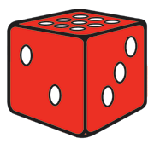
What day is it in the story?
What is Kit and Ana doing with their friends?
What games are Kit and his friends playing?
How do they feel?
What does Mom say about playing outside?
Do you agree with Mom? Why or why not?

Slide 6
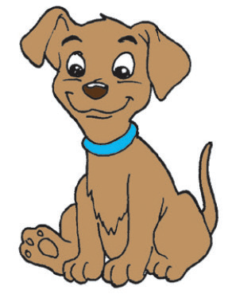
People consider their pets as their friends.
Another word for “friend” is “pal.”
They are synonyms.
Synonyms are words that have almost the same meaning.

Slide 7

People | Objects | Animals | Places
friends | ball | dogs | park
adults | bench | pigeons | playground
These words are name words or nouns.
A noun names a person, object, animal, or place.

Slide 8
Can you find the nouns in the box?
sister owl sad yellow
mall book church farm
teacher jump eyes good

