Slide 1
Baking Time
(Pronouns - He, She and They)

Slide 2
Sight Words
let | old | put | take | think
live | once | round | thank | walk
may | open | some | them | were
of | over | stop | then | when

Slide 3
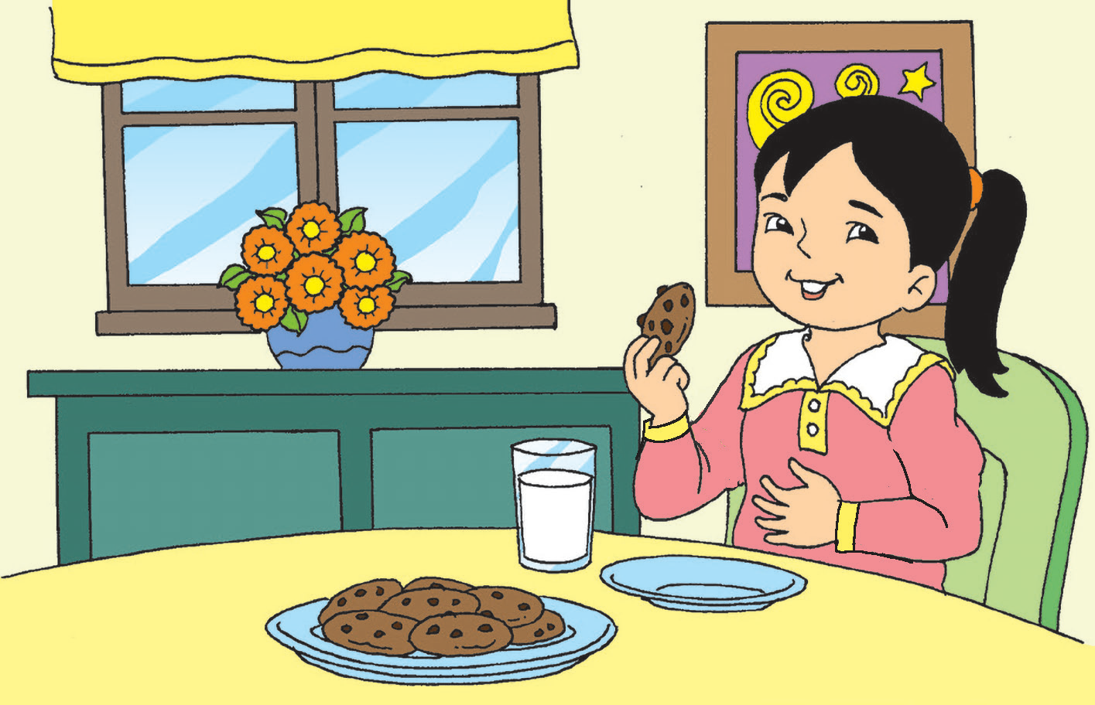
Baking Time
One of my favorite desserts is moist chocolate chip cookie.
Lucky for me, my aunt bakes the yummiest chocolate chip cookies in the world!
I love to smell the cookies as they bake in the hot oven.
When the cookies are cooked, Aunt Liz puts them on a tray.
I wait for them to cool. Well, sometimes, I do not.
Yum! Yum! Yum! Down they go into my tummy!

Slide 4

What is Ana’s favorite dessert?
Who bakes her favorite dessert?
What does Ana love to smell?
Where does Aunt Liz put the cookies for cooling?
How do you think Ana feels when she says, “Yum! Yum! Yum!”?
What does Ana mean when she says that sometimes she does not wait for the cookies to cool?

Slide 5

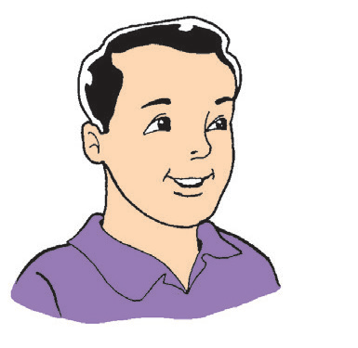
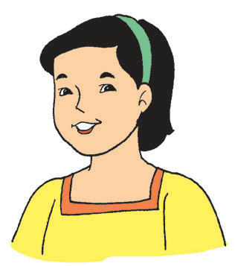
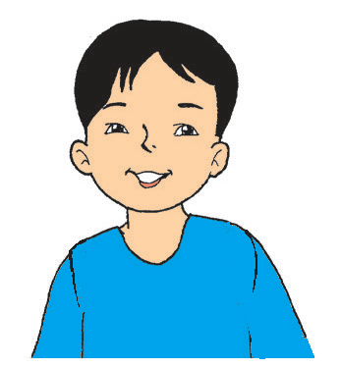
Aunt Liz is the sister of Ana’s mother.
Who are the other members of Ana’s family?
This is Dad.
He is my father.
This is Mom.
She is my mother.
This is Kit.
He is my older brother.

Slide 6
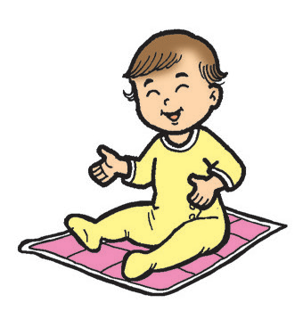
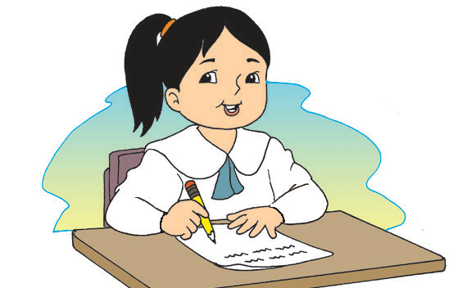
This is Mina.
She is my baby sister.
This is me.
I am Ana.

Slide 7
The words father, mother, sister, brother, and baby sister refer to family members.
These are words that tell about the family.
Other words for family members are aunt, uncle, cousin, grandmother, and grandfather.

Slide 8
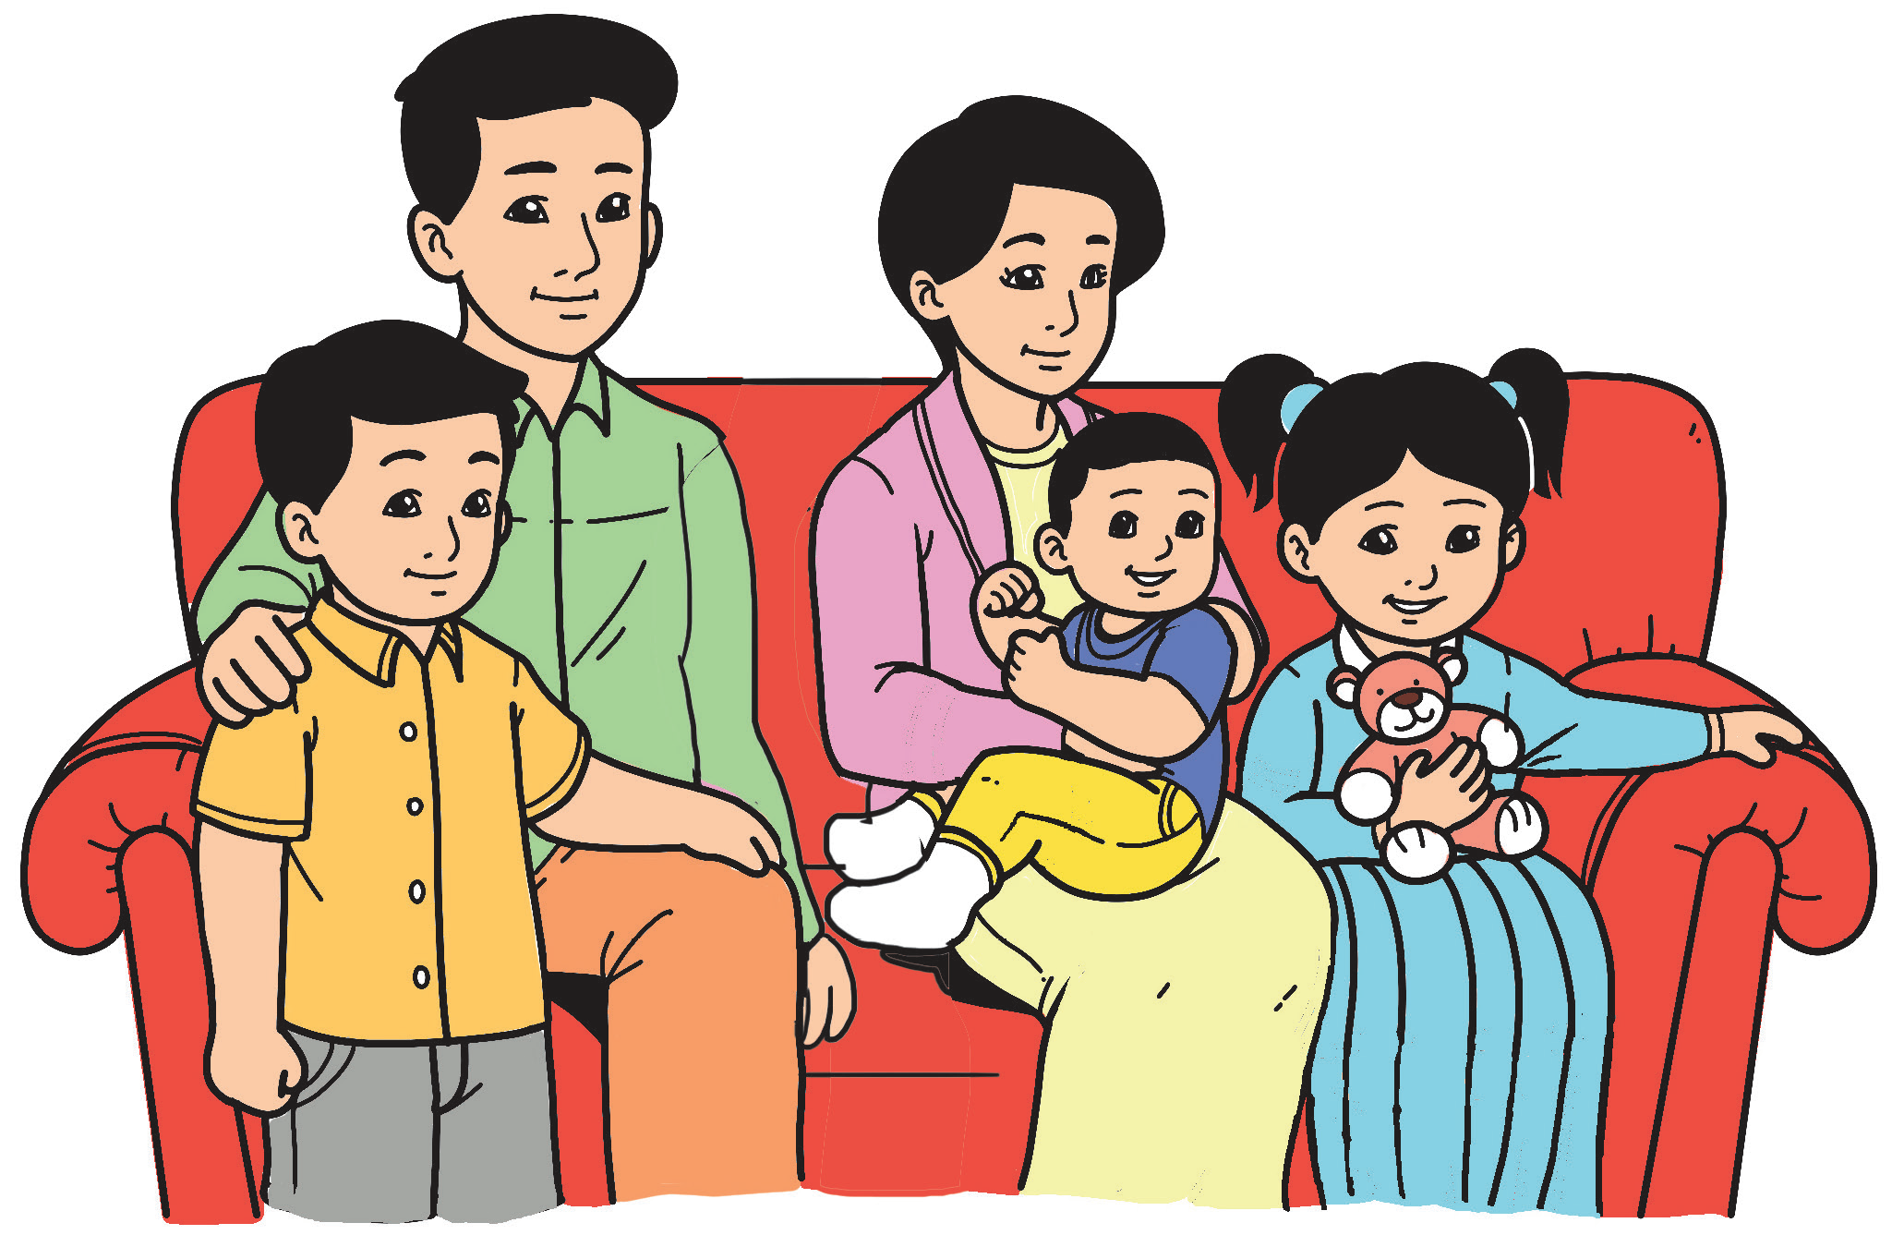

Ana’s family members
He is used in place of a male’s name.
She is used in place of a female’s name.
They is used in place of two or more people’s names.

