Slide 1
A Trip to the Beach
(Pronouns – It and We)

Slide 2
Vowel-Consonant (VC) pattern
Dad
b = ab
d = ad
g = ag
m = am
n = an
p = ap
t = at
x = ax
b = eb
d = ed
g = eg
m = em
n = en
p = ep
t = et
z = ez
a +
e +

Slide 3
Vowel-Consonant (VC) pattern
b = ib
d = id
g = ig
m = im
n = in
p = ip
t = it
x = ix
i +

Slide 4
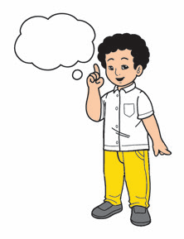
What comes to your mind when you hear the word “beach”?
Beach

Slide 5
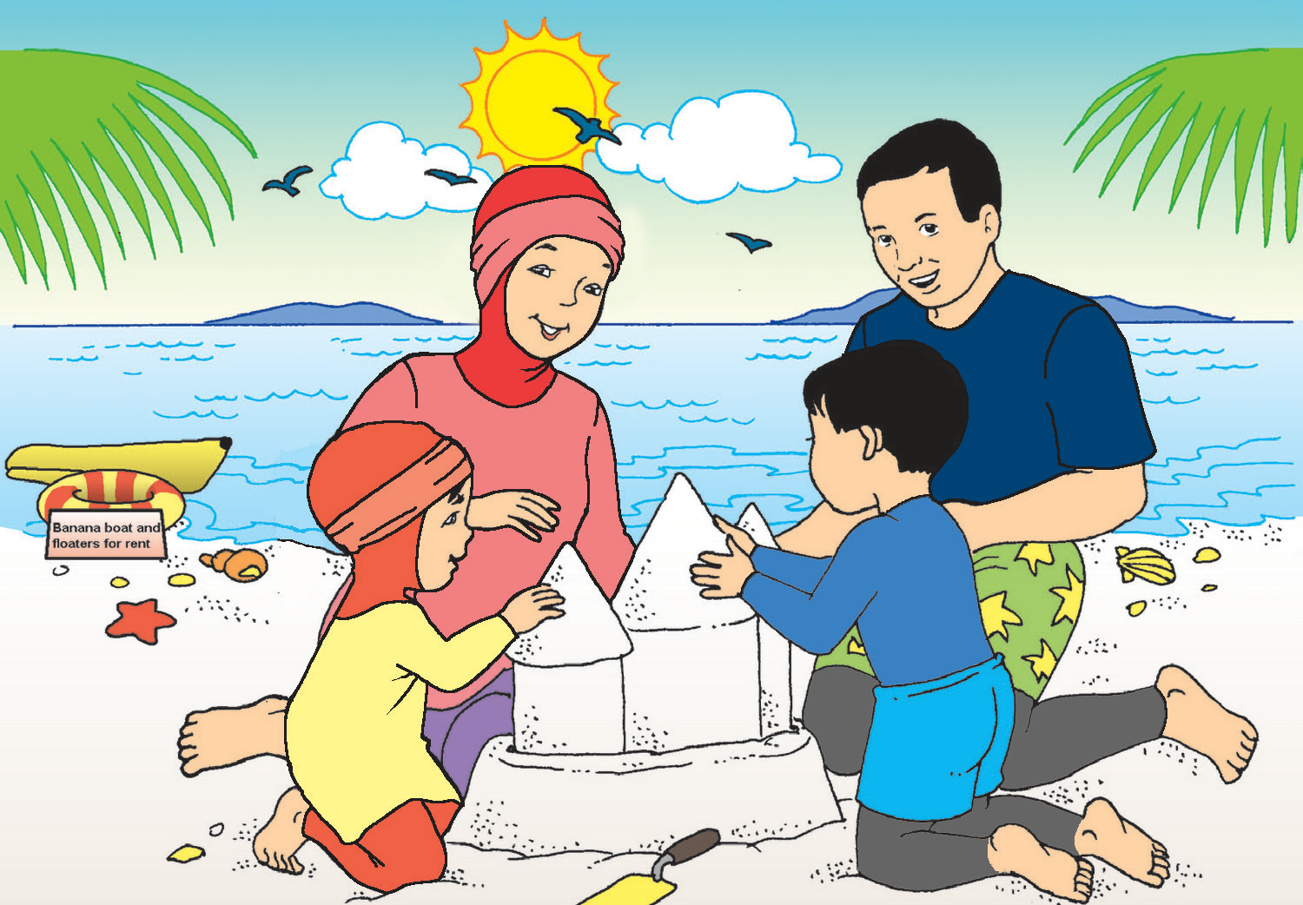
A Trip to the Beach
One fine sunny day, the Dizon family goes to the beach.
Ana and Kit pack swimwear, sunblock, and clothes in their bags.
Mom cooks food for lunch and snacks.
Dad makes a final check-up of the car.
They arrive at the beach in Anilao, Batangas after two hours.
The beach is beautiful. It has white sand with many colorful seashells. There are banana boats and floaters for rent. What a fun day for swimming along the seashore, building sand castles, and pretending to be sharks! Their food was great too.
“I will never forget this trip,” says Ana.

Slide 6

What does the Dizon family do one fine sunny day?
What can you say about the beach?
Why do you think Ana says, “I will never forget this trip”?
Why is it important to spend time with your family members?
How would you like to spend your day with your family?

Slide 7
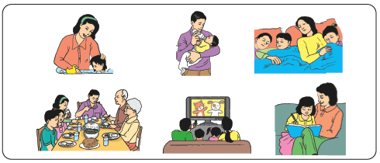
Activities that family members do together
Eat together | Watch a movie | Pray
Clean the house | Do homework | Joke around
Exercise | Go on a trip | Have a picnic
Go to the mall | Buy groceries | Take a walk
Shop | Go to the park | Go to church

Slide 8
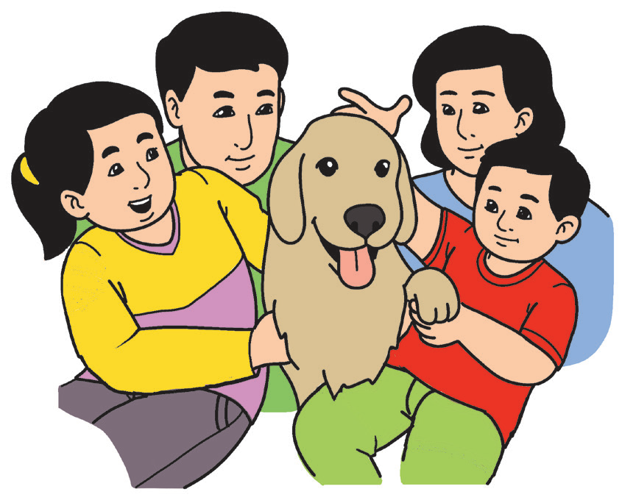
We are four in the family.
We have a pet dog named Cotton Candy.
It is big and brown. It has a long tongue too.

Slide 9

“We” is used in place of two or more persons’ names, including your name. It means you are part of the group that is speaking.
“It” is used to replace the name of an animal or thing.

