Slide 1
Kit’s Friend
(In Front of, Behind, and Beside)

Slide 2
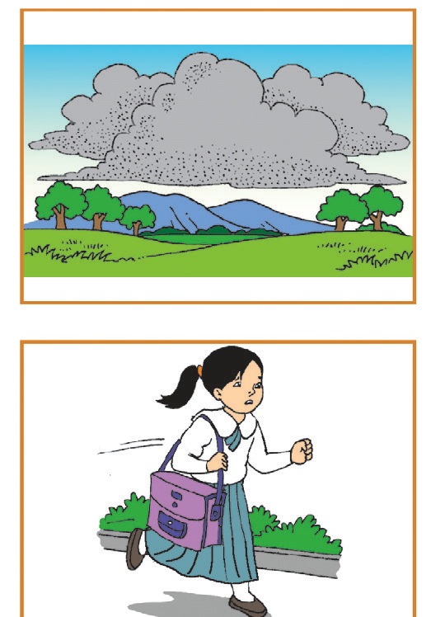


An effect is the end result of an action or a decision.
Can you draw the effect of each cause?
Cause Effect

Slide 3
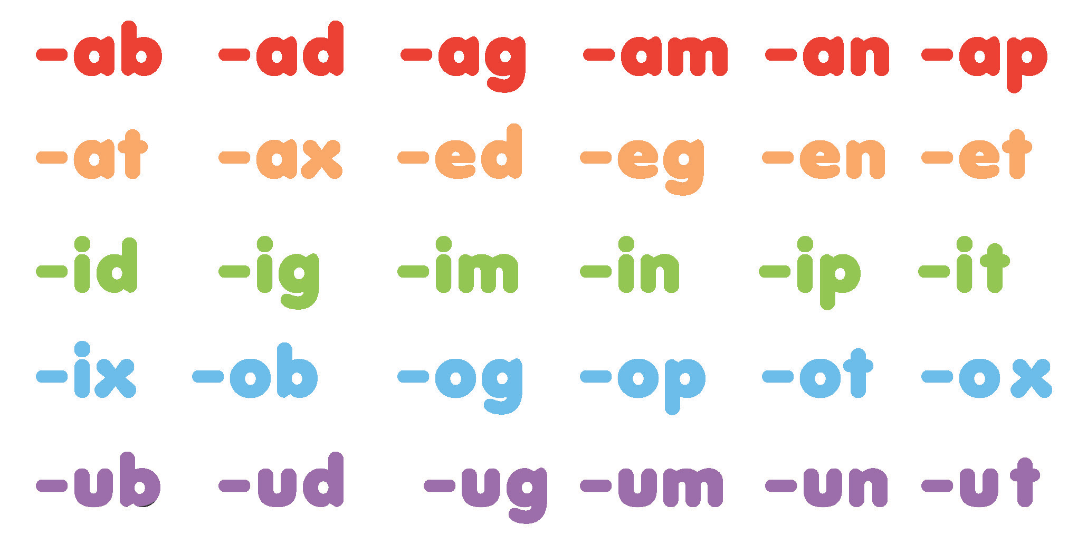

Slide 4

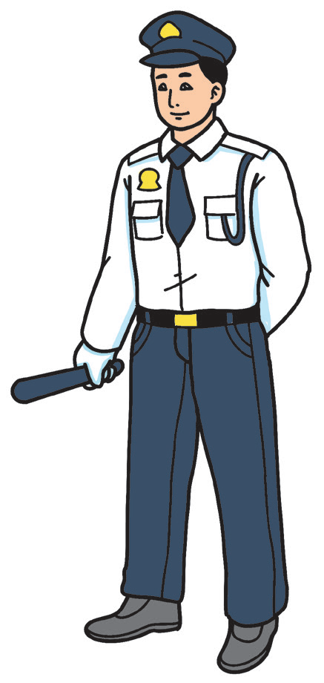
Kit’s Friend
Kit has a special friend in school.
He is not Nate, his best friend.
Kit sees his special friend every day. He greets Kit and all of his schoolmates, even his teachers, the principal, and visitors too.
He wears a blue and white uniform. He also has a cap and whistle. He asks visitors for their names every time they go inside the school. He protects pupils by not letting strangers inside the school.
He is Mang Ben, and Kit is proud to be his friend.

Slide 5
• Were you able to guess Kit’s special friend? How?
• What makes Kit’s friend special?
• How will you describe Kit’s friend?
• What do you think will happen if there is no Mang Ben in school?

Slide 6
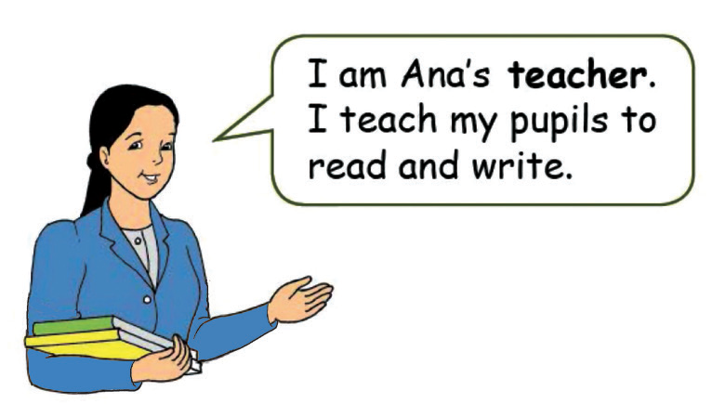
Mang Ben is one of the persons found in school. Here are other persons who help us in school.

Slide 7
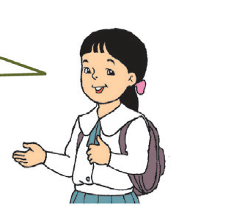
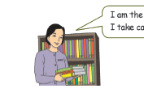
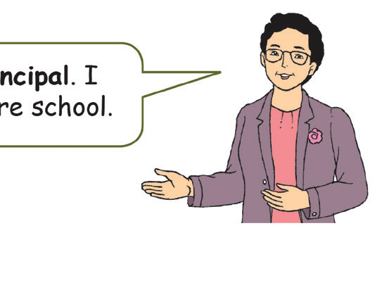
I am Pat. I am Ana’s classmate.
I am the librarian.
I take care of the books.
I am the school principal.
I look after the entire school.

Slide 8
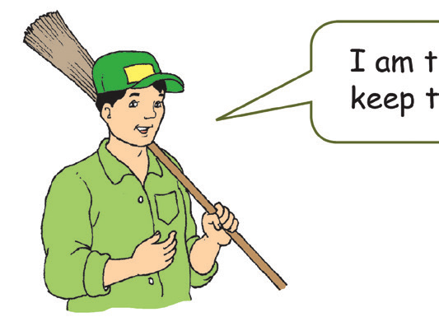
I am a janitor. I help keep the school clean.

Slide 9
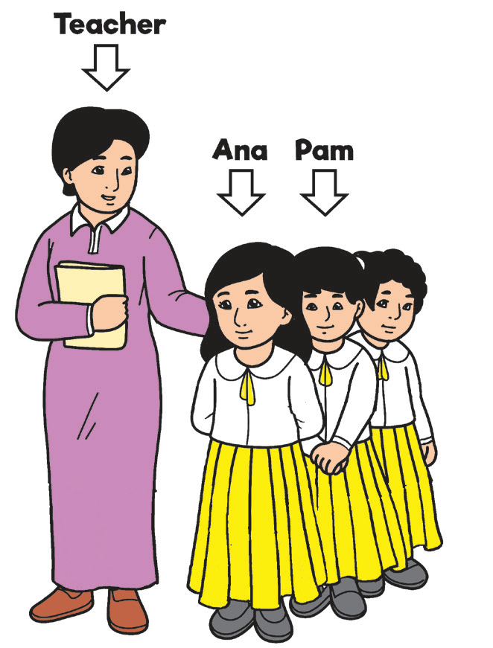
Ana is in front of the line.
Pam is behind her.
Ana’s teacher is beside her.
The words in front of, beside, and behind show the location or position of people and objects or things.

