Slide 1
Identifying Real or Make-Believe, Fact or
Nonfact Images

Slide 2
Identifying Real or Make-Believe, Fact or
Nonfact Images
Real images are true and can be proven as true. They can be experienced or witnessed by a person. Make-believe images do not exist in real life.
Fact images are images or statements that can be proven with evidence and are correct. Nonfact images cannot be proven and are usually based on our opinion.

Slide 3
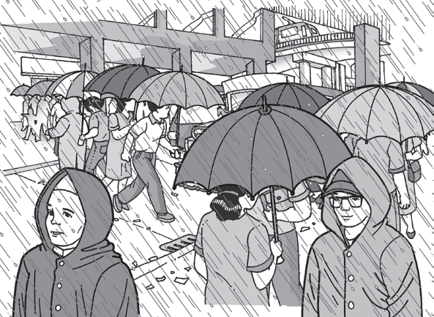
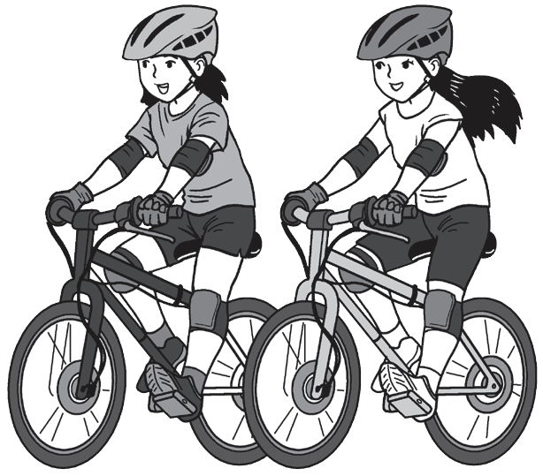
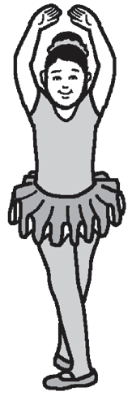
Identifying Real or Make-Believe, Fact or
Nonfact Images
Real Images
Real images are true and can be proven as true. They can be experienced or witnessed by a person. To identify if images or statements are real, one should look into things, ideas, and events based on real-life experiences using our five senses: seeing, smelling, tasting, hearing, and feeling.

Slide 4
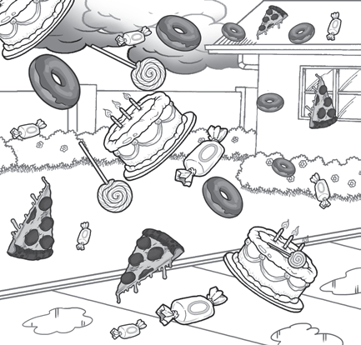
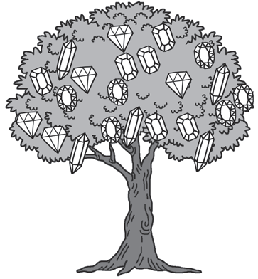
Identifying Real or Make-Believe, Fact or
Nonfact Images
Make-Believe Images
Make-believe images do not exist in real life. are products of our imagination, often exaggerated, and not likely to happen. They lack reality or proof of existence. Examples of make-believe images are actions or characteristics which cannot be present or cannot happen in real life for each word on your list (e.g., flying electric fan, talking table, your closet as a door to another world)

Slide 5
Identifying Real or Make-Believe, Fact or
Nonfact Images
Fact and Nonfact Images
In addition to real and make-believe images, one can also encounter fact and nonfact images. These images may be as confusing as real and make-believe images; thus, we need to be careful and critical. Fact images are images or statements that can be proven with evidence and are correct. Nonfact images cannot be proven and are usually based on our opinion.

Slide 6
Identifying Real or Make-Believe, Fact or
Nonfact Images
Fact and Nonfact Images
Example:
After this world health crisis, there will still be people wearing face masks and face shields as part of their daily routine. Scientists might also invent an invisible body shield that works as a force field to protect your whole body as you go places.
Fact: After this world health crisis, there will still be people wearing face masks and face shields as part of their daily routine.
This can be proven through surveys and can happen, especially to those people who are really cautious of their health and safety.
Nonfact: Scientists might also invent an invisible body shield that works as a force field to protect your whole body as you go places.
This is based on one’s imagination.

Slide 7
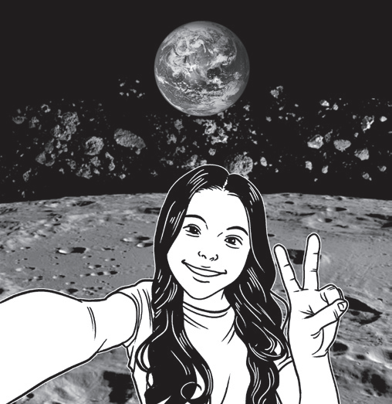
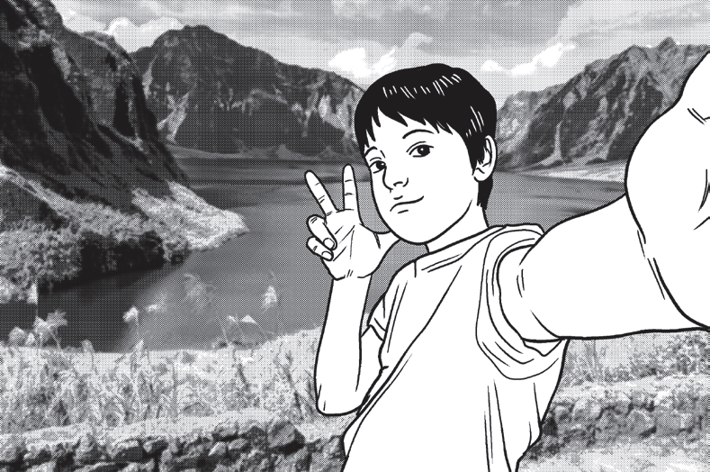
Identifying Real or Make-Believe, Fact or
Nonfact Images
Compare and contrast the two images using the Venn Diagram. Write their similarities and differences in your notebook.
A
B

Slide 8
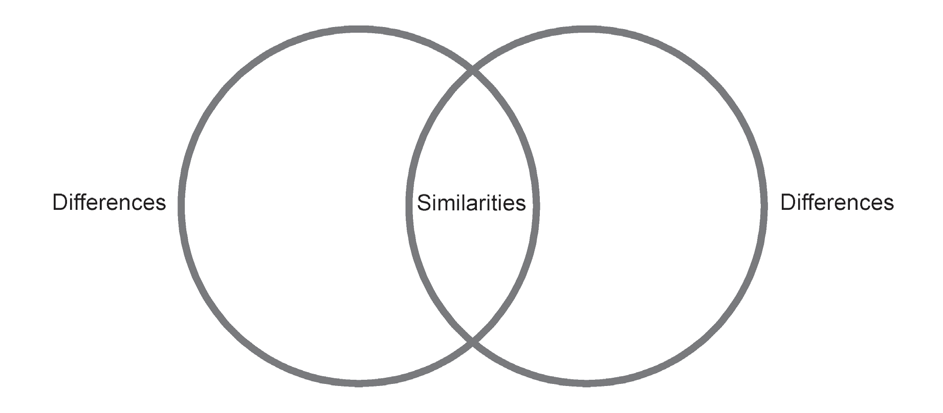
Identifying Real or Make-Believe, Fact or
Nonfact Images
Which of the two images would you consider as real? Explain your answer.

Slide 9
Identifying Real or Make-Believe, Fact or
Nonfact Images
Answers may vary.
Possible Answers:
Similarities: Both taking a selfie
Differences: Image A- a selfie outsie the planet Earth, no astronaut suit and oxygen tank, make-believe
Differences: Image B- a selfie with a mountain as the backgound, real

