Slide 1
Elements of Visual Media

Slide 2
Elements of Visual Media
It is highly likely that every day you encounter visual media. In fact, television, social networking sites, print magazines and newspapers, product labels, and even your gadgets contain visual media. Visual media elements carry with them various meanings, which deliver messages just like what print does to viewers like you.
Line, color, and symbol are elements of visual media. They are used to create a piece that can influence our emotions depending on our experiences. They also carry meaning with them, just like the words we read in various texts. Using these elements, you can create an exact representation of an image or something symbolic that can represent your emotions and ideas.

Slide 3
Elements of Visual Media
Visual media is a term closely related to movies, photography, television, and painting, to name a few. It caters to not only what your eyes can see but also your other senses like hearing and sometimes touching.
When watching a movie, you hear the sound effects and the conversation of the characters. The sound effects intensify scenes and spoken lines. Still pictures can also let you hear the sounds and feel different sensations by the way the elements are used to create a scene or a presentation that speaks to a viewer.

Slide 4
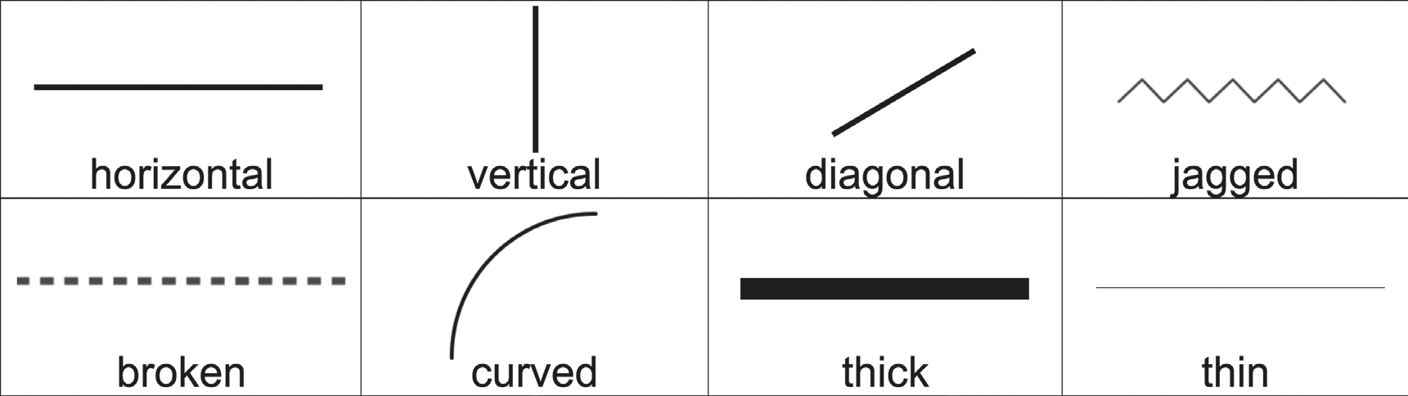
Elements of Visual Media
1. Line
A line is a set of points that moves in space.

Slide 5
Elements of Visual Media
1. Line
Its length is greater than its width.
It can be implied, abstract, or dimensional.
If it is implied, the meaning of the drawing is simply taken as what you see.
It can also be abstract, which you will need to interpret based on your experience, opinion, and emotion. Others may interpret it differently.
If the artwork is dimensional, depth can also be created by the effective use of lines; therefore, it can be measured.

Slide 6
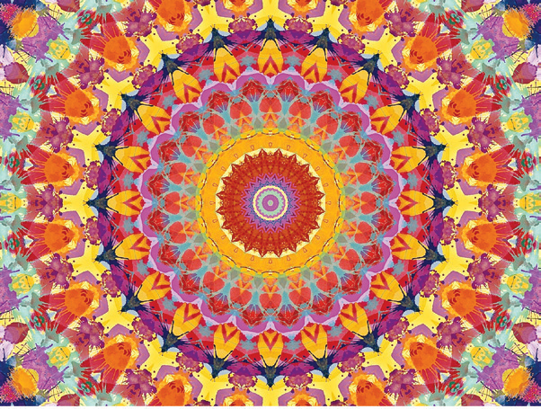
Elements of Visual Media
by EDDArts, CC0 Public Domain, via Pixabay
2. Color
Color describes the appearance of an object in terms of its hue, saturation, lightness, and contrast.

Slide 7
Elements of Visual Media
2. Color
This element has a strong influence on a viewer’s emotions.
It can create moods or set an atmosphere.
Colors have various components like:
  - hue, which is the name of the color itself (e.g., red, blue, yellow, and the like)
  - intensity, which tells how vivid or saturated a color is; and
  - value, which says how dark or light it is. It can create patterns and show harmony, symbol, or mood.

Slide 8


Elements of Visual Media
3. Symbol
Emoji One, CC BY-SA 4.0, via Wikimedia Commons
A symbol shows an image as a representation of emotions, ideas, and preferences. There are different kinds of visual symbols such as cartoons like anime, drawings, sketches, and the like.

Slide 9
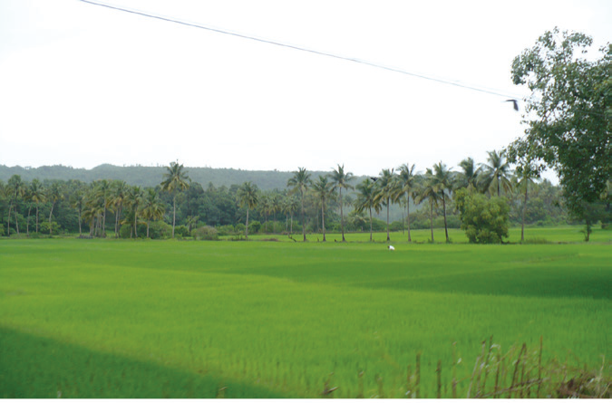
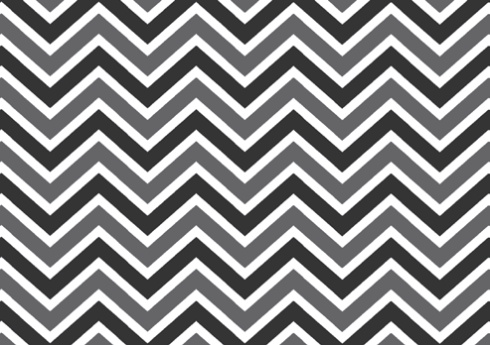
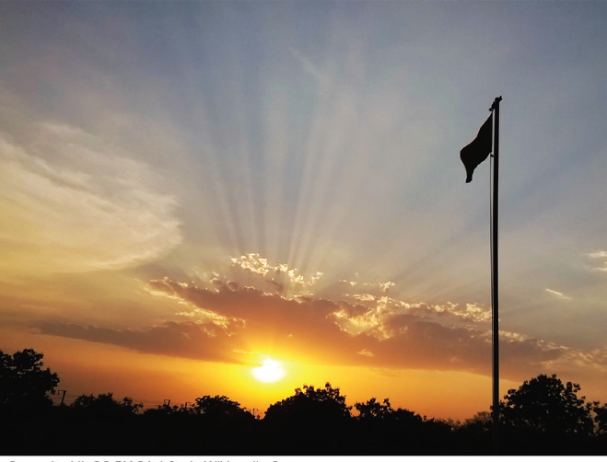
Elements of Visual Media
Choose the letter of the correct answer.
1. What is the dominant element in this illustration?
A. color B. lines C. symbol
2. What kind of line does the image show?
A. broken B. curved C. jagged
3. Which visual media element can be clearly seen in this image?
A. color B. lines C. symbol
by Nikkul, CC BY-SA 3.0, via Wikimedia
Sravanbaddi, CC BY-SA 4.0, via Wikimedia Commons

Slide 10

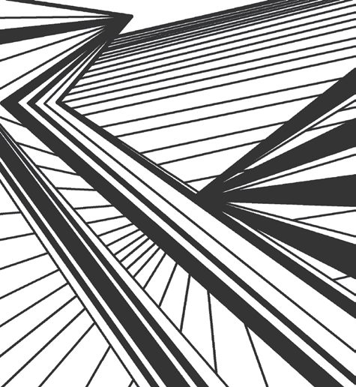
Elements of Visual Media
4. The given image is an example of a visual media element.
What is it called?
A. color B. line C. symbol
5. Which visual media element is used to create this image?
A. color B. line C. symbol

Slide 11
Elements of Visual Media
ANSWER KEY
1. What is the dominant element in this illustration?
A. color B. lines C. symbol
2. What kind of line does the image show?
A. broken B. curved C. jagged
3. Which visual media element can be clearly seen in this image?
A. color B. lines C. symbol
by Nikkul, CC BY-SA 3.0, via Wikimedia
Sravanbaddi, CC BY-SA 4.0, via Wikimedia Commons

Slide 12
Elements of Visual Media
ANSWER KEY
4. The given image is an example of a visual media element.
What is it called?
A. color B. line C. symbol
5. Which visual media element is used to create this image?
A. color B. line C. symbol

