Slide 1
Interpreting Visual Media

Slide 2
Interpreting Visual Media
All of us look at things differently. What is pleasing to your eyes may be ugly to another. What may deliver happiness to you may bring sadness to another.
The other three elements of visual media that convey various moods, emotions, and interpretations include gaze, framing, and social distance.

Slide 3
Interpreting Visual Media
1. Gaze
Gaze can refer to a viewer’s perspective as well as how the subject in a picture or image looks at the viewer which creates a certain effect.
Gaze varies and depends on a viewer’s background information and/or experiences.

Slide 4
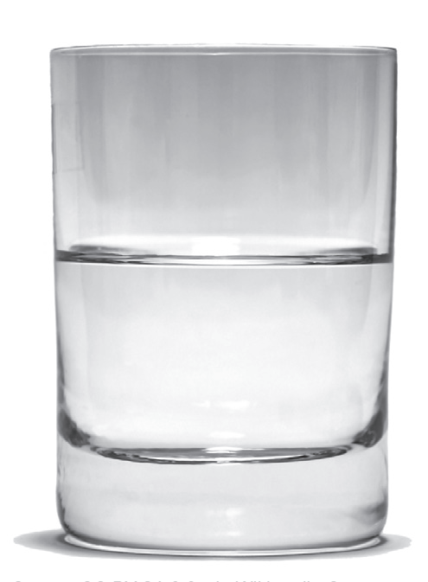
Interpreting Visual Media
Do you see this glass as half full or half empty? Whatever your answer is, it is correct because it is based on what you would like to emphasize.
The same is true when you watch movies or television series. You may wonder why your friend is laughing hard on a punch line while you think it is not that funny. This is because of the different experiences you and your friend have.
S nova, CC BY-SA 3.0, via Wikimedia Commons

Slide 5
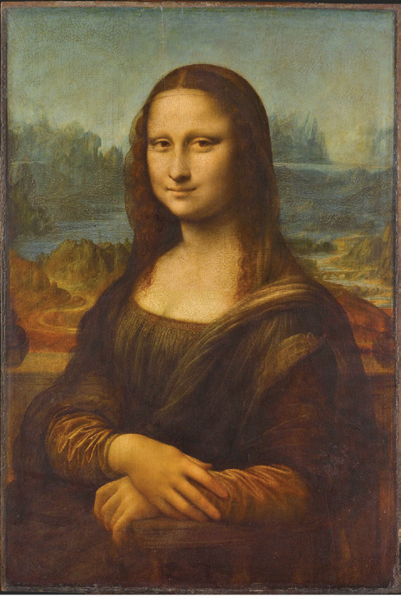
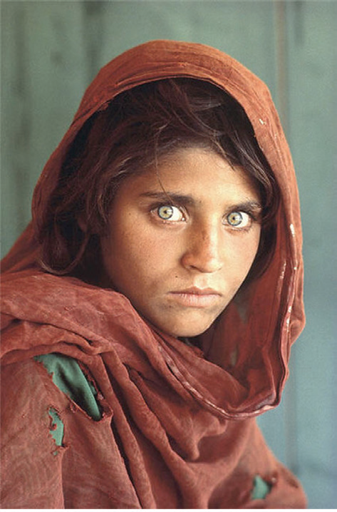
Interpreting Visual Media
Another aspect of gaze is the way the subject in an image/picture looks at the viewer. Look at the two images below.
Leonardo da Vinci, CC BY-SA 4.0, via Wikimedia Commons
by Steve McCurry via Olaf Torsu, CC BY
2.0, via Flickr
Do you see a difference in the way the two images look at you? What effects are created by the way they gaze at you?

Slide 6
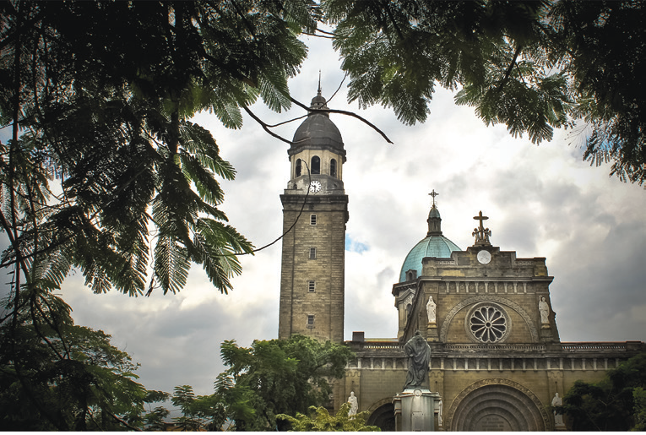

Interpreting Visual Media
2. Framing
Framing refers to a natural border used to enclose an object or an image. Framing can influence how a viewer interprets an image or an object depending on the range of experiences, social interactions, cultural influences, and stored information that a viewer has. Look at how nature becomes a natural frame in the given images.
Jsinglador, CC BY-SA 3.0, via Wikimedia Commons
by Ian D. Keating, CC0 Public Domain, via Pxhere

Slide 7
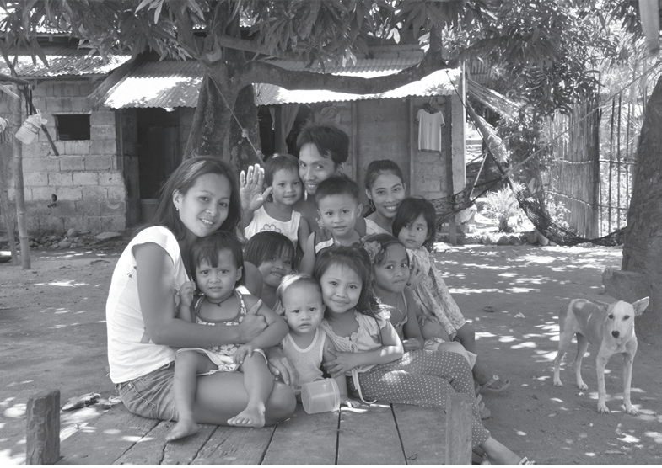
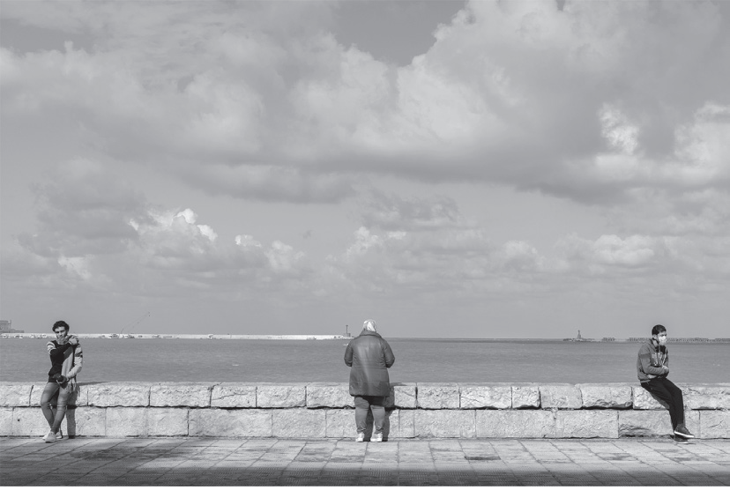
Interpreting Visual Media
3. Social distance
MCC Jason Penny, Public Domain, via Wikimedia Commons
Mohamed Hozyen, CC BY-SA 4.0, via Wikimedia Commons
Social distance refers to the use of space, which can create an effect if used between persons or objects.

Slide 8
Interpreting Visual Media
3. Social distance
When you look at an image with two persons who are too close to each other, you may interpret that they are in a close relationship. This interpretation may stem or come from the effect of our distance from the subject of the image. This distance refers to how much we know of what is shown in the illustration based on our experiences.

Slide 9
Interpreting Visual Media
A. Read each question carefully. Choose the letter of the best answer to each question.
1. This refers to a viewer’s perspective as well as how the subject in a picture or image looks at the viewer which creates a certain effect.
a. framing
b. gaze
c. social distance

Slide 10

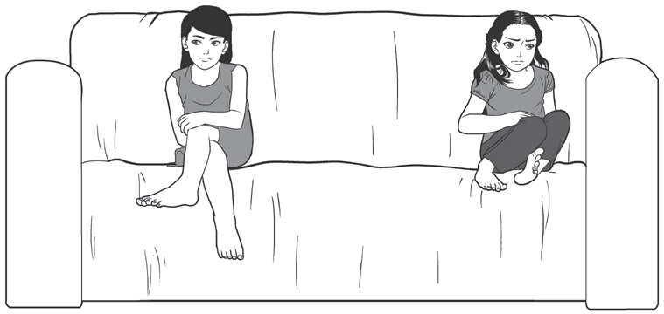
Interpreting Visual Media
2. What visual media element helps give
emphasis to Mt. Mayon?
a. framing
b. gaze
c. social distance
Derick Allen Escamillas, CC BY-SA 4.0, via Wikimedia Commons
3. Which visual element shows that the two
friends look like they had an argument?
A. framing
B. gaze
C. social distance

Slide 11
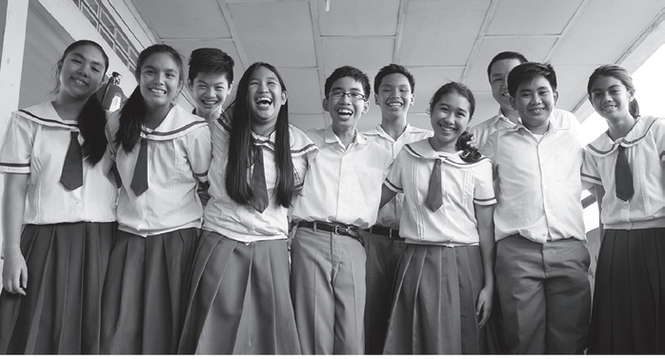
Interpreting Visual Media
4. What do you think is the relationship of the
people in the image?
A. acquaintances
B. enemies
C. friends
Gabbykawaii07, CC BY-SA 4.0, via Wikimedia Commons
5. Looking at the same image in item #4, how are you able to know their
relationship?
A. They are standing too close to each other.
B. They seem to be arguing about something.
C. The background shows how they are related to each other.

Slide 12
Interpreting Visual Media
ANSWER KEY
A. Read each question carefully. Choose the letter of the best answer to each question.
1. This refers to a viewer’s perspective as well as how the subject in a picture or image looks at the viewer which creates a certain effect.
a. framing
b. gaze
c. social distance

Slide 13
Interpreting Visual Media
ANSWER KEY
2. What visual media element helps give
emphasis to Mt. Mayon?
a. framing
b. gaze
c. social distance
Derick Allen Escamillas, CC BY-SA 4.0, via Wikimedia Commons
3. Which visual element shows that the two
friends look like they had an argument?
A. framing
B. gaze
C. social distance

Slide 14
Interpreting Visual Media
ANSWER KEY
4. What do you think is the relationship of the
people in the image?
A. acquaintances
B. enemies
C. friends
Gabbykawaii07, CC BY-SA 4.0, via Wikimedia Commons
5. Looking at the same image in item #4, how are you able to know their
relationship?
A. They are standing too close to each other.
B. They seem to be arguing about something.
C. The background shows how they are related to each other.

