Slide 1
Detecting Biases and Propaganda

Slide 2
Detecting Biases and Propaganda
People can use different ways to convince us to support or go against a certain idea. One way to support an idea or a certain product is through testimonials from people who have used a certain product and about how a certain product is helpful for them. On the other hand, when people convince us to go against an idea or a product, they sometimes use negative words or highlight the bad traits of a specific product.
Being unfamiliar with these techniques can prevent you from coming up with sound and fair decisions. In the process of doing so, your emotions and, more importantly, your biases are used as an advantage against you. Detecting biases and propaganda in texts and other forms of media requires a sharp eye for hidden meanings through the use of specific words and even the way that discussions are made.

Slide 3
Detecting Biases and Propaganda
What is a bias?
A bias is an existing opinion or liking that leads to a strong feeling of being for or against an idea, a person, or object. It is often based on an unverifiable and unjustifiable opinion. Biases can change over time depending on the experiences that a person may have.
Sometimes, a person’s biases can greatly change based on a single event or development. There are times when biases prevent a person from making a fair and sound decision which resulted to negative or harmful biases. On the other hand, biases can also be beneficial but it may depend on person’s preferences.
Example:
Racism is an example of how bias toward a certain race and even ethnicity can lead to different forms of harassment and discrimination.
An example of a beneficial bias is when one chooses to eat more vegetables because of the bias that vegetables provide good nutrients which promote good health.

Slide 4

Detecting Biases and Propaganda
What is propaganda?
Propaganda is the process of spreading opinions or beliefs that may be misleading and may eventually harm a person, a thing, an institution, or a cause. Propaganda techniques heavily rely on the biases and prejudices (ideas or opinions formed before having the evidence for their truth or usefulness) that their target audience may possess.
Look at the given advertisement and identify what the product claims to do. What elements in the advertisement help support the product’s claims? Do you think these elements would convince consumers to buy it? Why or why not?
The advertisement aims to convince the audience that the detergent powder is worth buying because of its efficiency in removing stains. This may excite consumers, who are tired of worrying about those hard-to-remove stains on clothes. The presence of a celebrity endorser makes this advertisement even more eye-catching.

Slide 5
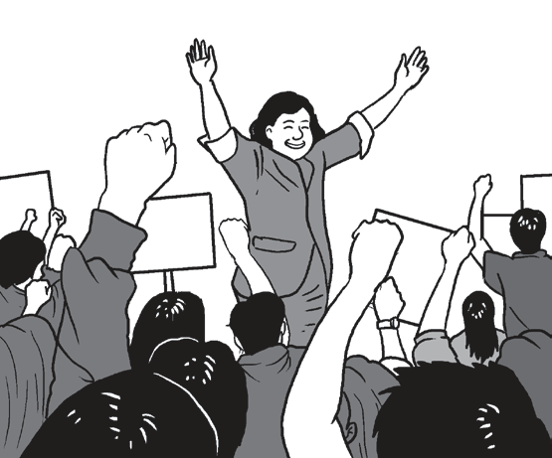

Detecting Biases and Propaganda
Types of Propaganda
1. Bandwagon
This technique uses people’s desires to be part of a crowd. If many people think that an idea is good, then it must be good.
Example: Ninety percent of the population thinks that she is the best senatorial candidate.
2. Name-calling or Labeling
This technique attacks an opponent by assigning negative things to them.
Example: One should not trust this person because he is
associated with wanted rebels in the community.

Slide 6
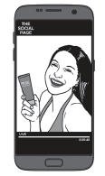

Detecting Biases and Propaganda
Types of Propaganda
3. Testimonial
This device uses popular people to make ideas known. Ideas are endorsed by them to send out the message that the product is good or effective.
Example: A social media influencer makes a review of the latest sunscreen this summer.
4. Plain Folks
This uses the language or reflects the behavior of the general public or common people to establish a connection with the product or idea.
Example: A housewife gives a testimonial about a laundry detergent that claims to make clothes look brand new again.

Slide 7

Detecting Biases and Propaganda
Types of Propaganda
5. Glittering Generality
This technique uses words that make generalizations “glittering” or for them to be presented in an appealing way.
Example: Rex Cupcake is enriched with Vitamins A, C, and D.
Note: Propaganda is present not only in the advertisements and commercials that we see every day but also in the texts that we read. We are heavily influenced by the things that we read which is why we need to be aware of the possible ways how these texts can affect the way that we think and formulate our opinions and biases.

Slide 8
Detecting Biases and Propaganda
How can we detect bias and propaganda in written texts?
1. Read the text critically.
Biases can be really subtle and hard to catch, so pay careful attention to the text or article that you are reading. You may want to read a text more than once.
Example:
Online learning is the best way to deliver education in the new millennium. It is not only fun, but it also allows learners to download exciting applications and chat with teachers and friends. Learners get instant results from their learning experience.
Analysis:
The given text shows bias to online learning by saying that it is the best way to deliver education even if there are other ways in which education can be delivered. The article should also consider the challenges that other students may face especially in accessing forms of technology and the Internet.

Slide 9

Detecting Biases and Propaganda
How can we detect bias and propaganda in written texts?
2. Look at the headline.
A headline is presented with very few words. It is meant to make a considerable impact on its readers. Just by reading the headline, you will know whether there is an argument being made or not. What bias do you think is present in the given headline?
The given headline implies that the government refuses to take responsibility for the lack of response at the time of this pandemic.

Slide 10
Detecting Biases and Propaganda
How can we detect bias and propaganda in written texts?
3. Be mindful of the words being used in the text.
Determine whether the word choices are harmful or overly good toward a particular person, idea, or group of people. An unbiased article will be neutral in its presentation of information to its readers.
Examples:
Headline 1: Mr. Y loses against Mr. X as city mayor.
Headline 2: Mr. X wins the mayoral race.
Let us analyze the given two headlines.
Headline 1 explicitly mentions which of the two politicians lost and won in the election instead of focusing only on the name of the politician who won, as shown in Headline 2. Headline 1 implies a writer’s bias against the other politician, and this defeats the purpose of objectively reporting facts.

Slide 11
Detecting Biases and Propaganda
How can we detect bias and propaganda in written texts?
4. Watch out for exaggerations.
Propaganda will always make an appeal to one’s emotions rather than logic. Using very colorful words that may highlight details that favor one over the other is a clear sign that the text is biased. Changing the data to hopefully impress readers is an example of exaggerating the ideas presented in a text.
Example:
Everything in the country is now functioning smoothly.

Slide 12

Detecting Biases and Propaganda
How can we detect bias and propaganda in written texts?
5. Observe the visual images that may come with the article.
Images such as cartoons or photographs contribute to the overall message of a news/article. Consider how these visuals make you feel regarding the main topic at hand. The given sample image may appear in an article about the mismanagement of waste in the country. The image supports the bias that there is a need to change the way our waste is disposed of and managed.
Headline 1:
“Pasaway” Filipinos still violate quarantine rules; studies show otherwise
Headline 2:
Expert: “Filipinos not pasaway”; COVID response slowed by poor crisis management

Slide 13
Detecting Biases and Propaganda
A. Read the following statements and identify whether these biases are harmful or not. Draw a circle (O) if the statement is a helpful bias or a cross (X) if it is an example of a harmful bias.
________1. Following a fad or a popular diet of drinking only fruit juice in order to be thin like a model or celebrity.
________2. Choosing to eat organic produce in order to help support a chemical-free lifestyle.
________3. Not wanting to get a checkup with a female physician because of one’s bias for male doctors.
________4. Choosing to work overtime on most days in order to go along with the bias that productivity equates to success.
________5. Engaging in more positive self-talk in order to motivate oneself to get through daily challenges.

Slide 14
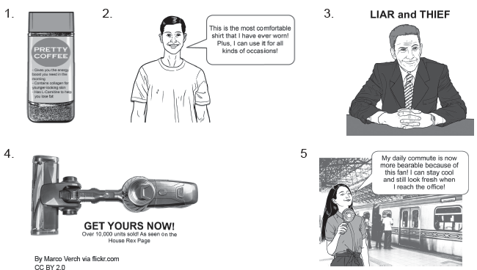
Detecting Biases and Propaganda
B. Analyze the following advertisements and identify what type of propaganda is present. Write only the letter of the correct answer.
A. bandwagon
B. name-calling or labeling
C. testimonial
D. plain folks
E. glittering generality

Slide 15
Detecting Biases and Propaganda
Answers:
A.
1. X
2. O
3. X
4. X
5. O
B.
1. E
2. C
3. B
4. A
5. D

