Slide 1
Seeing Similarities and Differences in Materials Viewed Through Different Sources

Slide 2
Seeing Similarities and Differences in Materials Viewed Through Different Sources
Now that you are in sixth grade, you have experienced a lot of things that are the same and different. From the food you eat, the clothes you wear, the music you listen to, and the movies and television shows you watch, you can now tell that these things have similarities and differences. Indirectly, you have acquired the skill of comparing and contrasting ideas. This is an important skill to have, especially when verifying information from various sources. Given such, these are the things that you should remember:
• The three different sources of information are print, broadcast, and digital or online.
• We compare and contrast information from the three sources of information to check if the ideas and pieces of learning we gain from them are valid and accurate.
• A Venn diagram is a tool to illustrate the comparison and contrast of information.

Slide 3
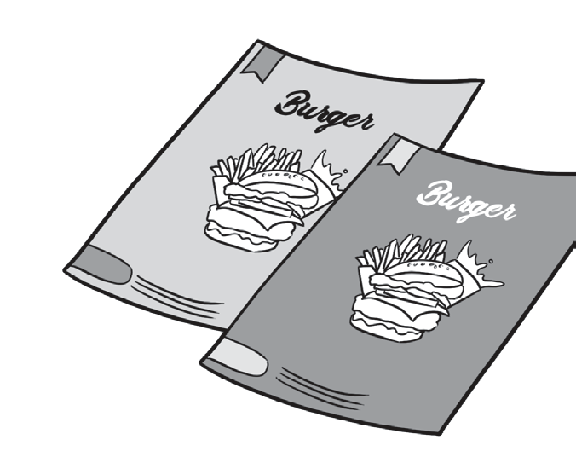
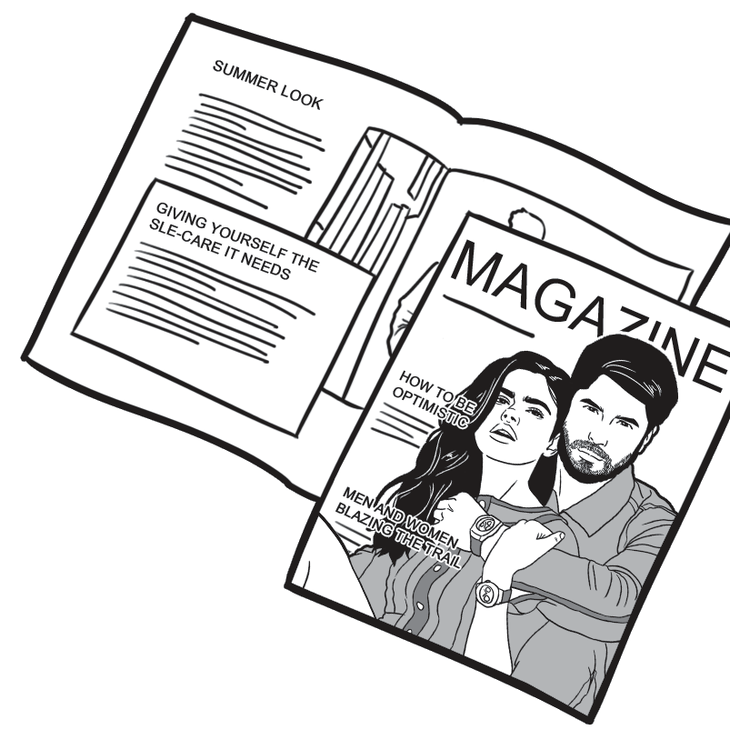


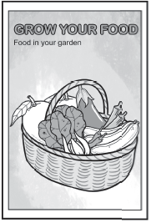
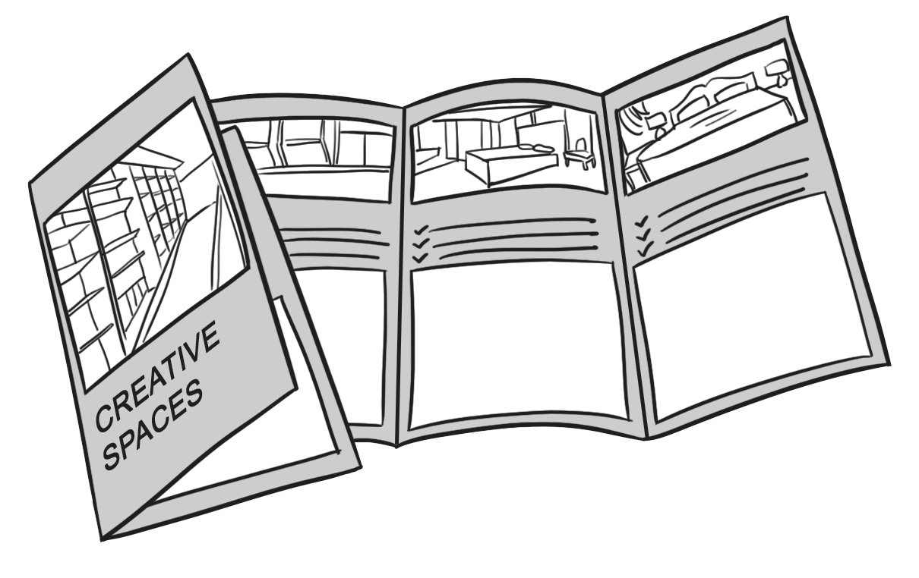
Seeing Similarities and Differences in Materials Viewed Through Different Sources
Sources of Information
Information on print is printed publication in the forms of newspapers, magazines, books, brochures, pamphlets, posters, and the like. One can hold and read them in actuality.

Slide 4
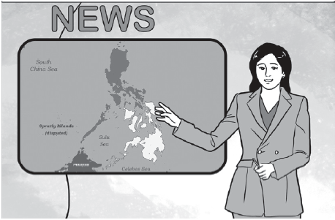
Seeing Similarities and Differences in Materials Viewed Through Different Sources
Sources of Information
Information being watched on television or heard over the radio is called broadcast media. They come in the forms of programs or shows.

Slide 5
Seeing Similarities and Differences in Materials Viewed Through Different Sources
Sources of Information
The information being consumed online is called digital media. It can be online news sites, websites, blogs, video channels, *podcasts, and the like. A person needs to have an Internet connection in order to access such media. Audio files available on the Internet can be downloaded to a computer or mobile device.

Slide 6
Seeing Similarities and Differences in Materials Viewed Through Different Sources
Sources of Information
To fully understand the different source of information, read the selection below.
The Media Around Us
Print, broadcast, and digital media are all sources of information. Unlike the other two sources of information, print media is information you read in its full details, but you can only read this information through newspapers and magazines. On the other hand, broadcast media is information delivered through the television or the radio. The information is short but accurate. The third source is digital media, where information is delivered through digital portals on the Internet. Unlike the two previous sources, digital media can be accessed anywhere and at any time.

Slide 7
Seeing Similarities and Differences in Materials Viewed Through Different Sources
Comparing and Contrasting
Comparing is when you identify how ideas, people, things, and places are the same.
Example: A guidance counselor and a librarian are both teachers.
The sentence shows two additional roles of a teacher in a school. One is a guidance counselor and the other, a librarian. Although the two have different additional functions in the school, they are still both teachers.
Contrasting, you are identifying how ideas, people, things, and places are different.
Example: One of the roles of a guidance counselor is to guide students to proper behavior, whereas a librarian sees order from students using the library.
A guidance counselor and a librarian are both teachers, but they differ in the functions of their offices.

Slide 8
Seeing Similarities and Differences in Materials Viewed Through Different Sources
Comparing and Contrasting
Here are some transition words that can help you write sentences that compare or contrast.
Compare and Contrast Transition Words
Compare | Contrast
same the same as similar similarly also too as well as likewise both alike | but however while whereas on the other hand different difference differently like although even though
Use these transition words in writing sentences to compare and contrast the information in a material viewed to other sources of information like print, broadcast, and online sources.
Learning the skill of comparing and contrasting helps a person address two or more subjects to show their similarities and differences. It may describe or explain, reveal strengths as well as weaknesses, or persuade you to value one idea over the other.

Slide 9
Seeing Similarities and Differences in Materials Viewed Through Different Sources
Comparing and Contrasting
Here are some pointers to consider when you are comparing and contrasting information:
• Identify similarities and differences between two or more things, people, places, or ideas.
• Provide factual detail about each piece of information.
• Identify your purpose for comparing and contrasting the information.
• Address each subject equally by presenting information for both topics

Slide 10
Seeing Similarities and Differences in Materials Viewed Through Different Sources
Comparing and Contrasting Using Venn Diagram
You can also compare and contrast ideas by using a Venn diagram. In a Venn diagram, two circles overlap each other. Circle A is one set of ideas that is different from Circle B. These two circles overlap in this type of diagram to show the similarities of the two sets of ideas.
Example:
Tablets or Books?
One of the top benefits of tablet PCs in the new normal classroom is its convenience. Instead of walking around the house with all your books in one gigantic bag, you only need to carry this smart device, which can store hundreds of digital books. Different from printed textbooks, a tablet is designed to be lightweight. However, unlike printed books, some digital books require an Internet connection to access them even after purchase and installation. Tablets run on batteries. A book, on the other, is always ready to be opened. Both books and tablets are sources of information, and similarly, they are a big help in every classroom.

Slide 11
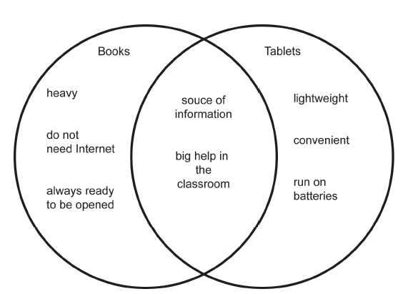
Seeing Similarities and Differences in Materials Viewed Through Different Sources
Comparing and Contrasting Using Venn Diagram

Slide 12
Seeing Similarities and Differences in Materials Viewed Through Different Sources
Comparing and Contrasting Using Venn Diagram
When we are to compare and contrast more than two things, we make use of a three-circle Venn diagram. This helps a reader to identify shared features of three objects or ideas.
Example:
Movies often capture the interest of viewers by making use of unique characters such as zombies, aliens, and robots. All these three often take the part of the villain that causes chaos or destruction in the story since they can all result in tragic human deaths. All three characters diff er in their origin. Zombies come from infected human beings who died and came back to life. Aliens, on the other hand, are creatures from another universe and visit Earth using their spaceship. Robots are machines. Zombies and aliens both crave the taste of fl esh. Aliens are smart and can communicate like humans; however, both zombies and robots have no emotions at all. Robots, just like aliens, use advanced technology. These characters may scare the viewers, but you do have to admit, they make our viewing experience awesome!

Slide 13
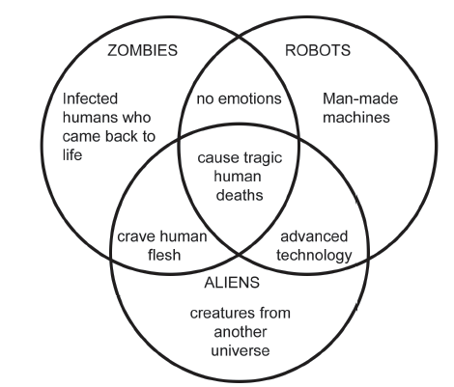
Seeing Similarities and Differences in Materials Viewed Through Different Sources
Comparing and Contrasting Using Venn Diagram
Notice how the pieces of information are organized in the three-circle Venn diagram. The center portion that overlaps all three circles contain the similarities of zombies, robots, and aliens. The portion that overlaps two circles only shows the similarity between two characters, while the portion of the circle that does not overlap with any of the other circles contains the characteristics that are different from the other two characters.
Another way to compare and contrast information is by means of arranging pieces of information in a table format.

Slide 14
Seeing Similarities and Differences in Materials Viewed Through Different Sources
Read “Weather Forecast on TV” and answer the table below. Fill it out with the needed details based on the texts.
Weather Report on TV
Good morning! For today’s weather, heavy rains continue in some parts of Metro Manila. Some down pours are due to the Habagat, which is enhanced by a low pressure area (LPA) near Vietnam. This LPA will not directly hit the country, but heavy rains are still expected in Metro Manila, particularly in Pasay and Taguig. The western section of Luzon will also be aff ected, including the Ilocos region, Bataan, Zambales,
Pangasinan, Nueva Ecija, Cavite, Batangas, as well as Mindoro and Palawan. We advise the public to take extra precautions since rains may persist until the evening. PAGASA warns that the same weather scenario will also be felt tomorrow and in the coming days due to the southwest monsoon. Please be on alert for floods or landslides in your area. There is no storm in the Philippine Area of Responsibility, but we should all remain prepared. PAGASA says it expects one more storm this June and ten to fifteen more storms within the year.

Slide 15
Seeing Similarities and Differences in Materials Viewed Through Different Sources
Compare and Contrast Transition Words
Place | Weather Condition | Caused By | Impacts
Metro Manila | Heavy rains | Habagat | Floods or landslides
The rest of Luzon | Heavy rains in the western section | Habagat | Floods or landslides
What are the pieces of information that were delivered similarly?
Weather Report on TV | Weather Forecast
What are the pieces of information that were delivered differently?
Weather Report on TV | Weather Forecast

Slide 16
Seeing Similarities and Differences in Materials Viewed Through Different Sources
Answers may vary.
Possible Answers:
What are the pieces of information that were delivered similarly?
Weather Report on TV | Weather Forecast
Heavy rains continue in some parts of Metro Manila. Some downpours are due to the Habagat, which is enhanced by a low-pressure area (LPA) near Vietnam. That LPA will not directly hit the country, but heavy rains are still expected in Metro Manila. Please be on alert for floods or landslides in your area | Metro Manila – Heavy rains, caused by Habagat, floods, or landslides
What are the pieces of information that were delivered differently?
Weather Report on TV | Weather Forecast
The specific names of the cities in Manila and provinces affected by Habagat were mentioned. It states that the same weather scenario will be felt in succeeding days. The Philippines is expecting another storm in June and 10 to 15 more storms within the year | No mention of specifi c cities and provinces aff ected by Habagat. It shows only the current weather forecast. No precautions are given.

