Slide 1
A Day at the Special Zoo

Slide 2
Animal words that have the consonant-vowel-consonant pattern:
dog bug cub
The first two letters have the consonant + short /o/ or short /u/ pattern.

Slide 3
lion elephant zebra monkey tiger habitat
near picture animals family zoo special

Slide 4
A Day at a Special Zoo
It was a sunny day.
Dad, Mom, Kit, and I went to the zoo.
We saw lions, elephants, zebras, monkeys, and tigers.
I saw tarsiers but I did not go near them.
The zoo guide said that we should only look at them and not disturb them.
He said that in the special zoo, they try their best to keep the animals in their
natural habitat or environment.
That is why there were many trees, ponds, rocks, and caves in this zoo.
Many of the animals there were rescued.
Kit took pictures of the animals. Kit took pictures of our family too.
I cannot wait to tell my friends about this special zoo!

Slide 5

Who went to the zoo?
What did they see at the zoo?
What did Kit do?
What made the zoo special?
Why do you think Ana stayed away from the tarsiers?
From whom were the animals rescued?

Slide 6

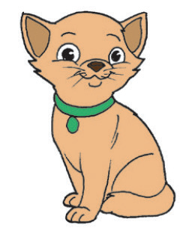
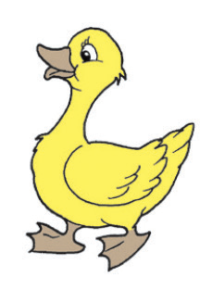
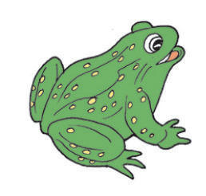

There are names for animals.
Do you know the names of the animals below?

Slide 7

