Slide 1
A Special Day

Slide 2
Sight words
after | again | an
any | as | ask
by | could | every
fly | from | give
going | had | has
her | him | his
how | just | know

Slide 3
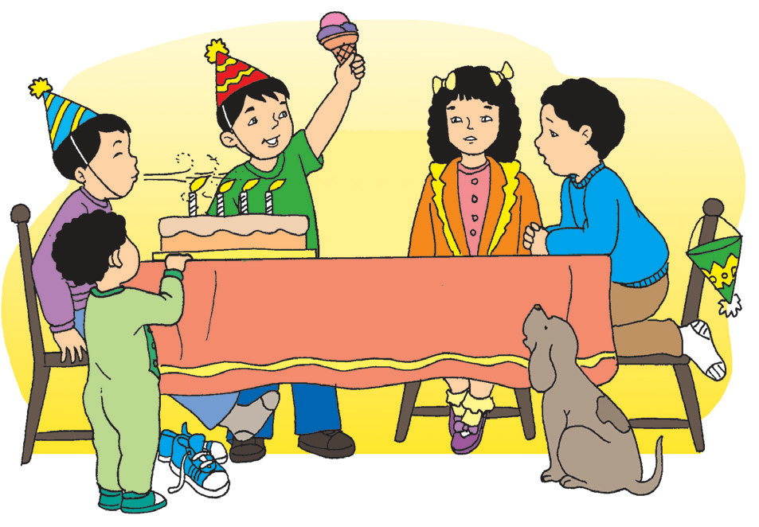
Today is Kit’s birthday.
He is eight years old.
We are holding a surprise birthday party for him. Ten friends are here.
First, they sing “Happy Birthday.”
Then, they eat the cake after Kit blows the candles.
Last, they play games and claim their prizes.
Kit gets a new pair of rubber shoes as a present.
He is going to the park to play basketball in his new shoes.
What a special day it is for Kit!
A Special Day

Slide 4

Whose birthday is it?
How old is he?
What do they prepare for him?
What do Kit and his friends do?
Why will Kit go to the park?

Slide 5

Birthdays are celebrations. When you celebrate, you remember special days or occasions.
How do you celebrate your birthday?

Slide 6

a gift | an invitation
a cake | an ant
a song | an egg
A or An is used with a noun.
A + noun that begins with a consonant
An + noun that begins with a vowel (a, e, i, o, u)

Slide 7
a question – an answer
a friend – an enemy
The boldfaced words have opposite meanings. They are antonyms.
Antonyms are words with opposite meanings.

