Slide 1
Donald, the New Boy in School

Slide 2
Listening
Making predictions means thinking ahead about what would happen next while reading. Sometimes, titles, pictures, events in the story, and even your own experiences help in making good predictions. In making good predictions and knowing the cause and effect, you need to listen and think very well.
It is also important to know the cause and/or effect of the events in a story. Knowing the cause of something helps in understanding why things happen. Knowing the effect of an event means understanding what happens aft er something is done.
A story can be in the first-person narrative because the character is the one telling the story.

Slide 3



Phonological Awareness
A drum’s sound: boom, boom
A guitar’s sound: ting, ting
A violin’s sound: eng, eng

Slide 4
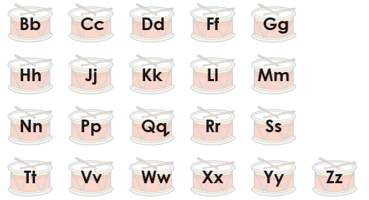
Alphabet Knowledge
Recall the consonants in the English alphabet. Listen to your teacher as he/she says the sound of each letter. Repeat aft er him/her.

Slide 5




Vocabulary
These words name colors and shapes. Name these words using your mother tongue.
Colors:
red blue green yellow orange brown
circle square triangle rectangle

Slide 6
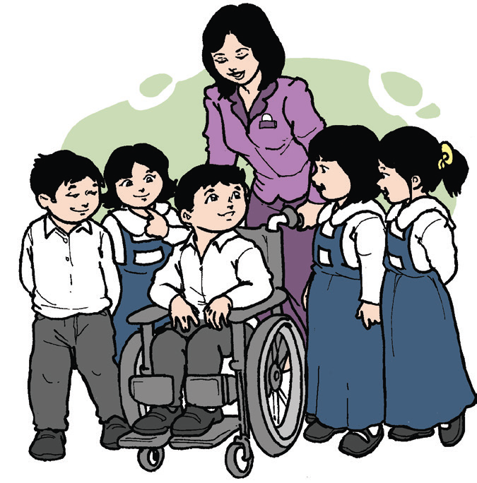
Donald, the New Boy in School
by May Javier
I know a story about a child named Donald, who was scared and unhappy. Soon, he would be in school.
Donald talked to his parents. He asked, “Will the children there laugh at me? Will there also be a child in a wheelchair like me?”
His parents assured him, “We know why you feel worried, but you will be all right.”
Donald felt a little better.
On Monday morning, a small yellow bus took Donald to school. The principal, Mrs. Eusebio, met him by the school gate.
“We hope you like our school, Donald,” she said. She led him down a long hallway into his classroom.

Slide 7
All the boys and girls in the classroom looked at Donald. I smiled at him. “Welcome to our class. We are glad you’re here,” I said.
“These are your classmates. This is Al. This is Charisse. That’s Weng, near the board, and those are Jhen, Thelma, and Tess.”
Everyone was quiet. Then I said, “Donald, I think your classmates would like to ask you some questions. Is that all right?”
Donald nodded, looking down.
What do you think will his classmates ask? Will Donald answer their questions?
Thelma asked the first question. “Why are you in a wheelchair?”
“Because I can’t walk,” Donald answered.

Slide 8
I said, “All right, boys and girls, it’s time to work.”
I helped Donald get started.
Donald stared at all the children, at me, and at the bright pictures on the walls. “Those pictures are attractive,” he said. “I am so happy to be in school.”
Will Donald enjoy school? Why do you think so?
As the days went by, Donald and his classmates got used to each other. Even without being asked, his classmates helped him. He helped me and his classmates, too. Sometimes, he helped the P.E. teacher open the windows with the long window pole.
Donald made friends, too. One of them was Keith. Donald loved to go outside with the other children. For the first time in his life, Donald played outdoor games with Keith, Zach, Abbie, and his other classmates. He couldn’t run like Keith, but he could move his wheelchair fast.
I am so happy for Donald and his classmates. And by the way, I am Donald’s teacher!

Slide 9
Reading Comprehension
A. Chat Room
Your teacher will divide the class into small groups. Then, listen as he/she reads the questions below that your group will answer.
Recall
1. Who is Donald?
2. What did his teacher do to make him feel good?
3. What was Donald able to do in school even if he was in a wheelchair?
B. Ask a Question
Ask a question about the story to your group mates.

Slide 10
C. Cause and Effect
Tell why:
1. Donald was worried about going to school.
2. Donald began to like school.
Tell what happened when:
1. Donald was asked why he was in a wheelchair.
2. Donald and his classmates got used to each other.
D. Identifying the Speaker
Who is telling the story? How were you able to tell before the speaker was revealed in the end?
E. Making Predictions
What predictions did you make when the teacher paused at some parts of the story? How did you make your prediction?

Slide 11
Grammar
Below are some simple sentences taken from the story, Donald, the New Boy in School by May Javier:
1. Donald talked to his parents.
2. Donald felt a little better.
3. Those pictures are attractive.
4. I am so happy for Donald and his classmates.
A simple sentence gives a complete thought. It may be about a person, place, thing, or an event. It ends with a punctuation mark.

