Slide 1
Understanding One’s Culture

Slide 2
Understanding One’s Culture
Yoruba is an ethnic group in West Africa. These people are from South- Western Nigeria and Benin. Yoruba people comprise a system of spiritual concepts and traditional practices. The traditional religion of Yoruba believes that all human beings pass through the ayanmo which means destiny or fate. Africa has a unique culture too. Their traditions are expressed through different art forms such as music, art, dance, sculpture, beadwork, and even literature. African folklore is one of the African community's traditions. This is passed down orally from one generation to the next.

Slide 3
Owner of the Sky: Olorun the Creator
Julius Lester (Yoruba Creation Myth)

Slide 4
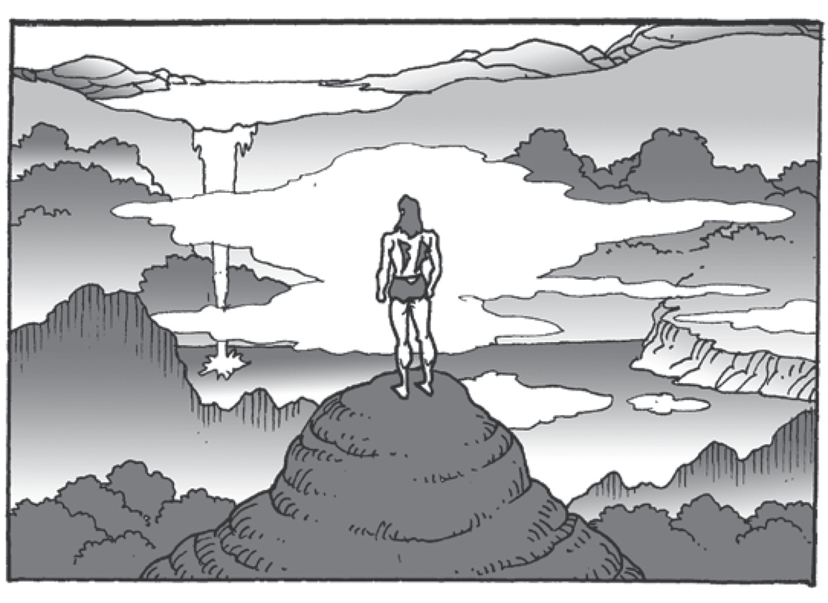
Owner of the Sky: Olorun the Creator
Olorun was the owner of the sky and the Highest Being. He lived in the sky with other spirits. In the beginning, the earth was all watery, just a marshy place, a waste. Sometimes, Olorun and the other Gods would come down and play in the marsh-waste. There were long spider webs hanging from the sky. They draped across sweeping spaces like graceful silk bridges.

Slide 5
Owner of the Sky: Olorun the Creator
Yet, there was no solid land anywhere; no ground on which to stand. There could be no human beings under the sky until there is a hard place where they can plant their feet. Olorun, Owner of the Sky and the Highest Being, called the chief of the divine ones. This chief was the Great God.
Olorun told the Great God, “I want you to make a fi rm ground down below, right away.” “Here,” Olorun went on, “Take this.” He gave Great God a shell. There was a small amount of earth in the shell and there was also a pigeon and a hen with fi ve toes inside.
Great God did as he was told. He went down to the marsh land sliding down the spider silks. Then, he threw the earth out of the shell and spread it about him. He put the pigeon and the hen down on the big chunk of earth from the shell. The pigeon and the hen began scratching the earth with their feet. It didn’t take long for them to scratch the soil over the whole marsh-waste. That was how the fi rm, hard ground came to be.

Slide 6
Owner of the Sky: Olorun the Creator
Great God went back to the sky. There he found Olorun waiting. “It is done. I’ve formed the ground, and it is solid and true,” Great God said. Olorun sent down Chameleon to take a look at the works of the Great God. Now, Chameleon took his time about most things. He walked slowly, and he went down the spider line from the sky carefully. He rolled his big eyes around, looking at everything. And slowly, he changed his color from sky blue to earth brown as he walked on the land Great God had made.
“Well, the earth is plenty wide,” Chameleon told Olorun when he had returned, “but it’s not quite dry enough.”
“Go again,” Olorun commanded. And Chameleon went down from the sky the second time. He came back to report to the Owner of the Sky once more.
“It is well,” Chameleon said. “The earth is wide, and it is dry this time.”
“Good,” Olorun said. He named the place Ife, and it meant wide. Ile was brought to stand on Ife, and Ile meant house. All other houses came from the first one that stood at Ife. And to this day, the city of Ile-ife is the most sacred to Olorun’s people.

Slide 7
Owner of the Sky: Olorun the Creator
It took four days to make the earth. On the fifth day, Great God was to be worshipped as the maker. Then, Olorun sent the Great God back to Ife to plant trees to feed humans when they came and to give them goods. He planted palm trees. The humans would drink their juice. More trees were planted there, and the rain was made to fall and water them.
The first people came from heaven. Olorun sent them down to the earth to live there.
Great God made some of the people’s parts out of the soil. He molded their bodies and heads. The task of bringing these still figures to life was left to Olorun, Owner of the Sky, the creator. The Great God was jealous of Olorun’s work. He wanted to give life to the earth figures he had made.

Slide 8
Owner of the Sky: Olorun the Creator
“I will watch Olorun so I can see how he does it,” thought the Great God. So he stayed
with the figures and hid amongst them, so that he might see the work of Olorun firsthand. But Olorun knew everything. He knew if somebody was watching. He saw Great God from where he hid himself. And he put Great God into a very deep sleep. Great God slept and slept. When he woke up again, all the people had come to life. He never saw it happen. So it is that Great God still only makes the bodies and heads of humans, both men and women. He leaves his marks on them though. And sometimes, the marks show how unhappy Great God is.
Source: World Tapestries: An Anthology of Global Literature. Globe Fearson. 1997.

Slide 9
Understanding One’s Culture
Idiomatic Expressions
- a type of informal language that cannot be taken literally. It can be a word, phrase, or sentence.
Example:
The Great God threw the earth out of the shell and spread it about him.
Context clues
- are words, sentences, and ideas that serve as a hint or clue. It comes before or after a word or phrase that you need to determine. We use context clues as a strategy to understand the meaning of unfamiliar words or phrases.
Example:
My abdomen just got hit by a car, and I am in a lot of pain down below.
context clue
idiom

Slide 10
Understanding One’s Culture
The Tone and Mood of the Story
The mood is the atmosphere of the story while the tone is the author’s attitude toward the subject of a story and it can often be expressed using a single word—informal, friendly, intimate, playful, solemn, or serious.. Identifying these two elements will help you find the meaning of the passage that you are reading.
How can we identify the tone and mood in a text?
• To know the mood, you have to analyze the setting of the story.
• To understand the tone, you have to analyze the characters and the details of the
language like the writer’s choice of words.

Slide 11
Understanding One’s Culture
Activity:
Answer the following questions and explain the behavior of the character from the myth.
1.Why is the Great God obedient to Olorun?
2. What did the Great God do for the people of Olorun?
3. Why did the Great God try to sneak behind Olorun?
4. Why did the Great God become jealous of Olorun?
5. Why is the Great God unhappy?

