Slide 1
An Exciting Day in School

Slide 2
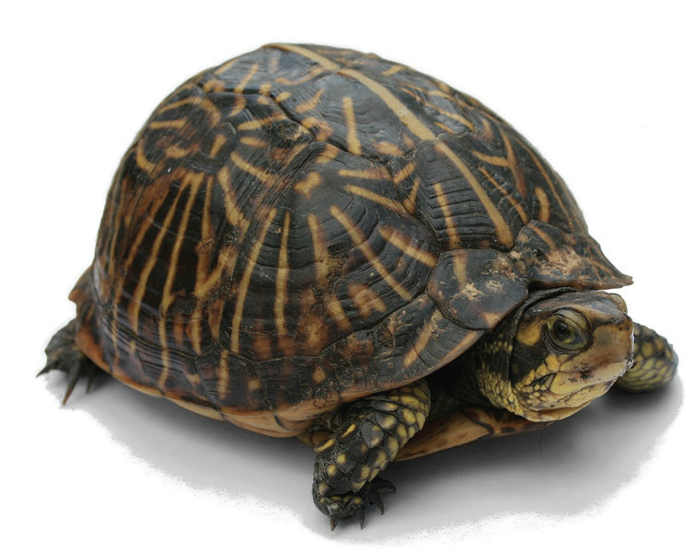
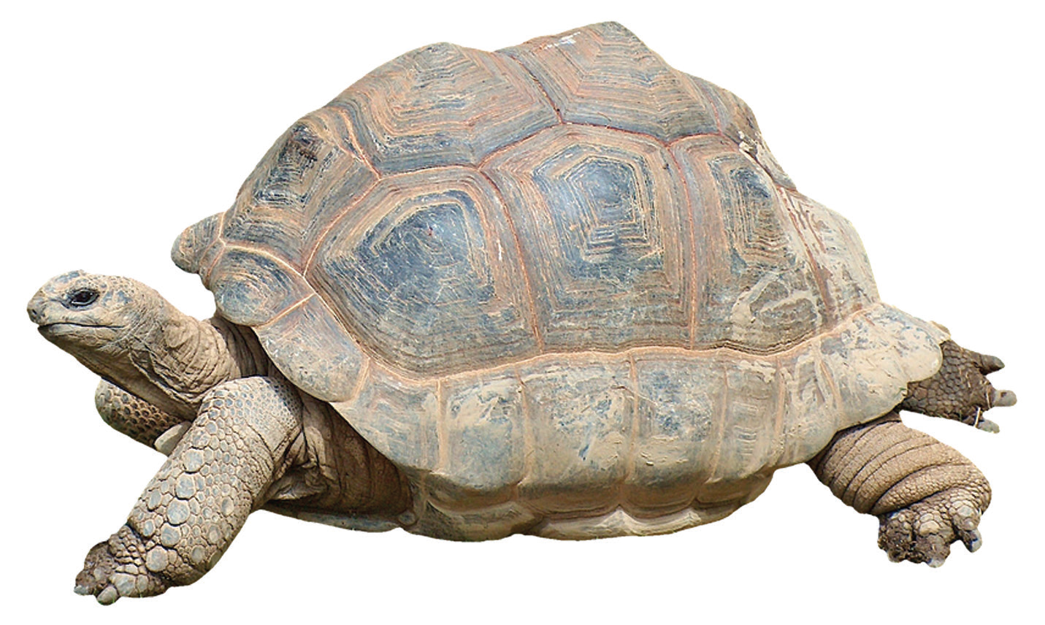
Listening
What do you know about turtles and tortoises?
Turtle
Tortoise

Slide 3
Phonological Awareness
Let’s play!
Cc Dd Ff Gg Hh Jj Kk Ll Mm Nn
Pp Qq Rr Ss Tt Vv Ww Xx Yy Zz
First, the teacher will recall the consonant sounds with you.
At a signal, your class will say “buzz, buzz” 10 times. As you say buzz, your teacher will say a consonant sound and call out one of your classmates. This classmate who was called out should stand and repeat the consonant sound that the teacher said.
At a signal, your class will say “shh, shh” 10 times. As you say this, the pupil who was called earlier will say another consonant sound and call out another classmate. This classmate who was called out should stand immediately and repeat the sound.
The game will continue until the teacher decides to stop.

Slide 4
Vocabulary
Compare these words with their equivalent in the language or dialect that you speak at home. Compare the spelling and pronunciation of the words in the different languages.
fair screamed pocket roller coaster
laughing hungry stuffed animal

Slide 5
An Exciting Day in School
by Dannie Reyes
May and Francis had Php300.00 each to spend at the school fair. As they walked to the fair, May thought that she had lost her money. She checked her pockets, then she and Francis started looking amongst the grass. May checked the pocket on her dress again and finally, she found her money. When May and Francis got to the fair, they looked at all the rides and games. They went on the bump car. They were quiet while they waited. They screamed as they were riding the bumper. When the ride was over, they got off laughing.
Francis got hungry. He wanted to look for a place to eat. But May said, “Let’s just buy ice cream in cones.”

Slide 6

As they licked their ice cream, they played a few games. May won a nice stuffed toy animal as the prize, but Francis did not win anything.
After three hours at the fair, May and Francis got tired. They sat for a while. As they walked home, they talked about their exciting day at the school fair.

Slide 7
Oral Language/Attitude
A dialogue is a conversation between two or more persons.
A mock interview is a make-believe interview. The interviewer is the one who asks questions and the interviewee is the person who answers the questions.
Topics where dialogue or a mock interview may be presented:
Sports I Like
Toys I Love
My Family
My Favorite Dessert

Slide 8
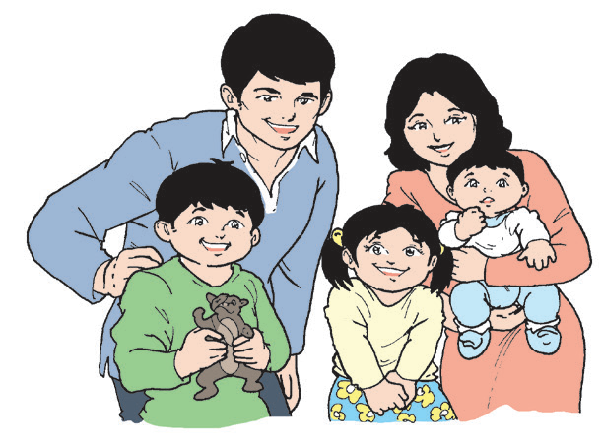
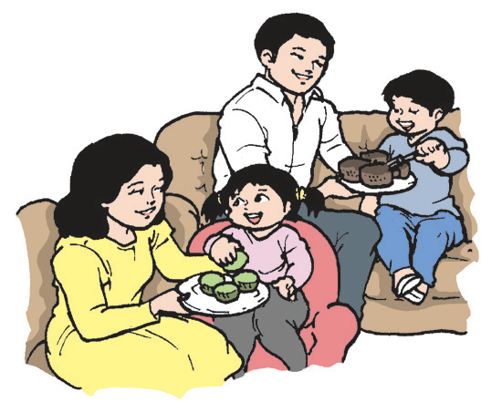
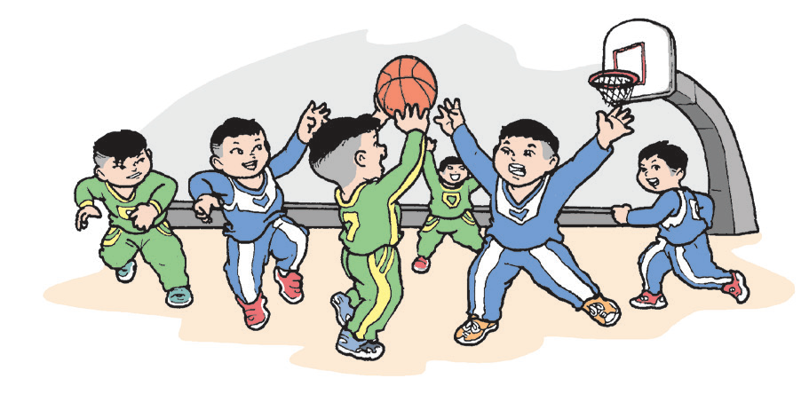
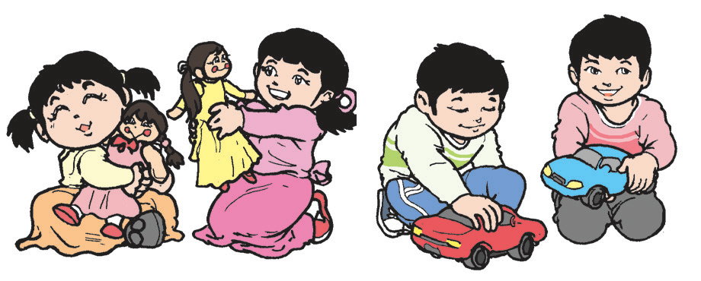
My Family
My Favorite Dessert
Sports I Like
Toys I Love

Slide 9
Grammar
Recall the two kinds of sentences.
Declarative Sentences:
1. They rode on a bumper car.
2. They were quiet while they waited.
3. Francis did not win anything.
Interrogative Sentences:
1. Did May and Francis enjoy the fair?
2. Where did May find her money?
3. What did they do at the fair?

Slide 10
Review
A telling or declarative sentence tells or explains something. It starts with a capital letter and ends with a period (.).
An asking or interrogative sentence asks a question. It starts with a capital letter and ends with a question mark (?).
Most questions start with who, where, when, why, how, and which. Asking sentences that are answerable by yes or no start with is, are, was, were, does, do, did, can, should, must, shall, may, would, could, and others.

