Slide 1
A Healthy Breakfast

Slide 2
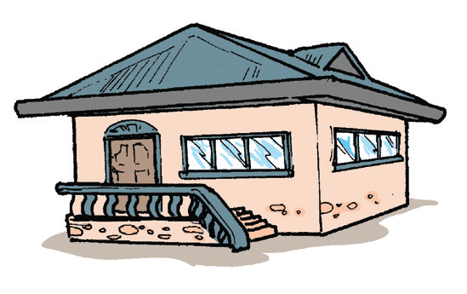
Home is where you live with other members of the family. It is a place where you feel comfortable and loved. There are many activities that families do together. Families eat, play games, travel, and laugh together.

Slide 3
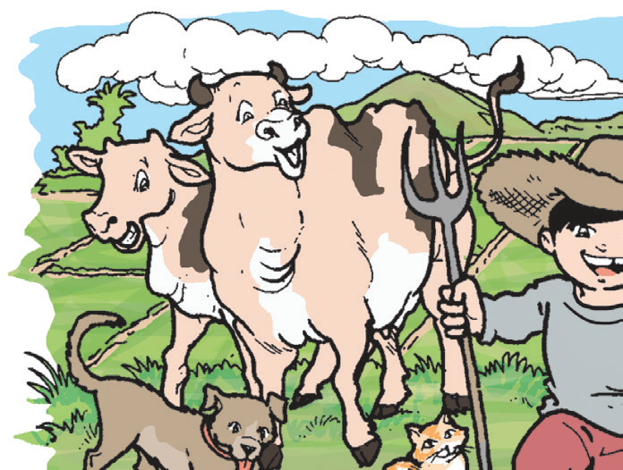
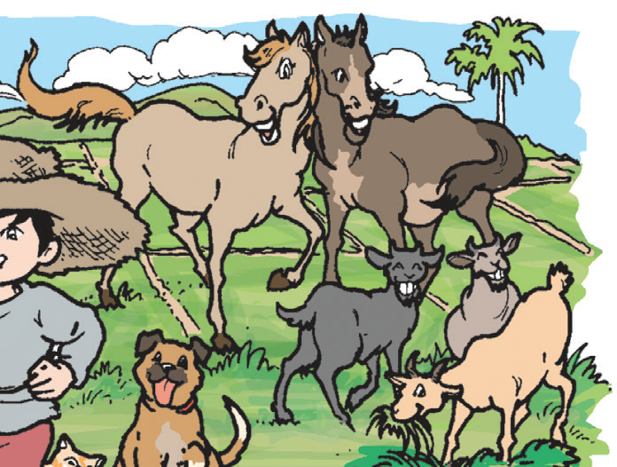
Listen as your teacher reads aloud a story. sounds that you will hear in the story. Take note of the characters, events, and setting.
Characters – the people, animals, or objects in the story. Who are the characters in the story you listened to? What can you say about Joel, his family, and his grandparents?

Slide 4
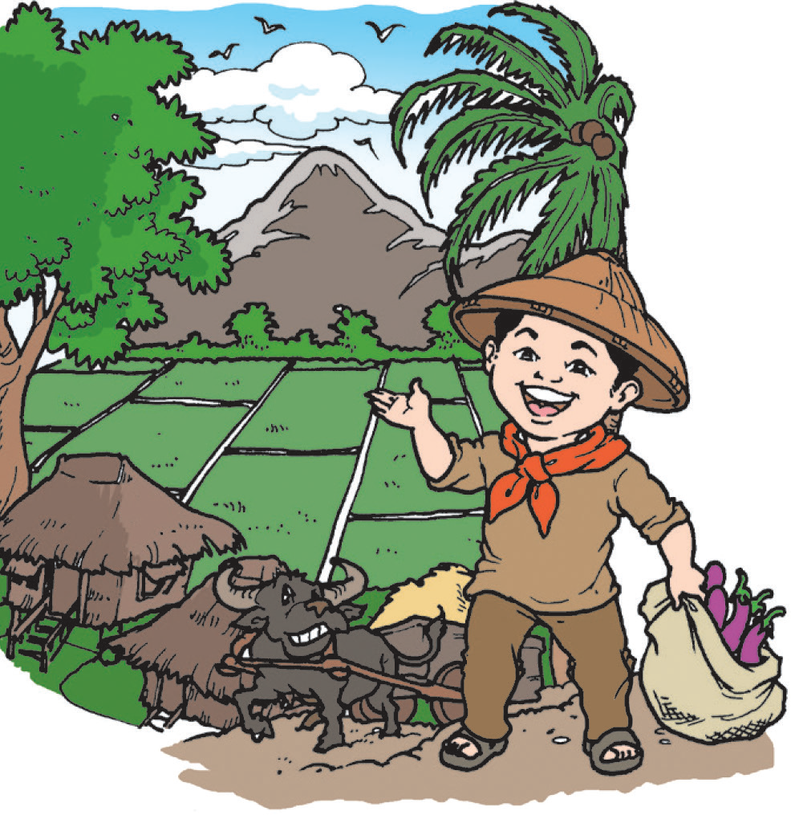
Setting – tells where and when the story happened. Where did the story happen? Describe the setting of the story you have just heard. What details in the story helped you know the setting of
the story?

Slide 5
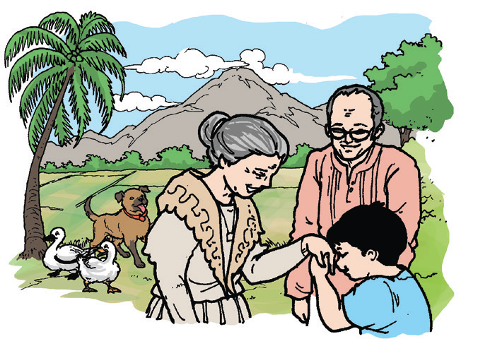
Events – tell what happened in the story. What happened at the beginning of the story? What happened next? What happened last?

Slide 6



Phonological Awareness
Listen to a recording of animal sounds. With a partner, imitate the animal sounds.
Frogs croak.
Cats meow.
Horses neigh.

Slide 7
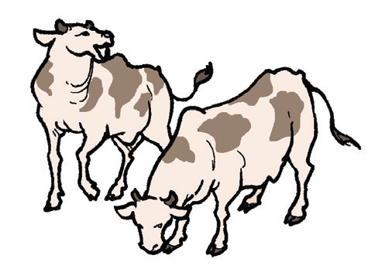
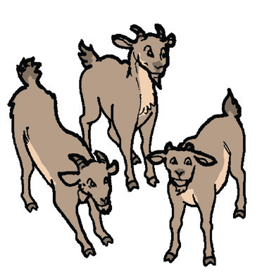
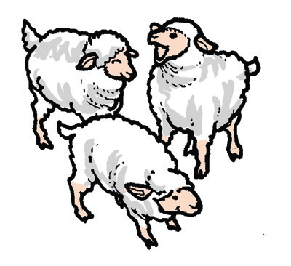
Cows moo.
Goats bleat.
Sheep baa.

Slide 8
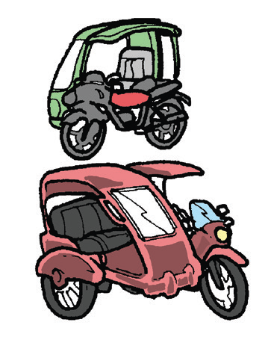
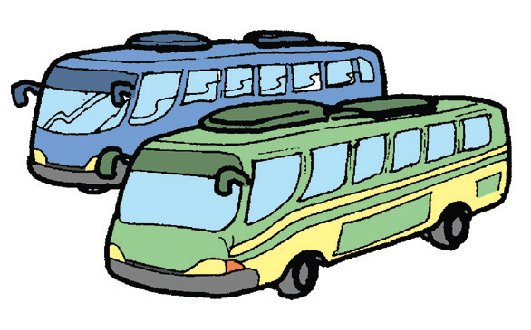
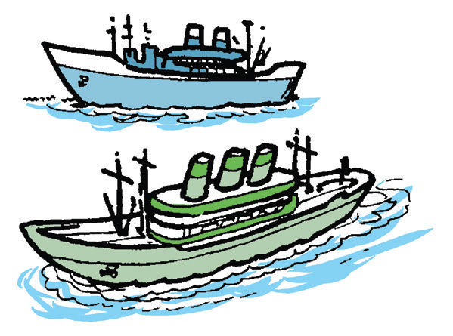
Other sources of the sounds you heard.
tricycles – vroom
buses – vroom
horn from ships – honk

Slide 9

Book and Print Knowledge
Along the way, Joel saw a lot of road signs. Can you read them?

Slide 10
Alphabet Knowledge
Listen and repeat after your teacher. Say the sound of each letter correctly.
Aa Bb Cc Dd Ee Ff Gg Hh Ii Jj Kk Ll Mm Nn Oo Pp Qq Rr Ss Tt Uu Vv Ww Xx Yy Zz

Slide 11
Vocabulary
Use your mother tongue to give the meaning of the following words. Use them correctly in sentences.
born live age hobbies
mother father sister brother
family home healthy breakfast

Slide 12
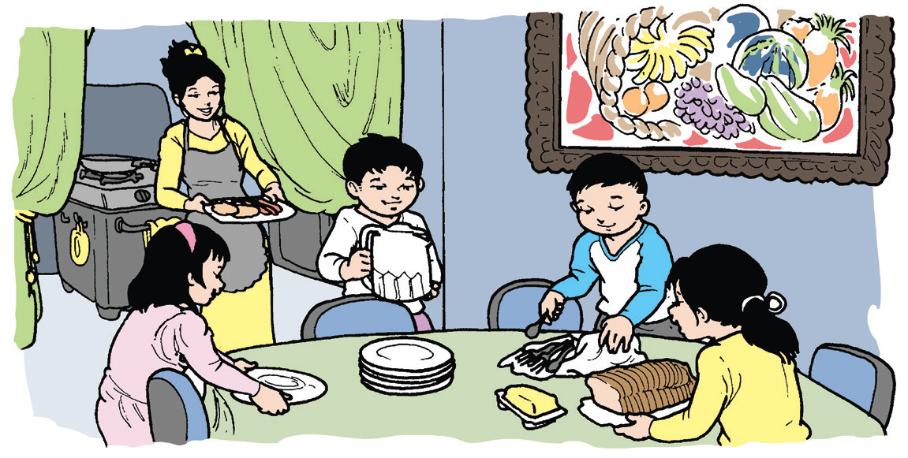
A Healthy Breakfast
by Kyla Zarza
Mom has just cooked breakfast. As it was a Saturday
morning, there was no school. However, Des, Joel,
Lexie, and Aiden woke up early to help Mom.
“Good morning, Mom!” they chorused.
“Good morning. I need help,” said Mom.
“May I help?” asked Des.
“Yes, Des. Please put the plates on the table.”

Slide 13
A Healthy Breakfast
by Kyla Zarza
“May I help?” asked Joel.
“Yes, Joel. Please fill the pitcher with water.”
“May I help?” asked Aiden.
“Yes, Aiden. You may put these spoons and forks on the table.”
“May I help?” asked Lexie.
“Yes, Lexie. You may put the bread and butter on the table.”

Slide 14
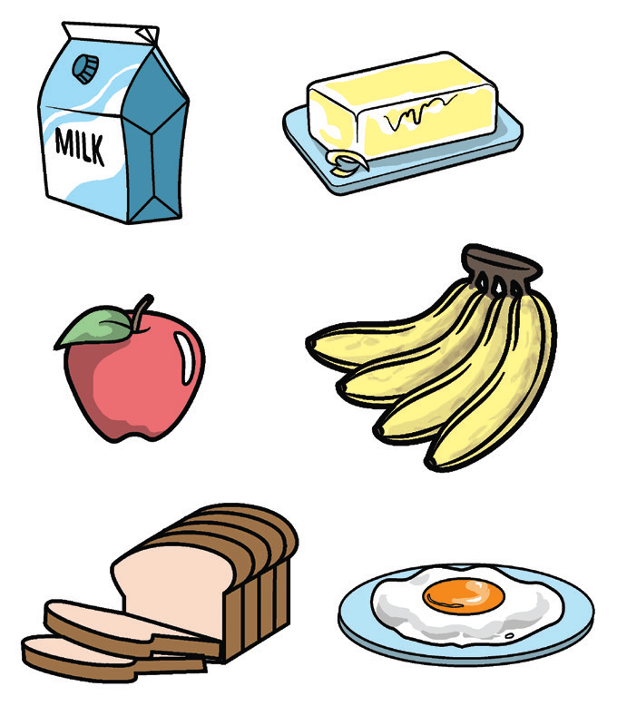
“Aiden and Lexie, please get the jam and the plate of eggs.”
Mom put glasses of milk for the children. Des placed the fruits on the table. Mom
finished her work fast. Her children helped her.
“Thank you very much, children. You have been helpful.”
“You are welcome, Mom!” The children chorused.
They sat at the table. Dad joined them.
“Wow, this is another healthy breakfast!” Dad exclaimed.
Mom replied, “Of course, we all need to be healthy.”

Slide 15
Dad had to leave.
“I need to go to the office. Goodbye, kids!”
Goodbye, Mom!”
“Goodbye, Dad.”
“I need help, kids,” Mom said.
“Can we wash the dishes?” the children asked.
“Oh, sure! That’s the help I need.”
They all laughed.

Slide 16


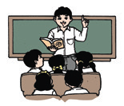
Choose a Task
You and your group mates will choose a task that you will do together from any of the following:
Awesome
Artists
(Show-and-Tell)
Draw a healthy breakfast. Show it to your classmates and talk about it.
Super Singers
Create a song that will
summarize the story.
Wonderful
Reporters
Give a creative report about what makes a healthy
breakfast.

Slide 17
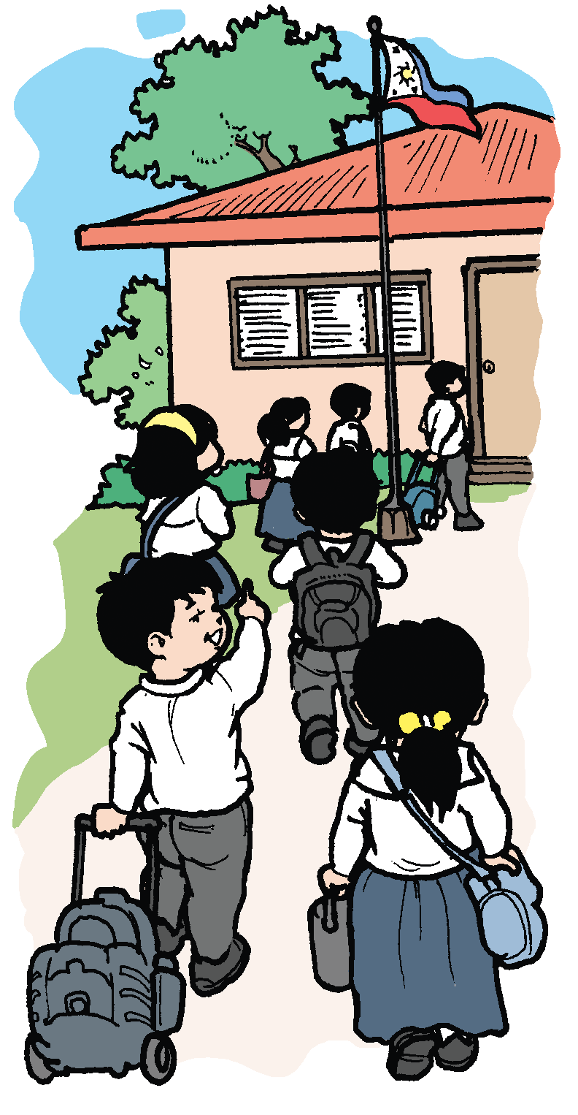
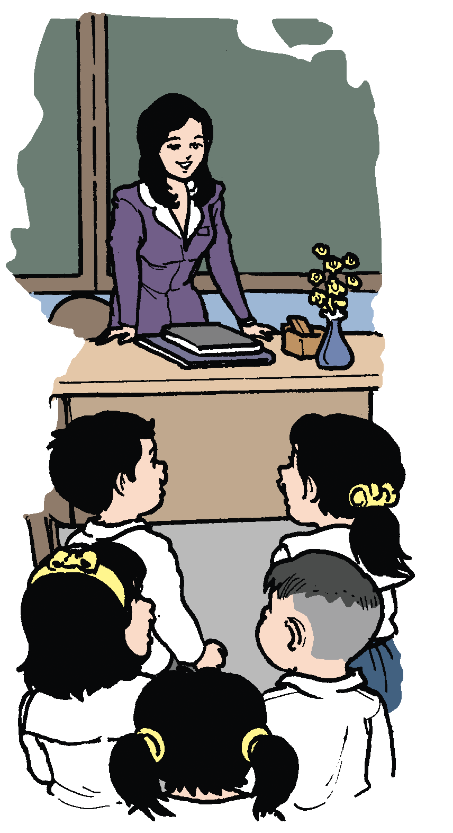
In school, you make several friends. It is good to talk to your friends about yourself. It is also good to listen to them when they talk about themselves.

Slide 18
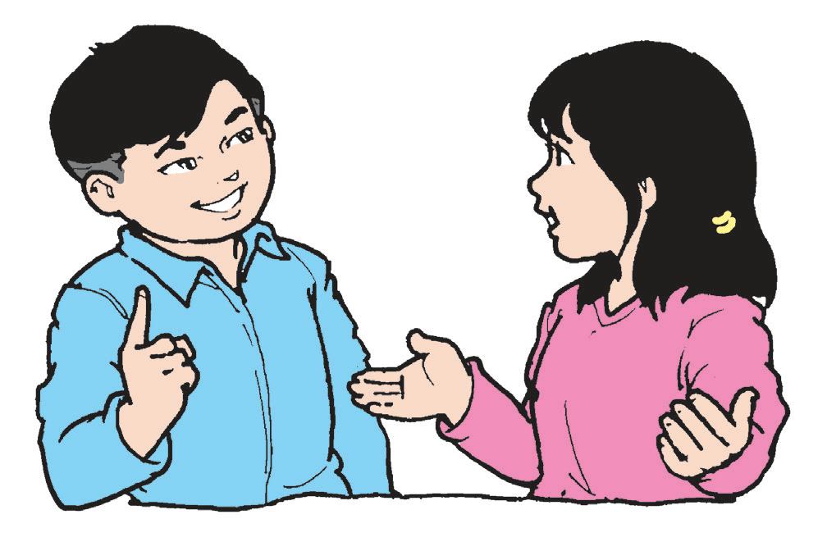
Oral Language
Your teacher will assign you a partner. Have a dialogue with your partner. Talk about yourself and your family. Be guided by the following questions:
1. What is your name?
2. How do you want to be called?
3. Who are your parents?
4. What do you like about them?
5. Do you have a sister or a brother?
6. What can you say about them?

Slide 19
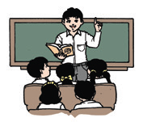
Grammar
Read the following groups of words. Some of them are sentences and some are not. Which of them are sentences? Which ones are not? Explain your answers.
Example: They all laughed. (It is a sentence.)
1. I need help.
2. had to leave
3. They sat at the table.
4. bread and butt er
5. We all need to be healthy.
6. have been helpful

Slide 20



A sentence is a group of words that expresses a complete thought.
A group of words that has an incomplete thought is a fragment. It is a
non-sentence.

Slide 21

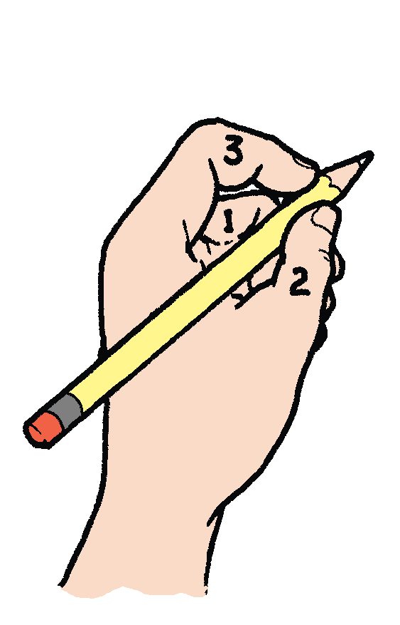
Writing
Practice holding the pencil properly.
Tripod Grip
1 – Tall Finger (side)
2 – Thumb (pad)
3 – Pointing Finger (tip)
All fingers are slightly bent.

Slide 22


Don’t do this!
Pressure
on the
pointing
finger.
All fingers
pulled into
a fist.

