Slide 1
My Special Kind of Friend

Slide 2
Listening
The problem in a story is the part where the main characters do not agree with one another. The problem can also be about the difficulties of the main character.
The solution of the problem in a story is usually found at the end. It tells how the problem was solved.

Slide 3
Alphabet Knowledge
Recall the consonants in the English alphabet. Give the missing consonants to fill out the empty spaces.
Aa | Bb |  | Dd | Ee
Ff |  | Hh | Ii
 | Ll |  | Nn | Oo
Pp |  | Rr |  | Tt
Uu | Vv |  | Xx
Zz

Slide 4
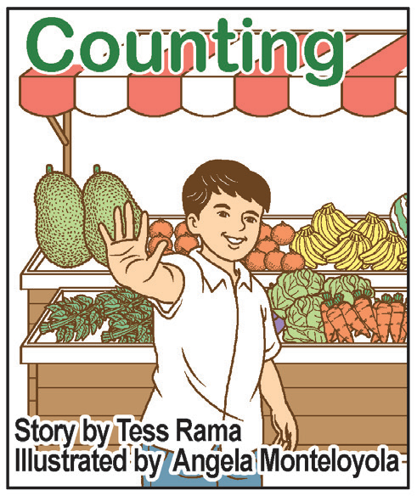
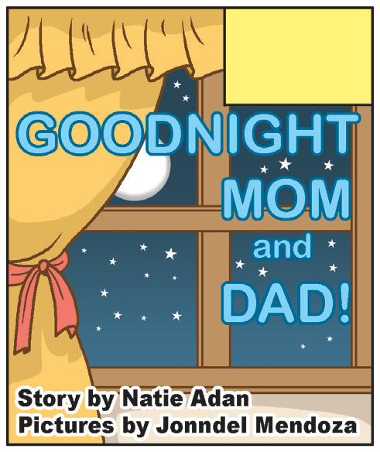
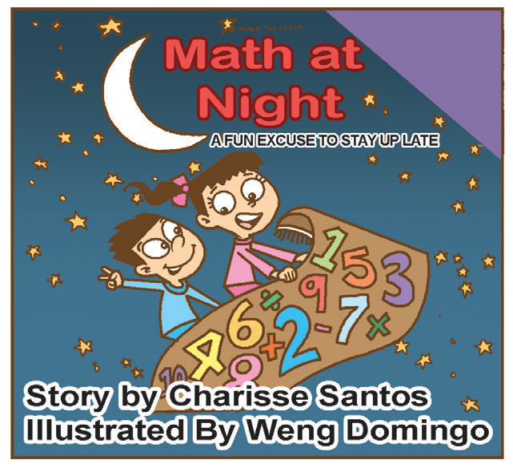
Book and Print Knowledge
Books are fun to read. People who write books are called authors. Those who draw pictures to make the book more interesting are called illustrators.
Look carefully at the books below. Tell the title of the book, the name of the author, and the illustrator.

Slide 5
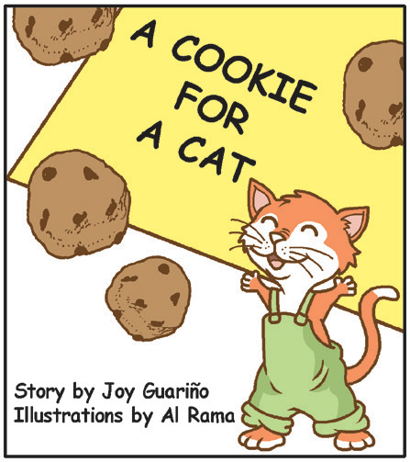
This is a storybook. This is the front cover of a book.
What do you see on the front cover of a book?
The title of the book is found on the front cover. The names of the author and the illustrator are also found on the front cover.

Slide 6
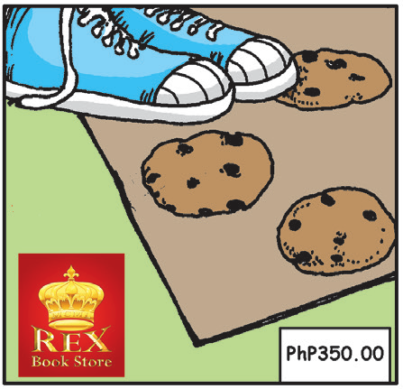
This is the back cover.
What do you see on the back cover of the book?
The back cover usually has the pictures, the name of the publisher, and sometimes, the price of the book.

Slide 7
Vocabulary:
Read these number words and give their equivalent words in your mother tongue.
1 – one 2 – two 3 – three 4 – four 5 – five
6 – six 7 – seven 8 – eight 9 – nine 10 – ten
11 – eleven 12 – twelve 13 – thirteen 14 – fourteen 15 – fifteen
16 – sixteen 17 – seventeen 18 – eighteen 19 – nineteen 20 – twenty
30 – thirty 40 – forty 50 – fifty 60 – sixty
70 – seventy 80 – eighty 90 – ninety 100 – one hundred

Slide 8
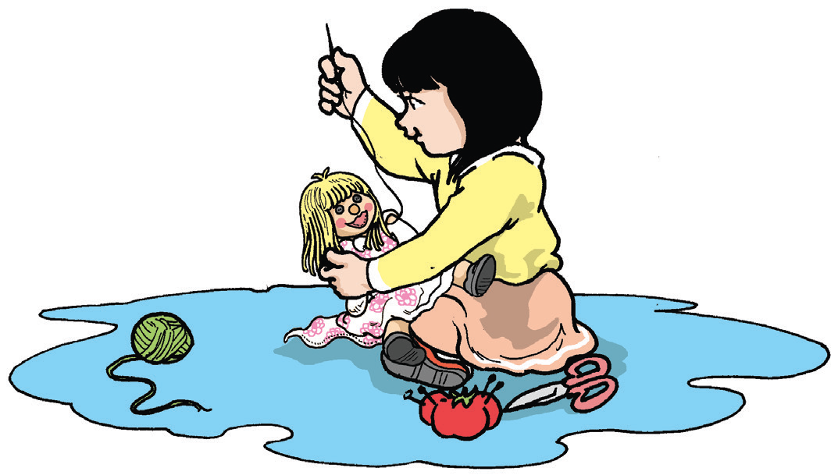
My Special Kind of Friend
by Thelma Torres
I have just moved to a new school where I had no friends. Here, groups of kids played together. They ran and laughed together. I was too shy to play with them. I felt so sad. Mom and Dad told me to make friends at school.
So, I did. I found myself a friend—a doll. My friend’s name is Winkie, my special kind of friend.
How did I make Winkie my doll friend? I gathered clothing materials. I used yellow yarn for her hair and buttons for her eyes. I cut from a red cloth to form her smiling lips. Her dress was
printed with small colorful flowers. Her body has soft
cotton inside.

Slide 9
My doll friend, Winkie, was my special and only friend at school. We played a lot. I could jog and jump with her. I could hop with her. I sat on my desk, and she watched me.
What a nice and unique friend Winkie was! The kids gathered to see my friend. Some walked over to see her. Some touched her soft body. They all liked her a lot!
They asked, “Who is your friend?”
I said, “I want you to meet Winkie, my doll and my special friend.”
They said, “It’s nice to meet you, Winkie.”
They asked, “How did you make a doll friend?”
I told them how I made the doll.
One kid said, “Come and play with us!”
Then, all the kids said, “Yes, play with us!”
So, I played with them. I am no longer sad. I have friends
at school now. Winkie watched us as we played.

Slide 10
Reading Comprehension
A. Chat Room
Your teacher will divide the class into small groups. Then, listen as he/ she reads the questions below that your group will answer.
Recall
1. Where and when did the story happen?
2. How did the girl make the doll?
3. How did she make the doll her friend?
Think Well
1. Why didn’t the girl play with the other kids in school?
2. Why did the other kids ask her to play with them later?
3. What do you like about the girl telling the story?
4. What is the problem in the story?
5. In the end, how was the problem solved?
6. Have you experienced having no friend? How did you feel? What did you do?

Slide 11
B. Ask a Question
Think of a question about the story that you can ask your seatmate.

Slide 12
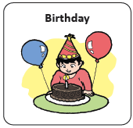

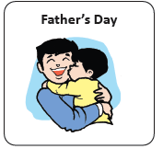



Oral Language
An event is an important thing that happens to you. There are family events or school events that you remember well.

Slide 13
Grammar
A telling or declarative sentence tells or explains something. It starts with a capital letter and ends with a period (.).
Examples:
1. Rommel grabbed his bag and ran to the gate.
2. Every Saturday morning, Keith and his father get up early.
An asking or interrogative sentence asks a question. It starts with a capital letter and ends with a question mark (?). Most questions start with who, where, when, why, how, and which.
Example:
What do you think of Rommel?

Slide 14
Asking sentences that are answerable by yes or no start with is, are, was, were, does, do, did, can, should, must, shall, may, would, could, and others.
Example:
Is Winkie a special kind of friend?

