Slide 1
One Morning in School

Slide 2

Book and Print Knowledge
Make sure you use proper eye movements (left to right, top to bottom, and return sweep) when you read the sets of words.
The following words have the same beginning letter sounds:
pin pet pat pen pan
bad bet bit bin build
wolf way wait word want

Slide 3
Phonological Awareness
These words have the same ending letter sounds:
big dig log tag mug
bad bed wed nod lid
cat mat dot pet pat

Slide 4
Alphabet Knowledge
Recall the English alphabet. Say the sound of each letter correctly.
Aa Bb Cc Dd Ee Ff Gg Hh Ii
Jj Kk Ll Mm Nn Oo Pp Qq Rr
Ss Tt Uu Vv Ww Xx Yy Zz

Slide 5
Vocabulary
A. Your teacher will explain the given words in both your mother tongue and in English.
born parents hobbies family
school teacher classmates principal
mall park playground garden
B. Explain what the given words mean using your mother tongue.
weekend courteous welcome

Slide 6
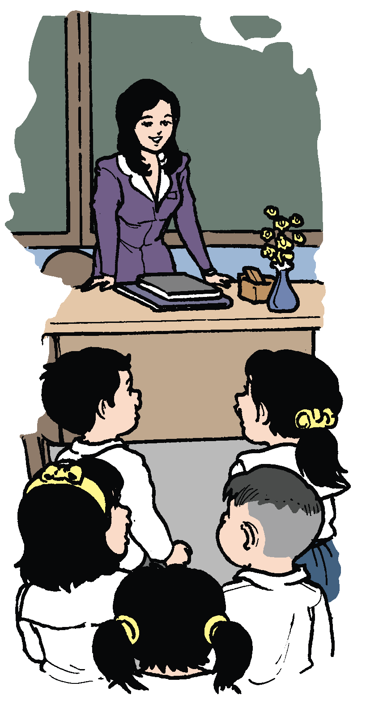
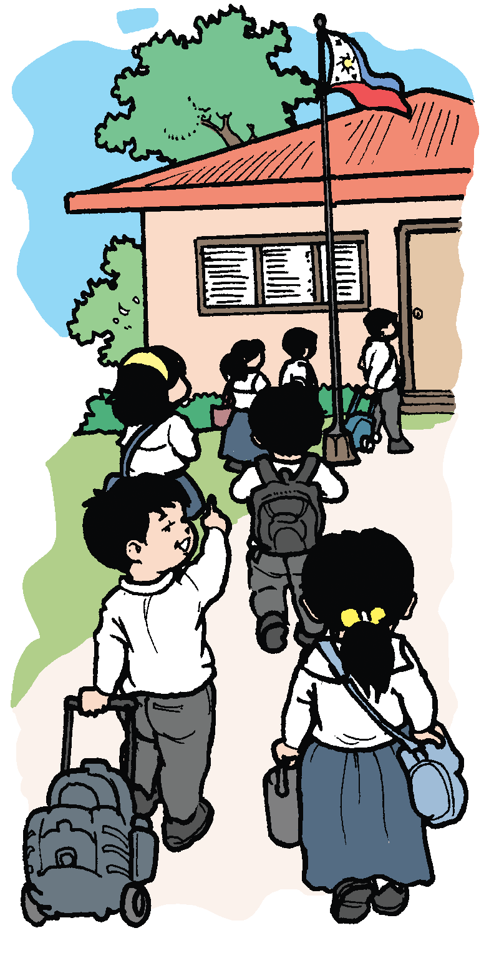
One Morning in School
by Kyla Desiree
Weekend is over.
In school, we’ll be there!
We’re back in class.
The teacher awaits us!
“Good morning, Teacher!”
“Good morning, Children!”
Courteous words, we say.
We are polite all day.
“May I go out, Teacher?”
She says, “You may.”
“Oh, thank you,” I say.
“You’re welcome, Kay.”

Slide 7
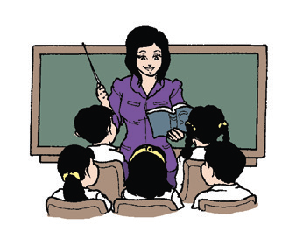
Oral Language
Polite Expressions
Below are some polite expressions which can be found in the poem:
1. Good morning, Teacher!
2. May I go out, Teacher?
3. Thank you.
4. You’re welcome.

Slide 8
We say, “Good morning,” “Good afternoon,” and “Good evening” when greeting somebody. The other person may also say the same.
We ask, “How are you?” or “How do you do?” to the person who is introduced to us.
The answer for “How do you do?” is “I’m fine, thank you, and you?” The other person may also ask back “How do you do, too?”
When someone thanks us for the help we gave, we answer “You’re welcome” or “Don’t mention it.”
We say, “Goodbye,” “So long,” and “See you later” when we are about to leave.

Slide 9
Dynamic Duo
Write a conversation with your partner using the polite expressions below. Present your dialogue in front of the class.
Good ____________ (morning, afternoon, evening)!
How are you?
How do you do?
May I know where the __________________is?
Kindly tell me how to go to the __________________.
Please show me the way to __________________.

Slide 10
Grammar
Nouns – names of people, places, things, and events.
Examples:
Names of Persons – mother, teacher, police officer, father (or dad), brother, Eden, baby, nurse, cousin, and family
Names of Places – house, school, park, mall, Bohol, Philippines, Japan, and California
Names of Things – books, paper, bag, plants, animals, and fruits
Names of Events – birthday, New Year’s Day, and Labor Day anniversary

Slide 11
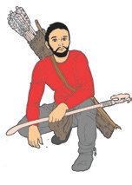






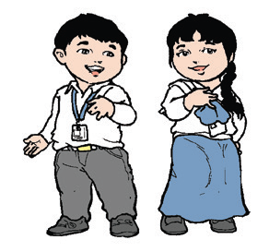
Examples:
ant
dove
hunter
leaf
arrow
school
teacher
children
class

Slide 12
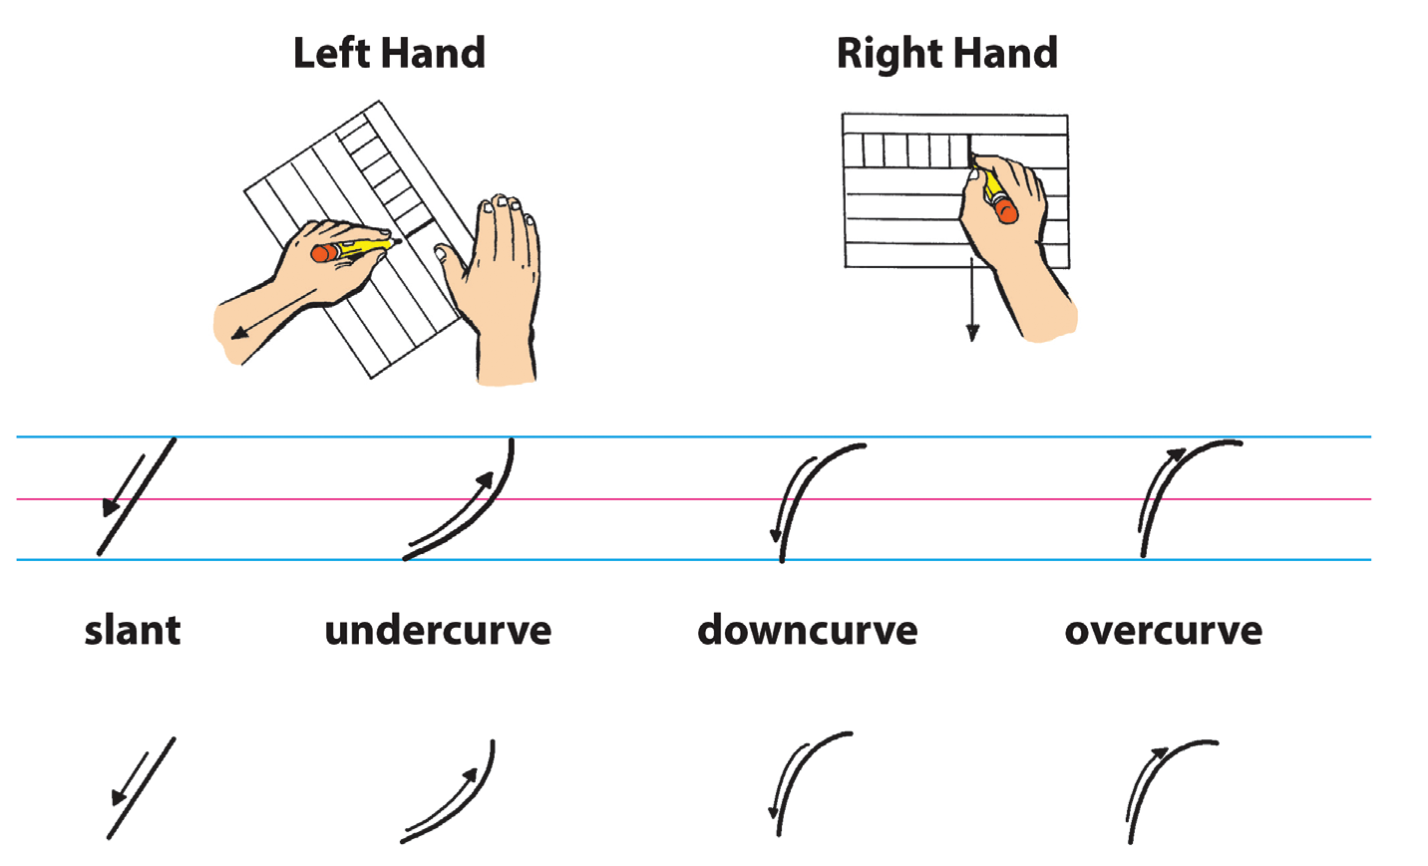
Writing
Look at the illustrations carefully. They show how you should position the paper and your hand when writing.

