Slide 1
The Best Place

Slide 2
Phonological Awareness
Here are some words that are found in the story you heard. They are rhyming words. What can you say about rhyming words?
• play, day
• cheer, dear
• happily, friendly, family
Words rhyme when they have the same ending sound. Sing and cling rhyme because both of them end with the -ing sound.

Slide 3
A. Here are more words found in the story. Do they rhyme?
smart good fun fast new
B. Can you pair the words above with some words below that rhyme with them?
wood fund run last
few put crash art

Slide 4
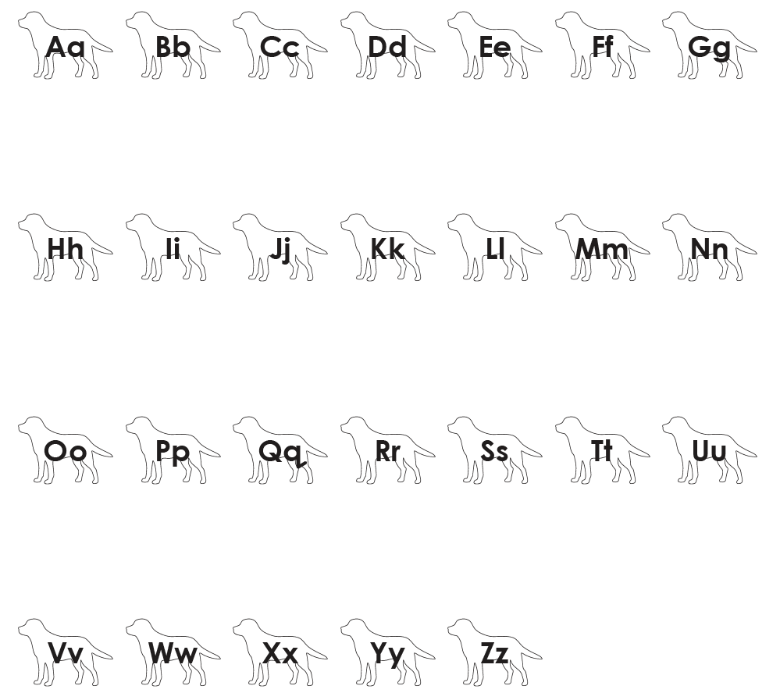
Alphabet Knowledge
Recall the letters in the English alphabet. Listen and repeat the sounds of the letters after your teacher.

Slide 5
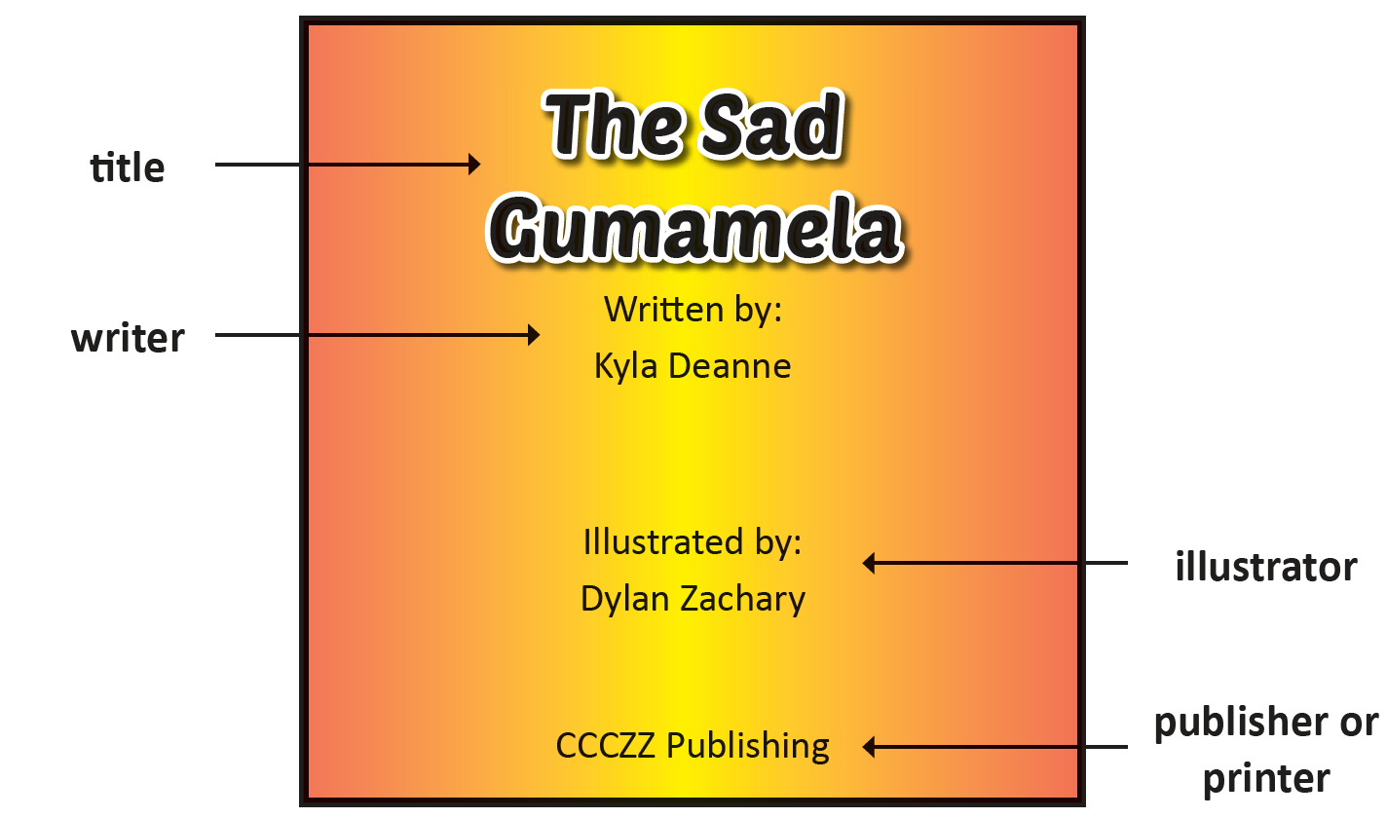
Book and Print Knowledge
The Parts of a Book
Recall the things that are found on the cover page of a book. Here you can find the title, the writer, and the illustrator’s names. When you open a book, you see the title page. Here is a sample title page:

Slide 6
Vocabulary
Recall words that you may use when you talk about colors, shapes, and numbers. Use them in sentences.
red | blue | green | yellow | orange
circle | square | rectangle | triangle | oblong
four | fourteen | forty | sixteen | sixty
eight | eighteen | eighty | nineteen | ninety
The English language differs from other languages and dialects in the Philippines. In the English language, the vowels a, e, i, o, and u have either the short or long sounds. The vowels in Filipino only have the short sound. The consonant sounds th, sh, ch, and z can be found in the English language. Tagalog does not have them. Tagalog consonants have only one sound each.

Slide 7
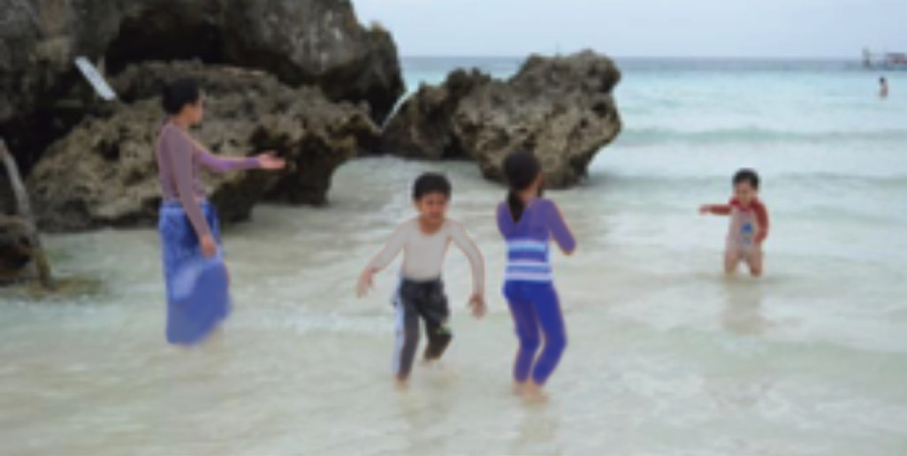
The Best Place
by Zachary Aiden
When my cousins Kyla and Dylan came to the Philippines, we brought them to some interesting places. We went to a farm zoo in Tagaytay and showed them Taal Lake. We strolled and shopped a little in the different malls in Metro Manila. We also visited Intramuros and Rizal Park.
Then, we stayed in a hotel in Manila that has aquariums. But the best place we visited was Boracay.
In Boracay, we enjoyed watching the waves, building sand castles, and playing with Dad and Uncle Carl at the beach. We also went boating. We wanted to go snorkeling but our parents did not allow us.
One evening, our grandma thought we should try
having dinner at the market. She bought seafood and had
them cooked. It was the first time for my cousins to eat at
the wet market. The food was yummy.

Slide 8
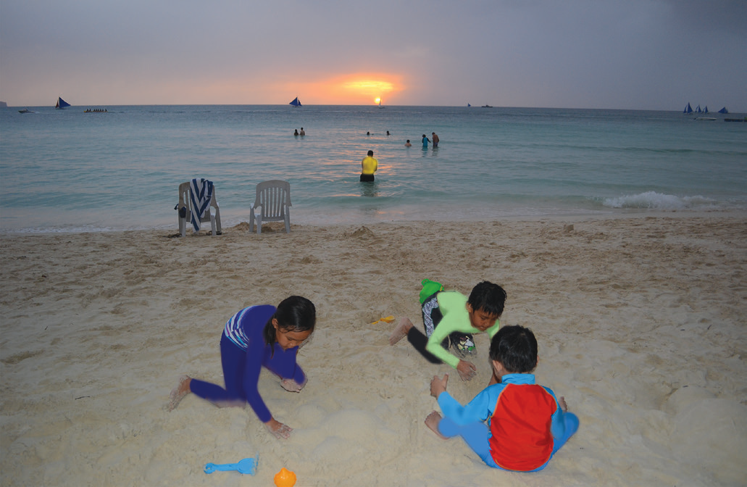
In the morning, we had a delicious breakfast. We also prepared three small cakes for Dad because it was his birthday. Then, we ran to the beach, swam, and gathered small seashells. We also wanted to collect sand but that was not allowed in Boracay.
We asked Mom, “May we collect sand?”
Mom said, “I am sorry, collecting sand is not allowed here.”
We answered, “That’s okay.”
We spent four days of fun and laughter in Boracay. We flew
back home ti red but happy. Then, it was ti me for my cousins to go
back to California. I felt so sad; I cried.
I begged, “Please do not leave yet.”
My cousin said, “I am sorry, we cannot stay any longer. Anyway,
we can see each other using video call.”
And that’s how we talk with each other now.

Slide 9
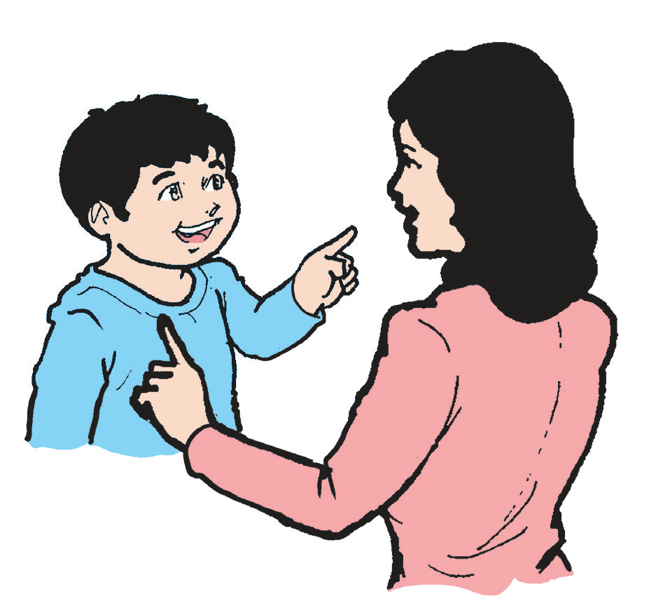
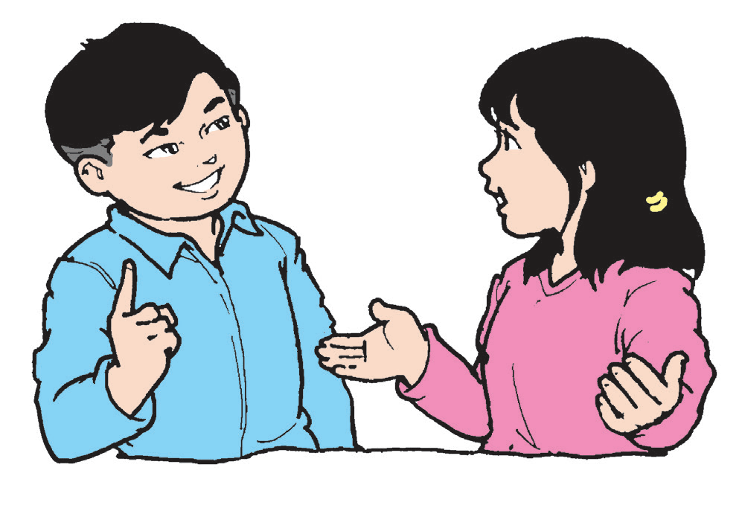
Oral Language
The following conversations are found in the story:
Please do not leave yet.
I am sorry. Collecting sand is not allowed.
I am sorry. We cannot stay.
May we collect sand?

Slide 10
What appropriate expression should you use if you say “no” or cannot give in to a request? You should say “sorry” when you cannot give in to a request.
You should also say “sorry” when you hurt somebody. When somebody says sorry to you, it is polite to say “It is okay.” or “It is all right.”
We use the expression please when we ask for help. We can use these expressions when we need help.

Slide 11
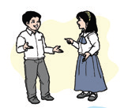
Complete the sentences below:
1. Please help me _______________________.
2. Can you please help me _______________________.
3. Can you please _______________________?
4. Please _______________________.

Slide 12
Grammar
Read the sentences below. They are about the story.
1. We went to Boracay.
2. We stayed in a hotel.
3. We enjoyed watching the waves.
4. We ate at the market.
5. It was Dad’s birthday.
6. Kyla and Dylan are my cousins.
Which words that are mentioned above name persons, places, things, and events?

Slide 13
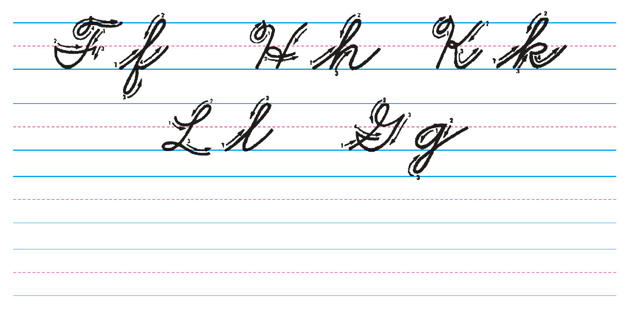
Writing
Copy the letters carefully. Follow the given strokes.

