Slide 1
Making a Timeline

Slide 2
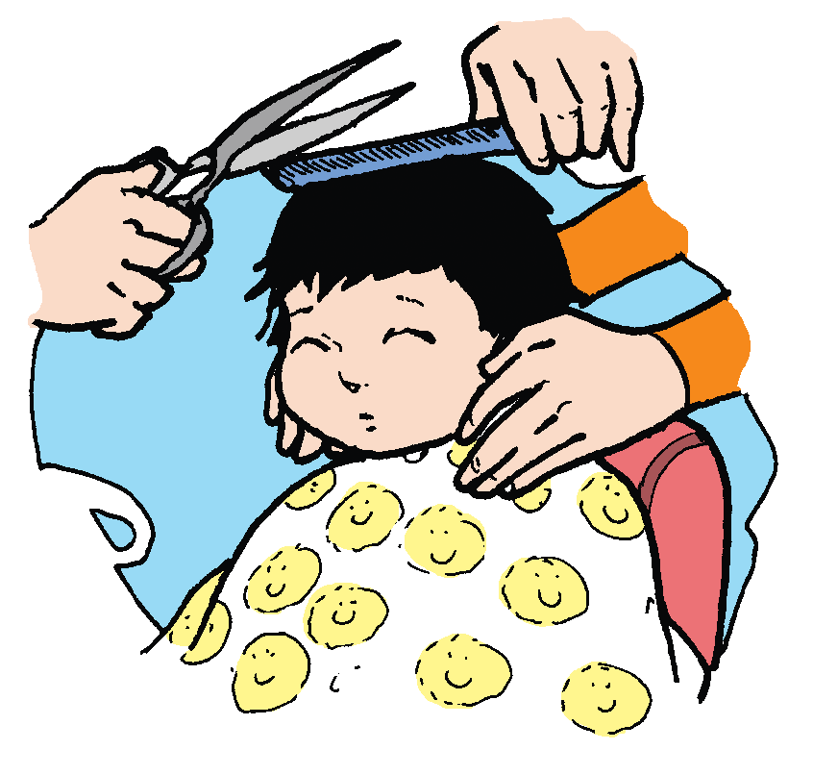
Making a Timeline
by Joseph A. Z.
Have you seen a timeline? People use it to understand history.
It shows what happened at different times. A timeline
looks like a number line. You can make a timeline to
record important events in your life.
Start by drawing a straight line on a piece of paper.
Make small slash marks to show important events
in your life. On top of the line, write the year or dates.
Below the line, write the events. You may start with the
year you were born.

Slide 3
Then, you can also show the year you first said a word
or the first time you walked. Write the year you went to
school for the first time. You can include all the dates
of important events in your life. You can ask your
parents/guardians/relatives to give you all the
important dates you need.

Slide 4
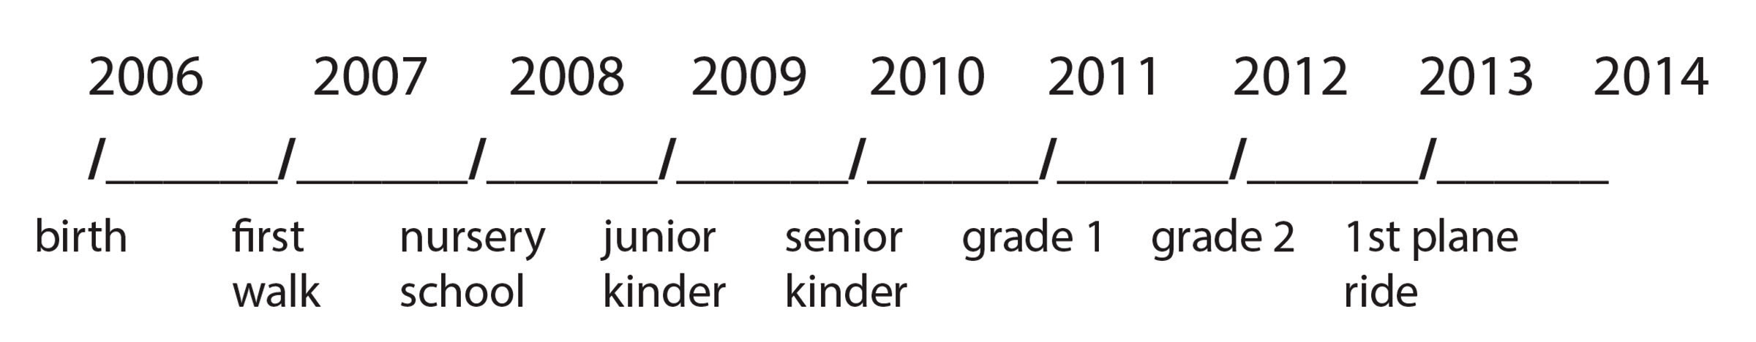
Below is a sample timeline:

Slide 5
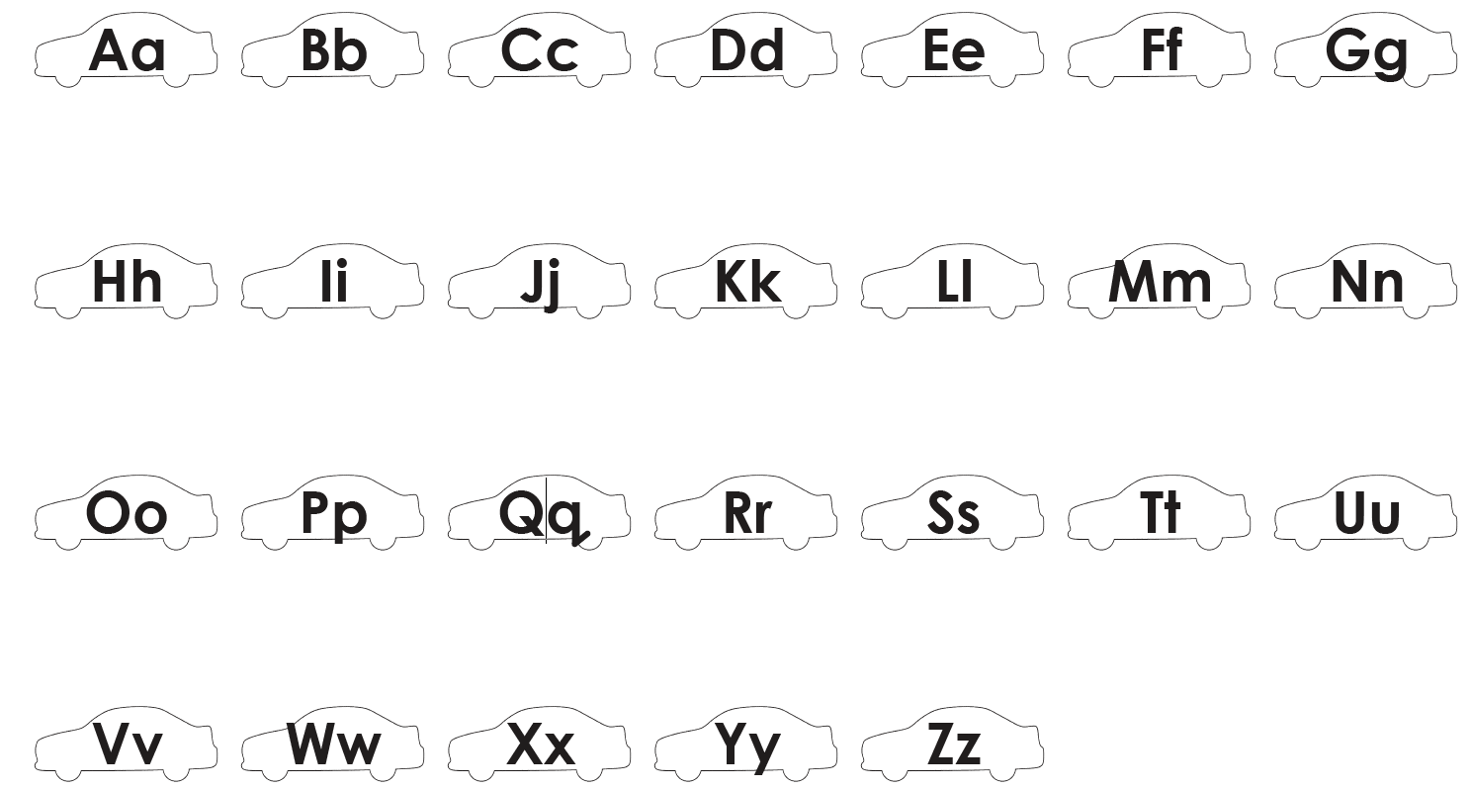
Alphabet Knowledge
Recall the letters of the English alphabet. Listen and repeat as the teacher reads the letters aloud.

Slide 6
Oral Language
The following expressions can be used to get information or make things clear:
Examples:
“May I know…?”
“Please tell me about…”
“I would like to know more about…”
“Can you explain…?”

Slide 7

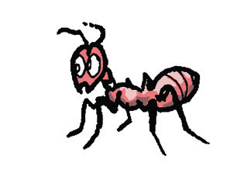
Grammar
Read the given groups of words that are taken from the reading selection:
a timeline an event a line an information
Below are more phrases that start with a or an. Note how a or an is used.
a boy
an ant

Slide 8
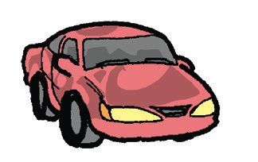

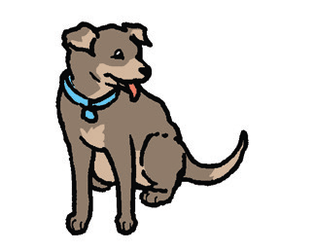

a car
an elephant
a dog
an insect

Slide 9

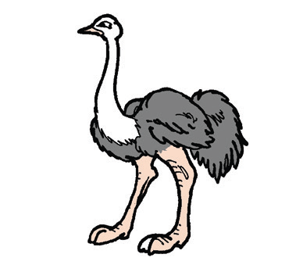


a fish
an ostrich
a girl
an umbrella
A is used before a word that starts with a consonant sound.
An is used before a word that starts with a vowel sound.

Slide 10
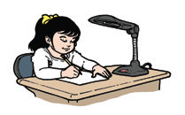
Choose a or an appropriately.
1. I have __________ friend.
2. We always play __________ exciting game online.
3. At ti mes, we watch __________ movie with our parents.
4. We eat in __________ restaurant.
5. When it rains, we share__________ umbrella.

Slide 11
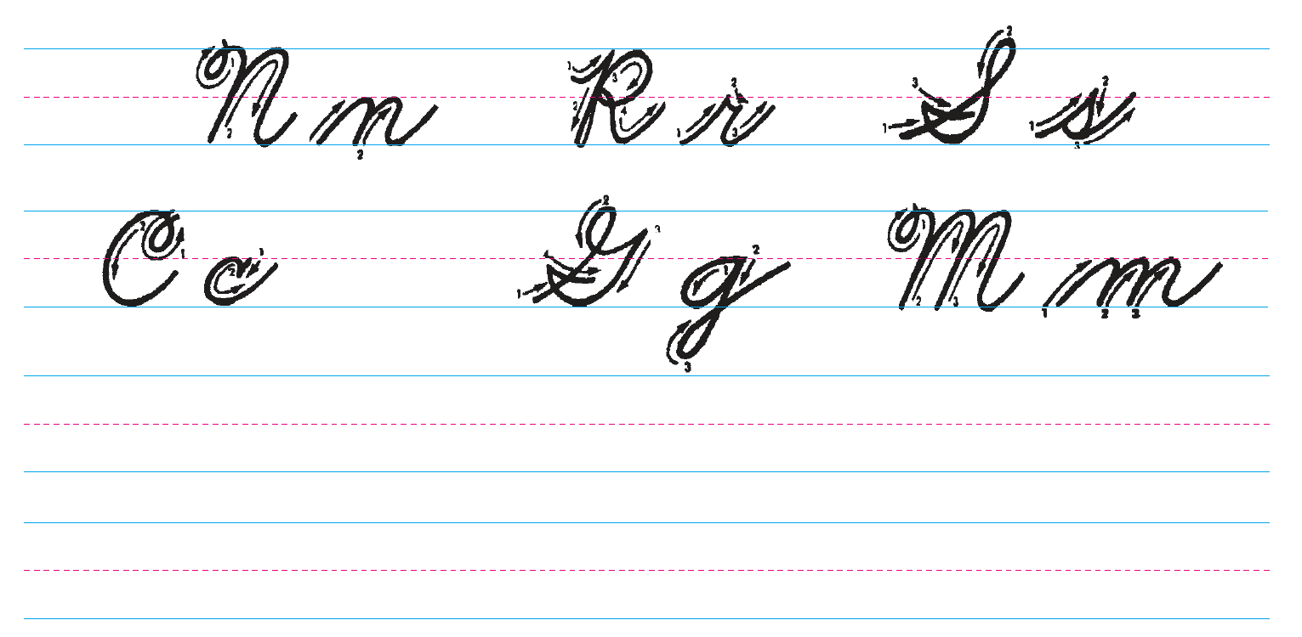
Writing
Follow the arrows as you copy each letter. Write the letters neatly and clearly.

