Slide 1
Saving for a Gift

Slide 2
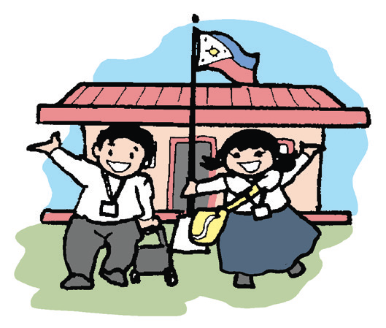
School, just like home, is a place where you will grow up in. Do you remember your first day in school? It can be scary for some pupils especially if one is new in that school.

Slide 3
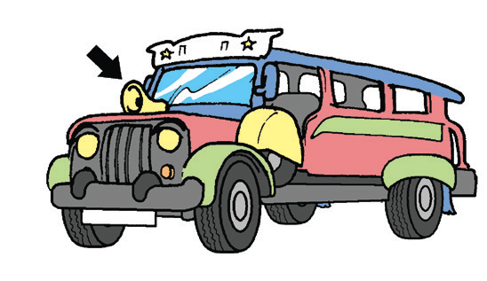
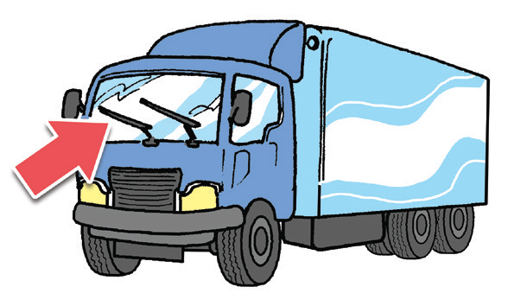
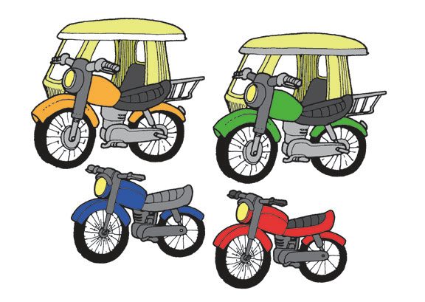
Phonological Awareness
On your way to school, you hear lots of sounds. Your teacher will ask you to listen to a recording of sounds from various vehicles. Below, draw a line that would connect the sound you hear to what makes the sound. The teacher will read them for you.
Vroom, vroom, vroom!
Beep, beep, beep! Swish, swish, swish!

Slide 4
Book and Print Knowledge
Read the following school signs:
Silence
Keep off
the grass
Fall in line
Keep right

Slide 5
Alphabet Knowledge
Animals and many things around us make sounds. People make sounds, too. We shout, cry, and whine. We produce words when we talk. Words are made up of letters in the English alphabet. Below are the vowels in the English alphabet. Say the sound of each vowel:
Uu Aa Ee
Oo Ii

Slide 6
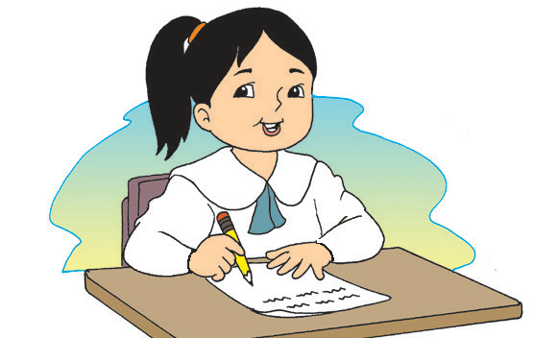

Vocabulary
Use your mother tongue to explain the given words. Use them correctly in sentences.
school teacher classmates library principal
market police officer mall park

Slide 7
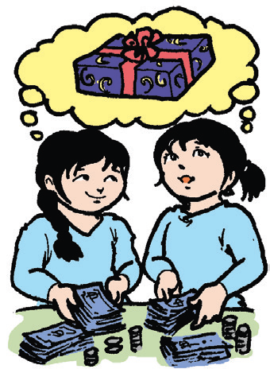
Saving for a Gift
by Rommel Lumanta
It was summertime. Eden and Luds wanted to earn money. They wanted to buy a special gift for their mother. They saved money, but it was not enough. They sold newspapers and bottles, but the money they raised was little.
Since the weather is hot, they thought of
selling something cold that people would like very
much.

Slide 8
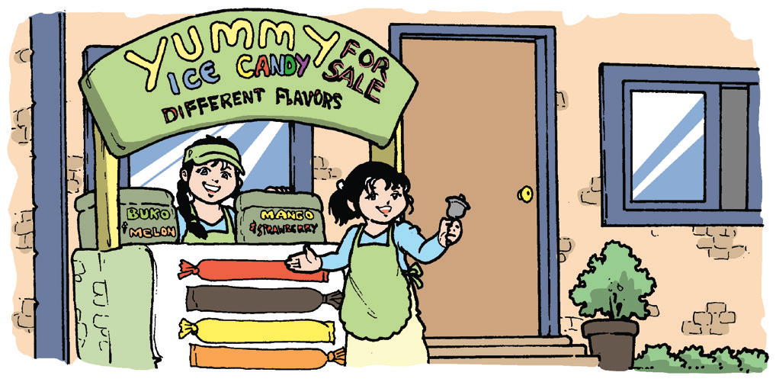
Eden approached her mother, “Mom, may we sell ice candies in front of our house?”
Mom answered, “Sure, your Ate Beck can help you. She will list down the flavors and other things that you will need.”
The girls shouted in glee,” Oh, thank you, Mom!”
The girls approached their sister,
“Can you please help us? We will sell ice candies.”
They also asked their housemate, Natie, to
help them buy what they need. They put up a
large sign in front of their house:
YUMMY ICE CANDY FOR SALE! DIFFERENT FLAVORS.

Slide 9
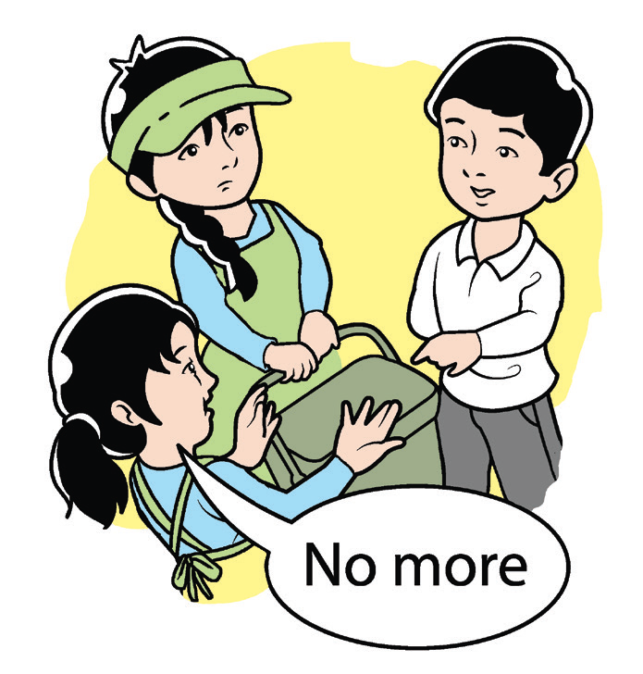
Soon, they had many customers. When they were about to
close their little store, a boy came to buy.
“Please do not close yet. May I buy ice candy?” The boy pleaded.
Eden answered, “I am sorry, but we have nothing more to sell.”
“That is all right,” the boy replied sadly.
At the end of the week, they earned more than what they needed to
buy a gift . Most of all, they learned to do business and they had much
fun. They planned to sell ice candies until the end of summer.

Slide 10
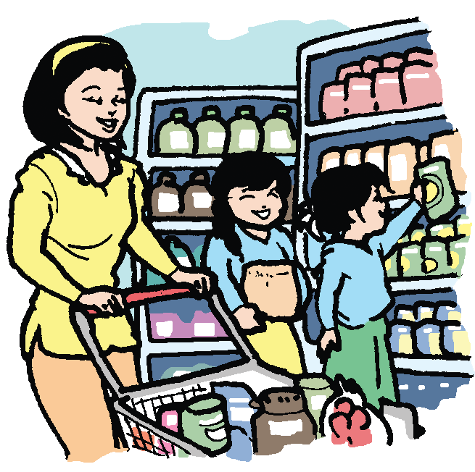
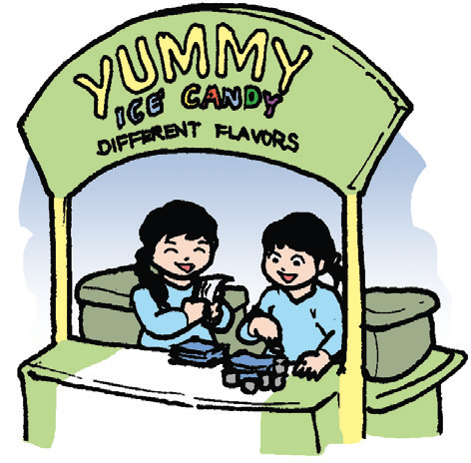
Recall
Give the correct sequence of events in the story. Recall what happened at the beginning, middle, and end of the story. Write the number 1 in the event that happened first, 2 for the second event, and 3 for the third or last event.
They got help so they could sell ice candies.
Eden and Luds decided to earn more money.
They earned more than
what they needed.

Slide 11
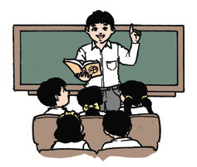
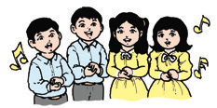
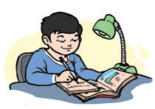
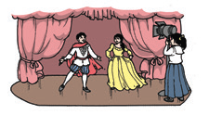
Choose a Task
You and your group mates will choose a task that you will do together from any of the following:
Word Smart
Take turns in
summarizing the story to
your group mates. To summarize
a story, recall the title, setting, characters, and important events in the story.
Music Smart
Create a short song that
would summarize the
story.
Picture Smart
Make a comic strip to
retell the story.
Body Smart
Role-play selling and
buying ice candy.

Slide 12
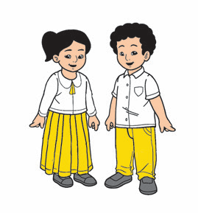
Oral Language
Think-Pair-Share
Your teacher will assign you a partner. With your partner, talk about your name and other things about yourself. Be guided by the following questions below:
1. Where did your parents get your name?
2. What is your nickname? Why were you given that nickname?
3. What are your hobbies?
4. Who are your friends? Why do you like them?

Slide 13

Grammar
A sentence is a group of words that expresses a complete thought.
A group of words that has an incomplete thought is a non-sentence.
The following groups of words were taken from the story. Tell which of these are sentences and which are non-sentences.
1. We will sell ice candy.
2. in front of their house
3. They asked their housemate.
4. The girls shouted.
5. to help them buy

