Slide 1
Amazing Albay
(Adjectives)

Slide 2
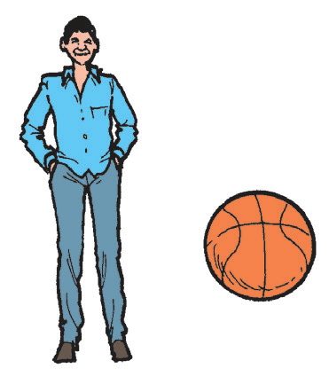

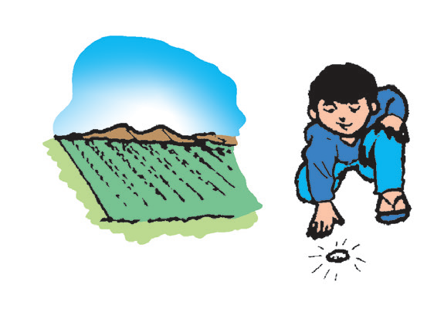
Phonological Awareness
Rhyming Words
Recall that words rhyme when they have the same ending sound. Sing and cling rhyme because both of them end with the “-ing” sound.
tall ball
clown brown
ground found

Slide 3
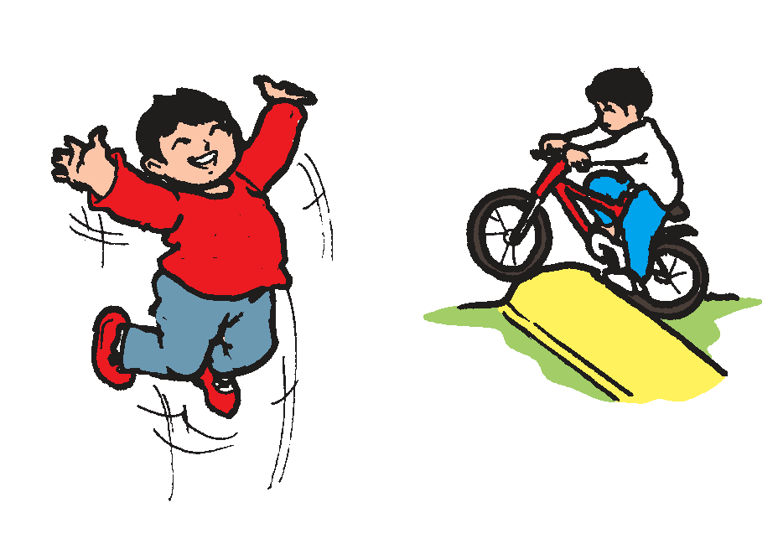
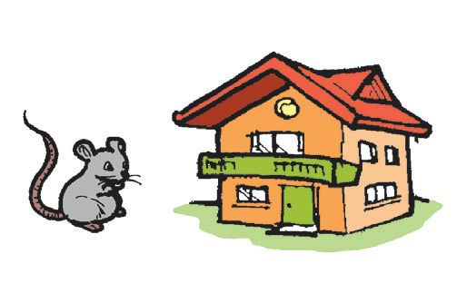
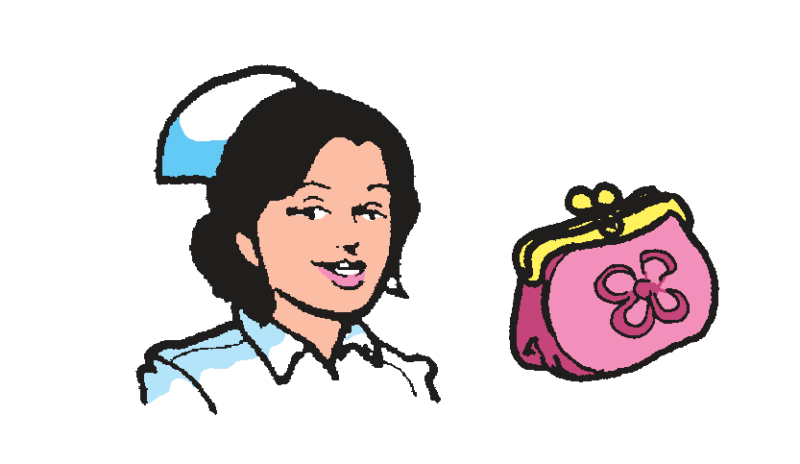
jump bump
mouse house
nurse purse

Slide 4
Book and Print Knowledge
Below is a page from a book. It is called Table of Contents. It is a list of the topics or titles that the book contains. It also gives the page number where each topic can be found.
TABLE OF CONTENTS
Title of the Story Page Number
The Music Maker................................................ 3
A Day at the Fair................................................. 10
The Duel.................................................................. 21
Seals........................................................................... 26
Surprise for Mom ................................................ 30
A Day at the Farm................................................ 42

Slide 5
Vocabulary
Recall the repeating words you have studied. Here are more examples of repeating words:
1. knock-knock – a sound made when you hit a door; sometimes used as the first line of a joke.
Example: Make a knock-knock on the door.
2. pitter-patter – a sound of quick light steps or taps
Example: I hear the pitter-patter of the raindrops on our roof.

Slide 6
Vocabulary
3. sing-song – a manner of speaking in which your voice rises
and falls in a pattern
Example: Reciting a poem should not be in a sing-song
manner.
4. topsy-turvy – upside down; disorderly
Example: The things in my room are topsy-turvy.
5. wishy-washy – weak; cannot decide
Example: He is wishy-washy about his problem.

Slide 7
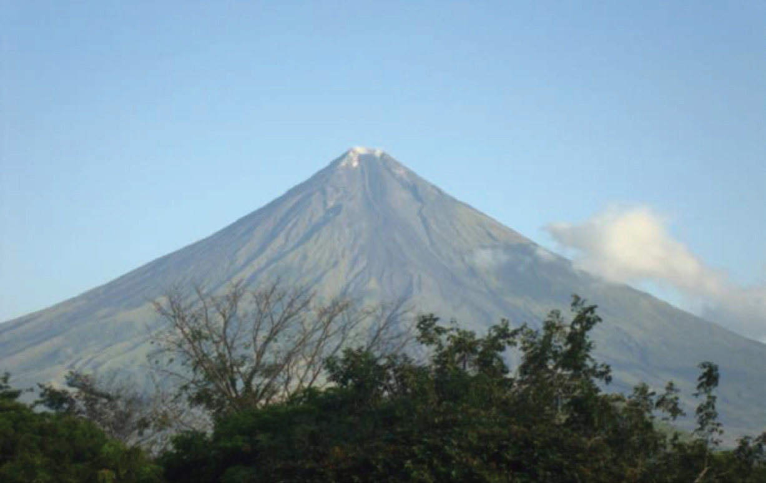
Amazing Albay
by Priscilla A. Reyes
My family and I spent a few days in Albay. It is in the Bicol Region. We took a plane from Manila to Legazpi. When we got off the plane, what beautiful sight do you think caught our attention?
Wow! What a perfect cone Mayon
Volcano has! From the airport, we
took a tricycle to reach the balai
where we would stay in for the
weekend. The lady owner welcomed
us with a smile.

Slide 8
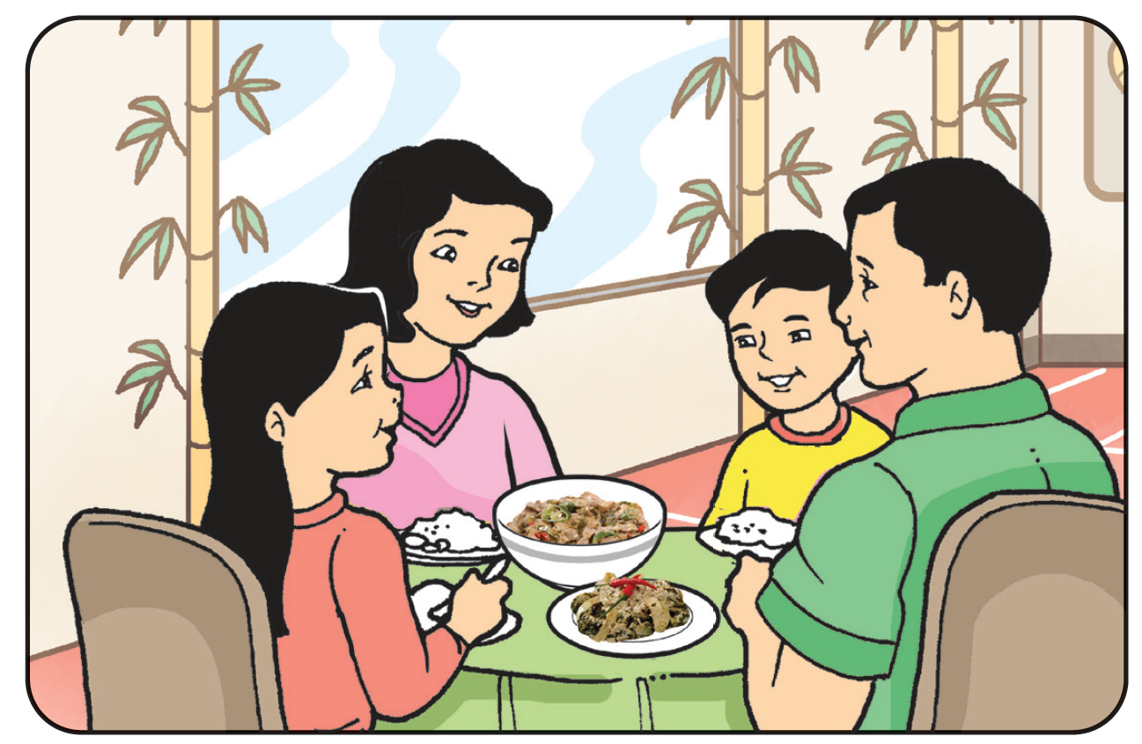
Without wasting our ti me, we went to The Embarcadero, a waterfront located at the harbor area of Legazpi City. It is Legazpi’s newest commercial and entertainment center with many stores, restaurants, and arcades. It has become popular among tourists.
For lunch, we had Bicol Express and
pinangat. We bought cheap and tasty snacks
sold on the streets like the sinapot, ginamsan,
balisongsong, dila-dila, and putot sabaan.

Slide 9
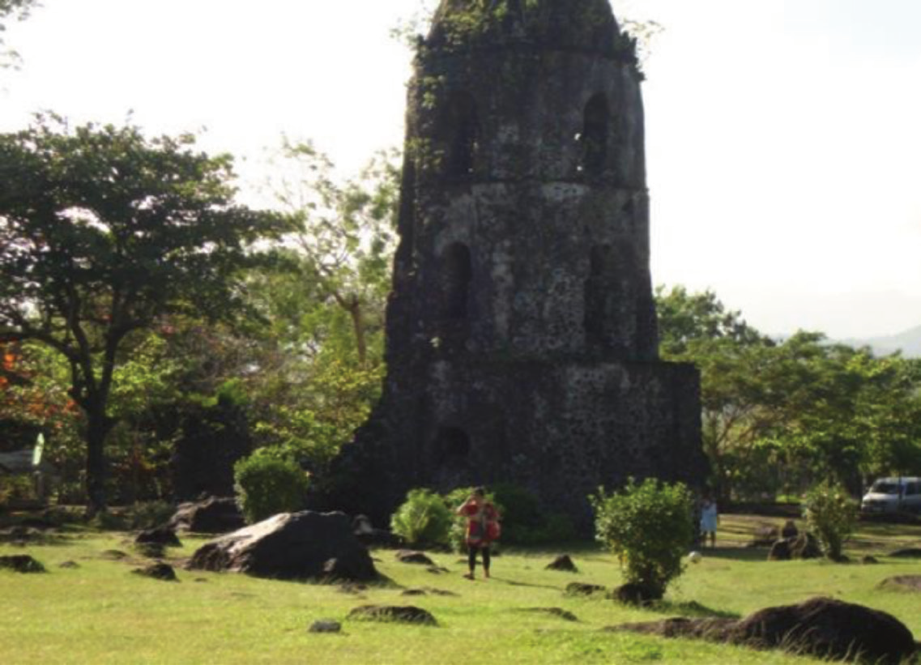
We went to Cagsawa Ruins. Cagsawa was a town built in 1814, but when Mayon Volcano erupted, the town were buried and man y people died. This is the most popular site for picture taking. There are stores that sell souvenir items. Mom bought a few. There is also a picnic area. What we failed to do was go to the beaches to watch the butanding or whale shark. Anyway, Dad said we might be back next year.

Slide 10
On our last day, before we got to the airport, my parents shopped for native products like pili nut candies, dried fish, pancit, and abaca handicrafts.
Soon, it was ti me to go home. I gave a last look at the beautiful Mayon Volcano.

Slide 11
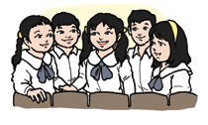
Think Well
1. How will you describe Mayon Volcano?
2. Why is Albay an interesting place to visit?
3. Ask each other questions about the story.

Slide 12
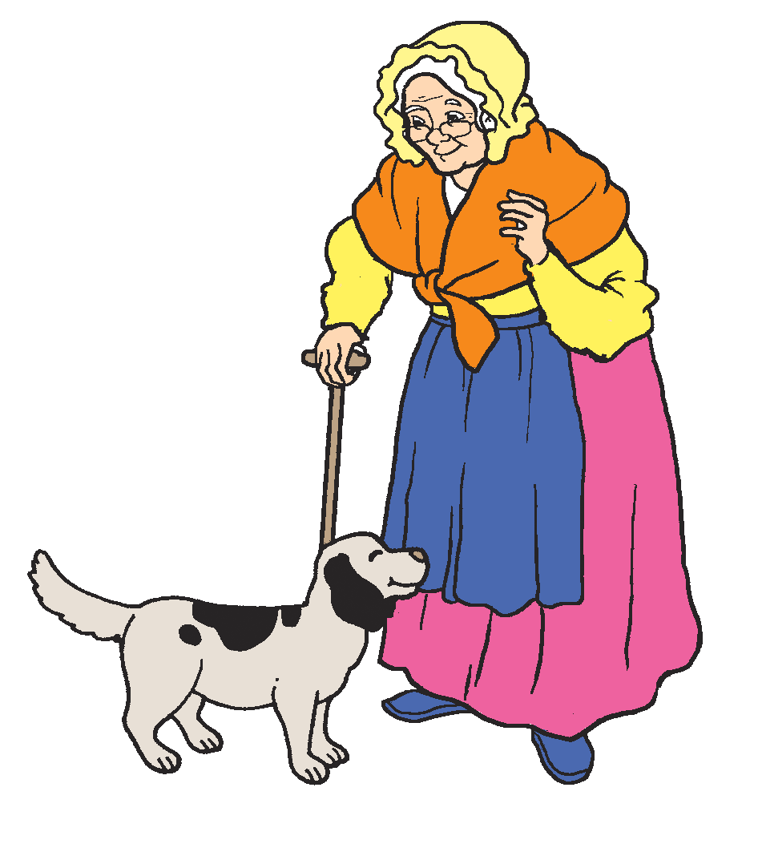
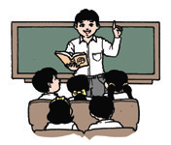
Oral Language
Rhymes
Old Mother Hubbard
Old Mother Hubbard
went to the cupboard
to get her poor dog a bone.
But when she got there,
the cupboard was bare.
And so the poor dog had none.

Slide 13
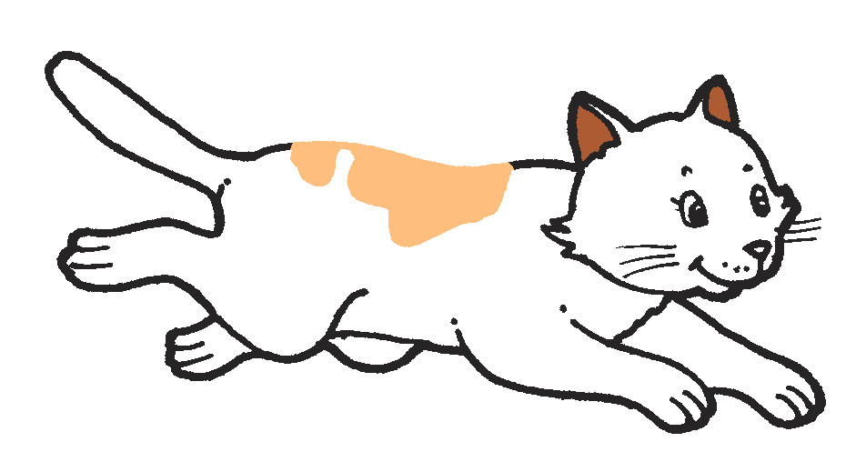
Oral Language
Rhymes
Pussycat, Pussycat
Pussycat, pussycat,
where have you been?
I've been up to London
to visit the Queen.
Pussycat pussycat,
what did you do there?
I frightened a little mouse
under her chair.

Slide 14
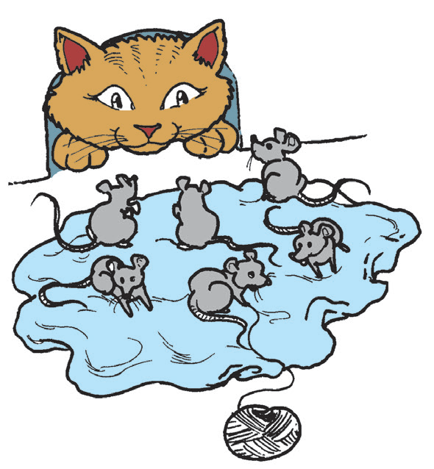
Oral Language
Rhymes
Six Little Mice
Six little mice sat down to spin;
Pussy passed by
and she peeped in.
What are you doing,
my little men?
Weaving coats for gentlemen.

Slide 15
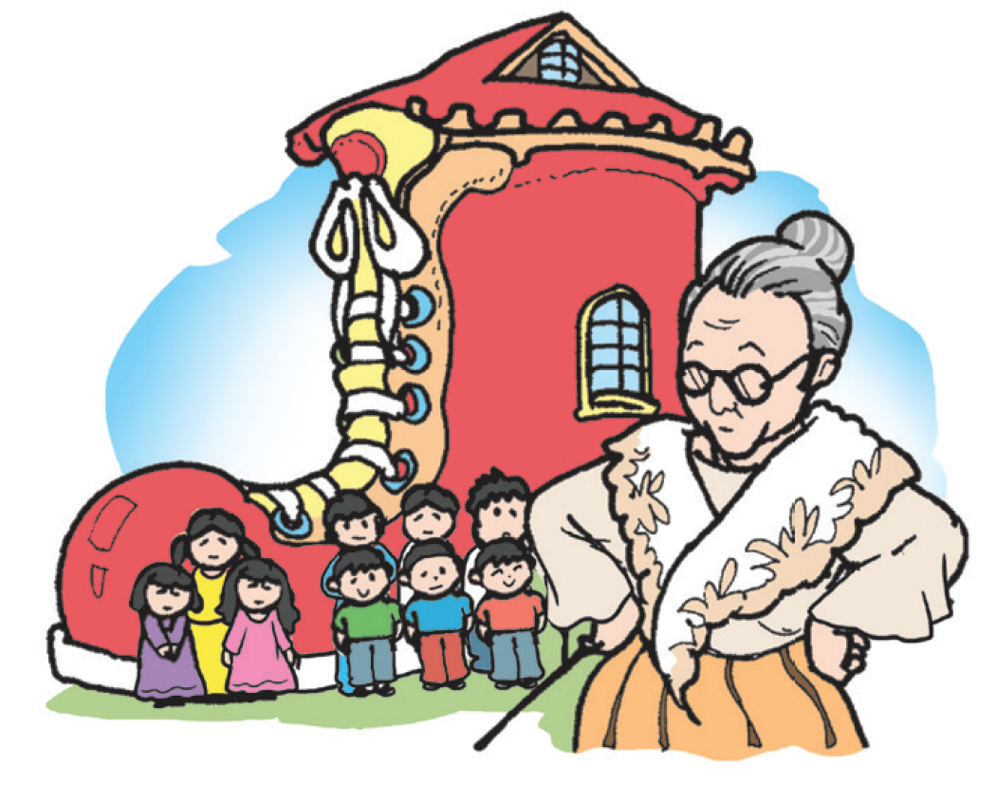
Oral Language
Rhymes
The Old Woman Who Lived
in a Shoe
There was an old woman
who lived in a shoe;
She had so many children
She didn’t know what to do.
She gave them some broth
without any bread,
And whipped them all soundly
and put them to bed.

Slide 16
Grammar:
Adjectives describe people, places, things, and events.

