Slide 1
The Elephant and the Monkey

Slide 2
Sequence is the order in which things happen in a story.
In some selections, the author does not give all the details. The reader, then, tries to figure out from his/her own information about the characters, the setting, and the events. This is what we call making inferences.
When we make inferences, we look for story clues. We also try to connect them with what we know or what we have experienced.

Slide 3

Book and Print Knowledge
Have you read books about nature? All the books you read have similar parts. The picture below shows the outer part of a book and what you can find on it.
The spine is the side part of a book that holds the pages together. The book title and the name of the writer are also printed here.
The cover is the hard and outer part of a book. It shows
the following important information:
Title – the name of the book
Author – the writer of the book
Illustrator – the person who drew the pictures in the book
Publisher – the company that printed the book

Slide 4
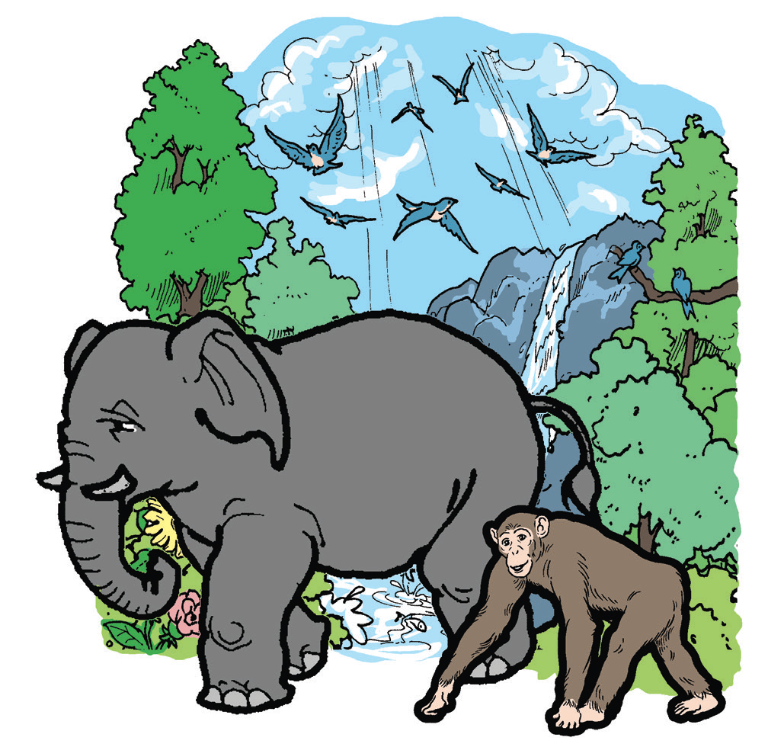
The Elephant and the Monkey
Once, an elephant and a monkey were friends. Both animals were very proud. One day, they quarreled. The large elephant was proud because he was very strong.
The little monkey was also proud because he was very quick.
“I can pull down the biggest tree,” boasted the elephant.

Slide 5
“Well, I can climb the tree before you can take one stem,” boasted the monkey.
The elephant shouted, “It’s better to be strong than to be quick.”
“No!” cried the angry monkey. “It’s much better to be quick!”
The quarrel became louder and louder. At last, the wise old owl heard them. He told them to stop and keep still. He asked what the fight was all about.
The elephant was the first to speak up. “Owl,” he said,
“Is it better to be strong or to be quick?”
The owl thought for a moment. Then, he said,
“Do as I tell you, and you will learn which is better.”
The elephant and the monkey listened to the wise owl.
“Go to the river and swim across it. On the other side of the riverbank is a tall tree with some fruits. Pick some of the fruits. You should bring them to me.”

Slide 6
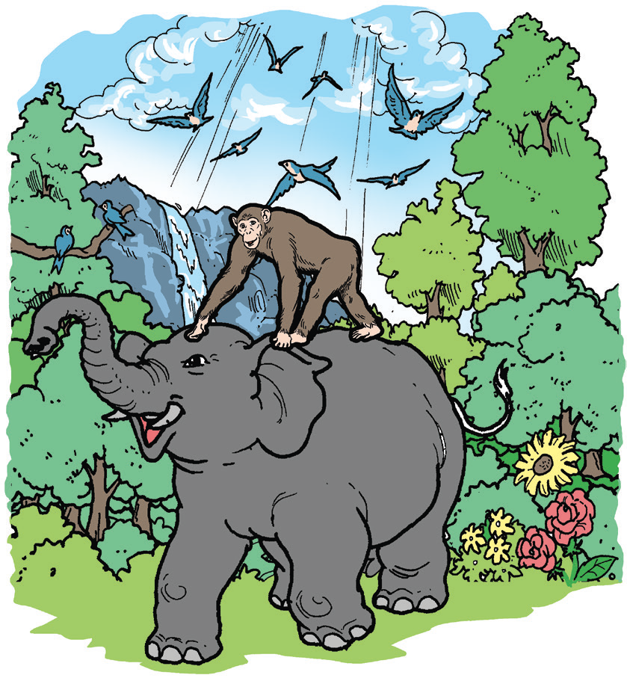
The elephant and the monkey hurried to the riverbank. It was a deep river. The monkey was afraid to cross it
“I’m bigger and stronger than you are. I make bigger steps. Get on my back and I’ll take you across the river,” said the elephant
proudly.
The monkey climbed on his back. Together, they crossed the deep river. They saw the tall tree standing straight on the riverbank. They saw a spider spinning a web on a twig. Fruits from several branches hung on the treetop.
The elephant lifted his trunk to pick the fruit. But even the lowest branch was out of his reach. Then, the elephant tried to pull the tree down. He couldn’t even shake it. The monkey began to laugh.

Slide 7
“You may be large and strong,” he said. “But I see that you need some help. I should climb the tree and drop the fruit to you. You may catch it.” The elephant stood to catch each fruit dropped by the monkey.
It was not long before the elephant’s mouth was full. It couldn’t hold any more. The monkey quickly came down and leaped on the elephant’s back. The two animals crossed the river again.
“We have brought you the fi nest fruits,” they called to the owl.
“We have done what you told us to do. But we haven’t learned if it is better to be strong or to be quick.”
The owl stared at them and said, “Just remember how you got the fruit. Being strong or quick alone was not enough. It took both of you to get the fruit from the tree.”
Never again did the monkey and the elephant act so proud and never again did they quarrel.
(Retold)

Slide 8
Sequencing
Identify number 1 before the event that happened first, 2 before the event that happened next, and 3 before the event that happened last.
_______ The elephant and the monkey were able to do together what the owl told them to do.
_______ The elephant and the monkey quarreled because they were proud of what they could do individually.
_______ The owl taught them a lesson by asking them to swim across the river to pick some fruits.

Slide 9
Oral Language
Cozy Chat
With a partner, talk about your activities and responsibilities in school.
Use any of the given groups of words below. Also, ask each other questions
about your activities and responsibilities in school.
greet my teacher and classmates play aft er lunch
borrow books from the library listen to the teacher
follow what the teacher says recite
write my answers do the seatwork
water the plants in the school garden read books

Slide 10
Below is a portion from the song, “My Favorite Things.” Read the lyrics and sing. Choose all the action words in the song.
When the dog bites,
When the bee stings,
When I’m feeling sad,
I simply remember my favorite things,
And then I don’t feel so bad.

Slide 11
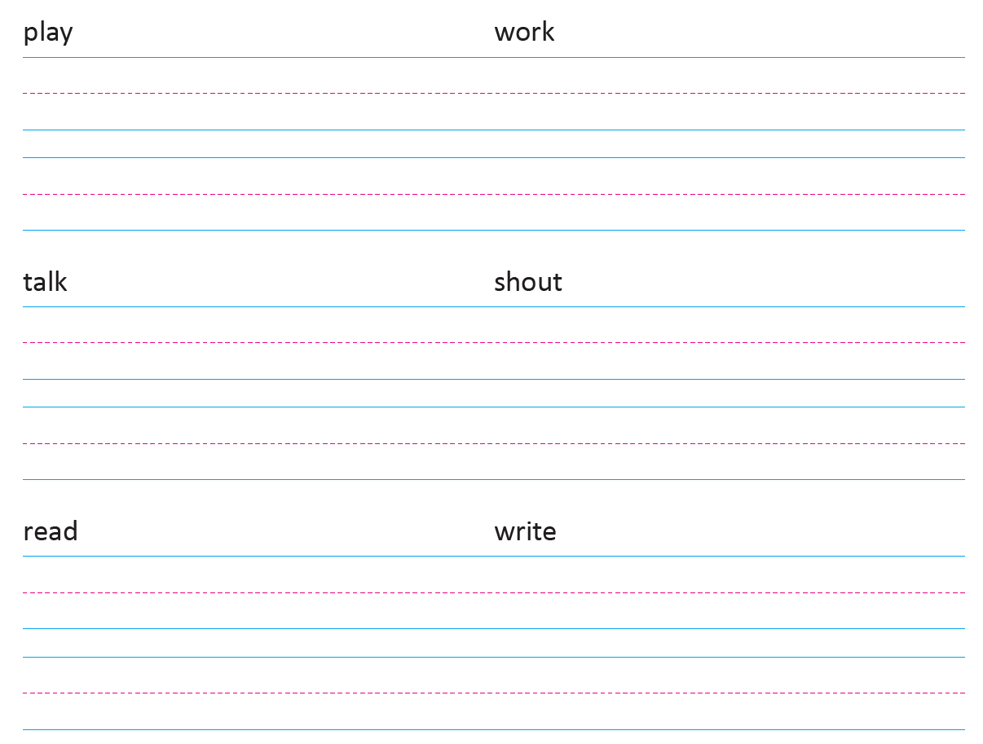
Writing
Copy the action words using cursive writing. Write the letters neatly and clearly on your paper.

