Slide 1
Let’s Predict
(Verb)

Slide 2

READING
Scientists can predict occurrences in nature such as typhoons, sunsets, sunrises, and eclipses. They can also tell the causes and effects of earthquakes and other natural occurrences.
Identifying the cause and effect within the story helps the reader to focus on what is happening in the story or why it happened.
Let us study the following :
Cause – the reason why something happens
Effect – the result of an action

Slide 3
The clue words are because, so, and since. These words will help you recognize causes and effects.
Identify the cause and the effect in the story.
The speaker in a story is the one who is telling the story. You can tell who is speaking by reading the given details.
Making predictions is guessing what might happen next in a story or what will happen at the end of the story.

Slide 4
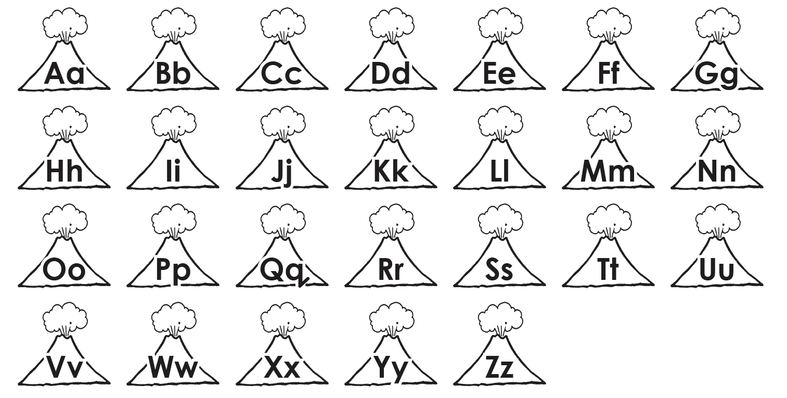
Alphabet Knowledge
Recall the letters in the English alphabet.

Slide 5
Book and Print Knowledge
Recall the proper eye movements.
left to right return sweep
top to bottom

Slide 6
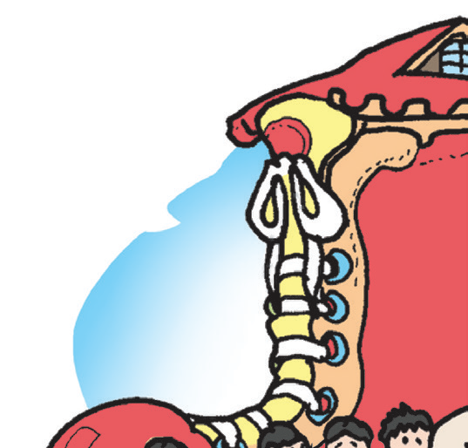
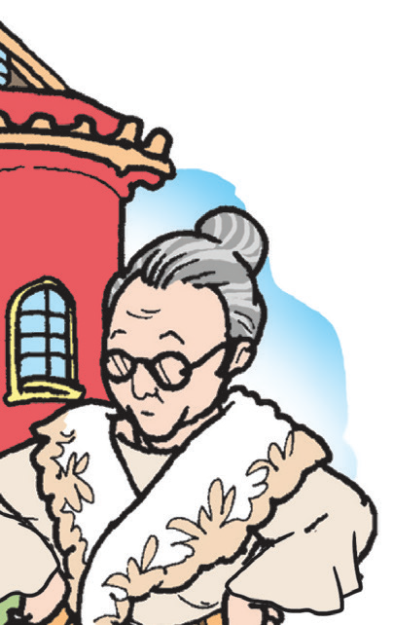
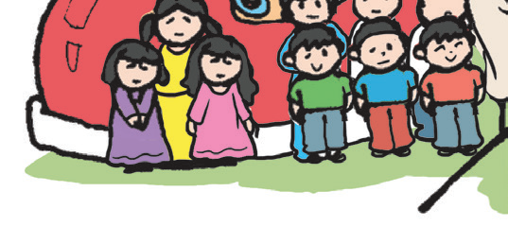
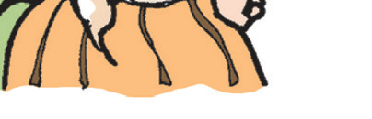
Read the following stanza from a poem using proper eye movements:
There was an old woman
who lived in a shoe;
She had so many children,
she didn't know what to do.

Slide 7
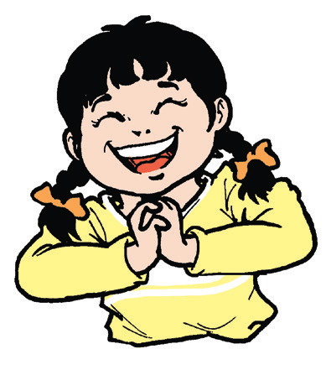
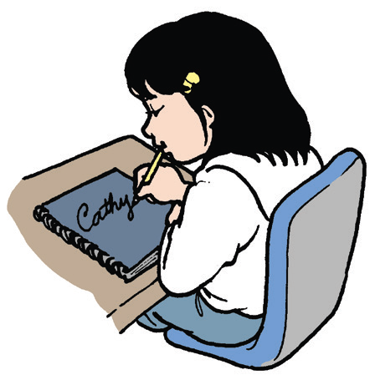
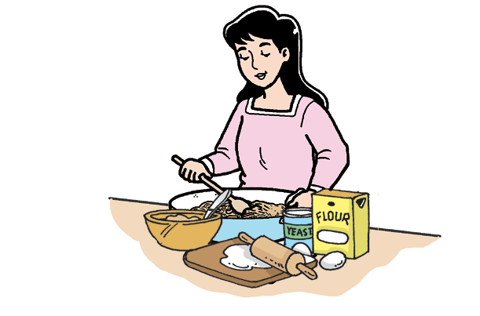
Vocabulary
Use the pictures to give the meaning of the given words:
excitement diligent mixture

Slide 8
Verbs are action words. Most sentences have action words. Listed below are some common verbs:
read talk listen write draw copy
count run walk jump pray make
bake cook push pull play sing
pay go stay stop swim stand

Slide 9
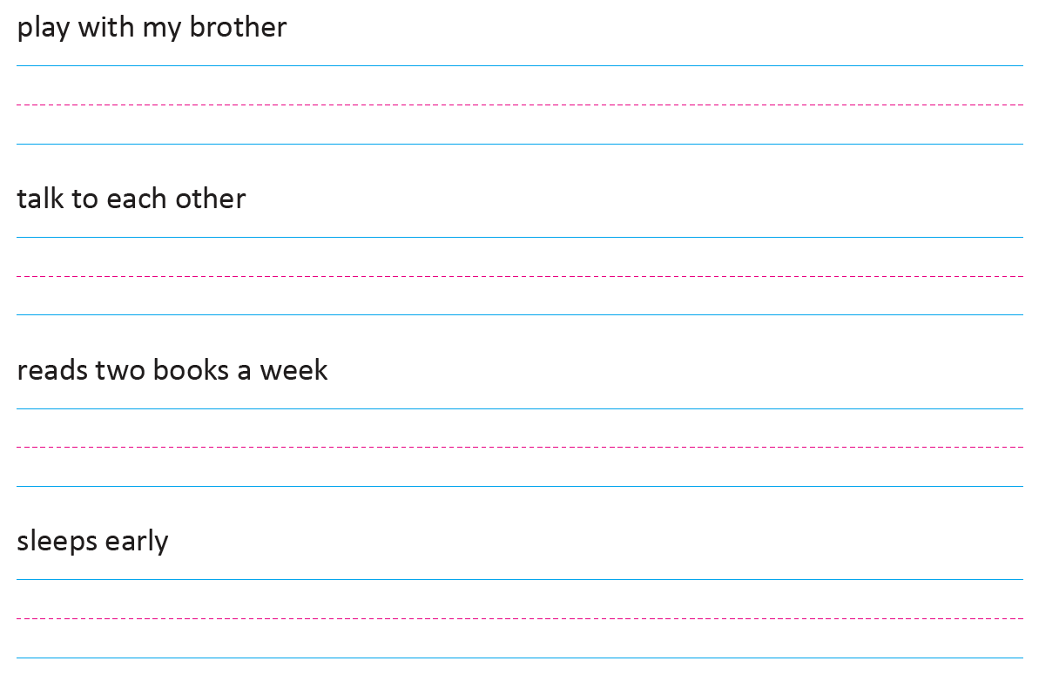
Writing
Copy these groups of words with action words. Use cursive writing. Write the words neatly and clearly in your paper.

