Slide 1
The Mango Tree and the Bamboo
(Adjectives: Colors and Shapes)

Slide 2
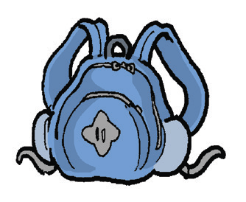
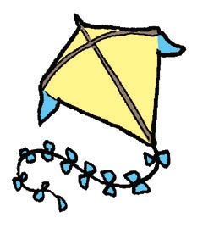

Alphabet Knowledge
The name of each picture starts with a consonant. Say and name the consonants.

Slide 3
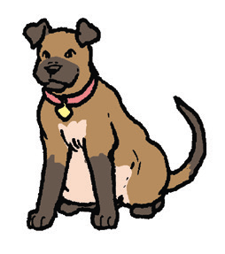

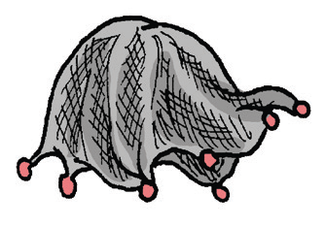
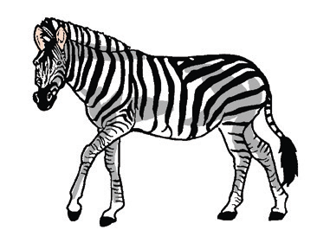
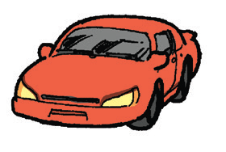


Slide 4
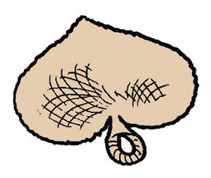

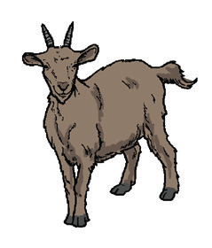

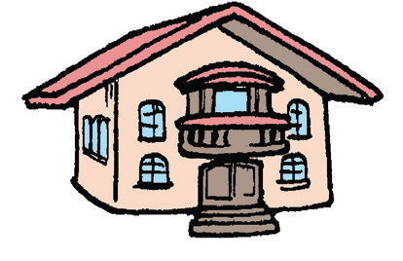


Slide 5
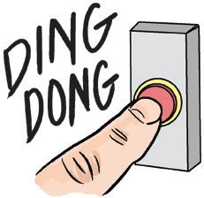
Vocabulary
In English, there are words or parts of words that are repeated to form new words. A good example is “bye-bye” which means goodbye. It is fun to play with words.
1. ding-dong – the sound of a bell
Example: Open the gate when you hear the ding-dong of the doorbell.

Slide 6

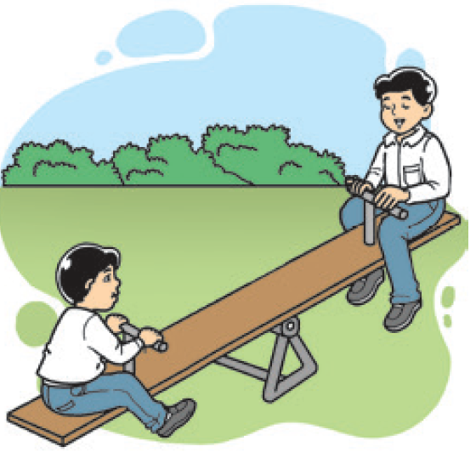
2. okey-dokey – yes; agree; or all right
Example: It’s okey-dokey with me if you come along.
3. see-saw – where children can sit and move up and down
Example: At the park, I played on a see-saw with my cousin.

Slide 7


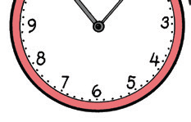
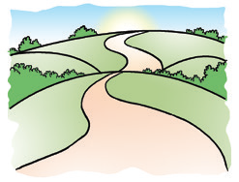
4. tick-tock – the sound made by a clock
Example: At night, the tick-tock of the clock seems to get louder.
5. zigzag – a series of sharp turns
Example: The zigzag road makes me
feel dizzy.

Slide 8
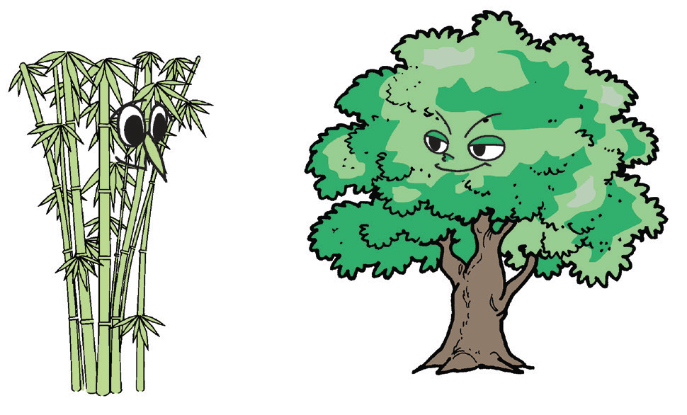
The Mango Tree and the Bamboo
The mango tree once boasted that he was very strong.
“Look at me,” he said. “I can stand the strongest wind. I’m not afraid of the storm. You can’t do that, Bamboo. You’re thin and weak.”
The bamboo replied, “What you say is true. But there are some things you can’t do: I can sing to the breeze. I can whisper to the woods. I can grow anywhere. I’m useful to man.”

Slide 9
“Oh, that’s nothing,” said the mango tree.
He went on boasting. Then, they called on the wind to be the judge.
“Give us a test,” said the bamboo.
“Let the wind find out who is stronger,” said the mango tree.
The wind chuckled at this. He began to blow and whistle. He howled and blew terribly.

Slide 10
At first, the mango stood his ground. He was very sure of his strength. But later, his roots gave way. He fell to the ground with a loud crash.
The bamboo swayed from left to right. He bent and swayed in the direction of the wind. The stronger the wind, the lower he bent. When the wind stopped, the bamboo was standing still. The proud mango tree lay shamefully on the ground.
(Retold)

Slide 11
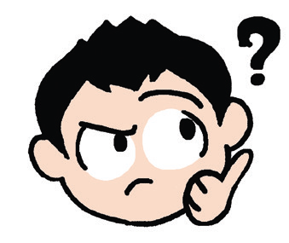
Think Well
The class will be divided into small groups. Then, listen as your teacher reads the questions below that your group will answer.
1. Why did the mango tree think that he was stronger than the bamboo?
2. How did the wind test the strength of the bamboo and the mango tree?
3. Why did the bamboo win?
4. What is the problem in the story?
5. What is the solution in the story?
6. In your own words, retell the story to your partner.

Slide 12
Oral Language
With your partner, talk about nature and the other things that you like a lot. You may choose from any of the following topics:
• Flowers I love
• My funny pet
• Animals I like
• At the beach
• Stargazing
• Cloud shapes

Slide 13
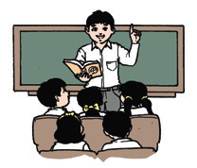
Grammar
Read this paragraph which was taken from the story, “The Crow and the Fox.” Take note of the words in boldface. What do they describe?
Crow was not honest but Fox would always trick her. Then, Crow thought she was beautiful! She oft en talked to her mirror. “Who is better-looking than me?” She would say, “Why, no one is! Everyone else is ugly!”

Slide 14
Grammar
Below are more sentences. Take note of the words that describe and the words that are being described.
Dylan is wearing long pants.
Kyla is glad to be home.
Deanne is kind to her pets.
Zach likes to eat delicious cupcakes.

Slide 15
Grammar
The words that describe people, places, and things are
called adjectives.
Here are more examples of adjectives:
nice, pretty, beautiful, handsome, dark, old, young, short, tall, small, high, low, many, few, happy, sad, mad, glad, afraid, hard, soft , sweet, sour, salty, far, near, and others.
Words for colors such as red, blue, and yellow can also be used as adjectives.
Words for shape such as round, oval, rectangular, square, and triangular can also be used as adjectives.

Slide 16
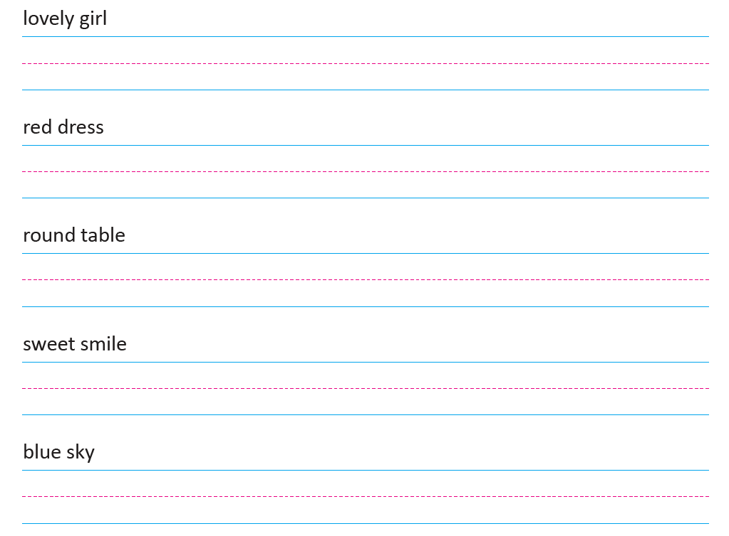
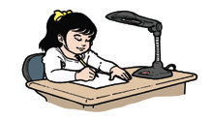
Writing
Write the given groups of words with adjectives neatly and clearly on your paper.

