Slide 1
Exploring East Asian Literature

Slide 2
Exploring East Asian Literature
Positive and Negative Messages
Our actions, either verbal or non-verbal convey messages. Message is defined as a verbal, written or recorded communication sent or left for a recipient. It may also be a significant political, social or moral point that is presented by a film, speech, gestures, etc.
Information is everywhere. These may come from books we read, magazines, billboards, newspapers or any other printed and digital materials. Not only that, we also gain information on consistent basis from the people around us and from the online platforms. While it’s good that we can access information easily, there is also danger in the kind of information we get since they may convey positive or negative messages.
Retrieved from:
https://fnhs.edu.ph/wp-content/uploads/2021/10/english8_q2_mod5of5_recognizingpositiveandnegativemessagespresentedinatext_v2.pdf

Slide 3
Exploring East Asian Literature
Listening to a Longer Narrative
Are you an active listener? You can consider yourself one if you concentrate on what you hear and process the information so that your views and the speaker’s message are unified or combined. That is ideal listening.
At times, however, you listen and absorb the information according to your perspective. You associate what you hear with your own experience, and you make meaning based on your perspective. This is called projective listening. This is being done when you try to relate your prior experiences and related daily tasks.

Slide 4
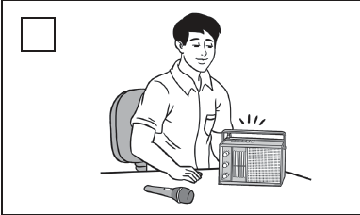
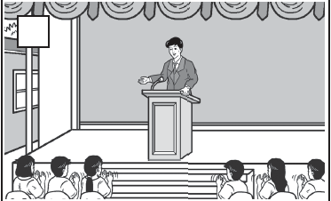
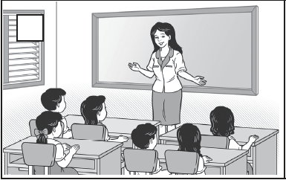
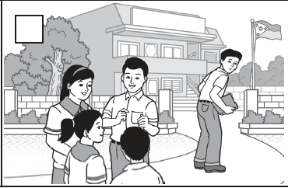
Exploring East Asian Literature
Go over the pictures below. Choose which pictures show projective listening.

Slide 5
Exploring East Asian Literature
Delivering an Entertainment Speech
Speeches need not always be informative; they do not always have to share information. A speech can also be entertaining, interesting, and funny.
How to improve verbal delivery:
1. Project your voice by speaking loudly so that people in the back of the room can hear you.
2. Speak at a comfortable rate; relax and smile to lighten the mood.
• Do not speak too quickly or too slowly.
• Pause occasionally so that you can breathe and the audience can understand
your ideas.
3. Speak clearly. Articulate your words, so that you do not mumble.

Slide 6
Exploring East Asian Literature
How to improve verbal delivery:
4. Keep your volume steady. Do not speak more softly at the end of each sentence.
5. Avoid speaking in a monotone.
• Vary the intensity and pitch of your voice.
• Concentrate on the feelings that you want to convey.
6. Avoid bad vocal habits.
• Do not use vocalized pauses (e.g., “uh,” “um,” “okay,” “like,” etc.).
• Do not use unusual inflection (e.g., Saying every sentence or phrase as if it were a question).
• Watch out for these problems as you practice.

Slide 7
Exploring East Asian Literature
How to improve nonverbal delivery:
1. Maintain composure while delivering your speech to your virtual audience. You can look
down at your notes when you need to but try to look up more.
2. Be animated. Move around your space as you speak. This helps control nervousness
and makes the speech more interesting for your audience.
3. Add emphasis to your speech by gesturing with your hands and arms.
4. Avoid distracting mannerisms and gestures, such as playing with your hair or swaying
your body.
5. Maintain good posture.

Slide 8
Exploring East Asian Literature
Read and deliver the anecdotes below. Take note of your classmates’ feedback for your reference and improvement.
Buddha’s Bugs!
(A Qing Dynasty Tale)
A Buddhist monk vowed to offer his blood to feed other living things, but after mosquitoes had bitten him for hours the itching got to him and he began swatting them with abandon. “What happened to your vow?” asked a bystander. The monk sighed. “Some of them have started coming back for seconds.”

Slide 9
Exploring East Asian Literature
Read and deliver the anecdotes below. Take note of your classmates’ feedback for your reference and improvement.
First Things First
(Ming Dynasty Tale, 1368–1644)
A doctor was detained by the furious relatives of a patient he had killed with the wrong prescription, but he escaped by night and swam across a wide river to reach home. When he saw his son studying medical texts, he said, “Don’t be in such a hurry to study medicine. First things first. And first, learn to swim.”

Slide 10
Exploring East Asian Literature
Circle the letter of the correct answer.
1. Which of the following is not used in projective listening?
A. listen to absorb information
B. ignore less important information
C. recall important information
D. process relevant information
2. Which does not describe an entertainment speech?
A. interesting
B. entertaining
C. funny
D. persuasive

Slide 11
Exploring East Asian Literature
Circle the letter of the correct answer.
3. Which of the following will help you improve verbal delivery?
A. speak at a fast rate
B. speak in monotone
C. project voice audibly
D. use a very soft voice
4. Which of the following does not enhance your nonverbal delivery?
A. mannerisms
B. good posture
C. emphasis
D. eye contact

Slide 12
Exploring East Asian Literature
ANSWER KEY
Circle the letter of the correct answer.
1. Which of the following is not used in projective listening?
A. listen to absorb information
B. ignore less important information
C. recall important information
D. process relevant information
2. Which does not describe an entertainment speech?
A. interesting
B. entertaining
C. funny
D. persuasive

Slide 13
Exploring East Asian Literature
ANSWER KEY
Circle the letter of the correct answer.
3. Which of the following will help you improve verbal delivery?
A. speak at a fast rate
B. speak in monotone
C. project voice audibly
D. use a very soft voice
4. Which of the following does not enhance your nonverbal delivery?
A. mannerisms
B. good posture
C. emphasis
D. eye contact

