Slide 1
What Is It, Zach? (Part 2)
(Adjectives for Places and Events)

Slide 2
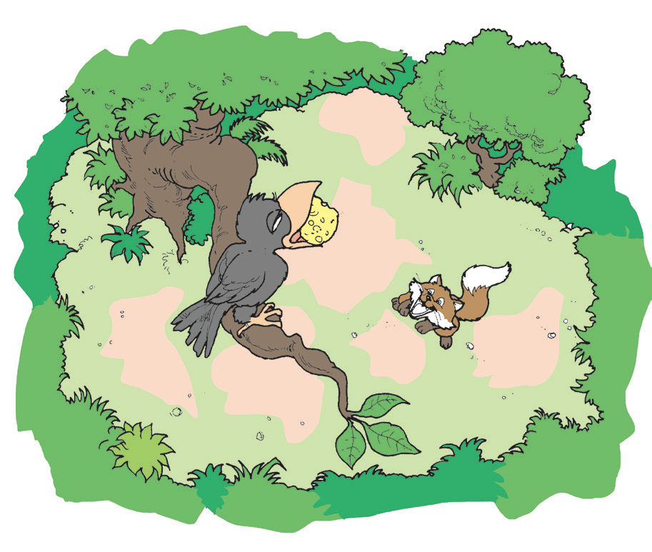
There are many interesting animals. Some can fly, hop, run, gallop, or swim. It is nice to read stories that have animals as the characters.

Slide 3
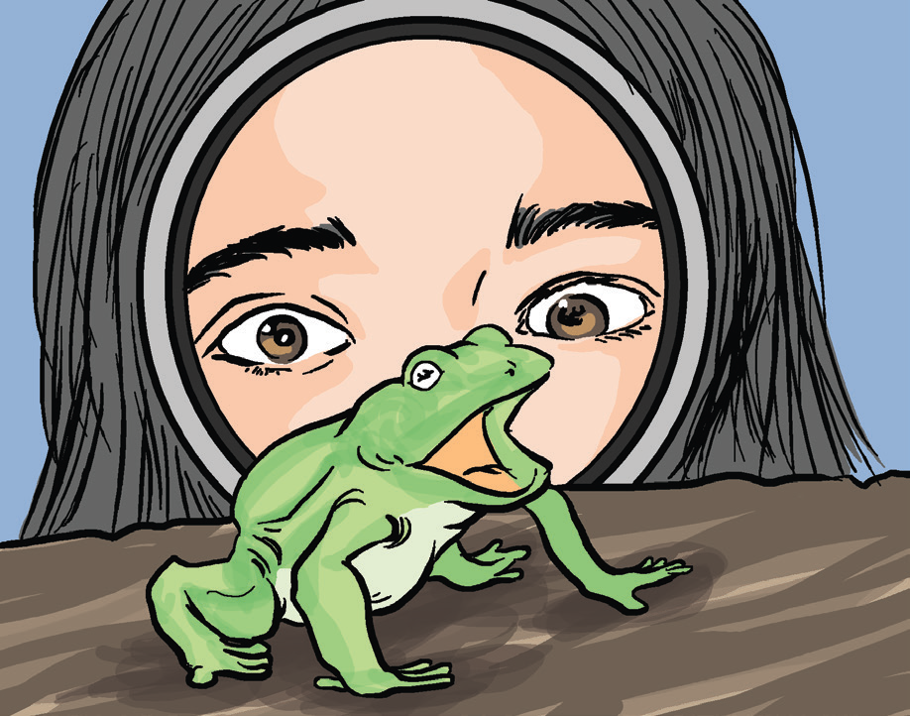
What Is It, Zach? (Part 2)
by Rommel Lumanta
“Look, Deanne, look at this funny thing.” Zach excitedly called out Deanne. He held the magnifying
glass near the head of the unmoving
frog. “Okay, I will go there to see,” said
Deanne as she bent down to look. Two
big eyes stared at her. Then, all of a
sudden, the funny thing that appeared
enormous hopped off towards the two
kids.

Slide 4
“Waaahhhhh!!!” cried the frightened Deanne.
“It’s okay, Deanne. It is just a frog. It is harmless,”
explained Zach.
Daddy Casey heard Deanne’s cry. “What is it,
Zach?”
“Nothing,” Zach said. He ran to tell Deanne
that frog had left.
The two walked together towards a leafy
hedge. Zach saw a spider spinning its web
and was sitting right in the middle of it. Casey
showed the spider to Deanne with his magnifying glass.

Slide 5
Deanne looked at the spider’s hairy legs, fat body, large eyes, and big mouth. The huge spider started moving and the web wobbled.
“Oh, the monster wants to eat us! Mommy! Daddy! There is a monster!” shrieked Deanne.
Mommy Gienah called out, “What is it, Zach?”
“Nothing, Mommy!” Zach shouted.
Deanne ran over to Mommy Gienah. “Mommy, Daddy, Kuya Zach showed me a scary frog and now, a scarier monster. I am so scared!”

Slide 6
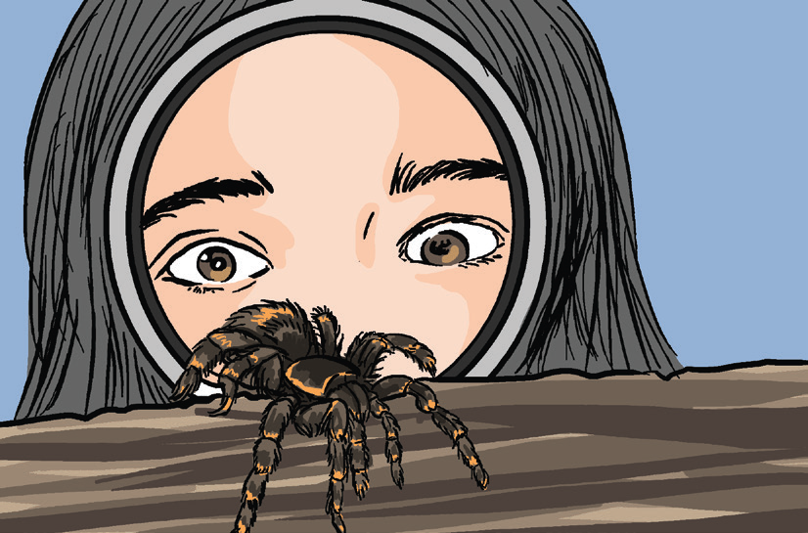
“That is all right, Deanne,” Mommy
Gienah soothed her. “There is no
monster. Kuya Zach is just playing with
his big magnifying glass again.”
“What have you been showing to your little sister, Zach?” asked Daddy Casey. “Next ti me, do not scare your sister.”
“Okay, Dad. I am sorry, Deanne!” Zach said as he sniff ed the smell of their lunch.
“Lunch is ready. Let’s all go inside the house,” Mommy told them.
They all had a hearty lunch.

Slide 7
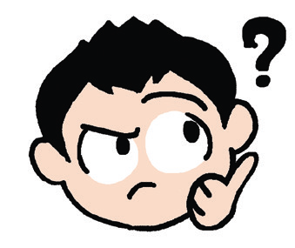
Think Well
1. What is the story about?
2. In what ways were Zach naughty?
3. Can you say that Zach is a nature lover?
Explain your answer.
4. Ask each other questions about the story.

Slide 8
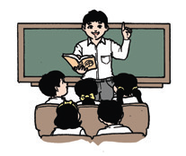
Oral Language
Following Directions
When following directions, make sure you listen very carefully. Understand the instructions that are given.
1. Draw a magnifying glass on top of a frog’s head.
2. Color the frog brown.

Slide 9
Grammar
Adjectives also describe places and events.
Examples: a clean school
a colorful garden
a joyful birthday party
a noisy New Year’s Eve
Here are sample adjectives for:
Places – big, nice, wide, beautiful, clean, dirty, interesting, peaceful, far, near
Events – noisy, exciting, joyful, quiet, peaceful, interesting

Slide 10

Writing
Copy the groups of words in cursive writing. Write the letters neatly and clearly in your paper.
1. There was a colorful parade.
2. The roads are wide and clean.
3. Grandmother’s house is near a river.
4. That night, the town was quiet and peaceful.

