Slide 1
Saving Birds and Trees

Slide 2
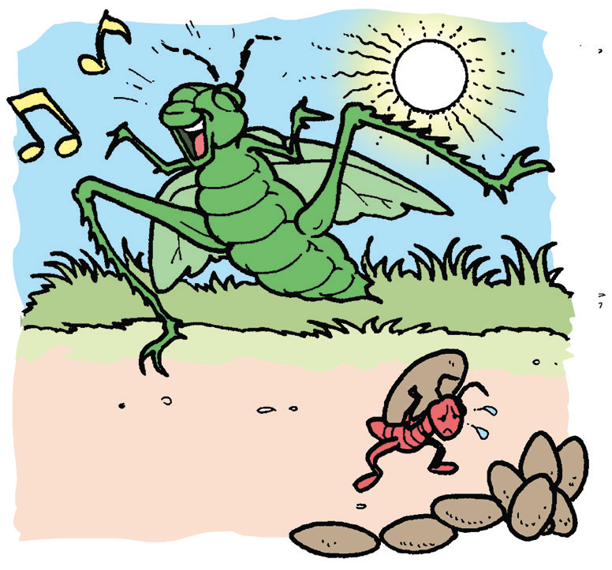
Elements of the story are things that make up a story.
• The theme tells what the story is about.
• The setting tells where and when the story took place.
• The characters are the people, animals, or objects that talk and
act in the story.
• The plot is made up of the events that happened from the
start up to the end of the story.

Slide 3
Book and Print Knowledge
Not everything around you is considered a part of nature. There are those that are man made. Can you recall the names of some stores and restaurants that you see in malls or along roads? Get a partner and name these manmade things together.

Slide 4
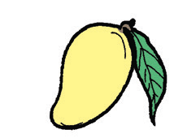
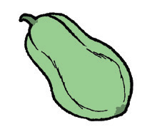
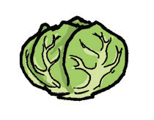
Vocabulary
Fruits and vegetables come from plants and trees. They are part of nature. Classify these words into fruits and vegetables. Name each fruit and each vegetable.
mango
papaya
cabbage

Slide 5
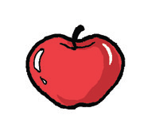
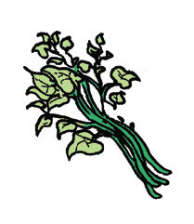
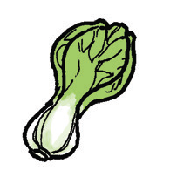
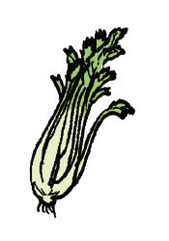
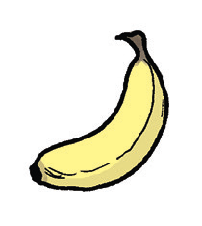
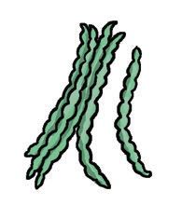
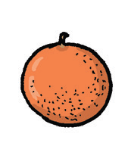
apple
pechay
kangkong
orange
banana
string beans
celery

Slide 6
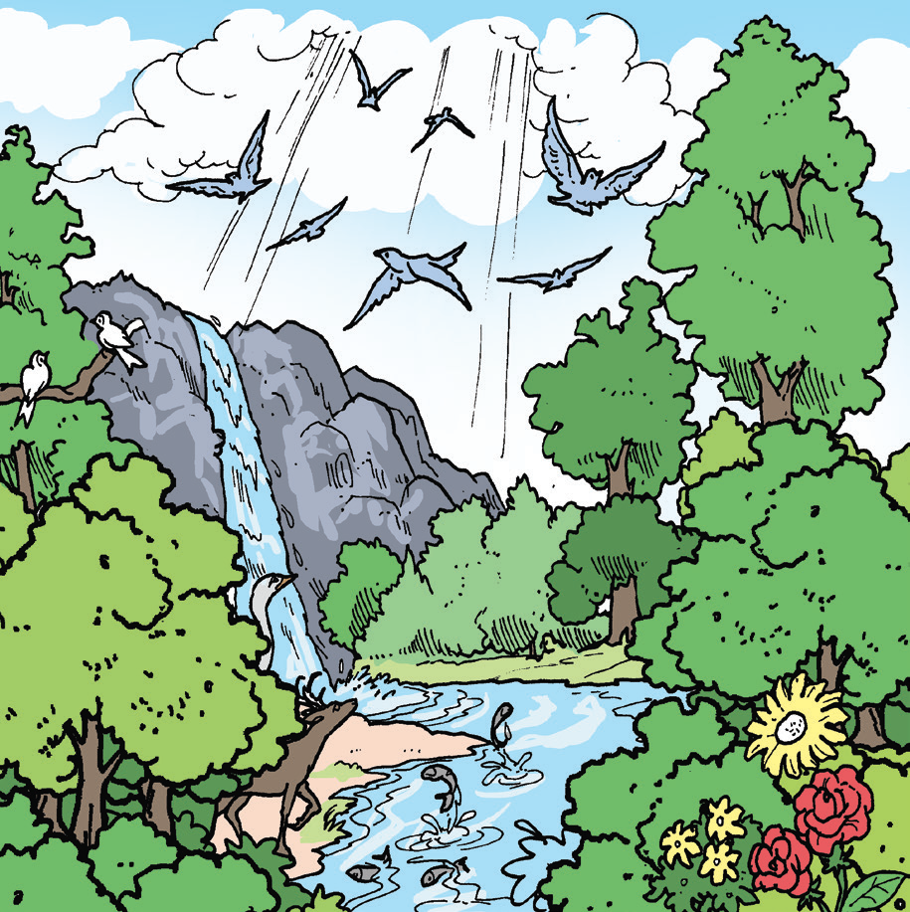
Saving Birds and Trees
by Keith Dylan
Our house is near a beautiful tree in a forest. The tree is very big and very old. It is a home for many birds. Birds and other animals live in the forest. No one can harm the trees and all the living creatures in the forest.
One day, many other birds flew to the forest. They came from the nearby city. There was hardly any tree left in that city. Their eggs fell and the newly-hatched babies died.

Slide 7
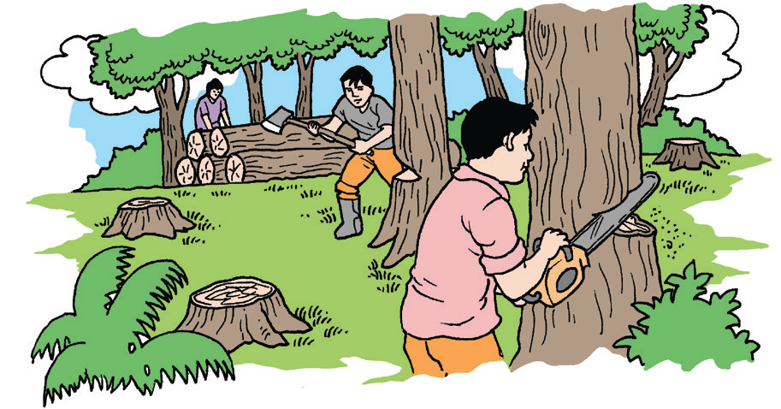
One day, I got scared because I saw a group of hunters and loggers on their way to our forest. My family got frightened because we knew they were going to cut
trees and shoot birds.
We thought of what to do to keep the birds and other animals safe. My father knew that a bird watcher named Mr. Casey was a friend of the birds. He belonged to a group of people that kept the environment safe.
If he could visit the forest, he would surely do
something to protect the trees, birds, and other
animals. He was our only hope. We planned to
make him visit the forest.

Slide 8
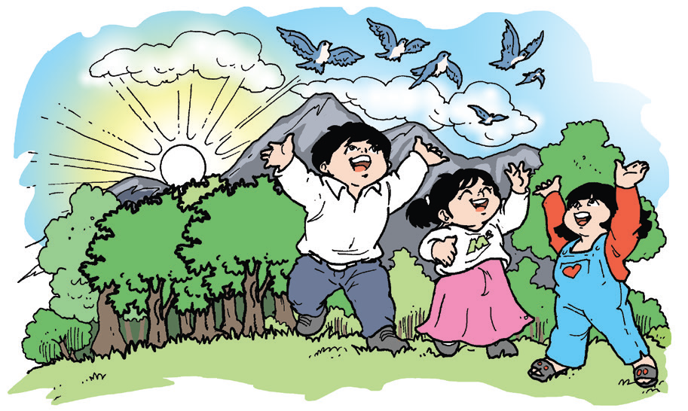
My father spotted Mr. Casey in his house near the forest. He invited him to visit the forest. He saw different kinds of lovely birds. He also saw the bad guys cutting down the trees.
Mr. Casey w as very angry. Using his cell
phone, he called the police. The bad
guys were arrested.
The government did all means to keep
the birds, trees, and animals safe.
They now live peacefully.
The number of bird watchers increased.
But it is alright with us because they keep the forest safe.

Slide 9
Reading Comprehension
Chat Room
Your teacher will divide the class into small groups. Then, listen as your teacher reads the questions below that your group will answer.
Recall
1. Where did the story happen?
2. Who are the characters in the story?
3. What are the important events in the story?
Think Well
1. What is the story about?
2. Why are the birds and trees unsafe when the bad guys come?
3. How did Mr. Casey save the birds and the trees from the hunters and loggers?
4. Do you think the bird watchers will protect the birds? Explain your answer.

Slide 10
Oral Language
With your group mates, talk about your activities and responsibilities at home. Below are some groups of words that you can use:
do my homework play with my brother/sister
wash the dishes set the table
watch television shows with my family help Mother cook
water the plants play with my toys
read books

Slide 11
Grammar
Recall the story, “First Day in School” that you listened to. Here’s a
conversation in the story between Deanne and her mother:
Deanne asks, “What if the kids will not play with me?”
“When you go to school, you will really like it. “
Mom answers, “You will meet lots of new friends and learn many new things.”
“When you go to school, find another little girl who looks scared and try to
help her feel better. If you do that,” her mother says, “you will feel happy
because you helped someone.”
Look at the underlined words in the story. These words show action. These are called action words or verbs.

Slide 12
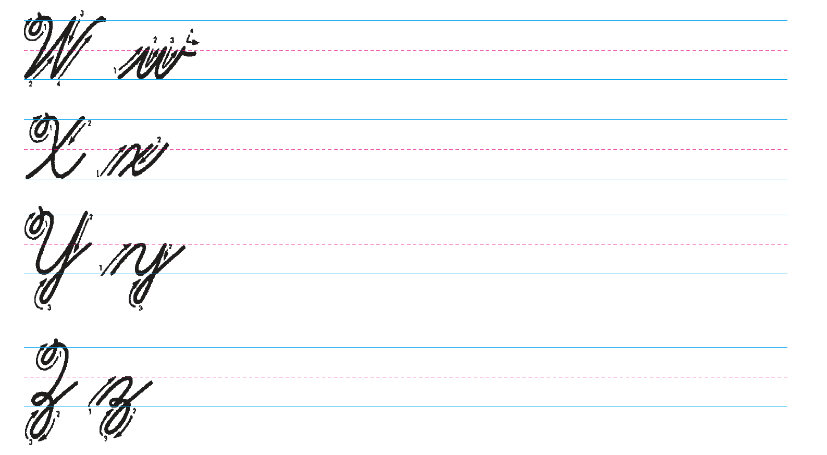
Writing
Copy the letters carefully and follow the given strokes.

